Slide 1
Training of a General Surgeon: Are we making the cut?
Phoenix Surgical Symposium - 2015
Steven B. Johnson, MD, FACS, FCCM
Professor and Chair (Banner/VA), Department of Surgery
University of Arizona College of Medicine – Phoenix
Program Director, Phoenix Integrated Surgical Residency
Banner Good Samaritan Medical Center

Slide 2
General Surgery Residency: Two Primary Goals
Prepare Graduates for General Surgery Practice
Prepare Graduates for Postgraduate Fellowships
Requires development of autonomous expertise in:
Cognitive knowledge
Technical skills
Professionalism

Slide 3
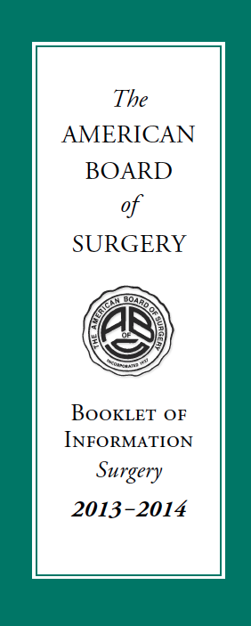
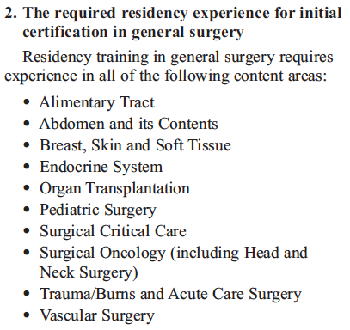
What Is General Surgery Training?

Slide 4
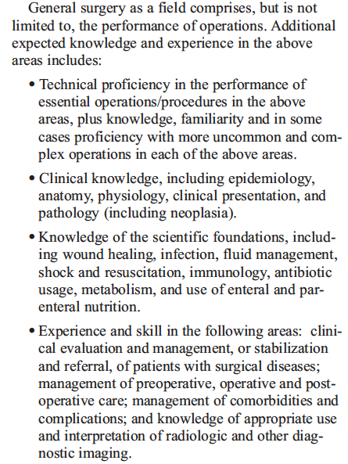
What Is General Surgery Training?

Slide 5
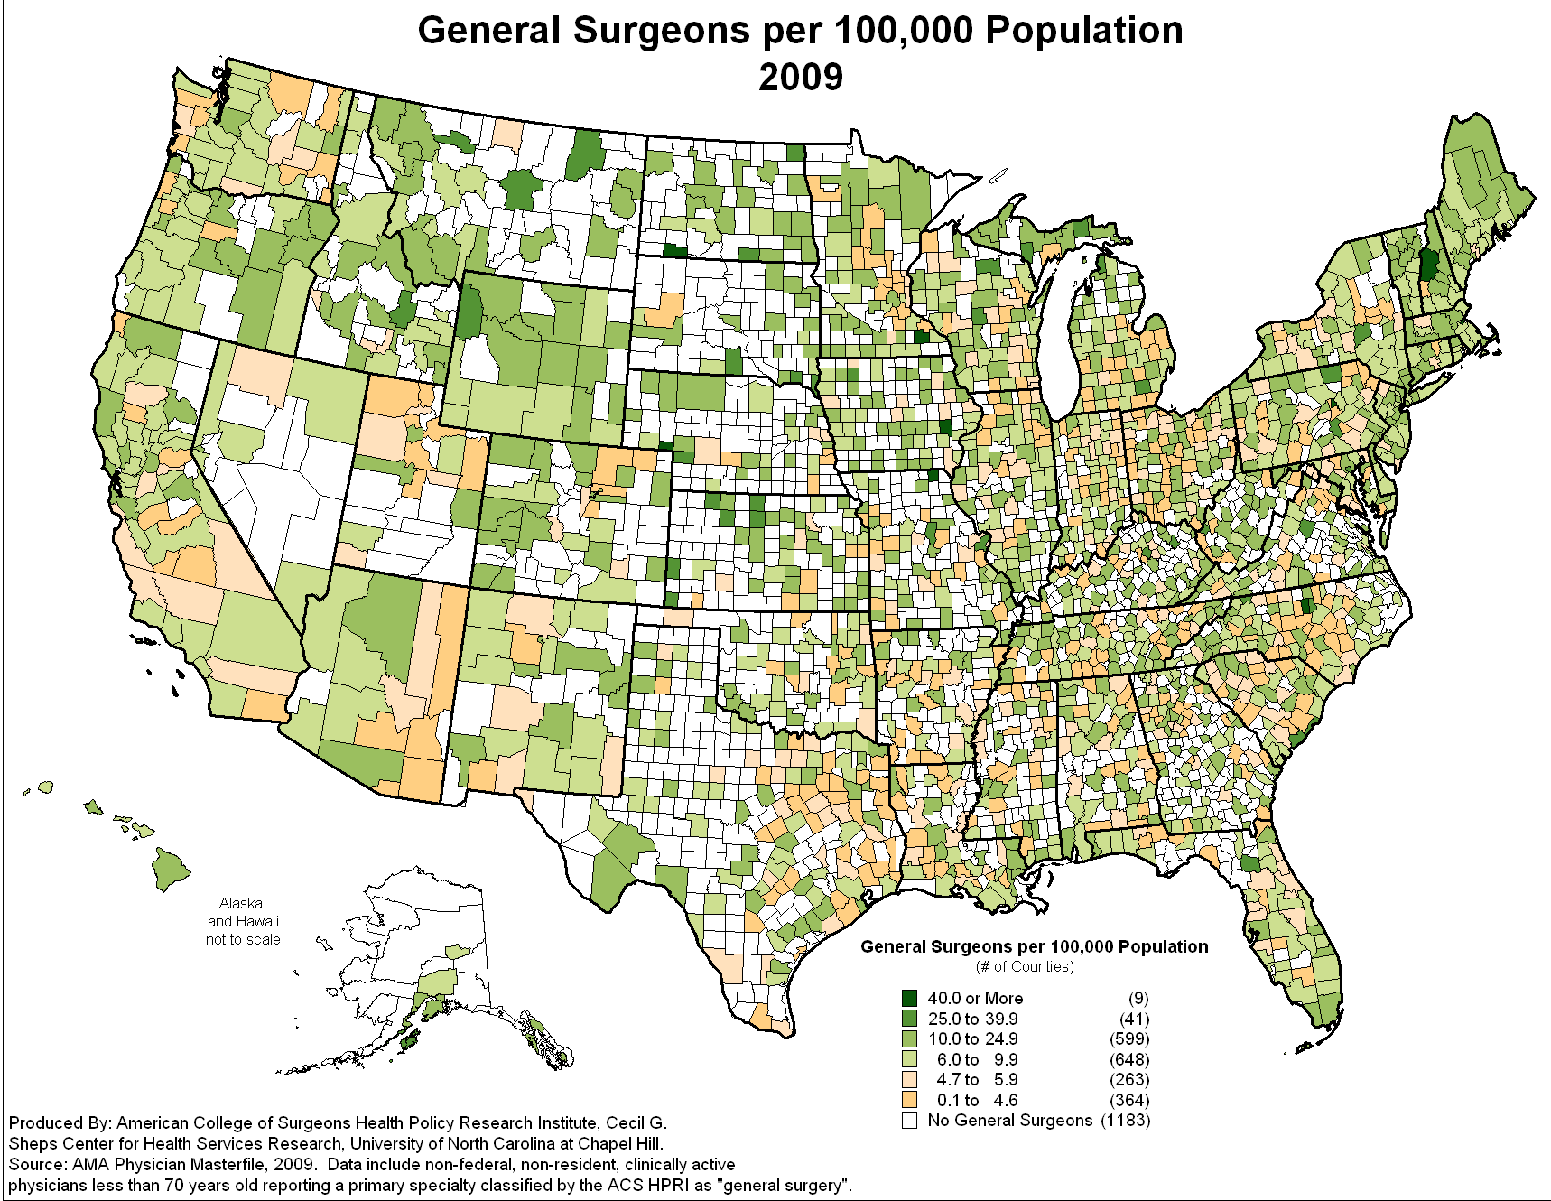
General Surgery Workforce
Number of general surgeons (per 100,000 pop.) has decreased 26% between 1981 and 2005
Heterogenous decreases:
Rural
Inner city
Changing demographic:
Older
More women

Slide 6
Training of a Surgeon – Fellowship training
% entering fellowship training after General Surgery residency
%
All regions increased except Southwest which has remained at
62% (lowest)
J Am Coll Surg 206:782, 2008
Notes:
Increase in residents entering fellowships between 1993 and 2005, now nearly 80% enter
The increase was mainly driven by community program graduates
Men but more so women increased
All areas of the nation had increases except the southwest which remained steady at 62%
US medical school graduates increased but not IMG which remained steady in mid 80’s%
Rate constant until after 2002, ? Influence of workhour restrictions

Slide 7
Residents’ Opinions on Specialty Training
General surgeons must become specialty trained to be successful: 55% agreed
I must complete specialty training to be competitive in the market: 64% agreed
If I complete specialty training, I’ll have a better lifestyle: 63% agreed
If I complete specialty training, I will have a better income: 78% agreed
JAMA 302:1301, 2009

Slide 8
Training of a Surgeon – Should it be different if fellowship bound?
The best training for a non-fellowship bound resident is an excellent broad-based general surgery residency
The best training for a specialty fellowship bound resident is an excellent broad-based general surgery residency
Being well trained in the fundamentals is the most important attribute

Slide 9
Fellowship Directors’ View of Residents
21% new fellows unprepared for operating room
24% could not recognize signs of complication
30% could not independently do lap chole
38% lacked patient ownership
56% could not perform laparoscopic suturing
66% could not operate for 30 minutes unsupervised in a major case
Ann Surg 258:440, 2013

Slide 10
Operative Training Experience
Our residents are getting less than we think
SCORE defined Essential and Complex Cases
121 key general surgery operations
18/121 – mean > 10 during residency
83/121 – mean < 5 during residency
31/121 – mean <1 during residency
63/121 – mode = 0 during residency
Bell, Ann Surg, 2009
J Surg Educ 70:783-788, 2013

Slide 11
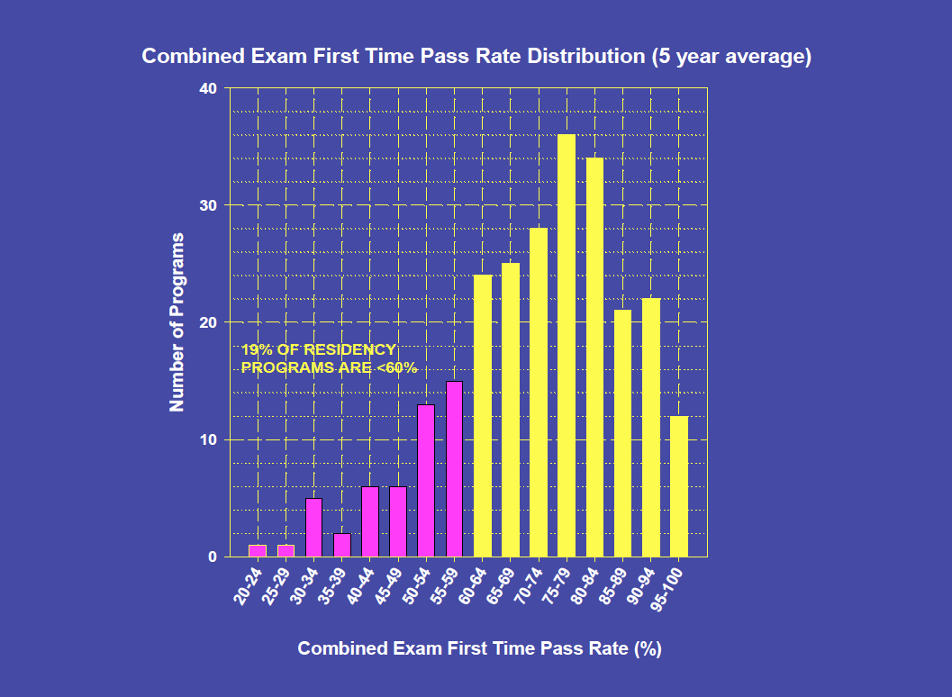
19% of Residency Programs are < 60%

Slide 12
Winds of Change in Surgery Residency Education
Surgical Diseases
80 Hours
Technology

Slide 13
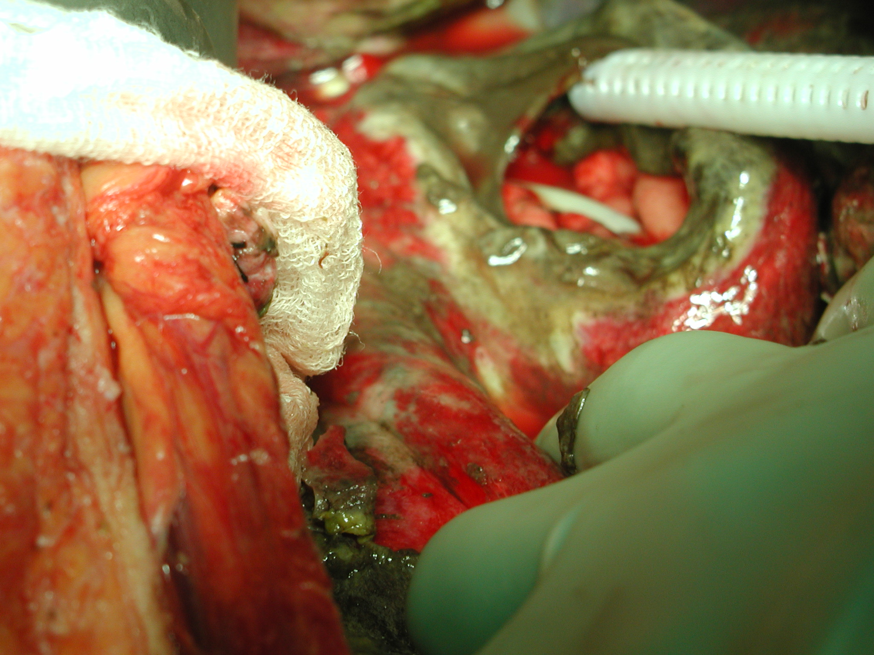
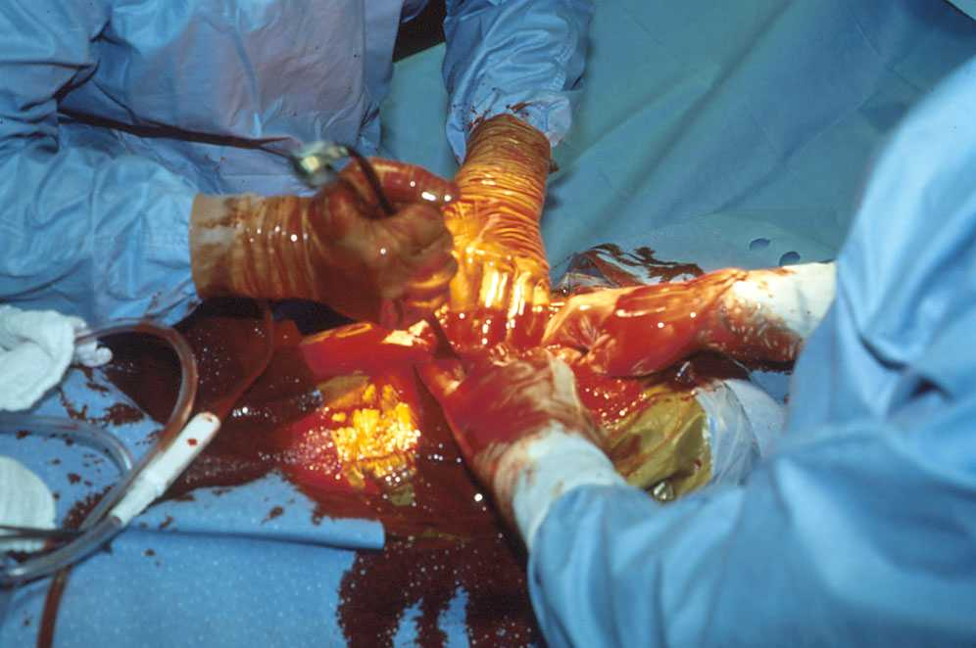
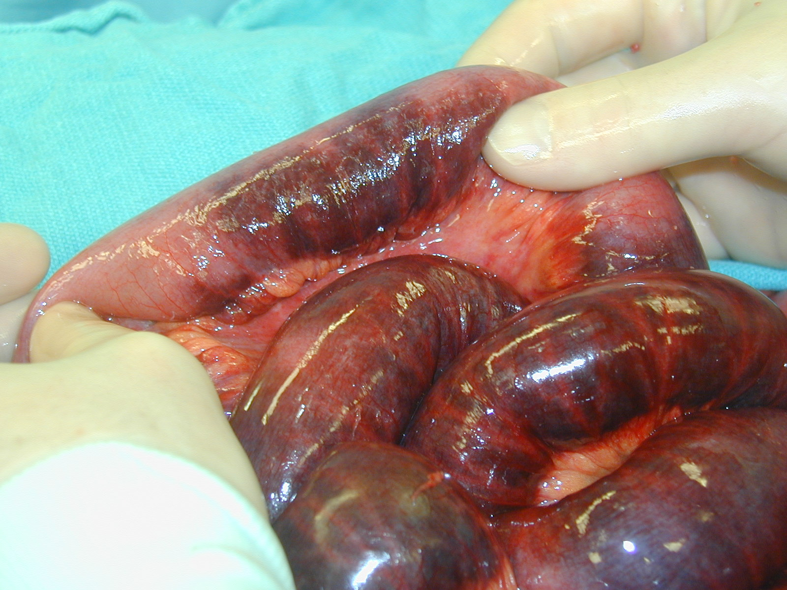
Impact of Work Hour Restrictions
Enacted in 2003, revised in 2010
Loss of 6 – 12 months of training
Largest impact on night and weekend emergent general surgery and trauma experiences (33 – 50% decrease)
Ability to observe a condition evolve

Slide 14
Impact of Work Hour Restrictions: Resident Education
Meta-analysis of 56 studies on surgical programs
Impact on resident education:
40 positive or neutral outcomes
18 negative outcomes
Impact on ABSITE:
5 positive studies
0 negative studies
Impact on operative cases:
18 positive or neutral outcomes
11 negative outcomes
Acad Med 86:34, 2011

Slide 15
Impact Work Hour Restrictions: Resident Well-Being
Evaluation of stress and burnout
18 studies showed positive outcomes
No studies demonstrate worsening of psychological well-being
Reduction in complaints about residents
No change in voluntary attrition rate (20%)
Concern over loss of “socialization” into field of surgery
Acad Med 86:34, 2011
J Am Col Surg 202:340, 2006

Slide 16
Impact Work Hour Restrictions: Faculty Well-Being
No study has shown a positive outcome on faculty
Five studies showed negative outcomes
Increased faculty workload and work hours
Decreased time available for teaching
Increased job dissatisfaction
Faculty perception of impact on resident training
Dissatisfaction with resident training (14 studies)
Dissatisfaction with patient care (10 studies)
Dissatisfaction with continuity of care (6 of 8 studies)
Acad Med 86:34, 2011

Slide 17
Impact of Work Hours Restrictions – Cases
Am J Surg 202:720, 2011

Slide 18
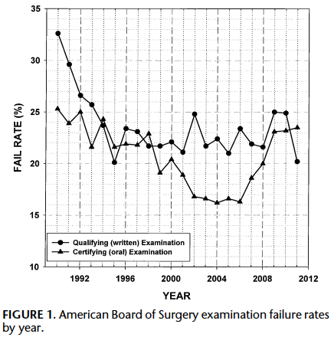
American Board of Surgery Exam Fail Rate
23.5%
16%
Ann Surg 256: 553, 2012

Slide 19
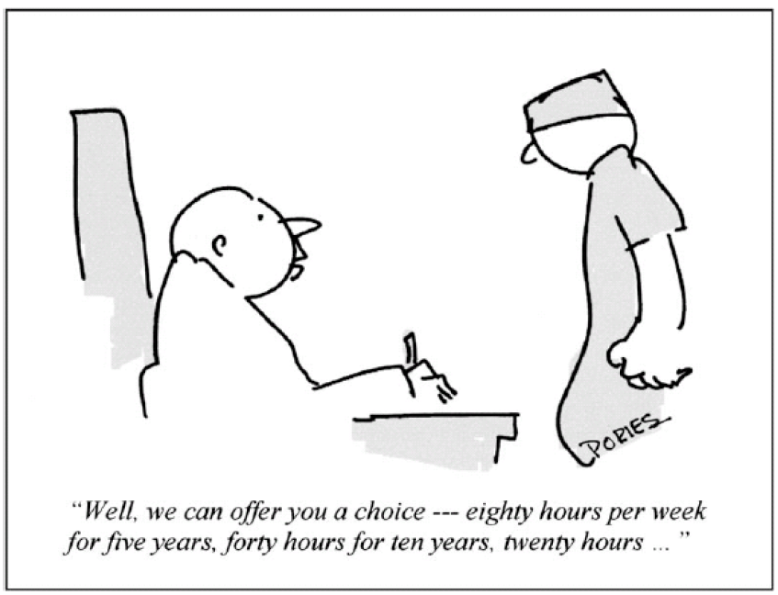
The Future of Duty Hour Restrictions…

Slide 20
Impact of Advances in Technology
Minimally invasive surgery
Endovascular surgery
Endoscopic procedures (ERCP)
Robotic surgery
Electronic medical record not as efficient

Slide 21
Impact of Changing Surgical Diseases
Surgery for peptic ulcer disease has been replaced by Bariatric surgery
We teach gastric acid secretion physiology but operate on gastric obesity physiology
Gastrin versus Ghrelin
Non-operative trauma management
Choledocholithiasis management
Breast cancer management

Slide 22
Training of a General Surgeon – What to Do?
General Surgery residencies needs to evolve
“Evolve or Become Extinct” T. Rex (circa unknown)
Goal should be development of autonomous expertise in an efficient, effective, safe manner
Objective evaluations that focus learning
Defined expectations of performance and professionalism

Slide 23
General Surgery Milestones
16 areas of summative evaluations based on the ACGME 6 competencies
Level of performance (0 – 4) determined in each of these 16 areas of evaluation completed for each resident every 6 months
Based on clearly defined expectations
Goal is to get the resident to succeed in the context of defined expectations
Gives feedback about how the program is doing
Self assessment based on these milestones

Slide 24
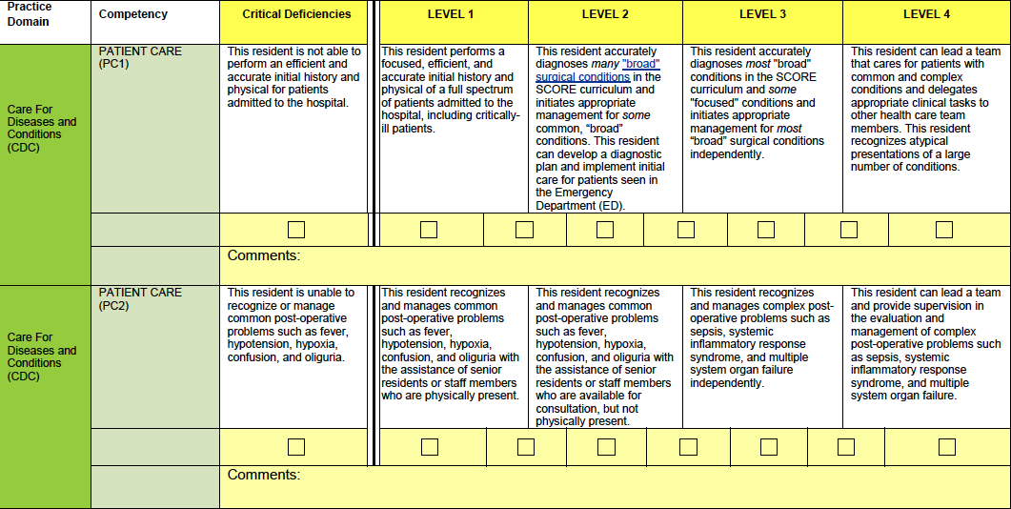
General Surgery Milestones: Patient Care
Ability to
diagnose
Post-op
care

Slide 25
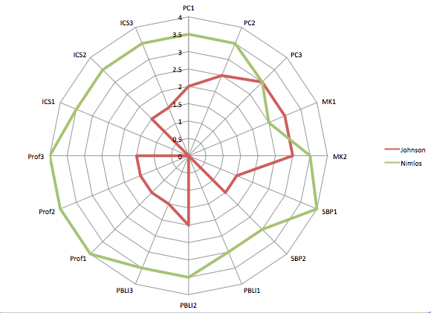
Interpersonal
Communication
Skills
Patient Care
Medical
Knowledge
Resident 1
Resident 2
Professionalism
System based
Practice
Problem Based Learning
And Improvement

Slide 26
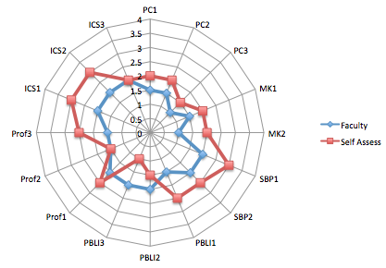
Faculty Assessment vs Self Assessment
PC: Patient Care
MK: Medical Knowledge
SBP: System Based Practice
PBLI: Problem Based Learning and Improvement
Prof: Professionalism
ICS: Interpersonal Communication Skills

Slide 27
Training of a Surgeon-Attributes of an expert surgeon
Technical skills
Economy of movement
Consistency of movement
Memory recall to avoid adverse outcomes
Automaticity of movement
Challenge themselves technically to improve
Cognitive abilities
Superiorly monitor and evaluate performance
Self detection and correction of errors
Use forward reasoning based on pattern recognition
J Surg Educ 67:37, 2010

Slide 28
Training of a Surgeon – Becoming an expert
Surgical expertise is acquired and highly localized (task specific)
Expertise is more related to repeated practice than innate ability
Wrong: Practice makes perfect
Right: Perfect practice makes perfect
Deliberate practice based on objective evaluation of skills is required to achieve expertise
Focus on defined task with repetitive performance
NEJM 355:2664, 2006

Slide 29
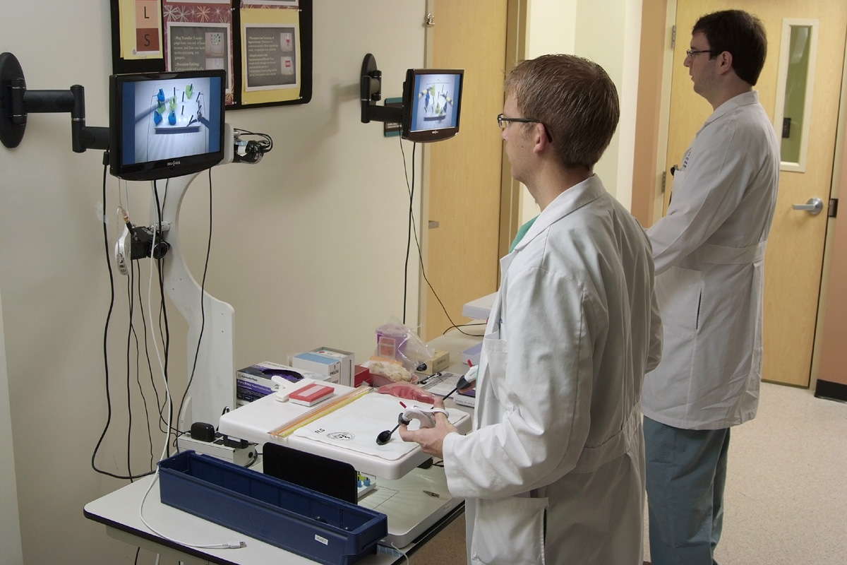
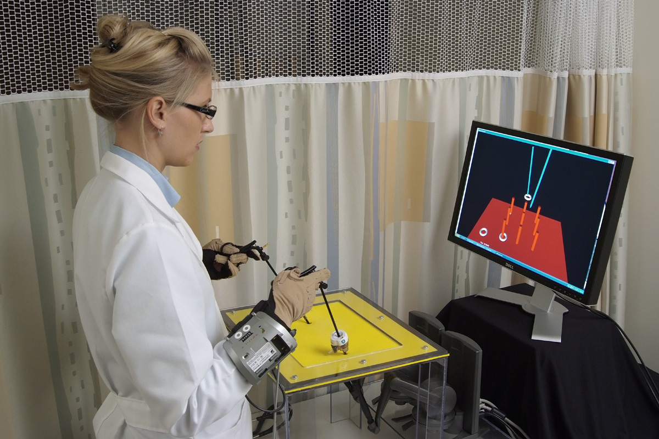
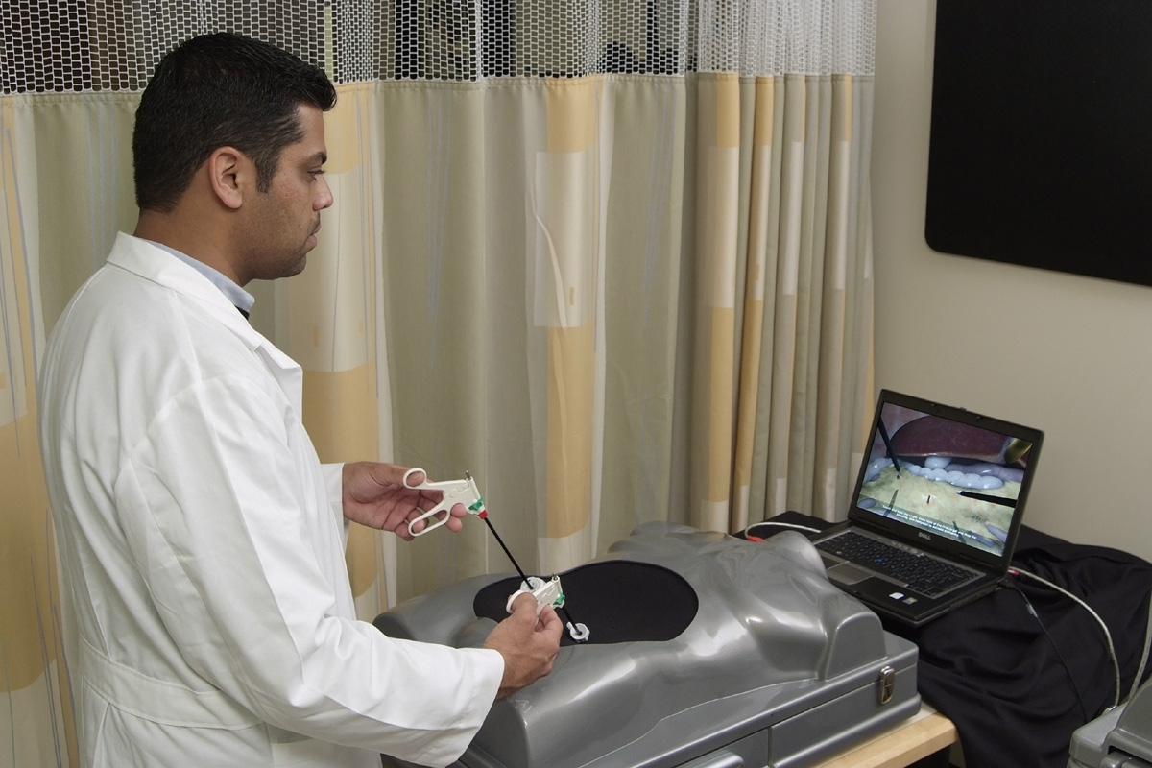
Training of a Surgeon – Role of Simulation training
Acquiring new skills
Assessing skills acquired
Remediation of deteriorating skills
Better for skill development in laparoscopy than open surgery

Slide 30
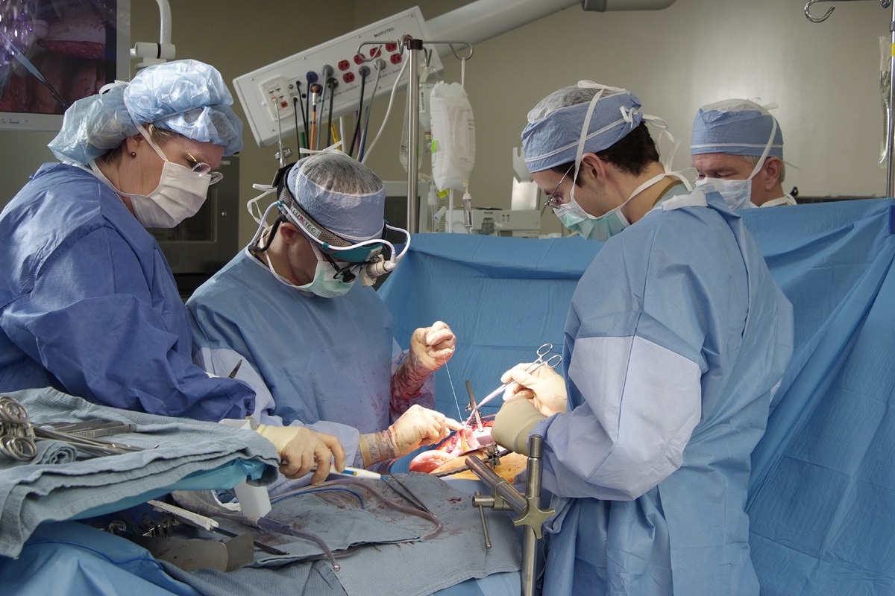
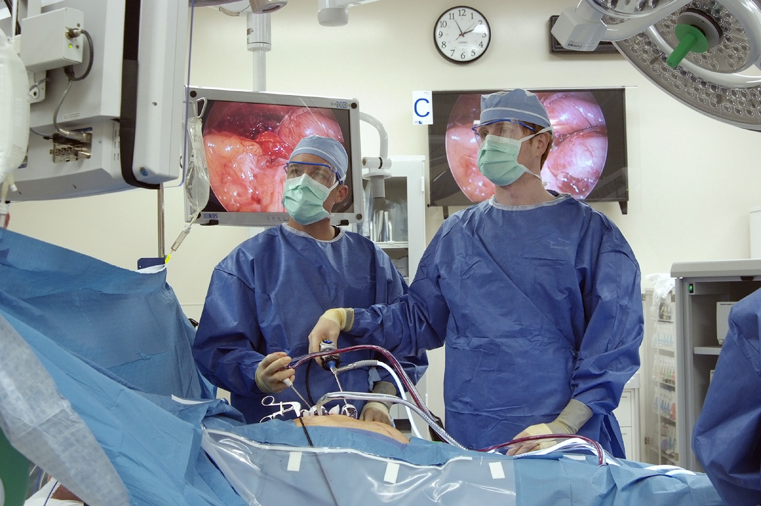
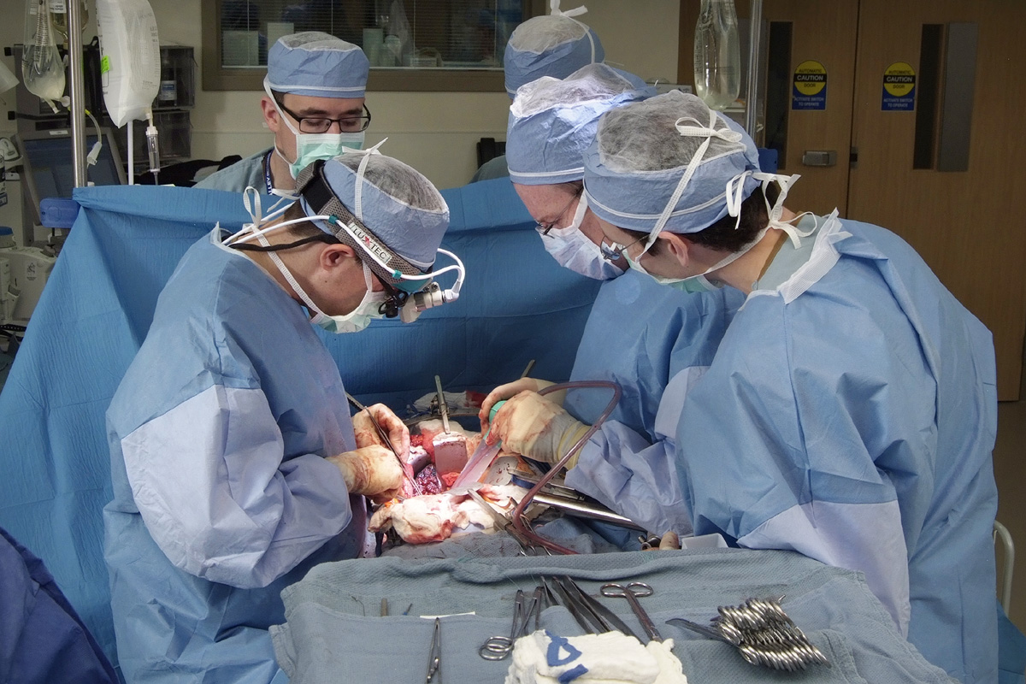
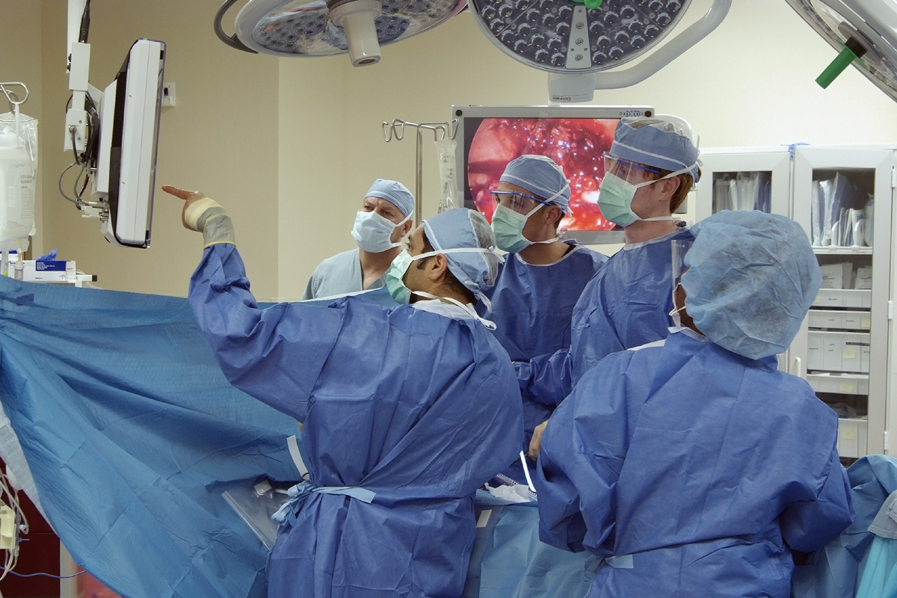
Training of a Surgeon – Hallow grounds

Slide 31
Developing Expertise and Autonomy: Learning Vector
Independence
Fading appropriate B
Attending Strategies
A Cueing appropriate
Dependence
Immaturity
Maturity
Learner Development

Slide 32
Cueing in Operative Teaching
Pointing with forceps, lap sponges, retraction
Framing next steps with the camera view
Vocal directives, “now dissect out the nerve”
Directing resident through discussion with student

Slide 33
Cueing and Fading to Promote Independence
Modulate cueing based on learner skill level
Residents recognize some faculty as great teachers for only one level of residents
Do not provide cues for teaching of operative flow – don’t tell them the next steps, ask them
Don’t do something – stand there
Work toward being a first assistant for chief residents

Slide 34
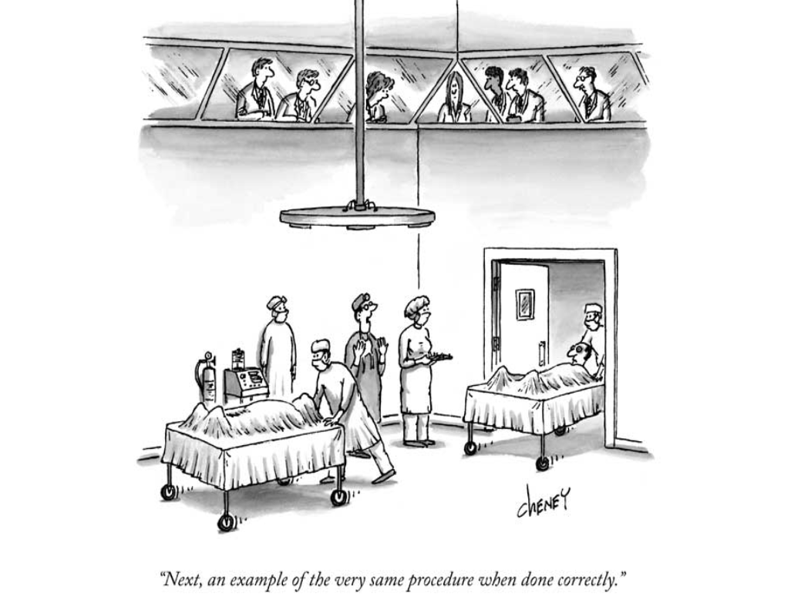

Slide 35
Training of a Surgeon – Learning from errors
Morbidity and mortality conference:
“The golden hour of surgical education”
Open discussion of patients with untoward outcomes to evaluate for improvement in care
How can care be improved?
Failure to learn from untoward events is a lost opportunity and disservice to future patients
Untoward outcome doesn’t mean something was not done correctly

Slide 36
Training of a Surgeon – What is Professionalism?
“Set of values reflected in the philosophy and behavior of individuals whose calling is first and foremost to serve individuals and populations whose care is entrusted to them, prioritizing the interests of those they serve above their own.”
Values: integrity, honesty, commitment, empathy
Assoc Surg Educ, 1993
Debas, Freischlag, Schecter, Warshaw. Arch Surg 138:977, 2003

Slide 37
Training of a Surgeon – Old Professionalism
Ownership of patient and outcome
Surgeon knows everything about patient
Surgeon does everything for patient
Continuity of care provided by one person
Old doctrine no longer feasible
Work hour restrictions preclude “always being there”
Increased complexity of patients
Many routine surgery patients no longer in-patient

Slide 38
Training of a Surgeon – New Professionalism
Maintain principles of ownership and continuity of care
Team-based care with shared accountability
Requires new skills
Team building
Conflict resolution and addressing accountability
Organization and sharing of patient information
Leadership and appropriate delegation of care
Surgery 136:953, 2004
Arch Surg 140:230, 2005
Notes:
Attendings are doing it now with signing out to partners, covering services based on weeks or on-call. We need to teach residents how to function in similar conditions

Slide 39
History of Surgical Training – Allen Whipple, MD
Rules for surgery residents in training:
1) Fit the operation to the patient, never the patient to the operation;
2) Be careful, thorough, and meticulous in your operating, but by all means don’t putter;
3) Do not touch tissue unnecessarily for at best it is traumatic;
4) Teamwork is the surgeon’s best friend;
5) Always be your own most severe critic.
JNMA 49:295, 1957

Slide 40
Summary
The goal of general surgery residency should be to train a great general surgeon, irrespective of future fellowship or practice
We have room to improve
Developing expertise should be a deliberate process
The challenges can be daunting but aren’t insurmountable

Slide 41
