Slide 1
TREATMENT OF CHOLEDOCHOLITHIASIS IN THE ERA OF LAPAROSCOPIC
CHOLECYSTECTOMY
Robert J. Fitzgibbons, Jr., MD, FACS
Professor of Surgery
Creighton University School of Medicine
Omaha, Nebraska
Notes:
1
1
1
1

Slide 2
Laparoscopic Cholecystectomy and The Common Bile Duct
In the Developmental Stage of Laparoscopic Cholecystectomy
CBD Treatment Was not Feasible

Slide 3
Laparoscopic CBD Evaluation

Slide 4
Purpose of this Presentation
Surgical Decision Making
  What are the Options?
  Who Goes First?
  When to do an Intraoperative Imaging Study of the CBD?
    Cholangiogram?? Sonogram??
  The Laparoscopic Approach to the CBD
  An Alternative to LCBDE

Slide 5
Purpose of this Presentation
Surgical Decision Making
  What are the Options?
  Who Goes First?
  When to do an Intraoperative Imaging Study of the CBD?
    Cholangiogram?? Sonogram??
  The Laparoscopic Approach to the CBD
  An Alternative to LCBDE

Slide 6
Treatment of Choledocholithiasis in Patients Undergoing L.C.
Laparotomy
ERCP with Sphincterotomy
  Preoperative
  Postoperative
LCBDE
  Transcystic
  Choledochotomy

Slide 7
Treatment of Choledocholithiasis in Patients Undergoing L.C.
Laparotomy
ERCP with Sphincterotomy
  Preoperative
  Postoperative
LCBDE
  Transcystic
  Choledochotomy

Slide 8
Treatment of Choledocholithiasis in Patients Undergoing L.C.
Laparotomy
ERCP with Sphincterotomy
  Preoperative
  Postoperative
LCBDE
  Transcystic
  Choledochotomy

Slide 9
Treatment of Choledocholithiasis in Patients Undergoing L.C.
Laparotomy
ERCP with Sphincterotomy
  Preoperative
  Postoperative
LCBDE
  Transcystic
  Choledochotomy

Slide 10
Purpose of this Presentation
Surgical Decision Making
  What are the Options?
  Who Goes First?
  When to do an Intraoperative Imaging Study of the CBD?
    Cholangiogram?? Sonogram??
  The Laparoscopic Approach to the CBD
  An Alternative to LCBDE

Slide 11
Who Goes First?
Preoperative per Oral Endoscopic (ERCP)+/- Sphincterotomy with Stone Extraction
vs.
Primary Laparoscopic
Notes:
2
2
2
2

Slide 13
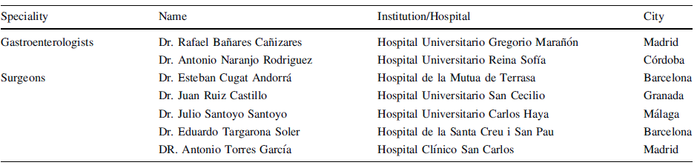
Expert Panel From Spain

Slide 14
Example Scenario (Indication)
Patient Less Than 40 with Frequent Right Upper Quadrant Pain Radiating to the Back
Liver Function Studies Normal
Ultrasound Shows Gallstones and a Dilated CBD

Slide 15

A Consensus was Reached for Only
41Out of 108 indications (38%)

Slide 16
Acceptable Indications for
Preoperative ERCP
Overwhelming Evidence of Choledocholithiasis
  + Sonogram of Stone in CBD
  Obstructive Jaundice
  Dilatated Extrahepatic Biliary System
ASA Class IV or V

Slide 17
Who Goes First?
Most Important Considerations
Available Equipment
Ability of the Surgeon

Slide 18
Is Cholecystectomy Always Needed After Successful ERCP with ES?
Randomized Trial of 120 Patients Assigned to Either WW or Routine Lap Chole after Successful ERCP + ES
  WW Group
    Nearly 50 % Suffered a Biliary Event by Median Follow-up of 30 Months
    55% Required Conversion to Open at the Time of Elective Chole (Compared to 20%in the Routine Group)
Boerma D,et al. Amsterdam.
Lancet 2002;360:761-765.

Slide 19
Purpose of this Presentation
Surgical Decision Making
  What are the Options?
  Who Goes First?
  When to do an Intraoperative Imaging Study of the CBD?
    Cholangiogram?? Sonogram??
  The Laparoscopic Approach to the CBD
  An Alternative to LCBDE

Slide 20
Laparoscopic Cholecystectomy and Operative Cholangiography
Two Purposes
Detect CBD Stones
Define Anatomy
Notes:
31
12
12
12
12

Slide 21
The Selective Approach to Operative Cholangiography
When Must It Be Done?
When Cystic Duct is Dilated
When CBD is Dilated
When Anatomy is Unclear
Miscellaneous Indications
Notes:
32
12
12
12
12

Slide 22
Laparoscopic Cholecystectomy and Operative Cholangiography
Selective
VS
Routine
Notes:
30
11
11
11
11

Slide 23
Laparoscopic Cholecystectomy and Operative Cholangiography
Common Bile Duct Injury
Notes:
33
13
13
13
13

Slide 24
Laparoscopic Cholecystectomy and Operative Sonography
Does It Have a Role?
Notes:
34
14
14
14
14

Slide 25
Intraoperative Imaging of the CBD
This Remains a Controversial Issue Even in 2014!

Slide 26
Purpose of this Presentation
Surgical Decision Making
  What are the Options?
  Who Goes First?
  When to do an Intraoperative Imaging Study of the CBD?
    Cholangiogram?? Sonogram??
  The Laparoscopic Approach to the CBD
  An Alternative to LCBDE

Slide 27
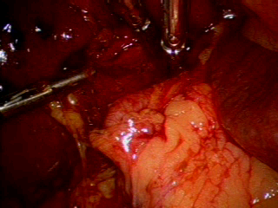
Laparoscopic Common Bile Duct Exploration
How do You Decide?
Choledochotomy
Transcystic
Notes:
15
15
15
15

Slide 28

Laparoscopic Common Bile Duct Exploration
Transcystic Technique
Balloon or Mechanical Dilatation of Cystic Duct
Notes:
16
16
16
16

Slide 29
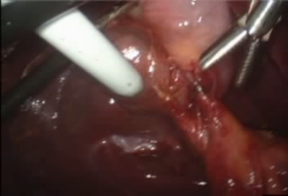
Laparoscopic Common Bile Duct Exploration
Transcystic Technique
Balloon or Mechanical Dilatation of Cystic Duct
Blind Balloon Catheter/Basket Manipulation
Notes:
16
16
16
16

Slide 30
Laparoscopic Common Bile Duct Exploration
Transcystic Technique
Balloon or Mechanical Dilatation of Cystic Duct
Blind Balloon Catheter/Basket Manipulation
Irrigation/Flushing +/- Glucagon (1mg)
Notes:
16
16
16
16

Slide 31
Laparoscopic Common Bile Duct Exploration
Transcystic Technique
Balloon or Mechanical Dilatation of Cystic Duct
Blind Balloon Catheter/Basket Manipulation
Irrigation/Flushing +/- Glucagon(1mg)
Balloon Catheter/Basket Extraction + Fluoroscopy
Notes:
16
16
16
16

Slide 32
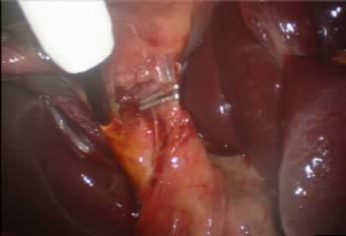
Laparoscopic Common Bile Duct Exploration
Transcystic Technique
Balloon or Mechanical Dilatation of Cystic Duct
Blind Balloon Catheter/Basket Manipulation
Irrigation/Flushing +/- Glucagon(1mg)
Balloon Catheter/Basket Extraction + Fluoroscopy
Fine Choledochoscopic Evaluation
Notes:
16
16
16
16

Slide 33
Laparoscopic Common Bile Duct Exploration
Transcystic Technique
Balloon or Mechanical Dilatation of Cystic Duct
Blind Balloon Catheter/Basket Manipulation
Irrigation/Flushing +/- Glucagon(1mg)
Balloon Catheter/Basket Extraction + Fluoroscopy
Fine Choledochoscopic Evaluation
Lithotripsy
Notes:
16
16
16
16

Slide 34
Laparoscopic Common Bile Duct Exploration
Transcystic Technique
Balloon or Mechanical Dilatation of Cystic Duct
Blind Balloon Catheter/Basket Manipulation
Irrigation/Flushing +/- Glucagon(1mg)
Balloon Catheter/Basket Extraction + Fluoroscopy
Fine Choledochoscopic Evaluation
Lithotripsy
Balloon Dilatation of Sphincter of Oddi
Notes:
16
16
16
16

Slide 35
Transcystic Laparoscopic Common Bile Duct Exploration
Advantages
T-Tube not Needed
Drain not Needed
Applicable in 80-90%
Disadvantages
Cystic Duct Dilatation Needed
Bad for Proximal Stones, those 10 mm or Greater
Expensive
Notes:
18
18
18
18

Slide 36
Laparoscopic Common Bile Duct Exploration
Choledochotomy Technique
Notes:
19
19
19
19

Slide 37
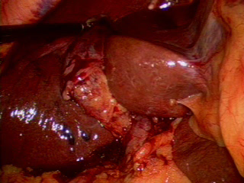
Laparoscopic Common Bile Duct Exploration
Choledochotomy Technique
Choledochotomy
Notes:
19
19
19
19

Slide 38

Laparoscopic Common Bile Duct Exploration
Choledochotomy Technique
Choledochotomy
Blind Balloon Catheter/Basket Manipulation
Notes:
19
19
19
19

Slide 39
Laparoscopic Common Bile Duct Exploration
Choledochotomy Technique
Choledochotomy
Blind Balloon Catheter/Basket Manipulation
Irrigation/Flushing +/- Glucagon(1mg)
Notes:
19
19
19
19

Slide 40
Laparoscopic Common Bile Duct Exploration
Choledochotomy Technique
Choledochotomy
Blind Balloon Catheter/Basket Manipulation
Irrigation/Flushing +/- Glucagon(1mg)
Balloon Catheter/Basket Extraction + Fluoroscopy
Notes:
19
19
19
19

Slide 41
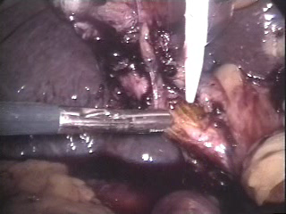
Laparoscopic Common Bile Duct Exploration
Choledochotomy Technique
Choledochotomy
Blind Balloon Catheter/Basket Manipulation
Irrigation/Flushing +/- Glucagon(1mg)
Balloon Catheter/Basket Extraction + Fluoroscopy
Large Choledochoscopic Evaluation
Notes:
19
19
19
19

Slide 42
Laparoscopic Common Bile Duct Exploration
Choledochotomy Technique
Choledochotomy
Blind Balloon Catheter/Basket Manipulation
Irrigation/Flushing +/- Glucagon(1mg)
Balloon Catheter/Basket Extraction + Fluoroscopy
Large Choledochoscopic Evaluation
Lithotripsy
Notes:
19
19
19
19

Slide 43
Laparoscopic Common Bile Duct Exploration
Choledochotomy Technique
Choledochotomy
Blind Balloon Catheter/Basket Manipulation
Irrigation/Flushing +/- Glucagon(1mg)
Balloon Catheter/Basket Extraction + Fluoroscopy
Large Choledochoscopic Evaluation
Lithotripsy
Choledochoenterostomy Robot??
Balloon Dilatation of Sphincter of Oddi??
    Carroll
Laparoscopic Antegrade Sphincterotomy
    DePaula
Notes:
19
19
19
19

Slide 44

Laparoscopic Common Bile Duct Exploration
Choledochotomy Technique
Choledochotomy
Blind Balloon Catheter/Basket Manipulation
Irrigation/Flushing +/- Glucagon
Balloon Catheter/Basket Extraction + Fluoroscopy
Large Choledochoscopic Evaluation
Lithotripsy
Choledochoenterostomy Robot??
Balloon Dilatation of Sphincter of Oddi??
    Carroll
Laparoscopic Antegrade Sphincterotomy
    DePaula
Closure of CBD with T-Tube??
Notes:
19
19
19
19

Slide 45
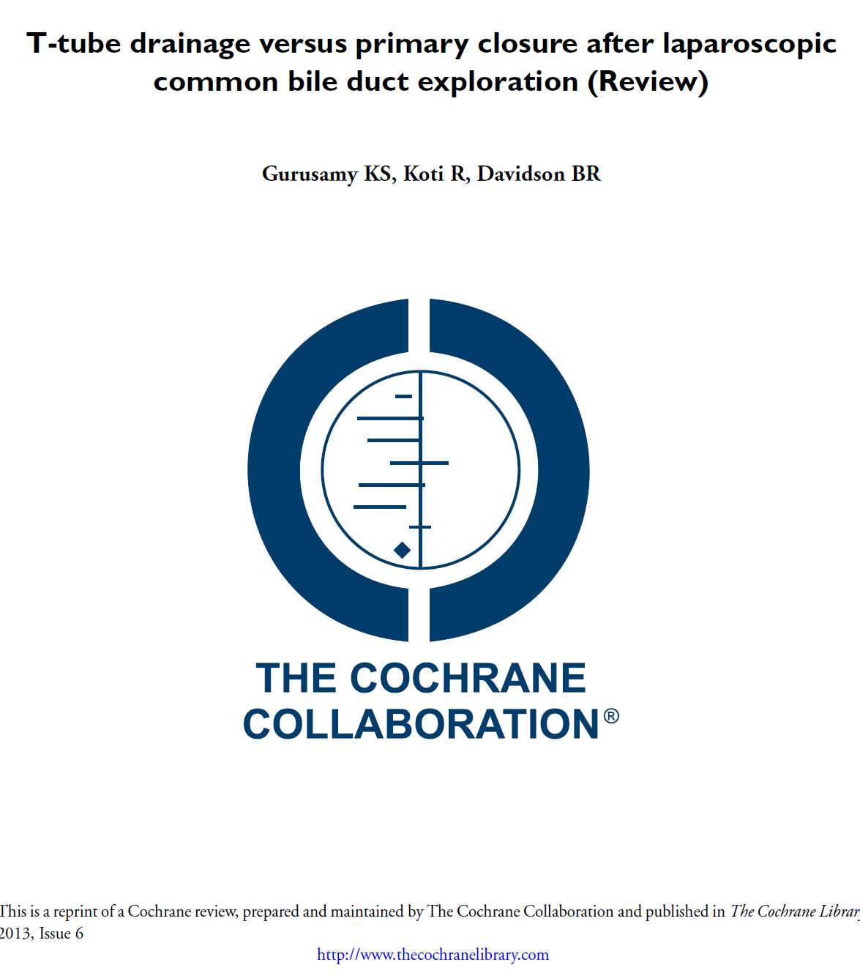
Primary Closure Versus T-tube Drainage After Laparoscopic Common Bile Duct Stone Exploration

Slide 46
Primary Closure Versus T-tube Drainage After Laparoscopic Common Bile Duct Stone Exploration
“We Have Insufficient Evidence to Recommend T-tube Drainage Over Primary Closure after Laparoscopic Common Bile Duct Stone Exploration or Vice Versa”
Cochrane Database Syst Rev. 2007 Jan 24;(1):CD005641

Slide 47
Primary Closure Versus T-tube Drainage After Laparoscopic Common Bile Duct Stone Exploration
“Based on Currently Available Evidence, There is No Justification For the Routine Use of T-tube Drainage After Laparoscopic Common Bile Duct Exploration in Patients With Common Bile Duct Stones”
Cochrane Database Syst Rev. 2013 Jun 21;6

Slide 48
Primary Closure is Better Than T-tube Drainage After Laparoscopic Common Bile Duct Stone Exploration

Slide 49
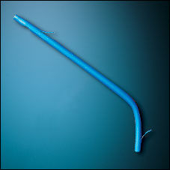
Biliary Stent

Slide 50
T-Tube Vs. No T-tube Vs. Stent
A technique for safe placement of a biliary endoprosthesis after laparoscopic choledochotomy. Isla AM, Griniatsos J, Wan A.
J Laparoendosc Adv Surg Tech A. 2002 Jun;12(3):207-11
Advantages of laparoscopic stented choledochorrhaphy over T-tube placement. Isla AM, Griniatsos J, Karvounis E, Arbuckle JD. Br J Surg. 2004 Jul;91(7):862-6

Slide 51
T-Tube Vs. Stent
Surg Laparosc Endosc Percutan Tech. 2012 Aug;22(4):345-8

Slide 52
Common Bile Duct Exploration by Choledochotomy
Advantages
Best for CBD Greater than 10mm
Large Choledochoscope
Good for Proximal Ducts
Disadvantages
T-Tube, Drain usually Needed
CBD Stricture Possible
Bypass Difficult
Expensive
Notes:
20
20
20
20

Slide 53
Laparoscopic CBDE
Is it for Everyone??
Notes:
21
21
21
21

Slide 54
Laparoscopic CBDE
Limitations
Specialized Training of the Surgeon is Required
Experience is Difficult to Obtain Because Choledocholithiasis is Found in Only 5% of Laparoscopic Cholecystectomies
Expensive Equipment Needs Cannot be Justified by All Institutions
Notes:
22
22
22
22

Slide 55
Laparoscopic CBDE
Potential Equipment Needs
Small Diameter Choledochoscope
Large Diameter Choledochoscope
Second Video System
Digital Fluoroscopy Unit
An Array of Baskets and Balloons
Lithotripsy System
Notes:
23
23
23
23

Slide 56
Lithotripsy During Laparoscopic Common Bile Duct Exploration
Mechanical
Electrohydraulic
Ultrasonic
Laser
  Conventional
  Tunable Dye
Notes:
17
17
17
17

Slide 57
Laparoscopic CBDE
Additional Questions
Should Patients with Questionably Positive Cholangiograms undergo Videoscopic CBDE?
Is Prolonged General Anesthesia Best for all Patients?
Do Some Stones Pass Spontaneously?
Notes:
24
24
24
24

Slide 58
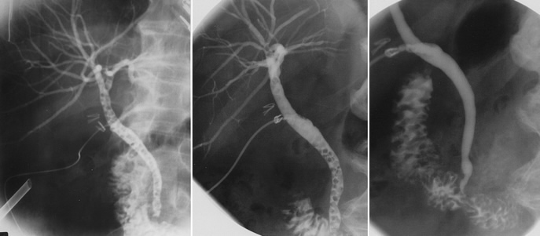
Spontaneous Stone Passage
Operation
48 Hours
6 Weeks
Ann Surg. 2004 Jan; 239(1): 28-33

Slide 59
TREATMENT OF CHOLEDOCHOLITHIASIS IN THE ERA OF LAPAROSCOPIC
CHOLECYSTECTOMY
Robert J. Fitzgibbons, Jr., MD, FACS
Professor of Surgery
Creighton University School of Medicine
Omaha, Nebraska
Notes:
1
1
1
1

Slide 60
Purpose of this Presentation
Surgical Decision Making
  What are the Options?
  Who Goes First?
  When to do an Intraoperative Imaging Study of the CBD?
    Cholangiogram?? Sonogram??
  The Laparoscopic Approach to the CBD
  An Alternative to LCBDE

Slide 61
Purpose of this Presentation
Surgical Decision Making
  What are the Options?
  Who Goes First?
  When to do an Intraoperative Imaging Study of the CBD?
    Cholangiogram?? Sonogram??
  The Laparoscopic Approach to the CBD
  An Alternative to LCBDE

Slide 62
A Middle of the
Road Approach
LCBDE
Nothing

Slide 63
An Alternative to Laparoscopic CBDE
A Double-Lumen Catheter System
Notes:
25
25
25
25

Slide 64
Characteristics of the Double Lumen Catheter System
Proximal lumen for Cholangiography
Distal Lumen for Guidewire Placement
Percutaneous Tear-away Introducer
Marking Ring for Placement Guideline
  Short-acting absorbable suture just above ring
  Drain recommended for bile

Slide 65
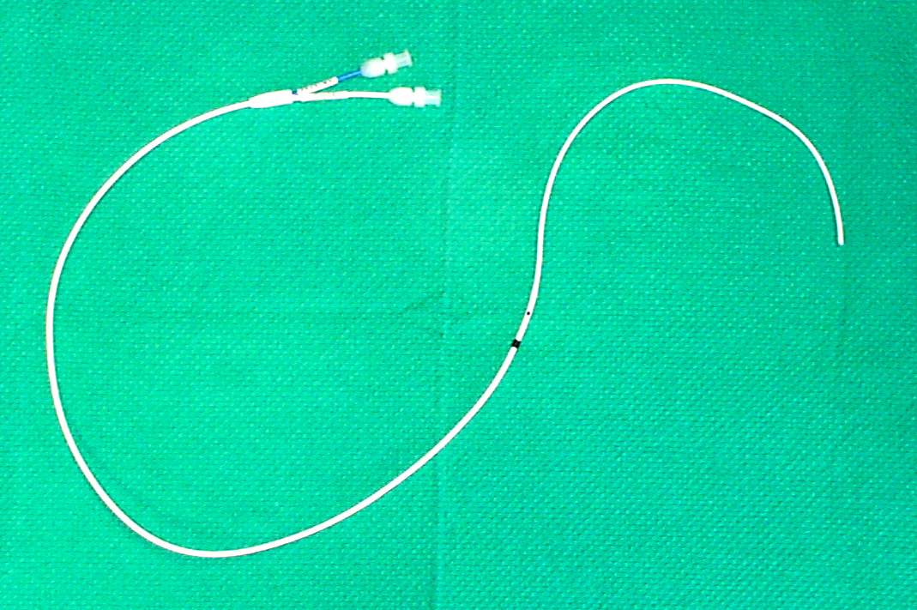
Proximal Port
Distal Port
Marking Ring
Distal Lumen
Cholangiogram Lumen

Slide 66
Laparoscopic CBDE
The Alternative Technique
Notes:
25
25
25
25

Slide 67
Purpose of the Alternative Technique
Provides Percutaneous Access for Serial Cholangiography after Laparoscopic Cholecystectomy
Allows Percutaneous Placement of a Transampullary Guidewire so that a Guidewire Assisted Sphincterotomy with Stone Extraction Can be Performed (“Rendez-Vous” Technique)
Notes:
26
26
26
26

Slide 68
