Slide 1
Blunt Cerebrovascular Injuries: Diagnosis and Management
43rd Annual Phoenix Surgical Symposium
Scottsdale, AZ
Elvis Presley Memorial Trauma Center
Department of Surgery
University of Tennessee Health Science Center
Memphis, TN

Slide 2
I have no conflicts to disclose

Slide 3
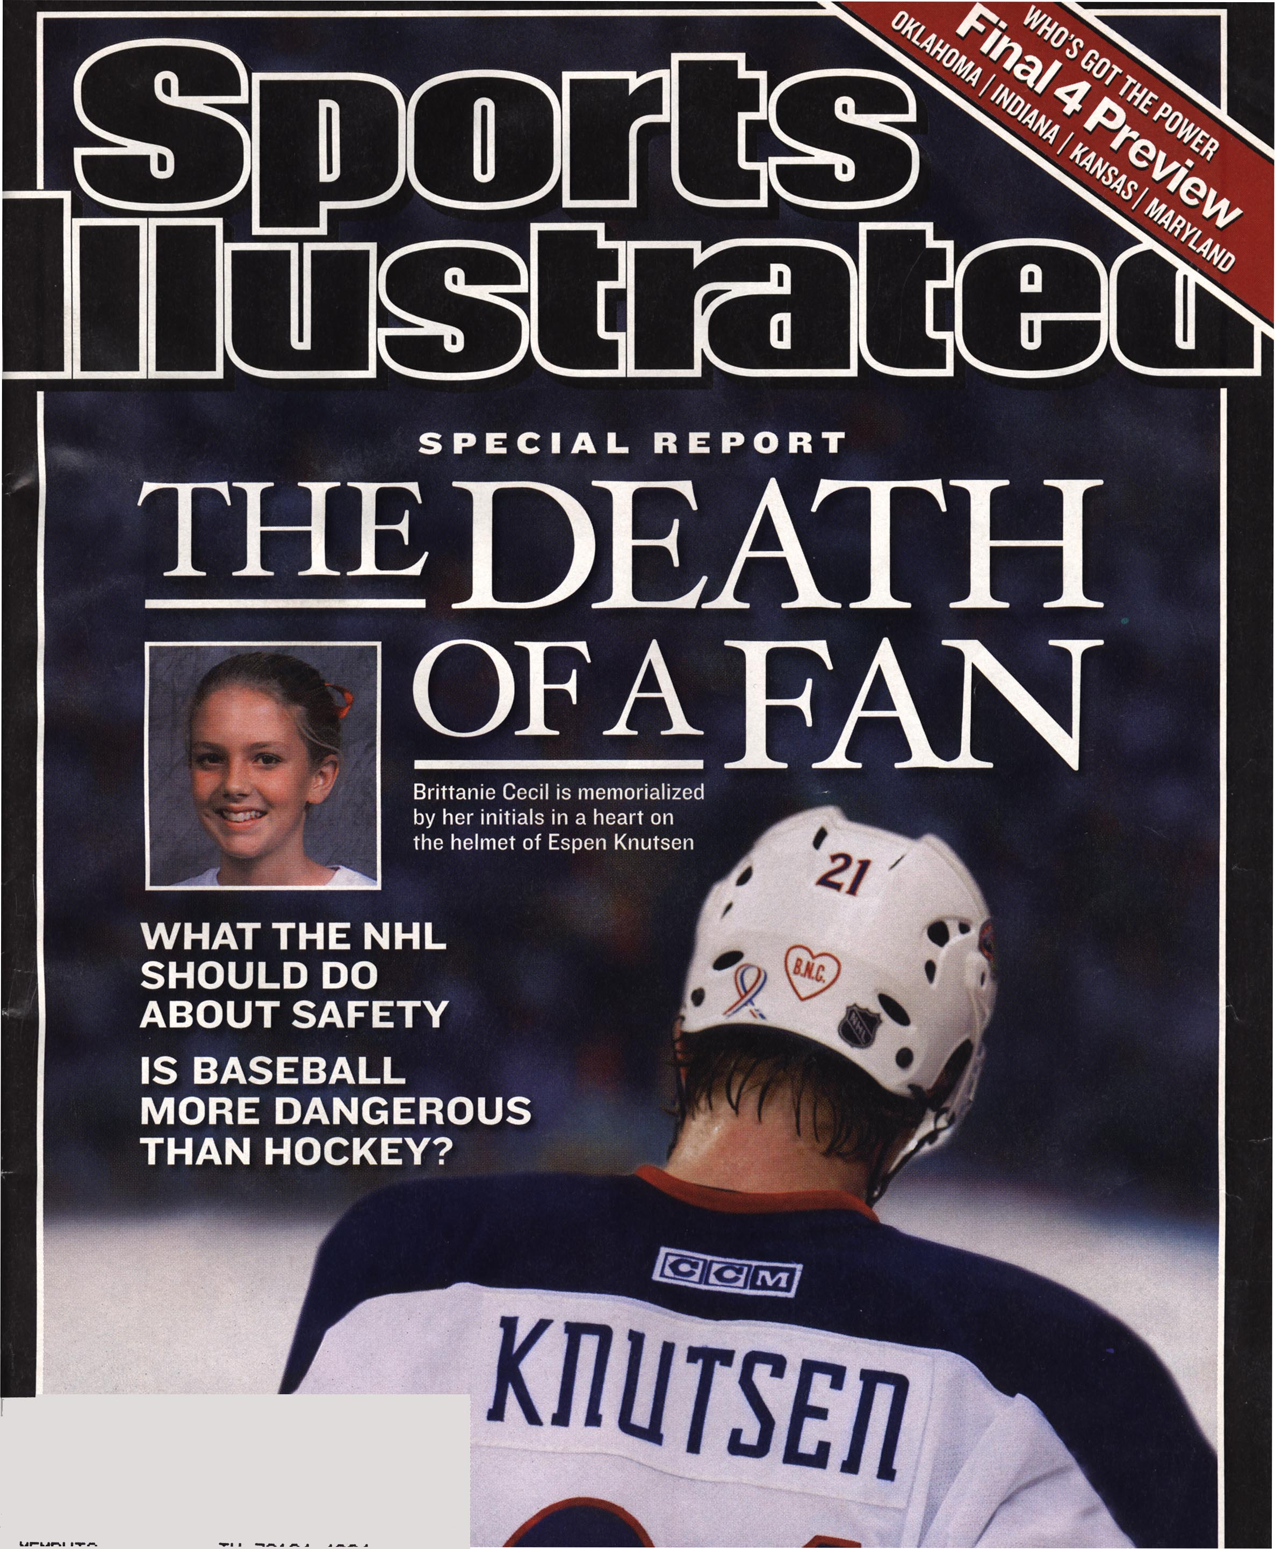

Slide 4
“This is just an incredibly rare thing,” David Miltzman, a Georgetown University emergency room doctor and expert on hockey injuries, told The Columbus Dispatch. “I wouldn’t have thought of that, and anyone who says they would have is lying.”
On the morning of March 18, Brittanie developed a high fever and lost consciousness … she died at 5:15 p.m., nearly 48 hours after she had been struck and two days shy of her 14th birthday.
After Brittanie was struck, she retained consciousness and was taken by ambulance to Columbus Children’s Hospital for observation and to receive stitches for a small gash. In the emergency room she suffered a seizure and was admitted to the hospital and by the next day she was conscious, communicative, and able to walk around in the hospital.

Slide 5
BCVI: Not Rare
Series | Incidence (% Blunt Trauma Admissions)
2001 Columbia | 1.1
2002 Denver | 1.55
2003 Memphis | 1.03
2006 Seattle | 1.6
2006 Dallas | 1.25
2008 Baltimore | 1.1

Slide 6
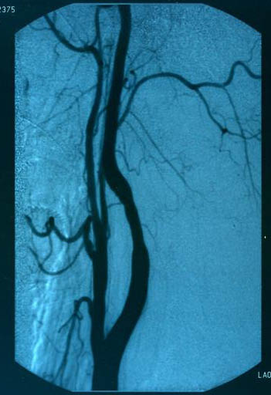
Blunt Carotid and Vertebral Injury Grades
Grade I: Luminal irregularity or dissection with <25% narrowing
Biffl et al, J Trauma 1999
Notes:
First, let’s look at the grading system for these injuries described by Dr. Biffl in the Journal of Trauma in 1999. Grade 1 injuries as luminal irregularity or dissection with <25% narrowing.

Slide 7
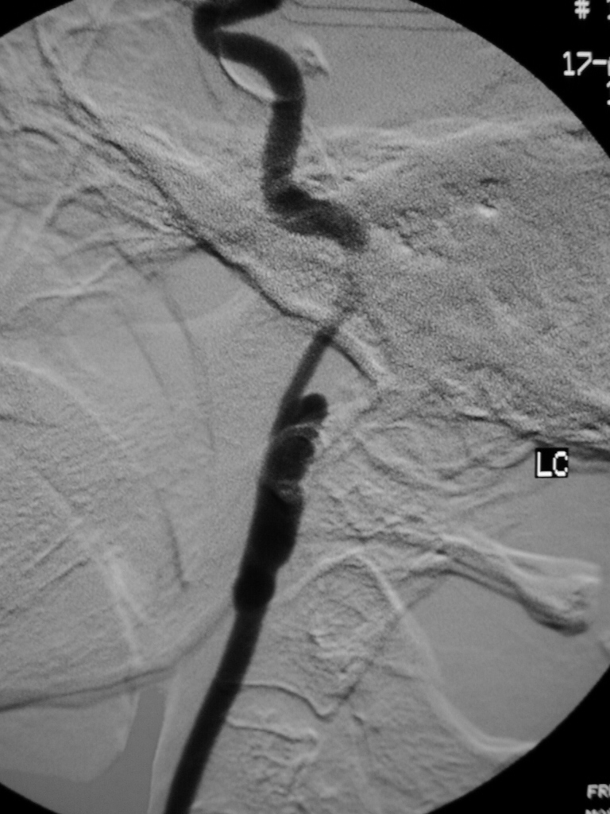
Blunt Carotid and Vertebral Injury Grades
Grade I: Luminal irregularity or dissection with <25% narrowing
Grade II: Dissection or intramural hematoma with >25% luminal narrowing, intraluminal thrombus,
or raised intimal flap
Biffl et al, J Trauma 1999
Notes:
Grade II: Dissection or intramural hematoma with >25% luminal narrowing, intraluminal thrombus, or raised intimal flap

Slide 8
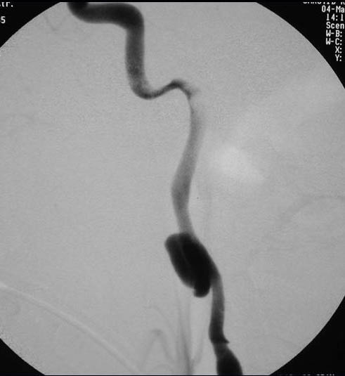
Blunt Carotid and Vertebral Injury Grades
Grade I: Luminal irregularity or dissection with <25% narrowing
Grade II: Dissection or intramural hematoma with >25% luminal narrowing, intraluminal thrombus,
or raised intimal flap
Grade III: Pseudoaneurysm
Biffl et al, J Trauma 1999
Notes:
Grade III: Pseudoaneurysm

Slide 9
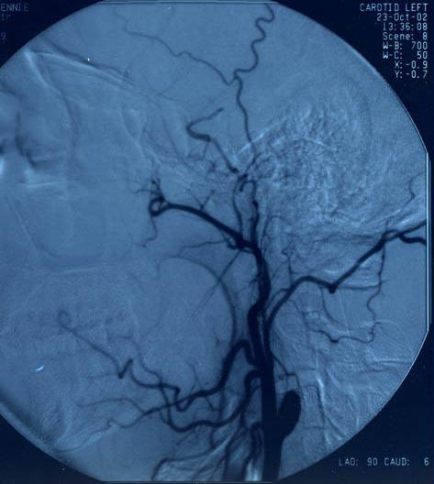
Blunt Carotid and Vertebral Injury Grades
Grade I: Luminal irregularity or dissection with <25% narrowing
Grade II: Dissection or intramural hematoma with >25% luminal narrowing, intraluminal thrombus,
or raised intimal flap
Grade III: Pseudoaneurysm
Grade IV: Complete occlusion
Biffl et al, J Trauma 1999
Notes:
Grade IV: Complete occlusion

Slide 10
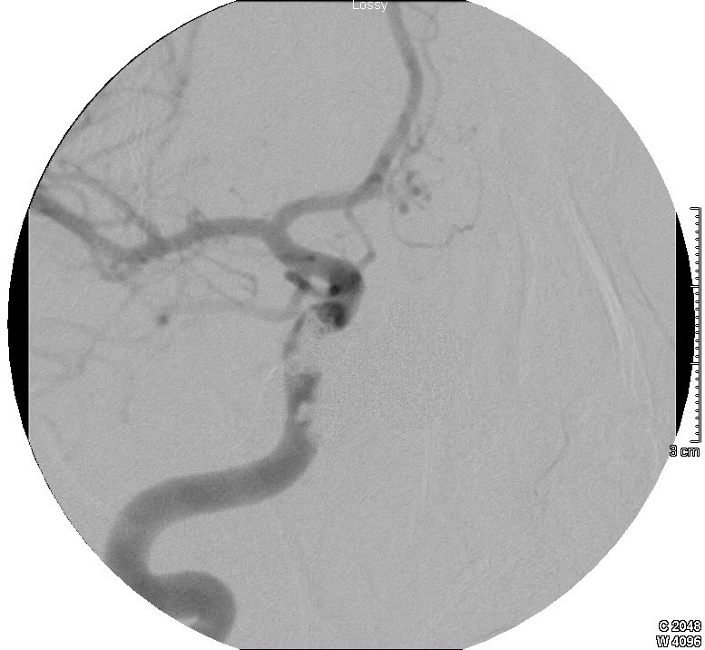
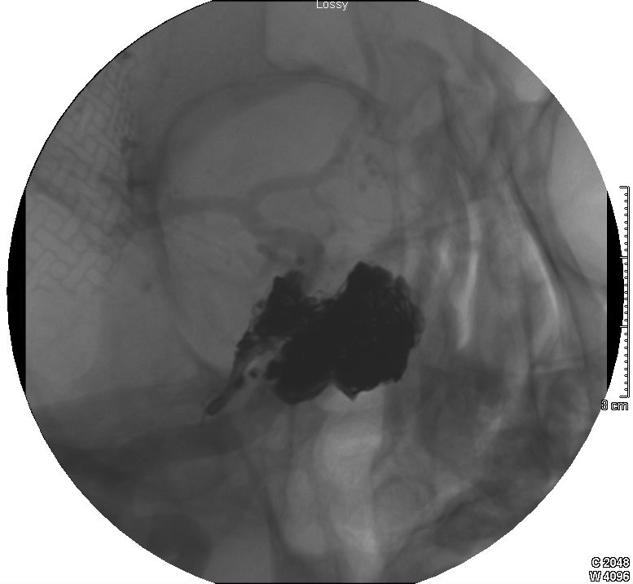
Blunt Carotid and Vertebral Injury Grades
Grade I: Luminal irregularity or dissection with <25% narrowing
Grade II: Dissection or intramural hematoma with >25% luminal narrowing, intraluminal thrombus,
or raised intimal flap
Grade III: Pseudoaneurysm
Grade IV: Complete occlusion
Grade V: Transection with extravasation
or AV fistula
Biffl et al, J Trauma 1999
Notes:
Grade V: Transection with extravasation or AV fistula

Slide 11
Issues
Screening for BCVI
Risk factors alone
CTA
Diagnosis of BCVI
CTA vs DSA
Management of BCVI
Anticoaculation
Stent
Both
Neither

Slide 12
Method of Screening
 | Angiography
Benefits | Gold standard Therapeutic options
Limits | Invasive Resource intensive

Slide 13
Method of Screening
 | Angiography | CT-Angiography
Benefits | Gold standard Therapeutic options | Readily available Less invasive Less expensive
Limits | Invasive Resource intensive | Unproven reliability

Slide 14
CTA as a screening test?
Study | Slices | CTA | Angio | Sensitivity
Eastman (06) | 16 | 162 | 146 | 98
Malhotra (07) | 16 | 119 | 92 | 74

Slide 15
CTA as a screening test?
Study | Slices | CTA | Angio | Sensitivity
Eastman (06) | 16 | 162 | 146 | 98
Malhotra (07) | 16 | 119 | 92 | 74
Sliker (08) | 16 | 77 | 77 | 64
Goodwin (09) | 16,64 | 158 | 158 | 41
DiCocco (11) | 32 | 684 | 684 | 51

Slide 16
Traditional Screening Criteria
Le Fort II and III fractures
Skull base fracture
Cervical spine fracture
Seatbelt mark
Horner’s syndrome
Unexplained neurologic deficit
20% of injuries are still missed

Slide 17
Methods
Patients screened for BCVI
Jan 2007 through May 2009
Radiology
All had angiography
32 slice CTA during initial trauma evaluation
Review charts
Radiology reports
Indications for screening
Mechanism and demographics

Slide 18
Results
28,642 Trauma patients evaluated
748 Screened with Angio
117 patients with 143 BCVI
16% of those screened
78 Carotid
65 Vertebral
Notes:
8 people with CAI and VAI
17 with 2 vessels; 3 with 3 and; 1 with 4 vessels

Slide 19
Traditional Criteria
Indication | # screened | % with BCVI
Skull base fx | 124 | 16
Le Fort fx | 76 | 11
Cervical spine fx | 406 | 15
Neck soft tissue | 135 | 14
Horner’s syndrome | 50 | 18
Unexplained deficit | 32 | 25

Slide 20
Expanded Criteria
Indication | # screened | % with BCVI
Skull base fx | 124 | 16
Le Fort fx | 76 | 11
Cervical spine fx | 406 | 15
Neck soft tissue | 135 | 14
Horner’s syndrome | 50 | 18
Unexplained deficit | 32 | 25
Abnormal CTA | 148 | 51

Slide 21
Expanded Criteria
Indication | # screened | % with BCVI
Skull base fx | 124 | 16
Le Fort fx | 76 | 11
Cervical spine fx | 406 | 15
Neck soft tissue | 135 | 14
Horner’s syndrome | 50 | 18
Unexplained deficit | 32 | 25
Abnormal CTA | 148 | 51
Abnormal CTA only | 44 | 43

Slide 22
Added value of CTA criterion
143 BCVI
Conventional
120
CTA only
23
Carotid
59
Vertebral
61
Carotid
19
Vertebral
4
16% screened for CTA only
Notes:
8 patients with both CAI and VAI

Slide 23
Role of CTA
Obtain a CTA on any patient that potentially has a head, face, or cervical spine injury during initial evaluation
Obtain an angiogram for traditional screening criteria and CTA abnormalities
Abnormal CTA is a screening criterion, NOT a screening test

Slide 24
Problems with DSA Screening
Resource intensive
Invasive
Resource intensive
Complications
Resource intensive

Slide 25
Methods
Patients screened for BCVI
June 2011 through May 2012, revised protocol
Radiology
All had angiography
64 slice CTA during initial trauma evaluation
Review charts
Radiology reports
Indications for screening
Mechanism and demographics

Slide 26
Results
594 Screened with CTA and DSA
128 patients with 163 BCVI
99 Carotid
61%
64 Vertebral
39%
Notes:
8 people with CAI and VAI
17 with 2 vessels; 3 with 3 and; 1 with 4 vessels

Slide 27
BCVI by Grade and Location
Grade | Carotids | Vertebrals | Total
1 | 44 | 19 | 39 %
2 | 27 | 17 | 27 %
3 | 23 | 4 | 16 %
4 | 4 | 24 | 17 %
5 | 1 | 0 | 1 %
Notes:
The grade and location of the 163 injured vessels are shown. Relatively even distribution among the vessels- The vast majority where grade I-II. Pseudoaneusyms (grade III) generally occurred in carotid arteries and occluded vessels (grade IV) generally occurred in vertebral arteries.

Slide 28
Results per Vessel
 | # vessels
Overall | 2376
Carotid | 1188
Vertebral | 1188
Notes:
Overall, 2376 vessels were examined.

Slide 29
Results per Vessel
 |  | No Injury (DSA-)
 | # vessels | (CTA -) True - | (CTA +) False +
Overall | 2376 | 2017 | 196
Carotid | 1188 | 979 | 110
Vertebral | 1188 | 1038 | 86
Notes:
There were 2,213 negative DSAs total,

Slide 30
Results per Vessel
 |  | No Injury (DSA-)
 | # vessels | (CTA -) True - | (CTA +) False +
Overall | 2376 | 2017 | 196
Carotid | 1188 | 979 | 110
Vertebral | 1188 | 1038 | 86
Notes:
of which 196 were false positive CTAs.

Slide 31
Results per Vessel
 |  | No Injury (DSA-) |  | Injury (DSA+)
 | # vessels | (CTA -) True - | (CTA +) False + | (CTA -) False - | (CTA +) True +
Overall | 2376 | 2017 | 196 | 52 | 111
Carotid | 1188 | 979 | 110 | 34 | 65
Vertebral | 1188 | 1038 | 86 | 18 | 46
Notes:
And 163 injuries on DSA,

Slide 32
Results per Vessel
 |  | No Injury (DSA-) |  | Injury (DSA+)
 | # vessels | (CTA -) True - | (CTA +) False + | (CTA -) False - | (CTA +) True +
Overall | 2376 | 2017 | 196 | 52 | 111
Carotid | 1188 | 979 | 110 | 34 | 65
Vertebral | 1188 | 1038 | 86 | 18 | 46
Notes:
of which 52 were false negatives on CTA.

Slide 33
CTA Diagnostics per Vessel
 | Carotids | Vertebrals | Overall
Sensitivity | 66% | 72% | 68%
Specificity | 90% | 92% | 91%
PPV | 37% | 35% | 36%
NPV | 97% | 98% | 97%
Notes:
With the 64 slice CTA protocol, the overall sensitivity per vessel was 68%, specificity was 91%, PPV 36%, and NPV 97%. Sensitivity for carotid artery injuries was 66% versus 72% for vertebral artery injuries.

Slide 34
Results per Patient
 |  | No Injury (DSA-) |  | Injury (DSA+)
 | # patients | (CTA -) True - | (CTA +) False + | (CTA -) False - | (CTA +) True +
Overall | 594 | 323 | 143 | 20 | 108
Carotid | 594 | 431 | 82 | 23 | 58
Vertebral | 594 | 461 | 72 | 14 | 47
Notes:
We then analyzed the CTA diagnostic results for the 594 patients.

Slide 35
Results per Patient
 |  | No Injury (DSA-) |  | Injury (DSA+)
 | # patients | (CTA -) True - | (CTA +) False + | (CTA -) False - | (CTA +) True +
Overall | 594 | 323 | 143 | 20 | 108
Carotid | 594 | 431 | 82 | 23 | 58
Vertebral | 594 | 461 | 72 | 14 | 47
Notes:
We then analyzed the CTA diagnostic results for the 594 patients.

Slide 36
CTA Diagnostics per Patient
 | Carotids | Vertebrals | Overall
Sensitivity | 72% | 77% | 84%
Specificity | 84% | 86% | 69%
PPV | 41% | 40% | 43%
NPV | 95% | 97% | 94%
Notes:
Overall sensitivity for the total 594 patients, sensitivity was 84%, specificity 69%, PPV 43%, and NPV 94%.

Slide 37
per Vessel / per Patient Sensitivity
TP
TP + FN
Sensitivity =
 |  |  |  |  |  | Sensitivity
 |  | RICA | LICA | RV | LV | Vessel | Patient
Patient 1 | CTA | TP | - | - | - | 100%
 | DSA | + | - | - | -
Patient 2 | CTA | - | + | - | - | 50%
 | DSA | + | + | - | -
Patient 3 | CTA | - | - | + | - | 33%
 | DSA | + | + | + | -
Total |  |  |  |  |  | 50% | 100%
Notes:
The easiest way to show how the sensitivity per vessels was lower than sensitivity for patients is through a simple example. DSA is used as the gold standard.
The 1st patient has a R ICA injury on CTA and DSA- resulting in a per vessel sensitivity of 100%.

Slide 38
per Vessel / per Patient Sensitivity
TP
TP + FN
Sensitivity =
 |  |  |  |  |  | Sensitivity
 |  | RICA | LICA | RV | LV | Vessel | Patient
Patient 1 | CTA | TP | - | - | - | 100% | 100%
 | DSA | + | - | - | -
Patient 2 | CTA | - | + | - | - | 50%
 | DSA | + | + | - | -
Patient 3 | CTA | - | - | + | - | 33%
 | DSA | + | + | + | -
Total |  |  |  |  |  | 50% | 100%
Notes:
The easiest way to show how the sensitivity per vessels was lower than sensitivity for patients is through a simple example. DSA is used as the gold standard.
The 1st patient has a R ICA injury on CTA and DSA- resulting in a per vessel sensitivity of 100%.

Slide 39
per Vessel / per Patient Sensitivity
TP
TP + FN
Sensitivity =
 |  |  |  |  |  | Sensitivity
 |  | RICA | LICA | RV | LV | Vessel | Patient
Patient 1 | CTA | TP | - | - | - | 100% | 100%
 | DSA | + | - | - | -
Patient 2 | CTA | FN | TP | - | - | 50%
 | DSA | + | + | - | -
Patient 3 | CTA | - | - | + | - | 33%
 | DSA | + | + | + | -
Total |  |  |  |  |  | 50% | 100%
Notes:
The 2nd patient has DSA injuries of both ICAs, but CTA only showed the R ICA, resulting in a per vessel sensitivity of 50%.

Slide 40
per Vessel / per Patient Sensitivity
TP
TP + FN
Sensitivity =
 |  |  |  |  |  | Sensitivity
 |  | RICA | LICA | RV | LV | Vessel | Patient
Patient 1 | CTA | TP | - | - | - | 100% | 100%
 | DSA | + | - | - | -
Patient 2 | CTA | FN | TP | - | - | 50% | 100%
 | DSA | + | + | - | -
Patient 3 | CTA | - | - | + | - | 33%
 | DSA | + | + | + | -
Total |  |  |  |  |  | 50% | 100%
Notes:
The 2nd patient has DSA injuries of both ICAs, but CTA only showed the R ICA, resulting in a per vessel sensitivity of 50%.

Slide 41
per Vessel / per Patient Sensitivity
TP
TP + FN
Sensitivity =
 |  |  |  |  |  | Sensitivity
 |  | RICA | LICA | RV | LV | Vessel | Patient
Patient 1 | CTA | TP | - | - | - | 100% | 100%
 | DSA | + | - | - | -
Patient 2 | CTA | FN | TP | - | - | 50% | 100%
 | DSA | + | + | - | -
Patient 3 | CTA | FN | FN | TP | - | 33% | 100%
 | DSA | + | + | + | -
Total |  |  |  |  |  | 50% | 100%
Notes:
The 3rd patient has DSA injuries of both ICAs and the R VA, but CTA only showed the RVA injury- So patient 3 has a per vessel sensitivity of 33%.

Slide 42
per Vessel / per Patient Sensitivity
TP
TP + FN
Sensitivity =
 |  |  |  |  |  | Sensitivity
 |  | RICA | LICA | RV | LV | Vessel | Patient
Patient 1 | CTA | TP | - | - | - | 100% | 100%
 | DSA | + | - | - | -
Patient 2 | CTA | FN | TP | - | - | 50% | 100%
 | DSA | + | + | - | -
Patient 3 | CTA | FN | FN | TP | - | 33% | 100%
 | DSA | + | + | + | -
Total |  |  |  |  |  | 50% | 100%
Notes:
Overall, these 3 patients have a per vessel sensitivity of 50%, but a per patient sensitivity of 100%.

Slide 43
False Negatives per Vessel
52 false negative CTAs
34 carotid
18 vertebral
22 Grade 1
65%
10 Grade 1
56%
Notes:
Now back to the 52 false negative vessels-
they were composed of 34 carotid artery injuries and 18 vertebral artery injuries.
There were 22 grade 1 carotids and 10 grade 1 vertebral vessel injuries.
Majority of FN grade 1 injuries.

Slide 44
False Negatives per Patient
20 false negative CTAs
12 carotid
8 vertebral
7 Grade 1
58%
3 Grade 1
38%
Notes:
There were 20 false negative patients-
composed of 12 carotid artery injuries and 8 vertebrals.
There were 7 grade 1 patients carotids and 3 grade 1 vertebral patients.

Slide 45
Follow-Up DSA after 1 Week by Initial Grade of Injury
Grade | I | II | III | IV | V
Carotids
Improved | 71% | 27% | 9% | 0 | 0
Unchanged | 17% | 35% | 91% | 50% | 100%
Worse | 12% | 38% | 0 | 50% | 0
Vertebrals
Improved | 58% | 30% | 50% | 16% | 0
Unchanged | 32% | 41% | 50% | 84% | 0
Worse | 10% | 29% | 0 | 0 | 0
Notes:
And vertebrals

Slide 46
Stroke Rates By Injury Grade
 | Carotid Injury |  | Vertebral Injury
Worst Injury Grade | Total | % Stroke | Total | % Stroke
I | 81 | 6 | 53 | 3
II | 58 | 10 | 20 | 30
III | 78 | 17 | 18 | 22
IV | 20 | 55 | 56 | 18
V | 9 | 77 | 0 | 0
Biffl et al, Ann Surg 2002 and Stein et al, J Trauma 2007

Slide 47
Theoretical Risk of Stroke
For 12 FN CAI on CTA:
(7 Grade I) x (6% SR for Grade I) = 0.42 patients
(2 Grade II) x (10% SR for Grade II) = 0.20 patients
(3 Grade III) x (17% SR for Grade III) = 0.51 patients
For 8 FN VAI on CTA:
(3 Grade I) x (3% SR for Grade I) = 0.09 patients
(2 Grade II) x (30% SR for Grade II) = 0.60 patients
(1 Grade III) x (22% SR for Grade III) = 0.22 patients
(2 Grade IV) x (18% SR for Grade IV) = 0.36 patients
Total 2.2 Patients (0.4% study population)
Notes:
We then analyzed our 20 false negative patients by individual grade of injury and their risk for stroke.
First, for the 12 false negative carotid artery injuries, composed of 7 grade 1, 2 grade 2, and 3 grade 3 injuries.
And then for the 8 false negative vertebral artery injuries, composed on 3 grade 1, 2 grade 2, 1 grade 3, and 2 grade 4 injuries.
By adding each of these together, the total theoretical risk of stroke equals 2.4 patients or 0.4% of the study population.

Slide 48
DSA Complications vs Missed Injuries
1 groin abscess requiring I&D
2 groin hematomas requiring drainage
2 iatrogenic dissections requiring stenting
1 stroke post DSA
Notes:
There were 6 (1%) procedure related complications- 1 groin abscess requiring I&D, 2 iatrogenic hematomas requiring drainage.
It is important to note that there were 2 iatrogenic dissections requiring stenting and 1 stroke post DSA.

Slide 49
DSA Complications vs Missed Injuries
1 groin abscess requiring I&D
2 groin hematomas requiring drainage
2 iatrogenic dissections requiring stenting
1 stroke post DSA
0.5% serious cerebrovascular complications
vs
0.4% theoretical risk of stroke using CTA screening
Notes:
So, when you compare these 3 serious cerebrovascular complications (0.5% population) it is virtually identical to the morbidity associated with potential missed injuries (0.4% of population).
We are closely monitoring our protocol change from DSA to CTA screening, and there have been no strokes identified from false negative studies in the 1st 6 months.

Slide 50
Is 64 Slice CTA Better?
Significantly improved sensitivity (68 vs 51%)
62% false negative CTAs Grade 1 injuries
Most Grade 1 injuries heal at 1 week
DSA complication rate 1%
91% specificity

Slide 51
J Trauma 2011
Lifetime Cost of Stroke
$608,483.00
“If CTA sensitivity is < 0.93 or CTA specificity is
< 0.81 then angiography is the most cost-effective
test.”

Slide 52
BCVI screening is a moot point …
without effective therapy
for stroke prevention

Slide 53
Stroke in BCVI
30 – 40% of carotids
10 – 15% of vertebrals
Stroke-related
mortality 5 – 15%

Slide 54
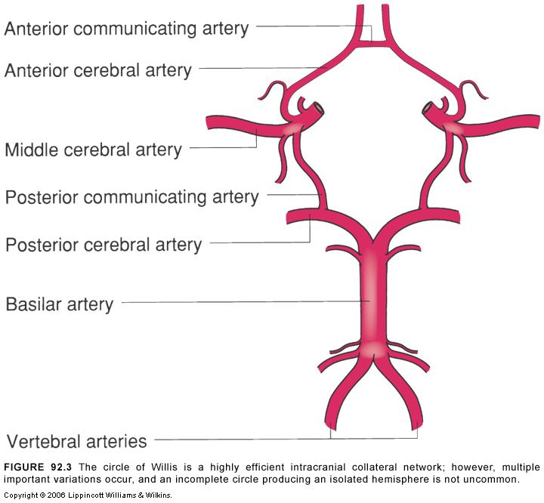
Circle of Willis
Anatomic Variants
Key issue concerning stroke
Most important potential collateral cortical flow
"Normal" anatomy 20%
Most variants due to segmental hypoplasia

Slide 55
Anticoagulation Therapy
Actions
Prevents thrombosis with dissection
Decreases embolization
Prevents ventral propagation

Slide 56
Anticoagulant / Antiplatelet - Contraindications -
Absolute
Ongoing hemorrhage
Impending surgery
Bleeding diatheses
Relative
Intracerebral hematomas
Subdural hematomas

Slide 57
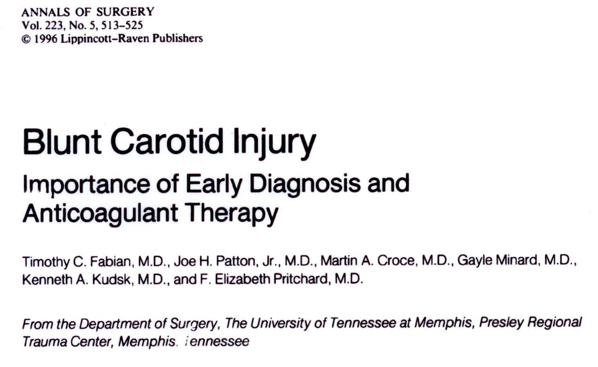

Slide 58
Independent Outcome Predictors - Logistic Regression Analysis -
Survival Improvement
GCS .056 .118
Heparin .015 .006

Slide 59
15 bilateral carotid injuries
Heparin
Asymptomatic side remained asymptomatic

Slide 60
Arch Surg 2004

Slide 61
Arch Surg 2009
 | # of BCVI (n = 422) | # with Stroke
Treatment for Asymptomatic Injuries (n = 282):
Heparin sodium | 192 | 1 (0.5%)
Aspirin | 67 | 0
Aspirin / clopidogrel | 23 | 0
No initial treatment (n = 140):
Contraindication / subtherapeutic | 107 | 23 (21%)
Stroke at presentation | 26 | 26 (100%)
Primary embolization / stent | 7 | 7 (100%)

Slide 62
2009
22 strokes of 200 lesions (11%)
50% mortality
Stroke 26% in untreated; 3.9% in treated
Conclusion: Treatment does reduce risk of infarction in patients with BCVI

Slide 63
Anticoagulation
or
Anti-platelet

Slide 64
Anticoagulation vs. Antiplatelet
Therapeutic equivalency (?)
Unfractionated heparin – rapid reversal
Antiplatelet agents – irreversible
Associated risks

Slide 66
Angiographic Pathology
Initial
Follow-Up
Dissection | 42
Pseudo | 6
Total | 48
NL | Diss | Pseudo | Occ
26 | 4 | 12 | 0
0 | 0 | 5 | 1
26 | 4 | 17 (35%) | 1
Fabian, et al. Ann Surg 1996

Slide 67
Angiographic Pathology
Initial
Follow-Up
Dissection | 42
Pseudo | 6
Total | 48
NL | Diss | Pseudo | Occ
26 | 4 | 12 | 0
0 | 0 | 5 | 1
26 | 4 | 17 (35%) | 1
Fabian, et al. Ann Surg 1996

Slide 68
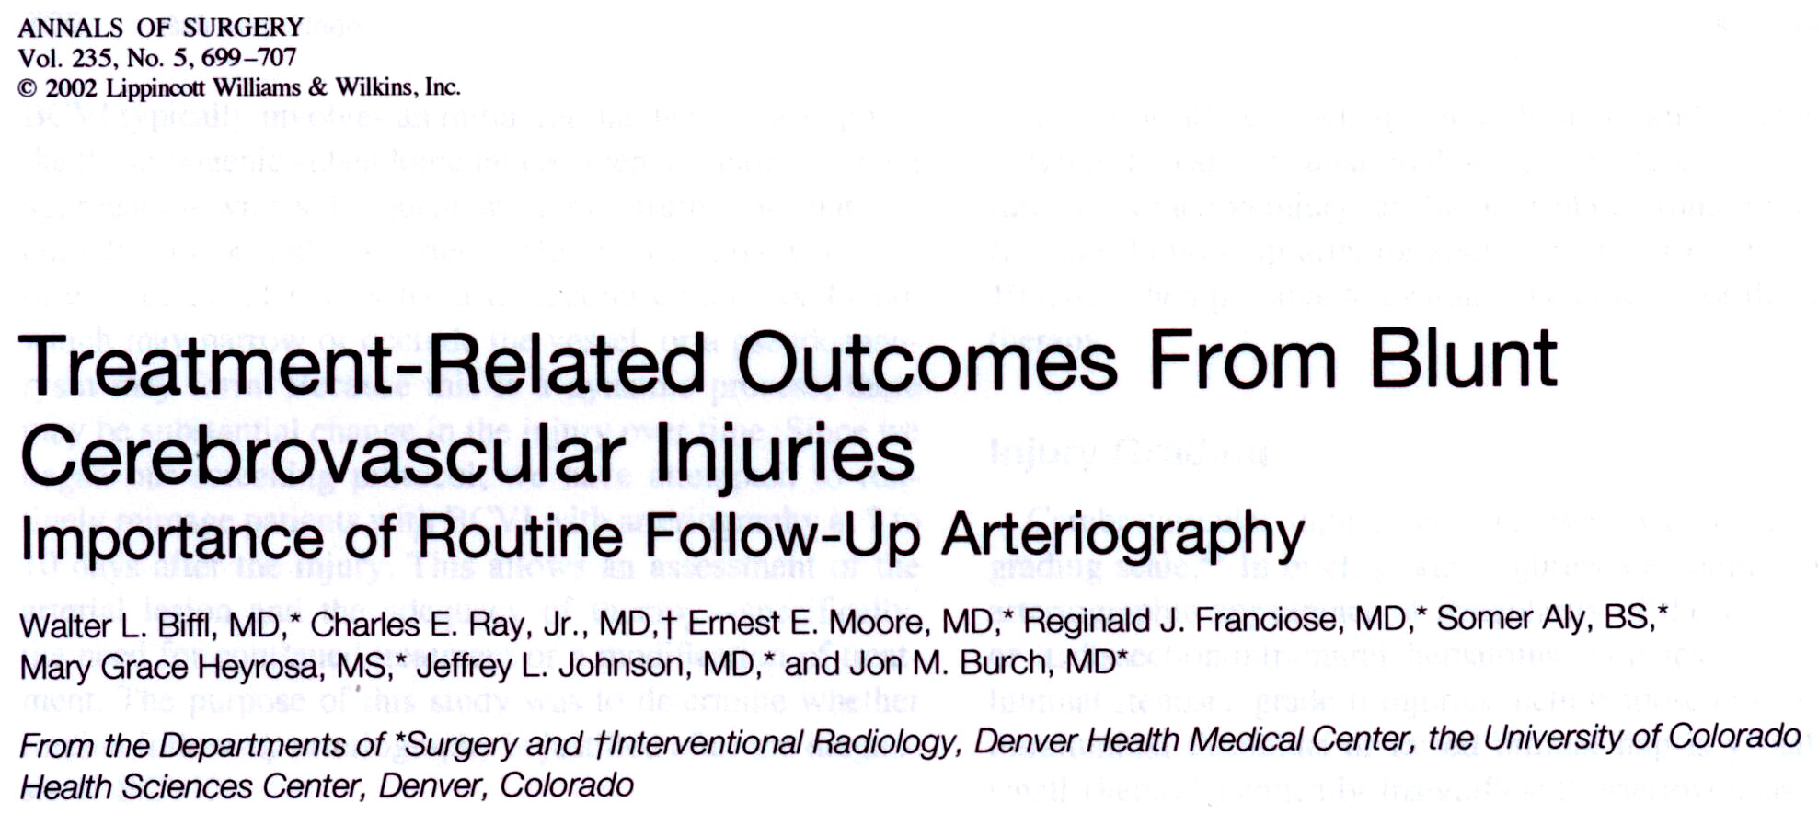
 | Initial | Grade III on Follow-up | % Pseudo
Grade I | 69 | 4 | 6
Grade II | 37 | 16 | 43
Grade III | 30 | 28 | 93
Total | 136 | 48 | 35
35

Slide 69
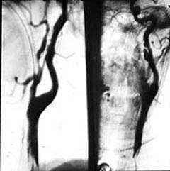

Slide 70
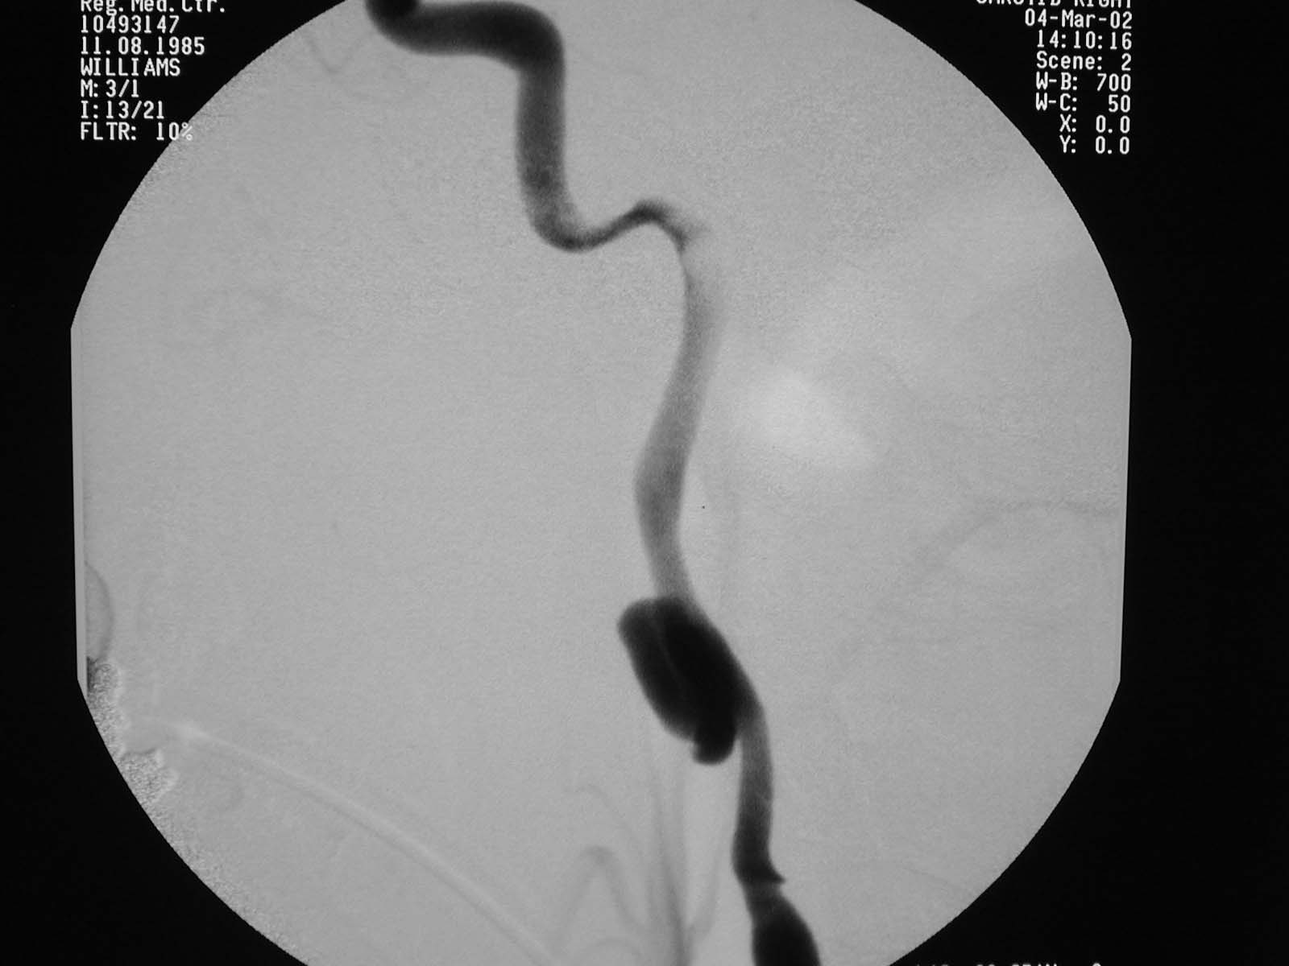

Slide 71
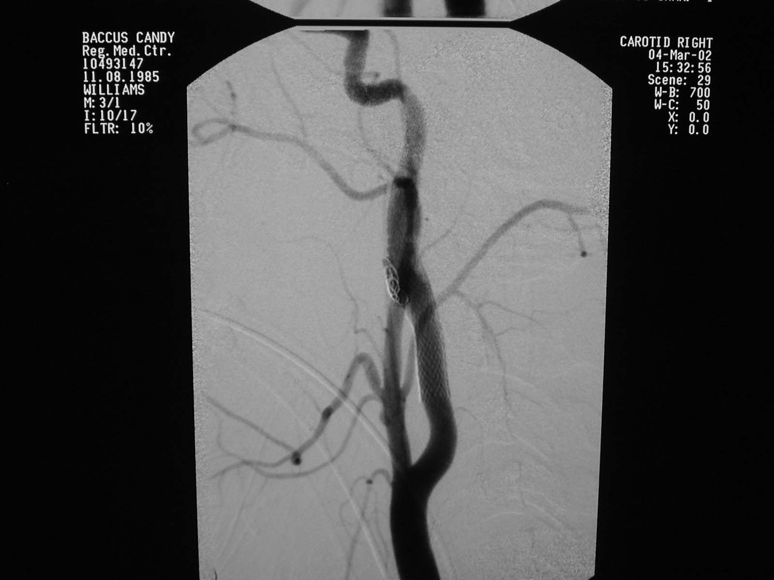

Slide 72
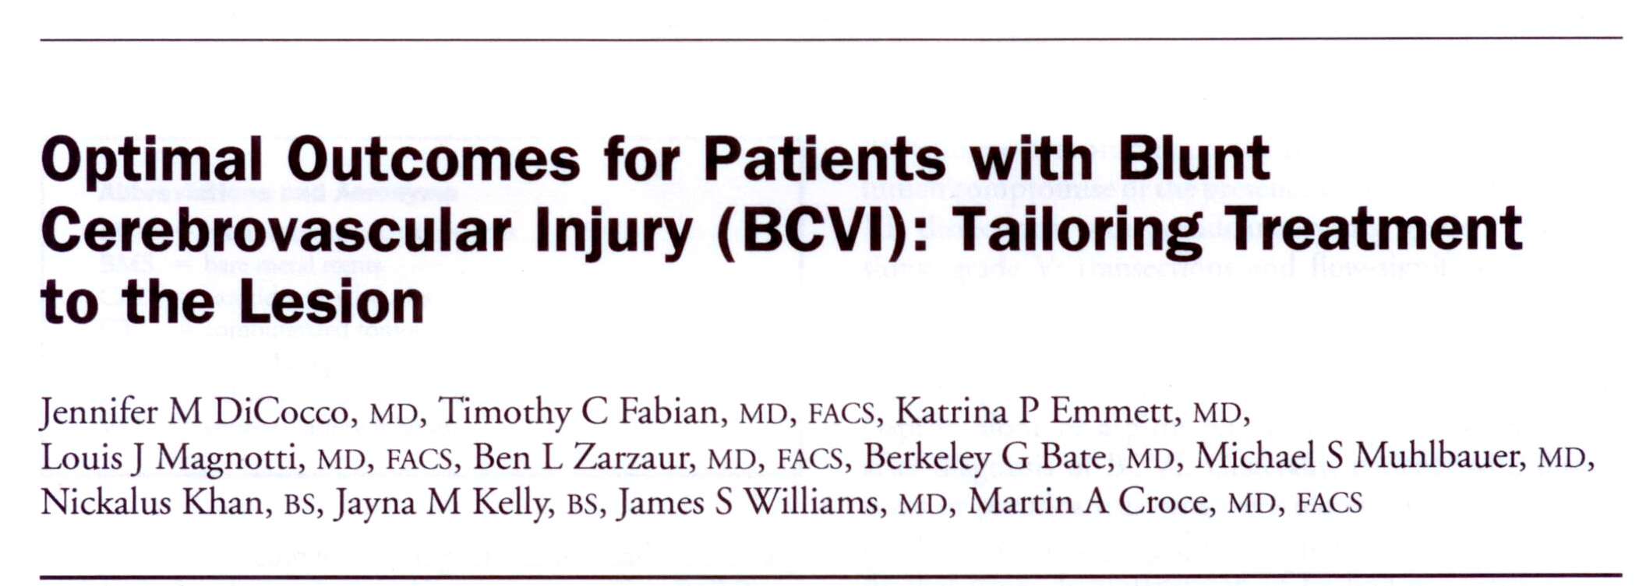
J Am Coll Surg 2011

Slide 73
Treatment Protocol
Grade I-III: Dissection +/- pseudoaneurysm
Heparin drip (goal PTT 40-60 sec)
Repeat angio
If not healed → endovascular treatment
Grade IV: Occlusion
Aspirin only
Grade V: Fistula or Transection
Endovascular treatment

Slide 74
Results
222 patient with BCVI
263 vessels injured
115 Carotid
148 Vertebral
29 patients have bilateral injuries
11 patients with both carotid and vertebral
Notes:
~50,000 Blunt trauma patients evaluated

Slide 75
222 Patients
22 Infarct before diagnosis
200 Asymptomatic at diagnosis
74 Carotid
131 Vertebral
2 infarcts
before treatment
1 infarct
before treatment
22 Medical
100 Medical
50 Endovascular
30 Endovascular

Slide 76
Outpatient Follow-up
85% follow-up
Mean 22 months; median 17 months
6 strokes
7% post-diagnosis stroke rate
5 potential strokes
Up to 9% in patients initially asymptomatic
13 outpatient deaths
17% overall mortality

Slide 77
Strokes in Asymptomatic Patients - Inpatient & Follow-Up -
72 Carotid
130 Vertebral
22 Medical
100 Medical
9%
3 - 6%
50 Endovascular
30 Endovascular
6%
3 - 10%

Slide 78
Current Literature
 | n | Stroke % post-diagnosis | Mortality %
Geneva 1994 | 7 | 33 | 43
La Crosse 1994 | 49 | 29 | 33
Denver 2002 | 171 | 14 | 11
Denver 2005 | 46 | 11 | --
Memphis 2007 | 110 | 8 | 26
Tyler 2008 | 11 | 10 | 18
Baltimore 2009 | 147 | 7 | 13
Memphis 2011 | 222 | 4 | 11

Slide 79
Current Literature
 | n | Stroke % post-diagnosis | Mortality %
Geneva 1994 | 7 | 33 | 43
La Crosse 1994 | 49 | 29 | 33
Denver 2002 | 171 | 14 | 11
Denver 2005 | 46 | 11 | --
Memphis 2007 | 110 | 8 | 26
Tyler 2008 | 11 | 10 | 18
Baltimore 2009 | 147 | 7 | 13
Memphis 2011 | 222 | 4 | 11
Including outpatient |  | 7 – 9 | 18

Slide 80
Current Algorithm for Blunt Carotid Artery Injury
Head CT
Cerebrovascular CTA
Negative CTA
Positive or indeterminate for carotid injury
Negative CTA WITH unexplained neuro exam
Continue evaluation – No angiogram necessary
Start heparin gtt
Neurosurgery consult
Definitive management of other injuries within 7 days – hold heparin 2 hours preop and 4 hours postop if necessary
4 vessel angiogram
Negative
Dissection and/or Pseudoaneurysm
Continue heparin gtt
Neurosurgery consult
Observation
No stent
Repeat radiologic study (angiogram, CTA, MRA)
ASA (325mg) and Plavix (75mg) OR warfarin (INR 2.0) when able
Stent
Repeat radiologic study (angiogram, CTA, MRA) in 6 months
ASA (325mg) and Plavix (75mg) when able

Slide 81
Summary
Diagnosis of blunt carotid injury requires high index of suspicion
Vertebral artery injuries are not as rare as initially thought and should be aggressively treated
CTA still lacks sensitivity, good specificity
CTA has high negative predictive value
64 slice CTA can replace DSA as screening test
Antithrombotic therapy with selective stent placement for more severe injuries is mainstay

Slide 82
Cautionary Tale for CTA

