Slide 1
Management of Pancreatic and Duodenal Trauma
43rd Annual Phoenix Surgical Symposium
Scottsdale, AZ
Elvis Presley Memorial Trauma Center
UTHSC Department of Surgery
Memphis, TN

Slide 2
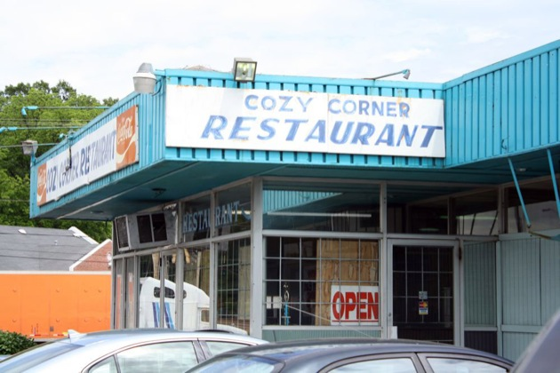
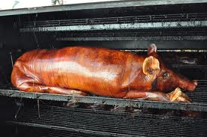
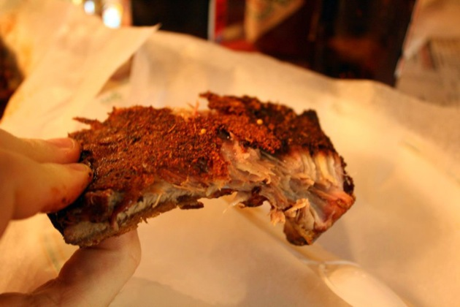
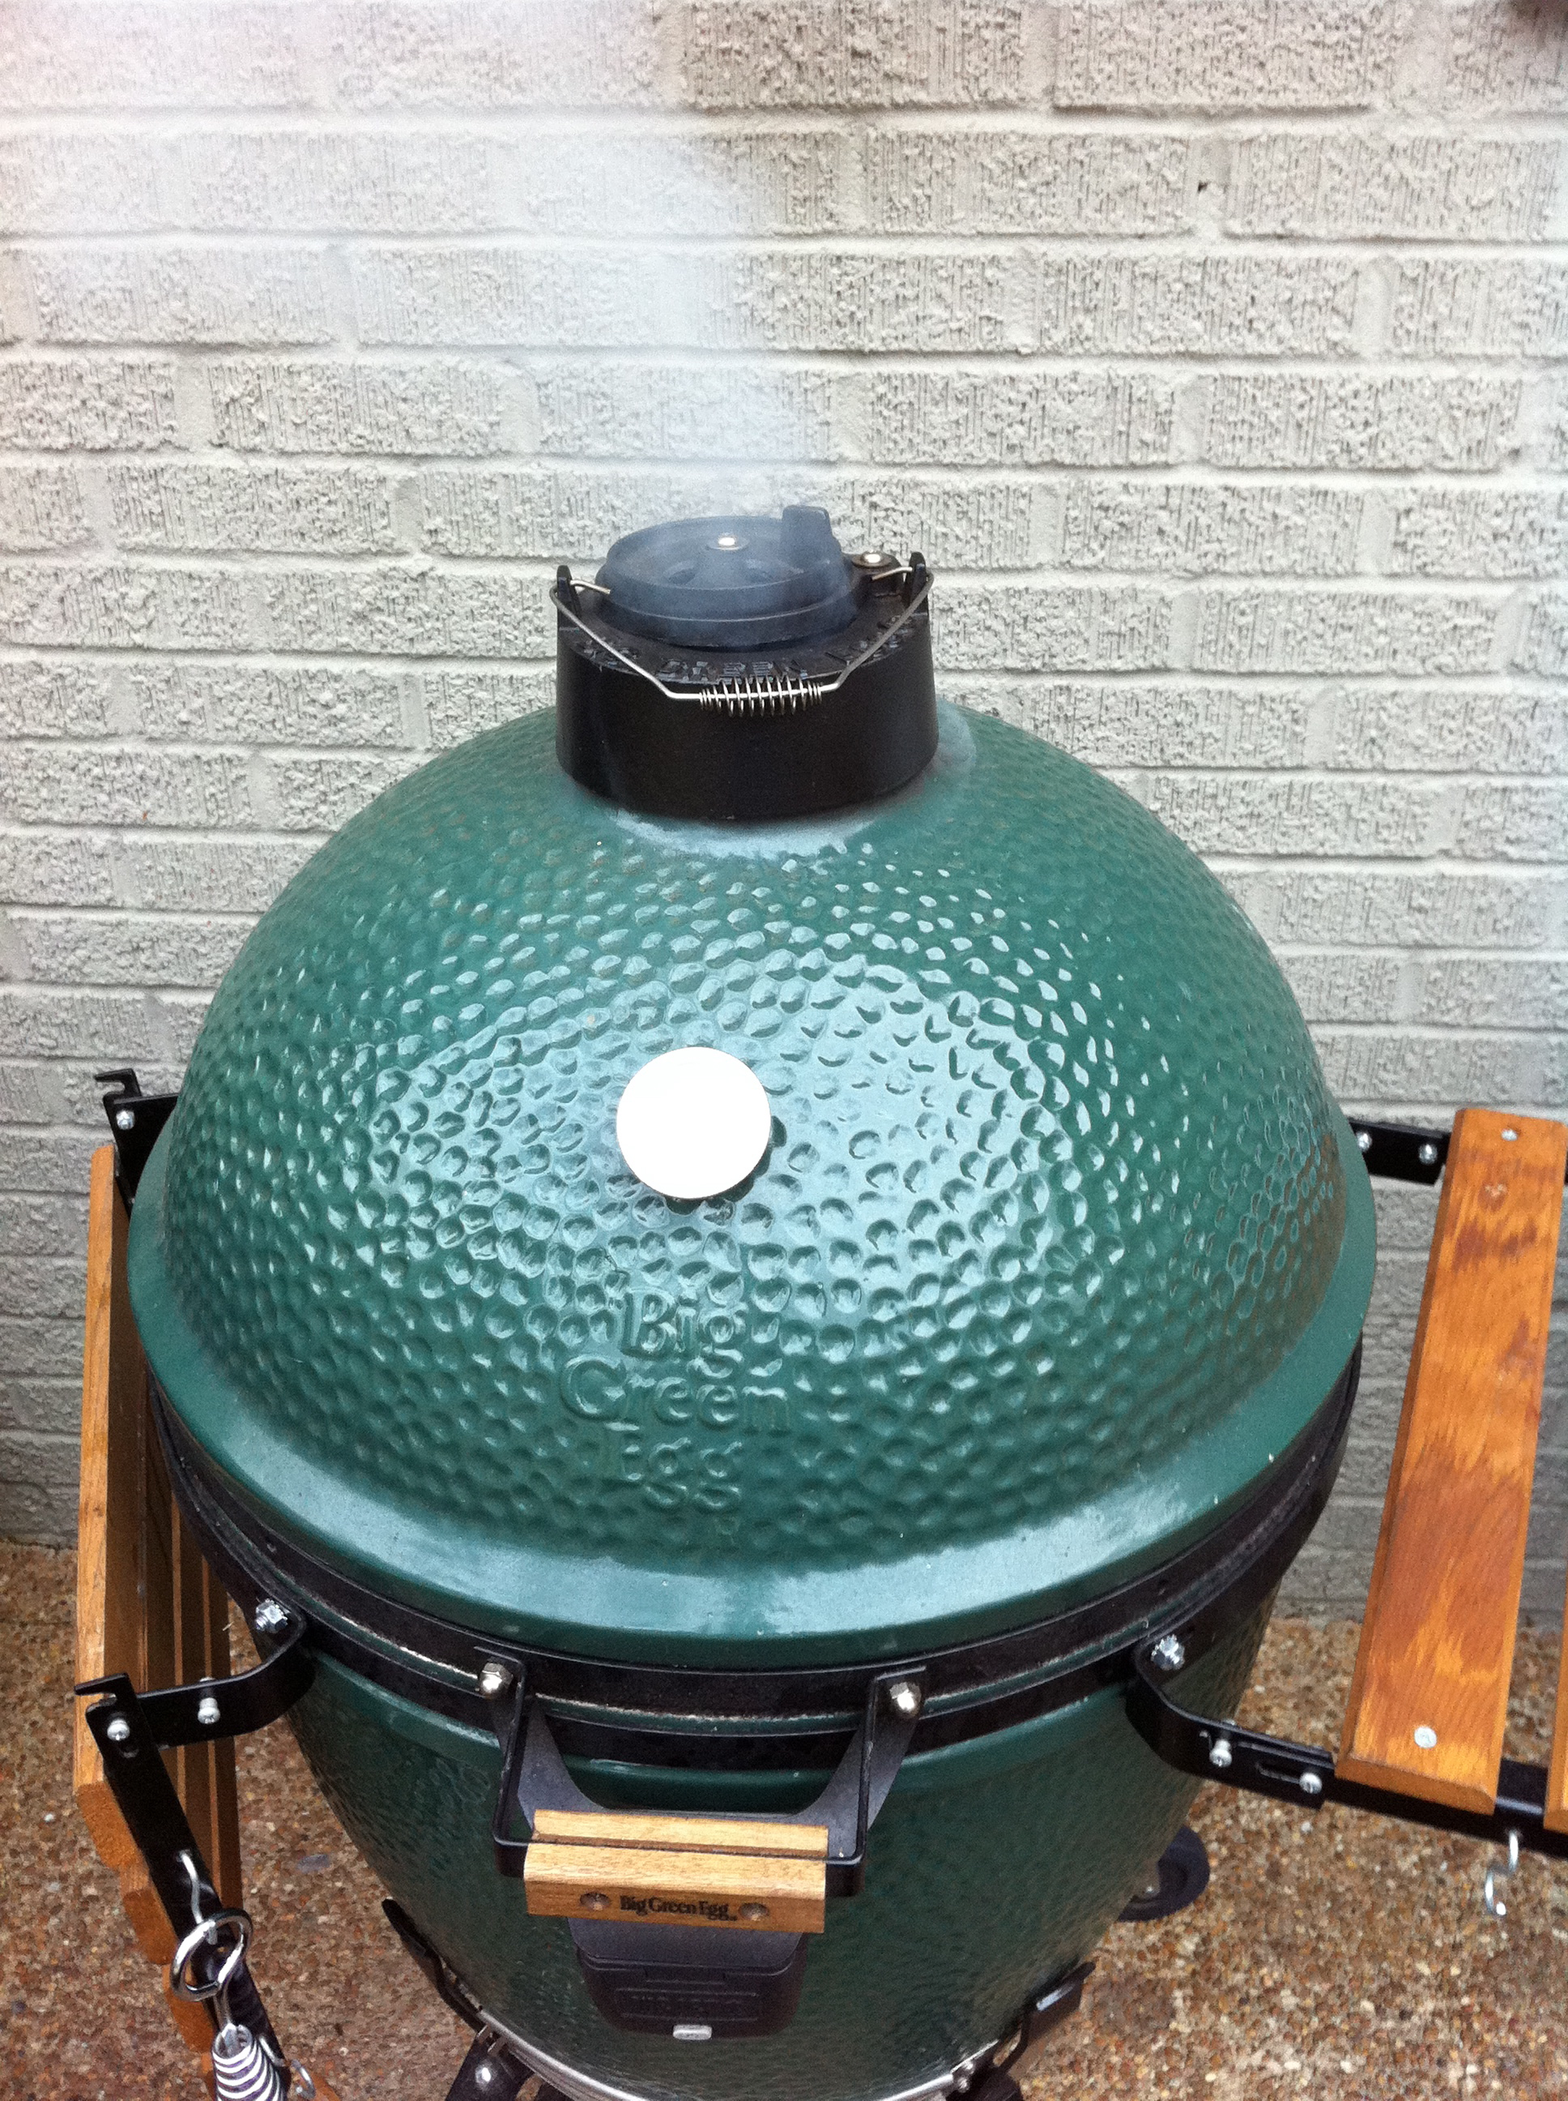
I have no conflicts to disclose
Barbecue
Not Barbecue

Slide 3
Duodenal Injuries
Incidence of ~5% in trauma laparotomies
Mostly penetrating
High morbidity and mortality
Mortality 6 - 25%
Morbidity 35 - 45%

Slide 4
Morbidity of Duodenal Wounds
 | Year | N | % fistula | % mortality
Morton & Jordan | 1968 | 131 | 6 | 1.5
Berne | 1974 | 50 | 14 | 0
Kelly | 1978 | 34 | 12 | 6
Stone & Fabian | 1979 | 321 | 3 | 2
decompression |  | 237 | 0.4 | 0.4
Snyder | 1980 | 237 | 7 | 4
Flint | 1980 | 75 | 8 | 5
Martin | 1983 | 313 | 2 | 0.6
pyloric exclusion |  | 128 | 6 | 1.6

Slide 5
Operative Diagnosis
Demands thorough exploration
Check all portions duodenum
Explore lesser sac
Investigate all hematomas in epigastrium

Slide 6
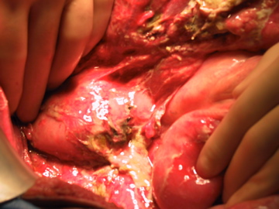

Slide 7
Duodenal Exploration
Wide Kocher maneuver – visualize left renal vein
Right medial visceral rotation
Mobilize ligament of Treitz

Slide 8
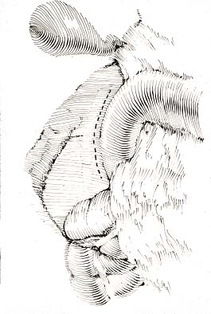

Slide 9
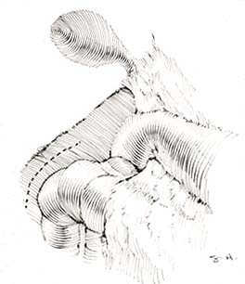

Slide 10
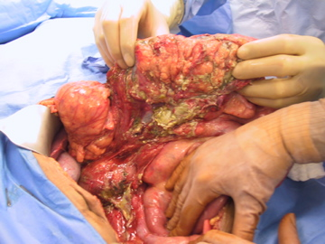

Slide 11
Duodenal Injuries
Primary repair
Duodenal exclusion
Jejunal patch
Pancreaticoduodenectomy

Slide 12
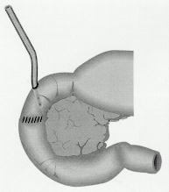
Tube Duodenostomy
Fistula maker – use reserved for the Smithsonian

Slide 13
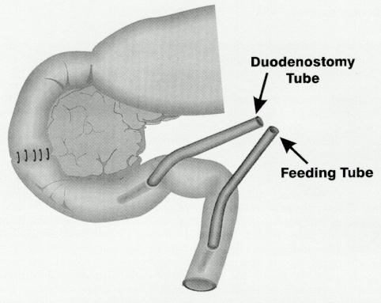
Duodenal Decompression
Afferent & efferent red rubber tube jejunostomies

Slide 14
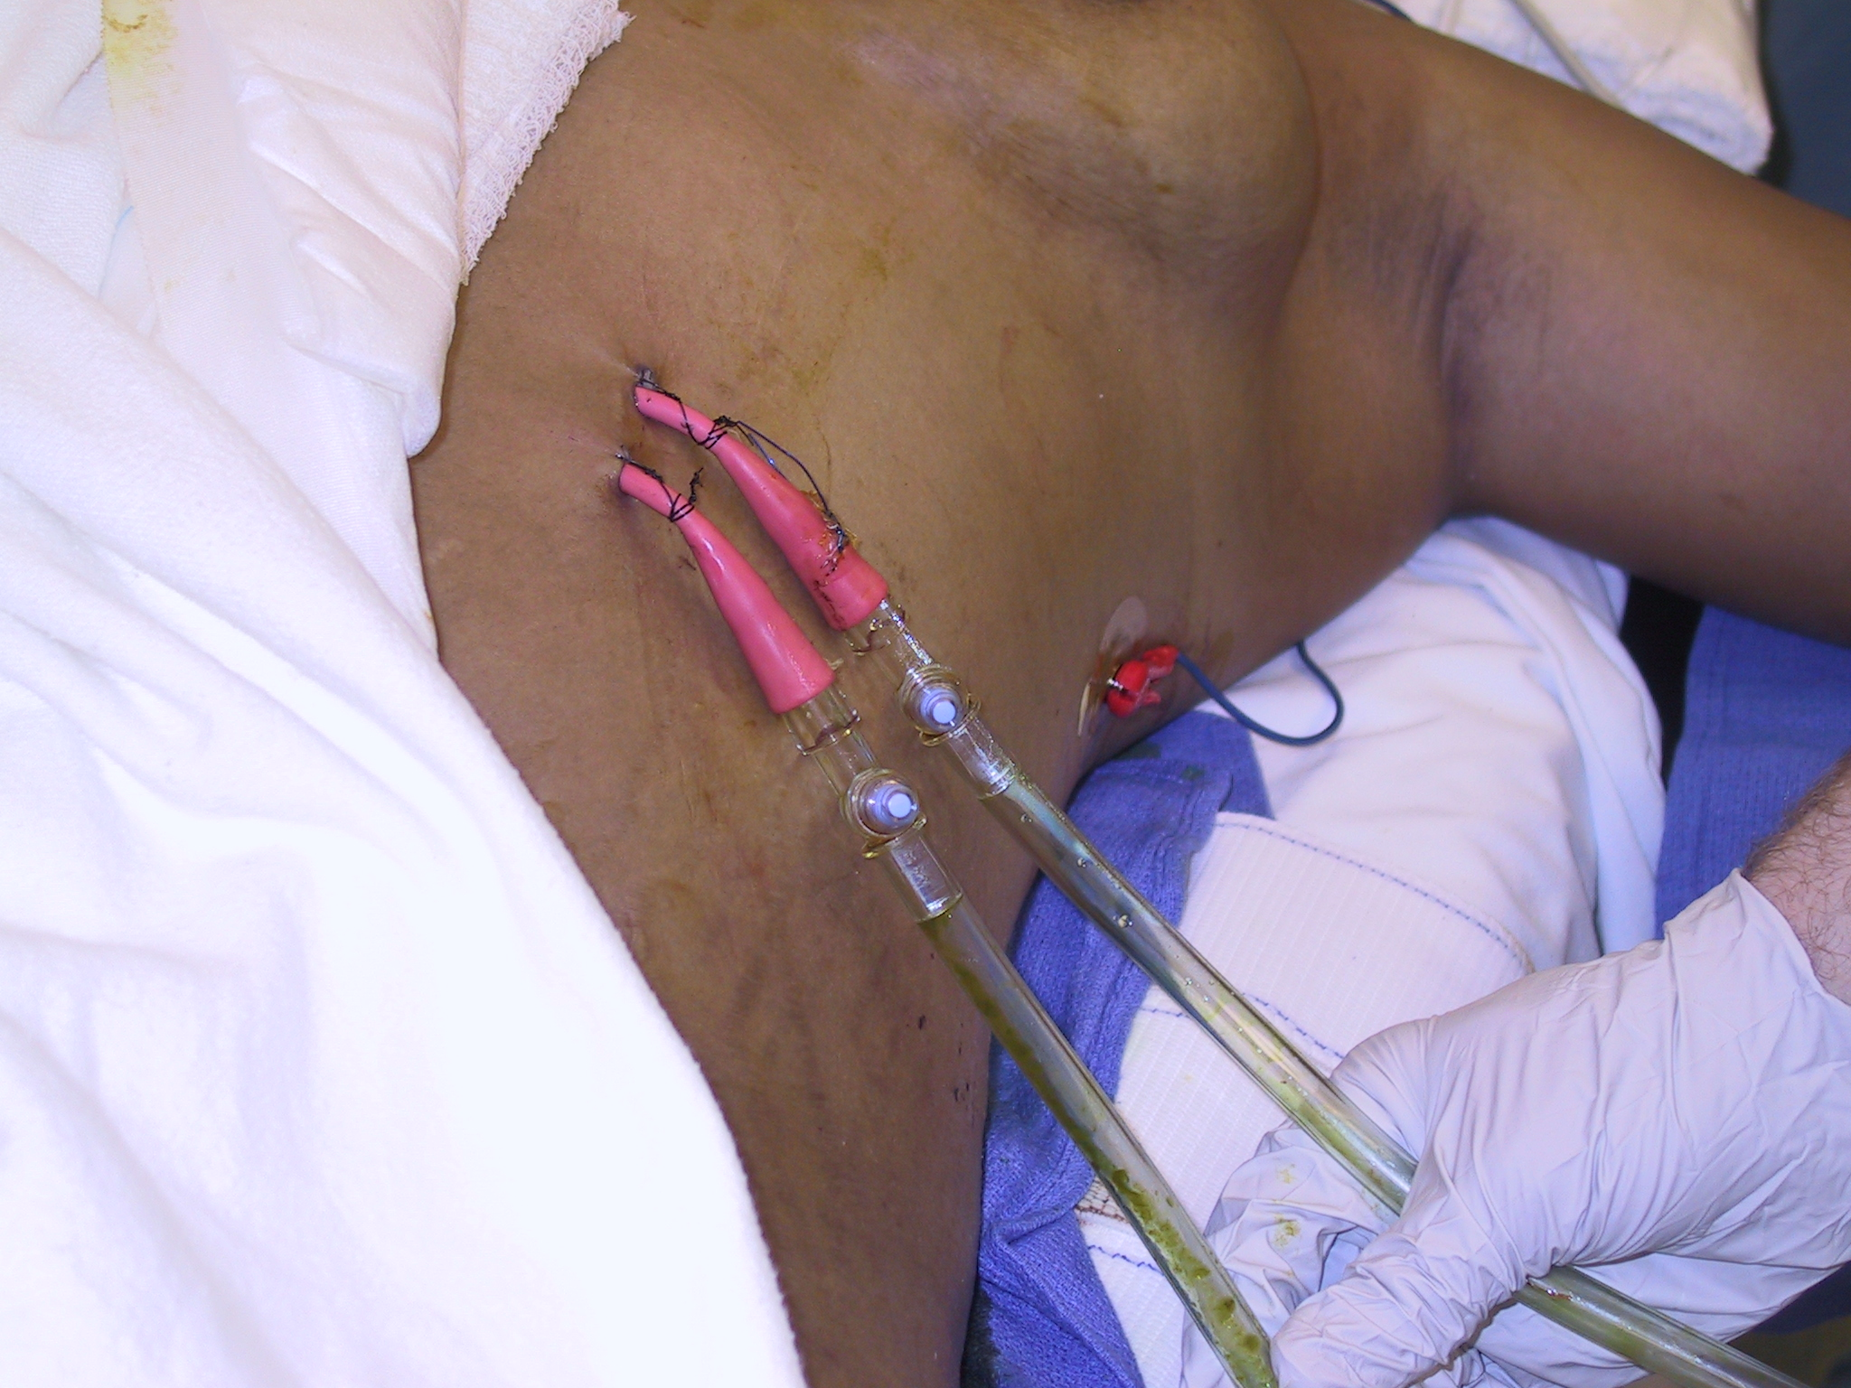
Feed me
Drain me

Slide 15
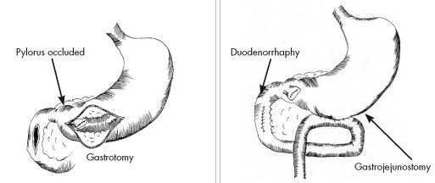
Pyloric Exclusion
Repair duodenal injury
Purse string closure of pylorus through gastrostomy, then gastrojejunostomy

Slide 16
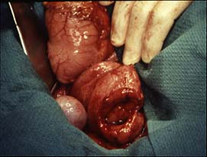

Slide 17
Study Population - 58 patients -
Age 32
90% male
ISS 20
BD –4.4
Shotgun
Stab
Gunshot

Slide 18
Results
Overall Mortality 16%
9 deaths occurred within 24 hours due to exsanguinating hemorrhage and were excluded
No deaths after 24 hours

Slide 19
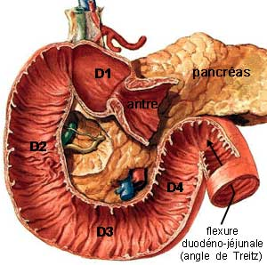
Location of Injury
6%
35%
17%
33%
30% of injuries involved more than one segment

Slide 20
AAST Classification
Grade I | Single segment hematoma; Partial thickness laceration without perforation
Grade II | Multiple segment hematoma; small (<50% of circumference) laceration
Grade III | Large laceration (50-75% of circumference of segment D2, or 50-100% of circumference of D1, D3, or D4)
Grade IV | Very large (75-100%) laceration of segment D2; rupture of ampulla or distal CBD
Grade V | Massive pancreaticoduodenal injury, devascularization of duodenum
J Trauma 1990, 30:1427

Slide 21
Repair Technique by Injury Grade
AAST Injury Grade | Primary Repair | Twin tube ostomies | Pyloric Exclusion | Pancreatico-duodenectomy
Grade I | 89% | 11% | 0% | 0%
Grade II | 43% | 53% | 4% | 0%
Grade III | 20% | 70% | 10% | 0%
Grade IV | 0% | 50% | 50% | 0%
Grade V | 0% | 0% | 0% | 100%

Slide 22
Repair Technique by Injury Grade
AAST Injury Grade | Primary Repair | Twin tube ostomies | Pyloric Exclusion | Pancreatico-duodenectomy
Grade I | 89% | 11% | 0% | 0%
Grade II | 43% | 53% | 4% | 0%
Grade III | 20% | 70% | 10% | 0%
Grade IV | 0% | 50% | 50% | 0%
Grade V | 0% | 0% | 0% | 100%

Slide 23
Repair Technique by Injury Grade
AAST Injury Grade | Primary Repair | Twin tube ostomies | Pyloric Exclusion | Pancreatico-duodenectomy
Grade I | 89% | 11% | 0% | 0%
Grade II | 43% | 53% | 4% | 0%
Grade III | 20% | 70% | 10% | 0%
Grade IV | 0% | 50% | 50% | 0%
Grade V | 0% | 0% | 0% | 100%

Slide 24
Repair Technique by Injury Grade
AAST Injury Grade | Primary Repair | Twin tube ostomies | Pyloric Exclusion | Pancreatico-duodenectomy
Grade I | 89% | 11% | 0% | 0%
Grade II | 43% | 53% | 4% | 0%
Grade III | 20% | 70% | 10% | 0%
Grade IV | 0% | 50% | 50% | 0%
Grade V | 0% | 0% | 0% | 100%

Slide 25
Repair Technique by Injury Grade
AAST Injury Grade | Primary Repair | Twin tube ostomies | Pyloric Exclusion | Pancreatico-duodenectomy
Grade I | 89% | 11% | 0% | 0%
Grade II | 43% | 53% | 4% | 0%
Grade III | 20% | 70% | 10% | 0%
Grade IV | 0% | 50% | 50% | 0%
Grade V | 0% | 0% | 0% | 100%

Slide 26
Complications

Slide 27
Duodenal Injury
Penetrating
Blunt
<25% of wall
>25% of wall
Primary repair
Twin jejunostomies
Tissue loss, tension, medial wall
Pyloric exclusion + patch
Pancreaticoduodenectomy only if dissection done by injury

Slide 28
Pancreatic Trauma
Significant mortality associated with pancreatic trauma
Reported rates from 9 to 34%
Frequent complications
Reported rates from 30 to 60%
No consensus

Slide 29
Options
Identification of pancreatic duct injury is single most important predictor
Different management approaches
Intra-op pancreatography
ERCP
Operative exploration and examination

Slide 30
Prior Experience
124 patients found to have a pancreatic injury at the time of exploration were evaluated in terms of management and outcome
Proximal injuries can be managed with closed suction drainage with low morbidity
Distal injuries can be managed by using a simplified management algorithm
Patton et al, J Trauma 1997

Slide 31
Management Algorithm
Pancreatic injury
Proximal
Distal
Duct injury?
Duct injury?
Yes
No
No
Indeterminate
Yes
Low probability
High probability
Closed suction
drainage
Distal pancreatectomy
Notes:
This is the management algorithm. Injuries to the right of the mesenteric vessels are considered proximal and are managed with closed suction drains alone. Injuries to the left of the mesenteric vessels are considered distal. Distal injuries are evaluated at the time of explorations. Pancreas injuries that are clearly far away from the duct or have no clinical indicator of duct injury are also managed with closed suction drains alone. Injuries with obvious duct disruption (such as an observed pancreatic duct) as are managed with distal resection and closed suction drains. The remaining injuries that are indeterminate with regard to duct status are stratified into low and high probability of duct injury, Low probability injuries (such as a tangential or peripheral injuries) are managed with closed suctions drains, while high probability injuries (such as a centrally located injuries) go on to distal resection and drainage.

Slide 32
Indicators of Ductal Injury
Direct visualization of the duct
Complete transection
Laceration of > one-half of the gland
Severe maceration
Leakage of pancreatic fluid

Slide 33
Study Population
245 Patients
35 Deaths
87 Proximal
123 Distal

Slide 34
Study Population
 | ALG | PS
Age | 31 | 30
Male | 80% | 79%
Penetrating | 69% | 81%
ISS | 27 | 21
24h Trans | 10 | 8.3

Slide 35
Ductal Injury
28 - Injury
123 Distal Injury
29 + Injury
66 Indeterminate Injury
34 Low Probability
32 High Probability

Slide 36
Study Population
 | ALG | PS
Proximal Drainage | 87 | 37
Distal Drainage | 62 | 33
Distal Resection | 61 | 52

Slide 37
Complications
 | ALG | PS | p
Proximal Drainage | 14% | 14% | 0.948
Distal Drainage | 11% | 25% | 0.050
Distal Resection | 26% | 58% | 0.003

Slide 38
Pancreatic Fistula
 | ALG | PS | p
Proximal Drainage | 8.1% | 8.1% | 0.991
Distal Drainage | 6.5% | 11.5% | 0.339
Distal Resection | 11.5% | 27.3% | 0.050

Slide 39
Pancreatic Abscess
 | ALG | PS | p
Proximal Drainage | 5.7% | 5.4% | 0.940
Distal Drainage | 4.8% | 13.5% | 0.110
Distal Resection | 14.8% | 30.3% | 0.070

Slide 40
Mortality
ALG | PS
0% | 1.6%
p=0.065

Slide 41
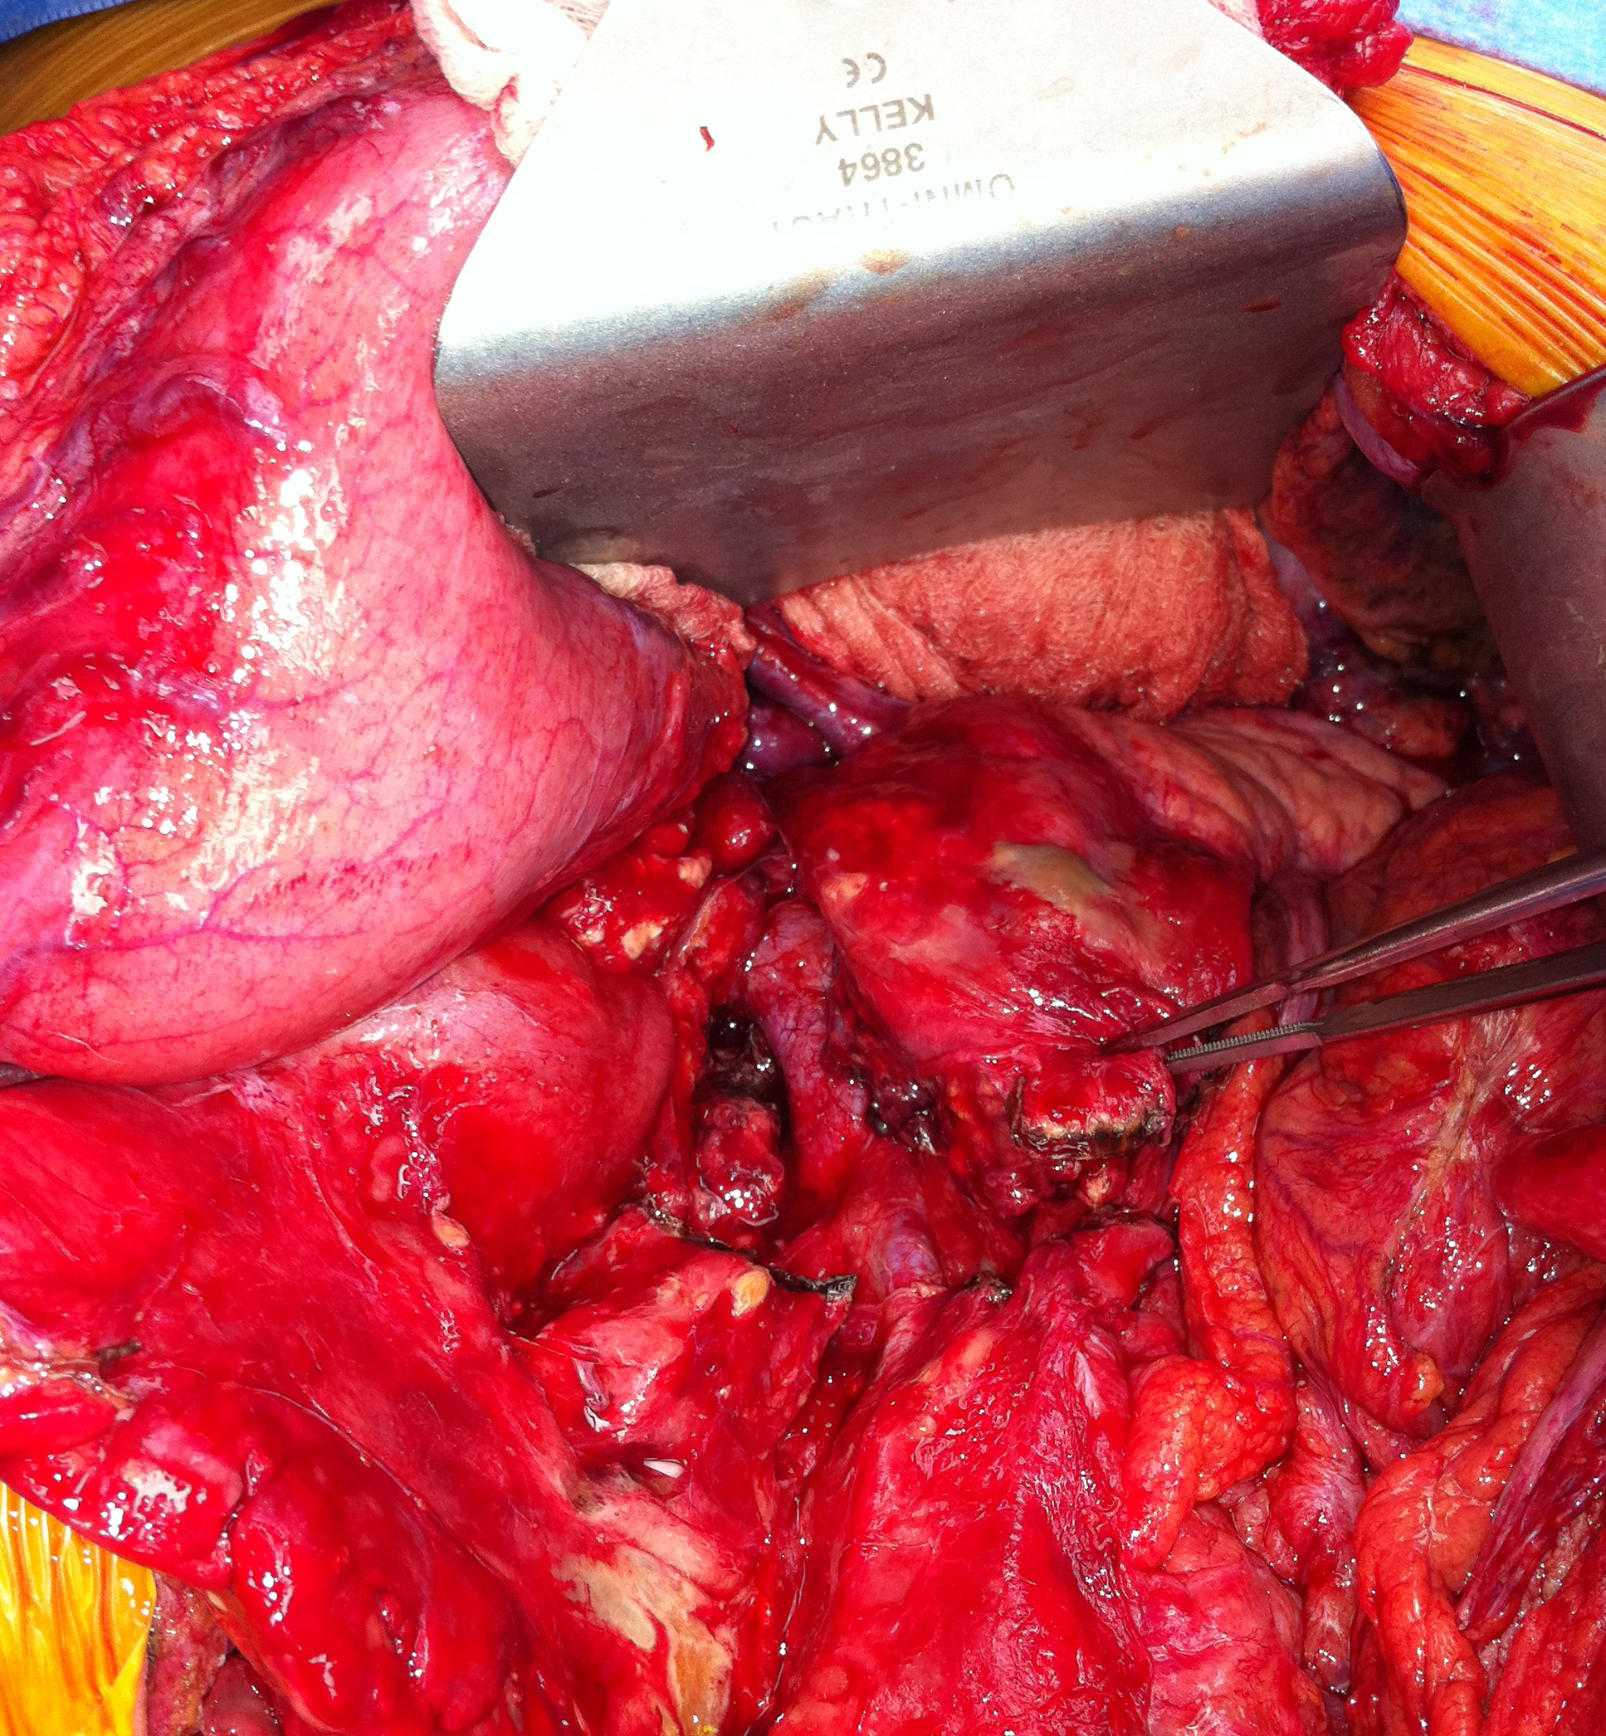
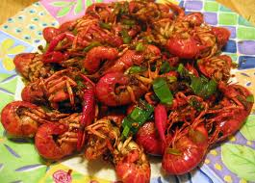
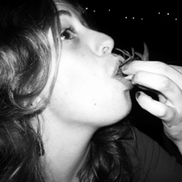
Pancreatic wounds…
…are like eating crawfish
Eat the tail
Suck the head!

Slide 42
Summary
Primary repair for most duodenal wounds + decompression
Pyloric exclusion for more complex wounds
Proximal pancreatic injuries can be treated with drainage alone
For distal injuries, clinical decision based on defined criteria and suspicion of ductal injury dictates definitive management

Slide 43
Keep
It
Simple,
Stupid

