Slide 1
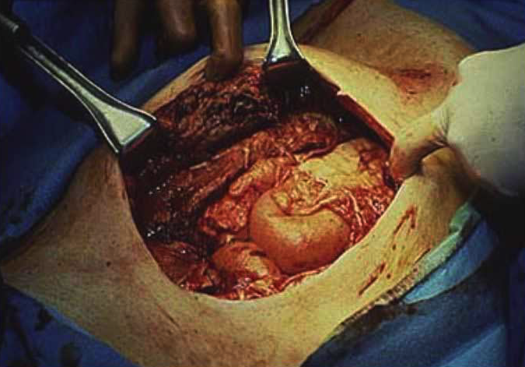
Abdominal Wall Reconstruction
43rd Annual Phoenix Surgical Symposium
Scottsdale, AZ
Elvis Presley Memorial Trauma Center
UTHSC Department of Surgery
Memphis, TN

Slide 2
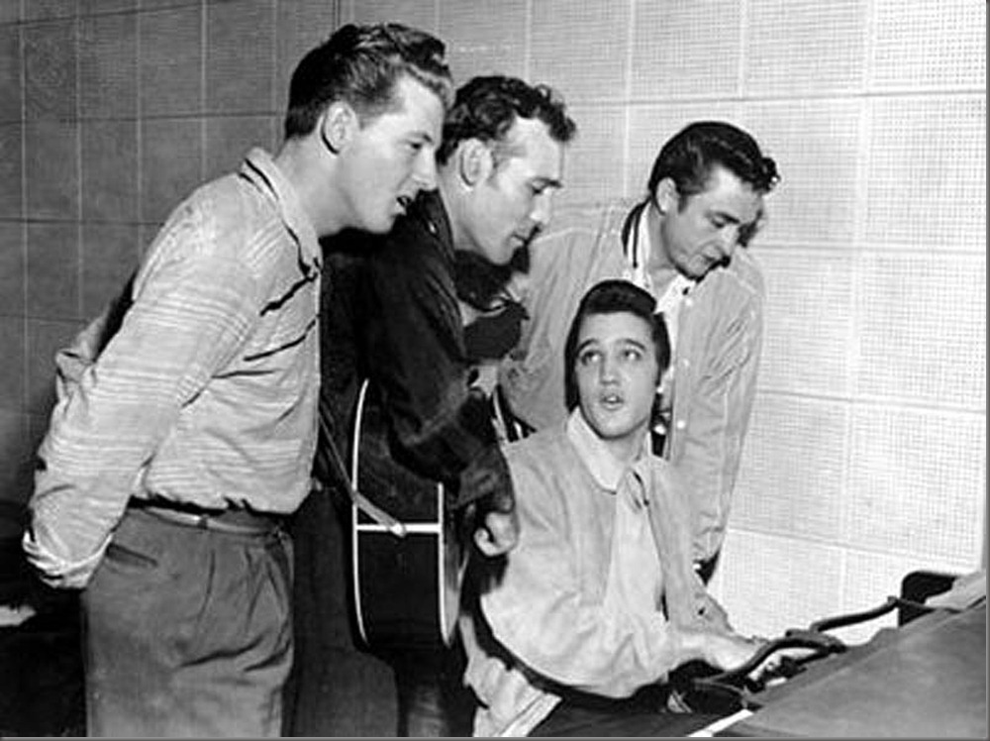
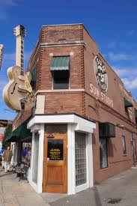
I have no conflicts to disclose

Slide 3
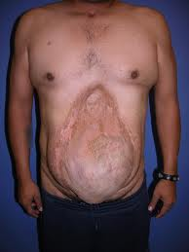
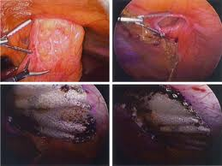
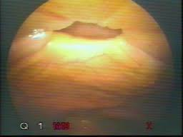
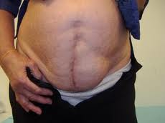
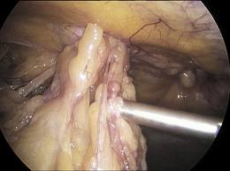
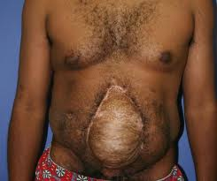

Slide 4
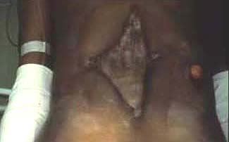
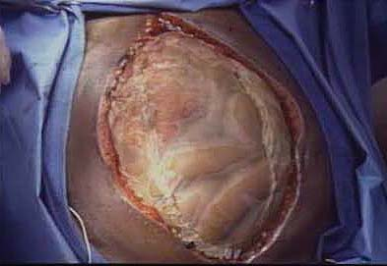
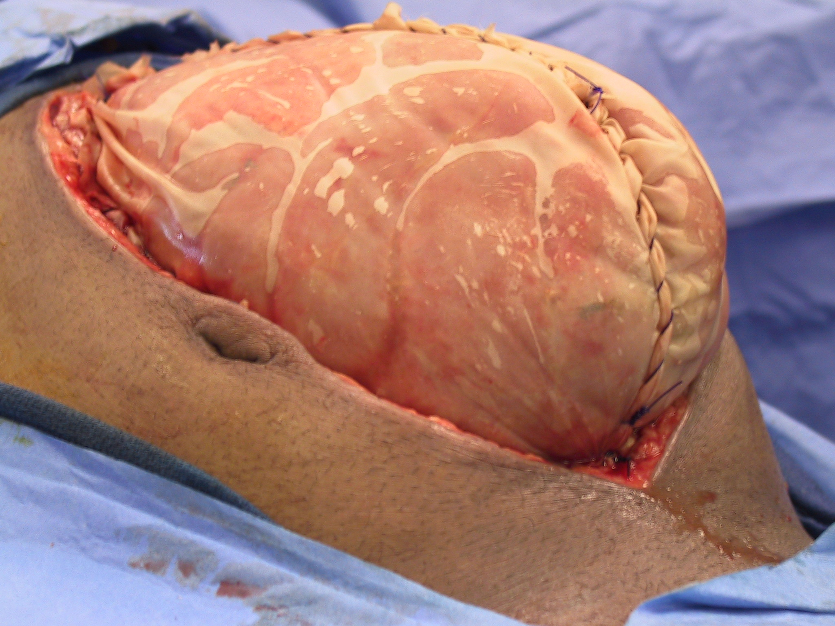
Etiology of Defect
Abdominal wall loss
Necrotizing fascial infection
Close range shotgun blast
Planned re-exploration
Diffuse suppurative peritonitis
Pancreatic sepsis
Massive edema
Resuscitation from shock
Resuscitation from sepsis

Slide 6
Abdominal Wall Reconstruction - Staged Management Technique -
Stage I
Prosthetic insertion
14 - 21 days
Stage II
Planned ventral hernia
8 - 12 months
Stage III
Definitive reconstruction

Slide 7
Abdominal Wall Reconstruction - Staged Management Technique -
Stage I
Prosthetic insertion
Stage II
Planned ventral hernia
Stage III
Definitive reconstruction

Slide 8
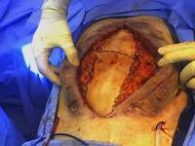
Multiple Methods for Coverage

Slide 9
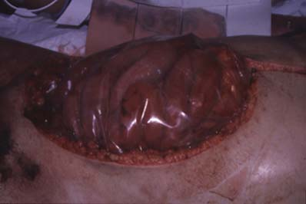

Slide 10
Acute Coverage Recommendations - Plastic -
Massive visceral edema
Gauze packing
? Planned re-exploration

Slide 11
Acute Coverage Recommendations - Polypropylene -

Slide 12
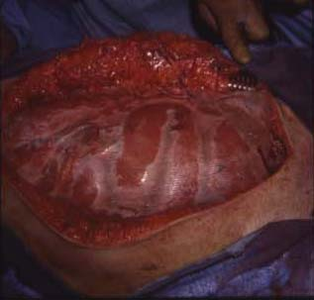

Slide 13
Fate of Marlex
Mesh
Closure Retention Hernia Fistula Extrus
Primary (6) No 2 -- --
Granulation (6) Yes 1 1 5
STSG (9) Yes 3 3 9
Skin & subcut (3) Yes 1 -- --
Voyles, Ann Surg 1981

Slide 14
PPM Use in Emergency Setting - Summary of 14 Reports -
Patients 128
Fistula (%) 23
Hernia (%) 20
Extrusion (%) 12
Jones & Jurkovich, Am Surg 1989

Slide 15
Acute Coverage Recommendations - PTFE -

Slide 16
Acute Coverage Recommendations - Absorbable -
Massive visceral edema
Abdominal wall loss
Planned re-exploration
Gauze packing

Slide 17
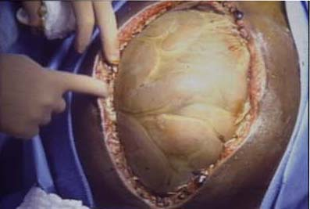

Slide 18
Vacuum Assisted

Slide 19
Delayed Fascial Closure - negative pressure -
53 with open abdomen
43 attempted closure
38 closed
88%
Miller, Ann Surg 2004

Slide 20
Delayed Fascial Closure - negative pressure -
74% sepsis
12% ischemia
14% other
209 patients
112 patients
35% incisional hernia
Brandl, Hernia 2013

Slide 22
Patient Population - April 2003 to July 2007 -
17,379 patients admitted
1343 emergent laparotomy
248 open abdominal management
51 met inclusion criteria
31 VAC
20 MESH

Slide 23
Outcomes
 | VAC | MESH
% Abdominal abscess | 12 | 9
% Delayed fascial closure | 31 | 26
% Fistula | 21 | 5

Slide 24
GI Tract Fistulae

Slide 25
Summary
Benefits of VAC
quick placement
sutureless
able to remove excess fluid
able to reexamine abdominal contents regularly
Benefits of MESH
transparent
pleated by bedside
permanent feeding tubes not a problem
place on all body habitus and loss of domain

Slide 26
Summary
Disadvantages of VAC
not practical with tube enterostomy
not transparent
commercial version expensive
not useful with loss of domain
Disadvantages of MESH
fascial sutures
difficult to quantitate fluid loss
more expensive than traditional VAC

Slide 27
Vac/Mesh Abdominal Closure - delayed fascial closure -
Prospective study, 4 sites
151 open abdomen
111 vac/mesh
99 fascial closure
89%
Acosta , Br J Surg 2011

Slide 28
Vac/Mesh Abdominal Closure - 1 year follow up-
Prospective study, 4 sites
111 patients with vac/mesh
64 survivors
23 clinical hernia
36%
18 CT hernia
36%
23 no hernia
36%
Bjarnason, World J Surg 2013

Slide 29
Abdominal Wall Reconstruction - Staged Management Technique -
Stage I
Absorbable mesh insertion
14 - 21 days
Stage II
Planned ventral hernia
Stage III
Definitive reconstruction

Slide 31
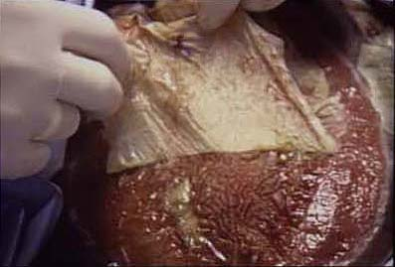

Slide 32
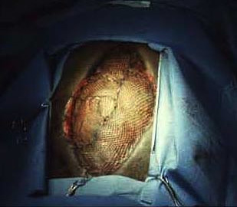

Slide 33
Timing of Wound Coverage and Fistulae
 | Mesh days | p - value
No fistula n = 101 | 18.1 | < 0.04
Fistula n = 14 | 26.5
Jernigan Ann Surg 2003

Slide 34
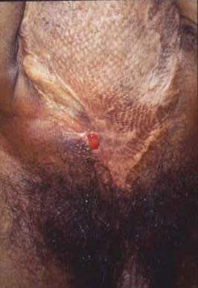

Slide 35
Timing of Fistula Development in the Open Abdomen
Pre-Mesh
With
Mesh
Post-Mesh
Fischer, et al. J Trauma 2009

Slide 36
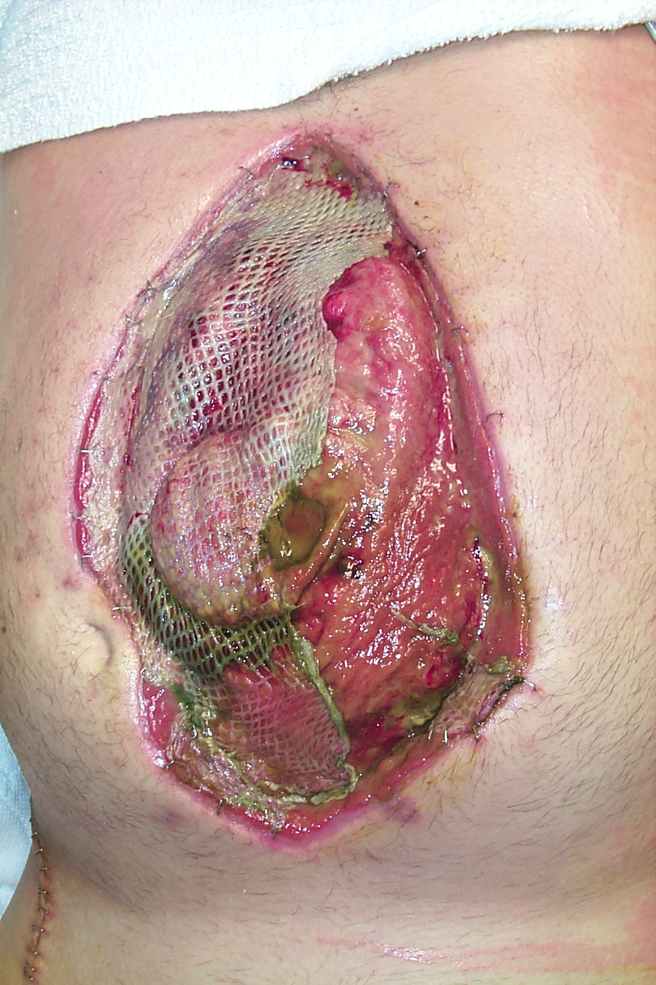

Slide 37
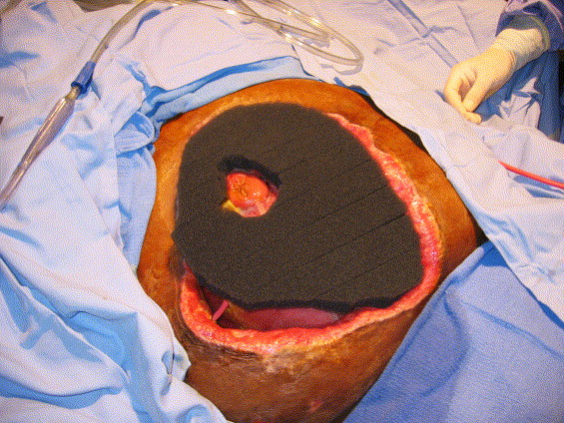
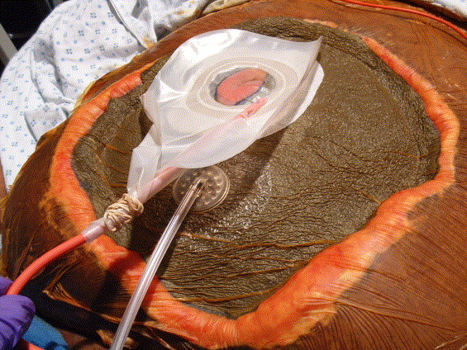
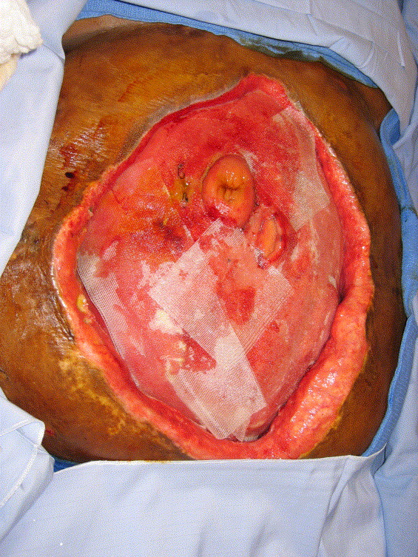
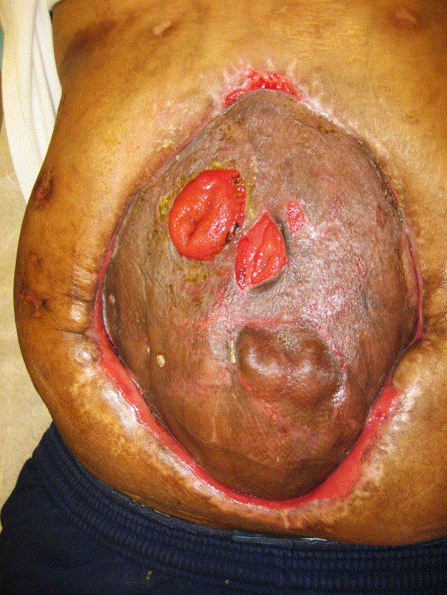
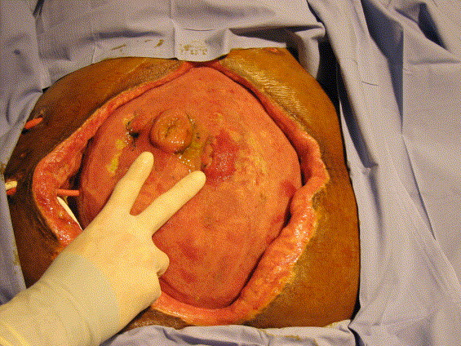
Wound VAC- “Floating Stoma”

Slide 38
Abdominal Wall Reconstruction - Staged Management Technique -
Stage I
Absorbable mesh insertion
14 - 21 days
Stage II
Planned ventral hernia
8 - 12 months
Stage III
Definitive reconstruction

Slide 39
Reconstructive Techniques
Advantages
Disadvantages
Prosthetic materials
simple
hernia, fistulae, infection
Biomaterials
simple
dissolution, long term integrity?
Muscle flaps
autogenous
complex, little experience
Components separation
autogenous, simple
inadequate for large defects
Modified comp. separation
autogenous, simple
hernia, fistula rates?

Slide 40
Single Stage Components Repair - 26 patients -
All with contaminated abdominal wall defects
19 abdominal sepsis
4 visceral edema
3 wound issues
Mean defect size 267 cm²
15% adjunctive mesh
8% recurrence rate @ mean 27 months (13-78 months)
van Geffen, J Am Coll Surg, 2005

Slide 41
Components + Dermal Allograft - 16 patients -
Incisional hernias
56% with infection
Component separation repair with under- & overlay with AlloDerm
No recurrent hernias, mean 16 months (9-23 months)
Kolker, Ann Plas Surg, 2005

Slide 42
Reported Series
 | n | Months Follow-up | Recurrence
De Vries Reilingh 2003 | 43 | 15.6 | 28%
Lowe 2003 | 30 | 9.5 | 10%
Jernigan 2003 | 73 | 24 | 6%
De Vries Reilingh 2007 | 37 | 36 | 57%
Rodriguez 2007 | 23 | 7 | 9%
De Moya 2008 | 6 | 12 | 100%
Diaz 2009 | 165 | 10.4 | 25%
Ko 2009 | 200 | 10.3 | 22%
Total | 577 | 13.9 | 23%

Slide 43
Extreme Variability
Fascial approximation
tension
Mesh bridge
Fistula, infection
Mesh under/overlay
Infection
Biomaterial bridge
Laxity, wound issues
Biomaterial under/overlay
Wound issues

Slide 44
The gazelle doesn’t have to be as fast as the cheetah, it only has to be faster than the slowest gazelle.

Slide 45
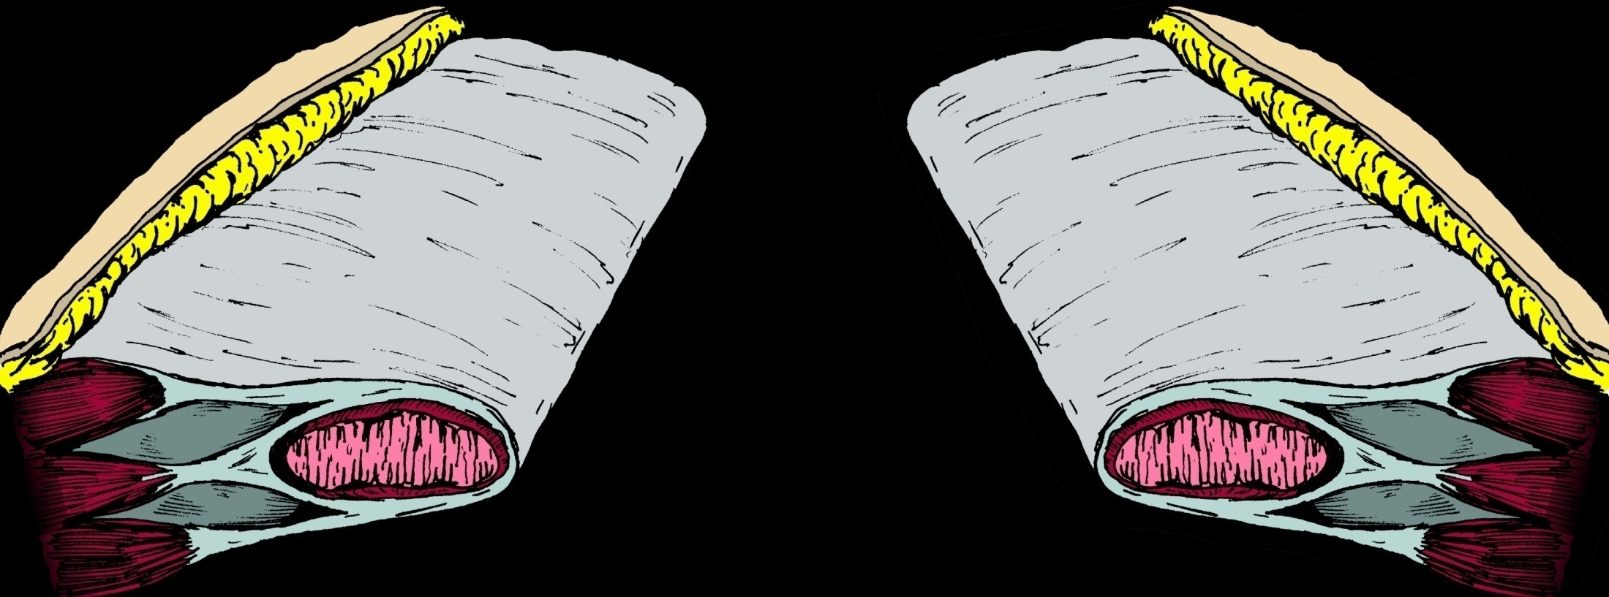
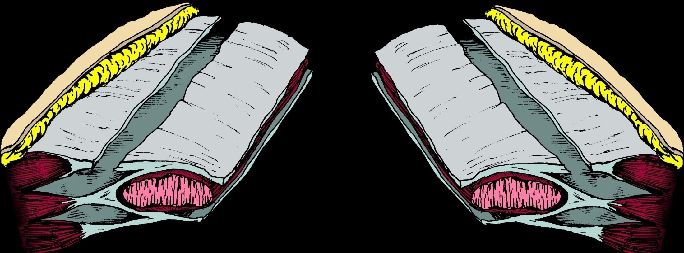
Components Separation
Release of external oblique to gain extra length in midline (3-5cm on each side)
Ramirez et al, 1990

Slide 46
Components Separation
Variable rate of recurrence, depending on follow-up interval
May require prosthetic for large defects
Ramirez et al, 1990

Slide 47
Modified Components Separation
Components separation, plus:
Dissection of posterior sheath from the rectus
Division of anterior component of internal oblique down to arcuate line
Suture medial border of posterior rectus sheath to lateral border of anterior rectus sheath
Fabian et al, 1994

Slide 48
Modified Components Separation
Gives additional length, 10-15cm
Often avoids the use of a prosthetic
Fabian, Ann Surg, 1994

Slide 49
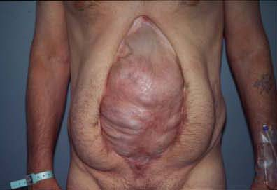

Slide 50
Timing of Reconstruction
Reconstruction not considered until skin graft is easily separated from viscera

Slide 51
Release of External Oblique

Slide 52
Posterior sheath mobilized from rectus abdominus

Slide 53
Division of Posterior Components

Slide 54
Approximation of the separated components

Slide 55
Completed repair

Slide 56
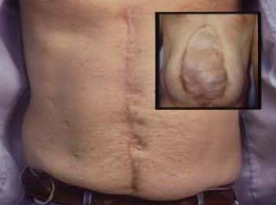

Slide 57
152 Patients
38 Lost to follow-up
114 Long term follow-up
75%
98 Successful Repair
16 Recurrence
11 Salvage repair

Slide 58
Surgical Techniques
No Separation (NS)
NS + prosthetic
Components Separation (CS)
CS + prosthetic
Modified Components Separation (MCS)
MCS + prosthetic
DiCocco J Am Coll Surg 2010

Slide 59
Study Population
- 114 patients -
Nontrauma
Female
Blunt
Male
Penetrating
Age | 35
BMI | 27
Defect size | 620cm²
Notes:
59
59
Again, demographic analysis of our study population showed a mean age of 38 years, 78% males, and 78% sustained blunt force trauma.
In analysis of Markers of Injury Severity, our study population had a mean GCS of 12 and mean Injury Severity Score of 21.
In analysis of Markers of Severity of Shock, our study population had a mean base deficit of 3.3 and a mean admission lactate level of 3.9.

Slide 60
Methods of Repair
 | NS n=13 | CS n=34 | MCS n=67
Age | 32 | 33 | 37
BMI | 29 | 27 | 27
% Female | 15 | 15 | 18
% Prosthetic use | 46 | 26 | 45
% With ostomy | 23 | 21 | 15
% With fistula | 23 | 18 | 16
% Recurrence | 15 | 18 | 12

Slide 61
Methods of Repair
No Separation
Components Separation
Modified Components

Slide 62
Methods of Repair
5%
20%
8%
44%
0%
33%
No Separation
Components Separation
Modified Components

Slide 63
Timing of Reconstruction
 | % with prosthetic | p - value
< 12 months | 6 | 0.04
> 12 months | 25

Slide 64
 | n | Months Follow-up | Recurrence
De Vries Reilingh 2003 | 43 | 15.6 | 28%
Lowe 2003 | 30 | 9.5 | 10%
Jernigan 2003 | 73 | 24 | 6%
De Vries Reilingh 2007 | 37 | 36 | 57%
Rodriguez 2007 | 23 | 7 | 9%
De Moya 2008 | 6 | 12 | 100%
Diaz 2009 | 165 | 10.4 | 25%
Ko 2009 | 200 | 10.3 | 22%
Total | 577 | 13.9 | 23%
Memphis Study | 114 | 63.6 | 14%
p=0.03

Slide 65
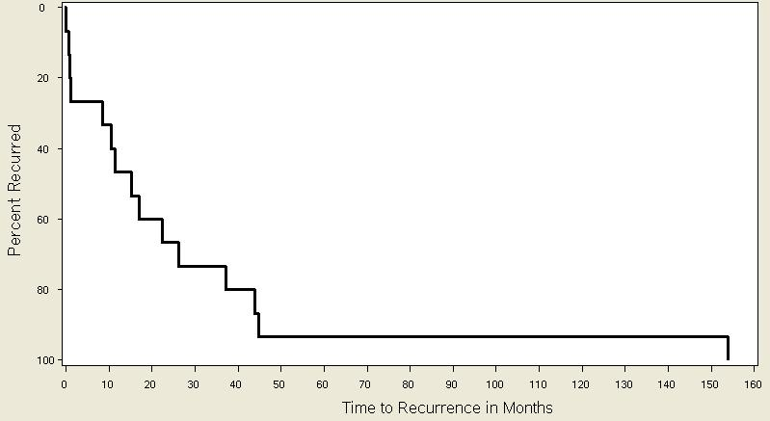
Timing of Recurrences
Previous studies limitations:
Inadequate follow-up
Missed recurrences
Higher recurrence rates

Slide 67
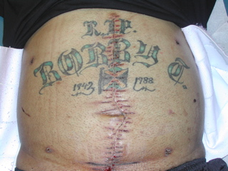

Slide 68
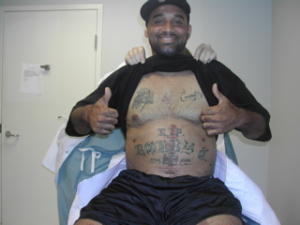
I approve!

Slide 69
Summary
Open abdomens save lives
Fistulas associated with prolonged time to coverage
Optimal time for reconstruction is 8 – 12 months to avoid loss of domain
Try to cover the mesh
Lowest long term recurrence rate seen with modified components separation

