Slide 1
History of Colon Wound Management
43rd Annual Phoenix Surgical Symposium
Scottsdale, AZ
Elvis Presley Memorial Trauma Center
UTHSC Department of Surgery
Memphis, TN

Slide 2


I have no conflicts to disclose

Slide 3
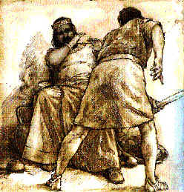
History of Colon Wounds
1330 BC
“And the hilt also went in after the blade; and the fat closed upon the blade, for he drew not the sword out of his belly; and the dirt came out.”
        Judges 3:21-22

Slide 4
Civil War Experience
Penetrating colon wounds managed predominantly non-operatively
Staggering mortality rates (>90%) with most patients succumbing to infection and sepsis
Attempts at surgery led to mortality rates equivalent to non-operative management

Slide 5
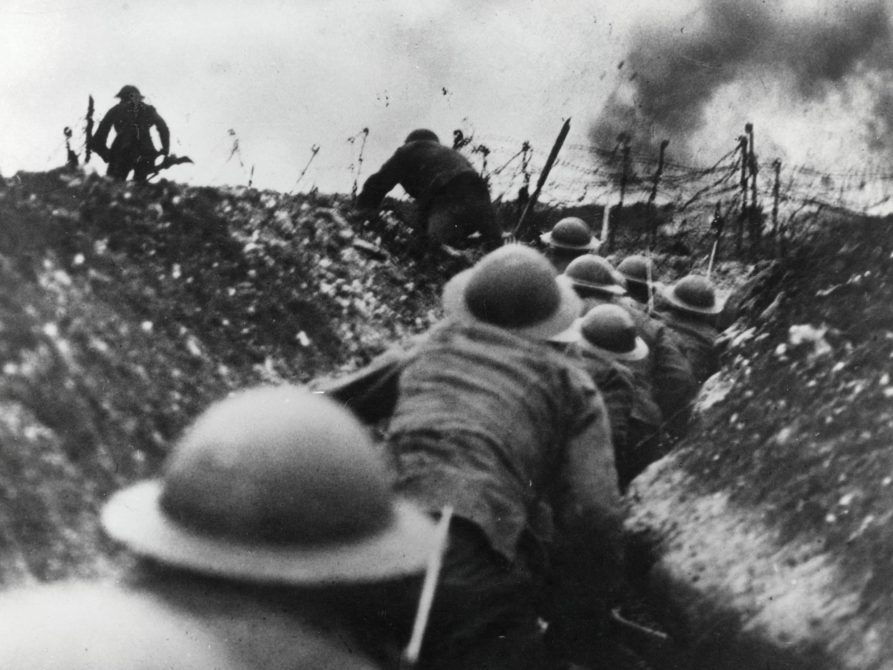
World War I
Introduction of high-velocity missiles
Most destructive injuries
Early care consisted of expectant management
Later attempts were made at primary repair or diversion
Mortality 60-75%

Slide 6
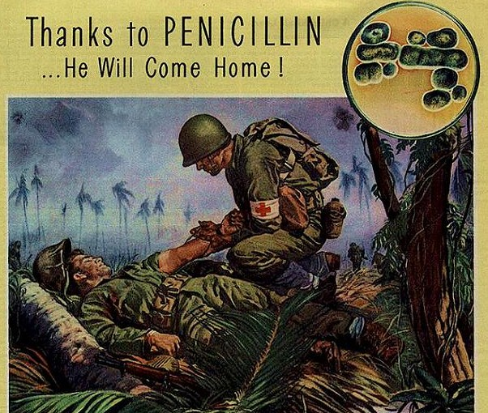

World War II
Mortality fell to 22-35%
Advancements in
  Triage
  Aggressive resuscitation
  Improved antibiotics
  Blood banks
Exteriorization of ALL colon injuries

Slide 7
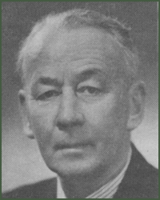
"The treatment of colon injuries is based on the known insecurity of suture and the dangers of leakage. Simple closure of a wound of the colon, however small, is unwarranted; men have survived such an operation, but others have died who would still be alive had they fallen into the hands of a surgeon with less optimism and more sense. Injured segments must either be exteriorized, or functionally excluded by a proximal colostomy."
W. H. Ogilvie 'Forward Surgery in Modern War', 1944

Slide 8
“The exteriorization of colon injuries, a step which I have repeatedly advocated since the outbreak of war is, perhaps the greatest single factor in the improved results we are able to record.”
Primary repair
COURT MARTIAL
W. H. Ogilvie ‘Abdominal Wounds in the Western Desert’, 1944

Slide 9
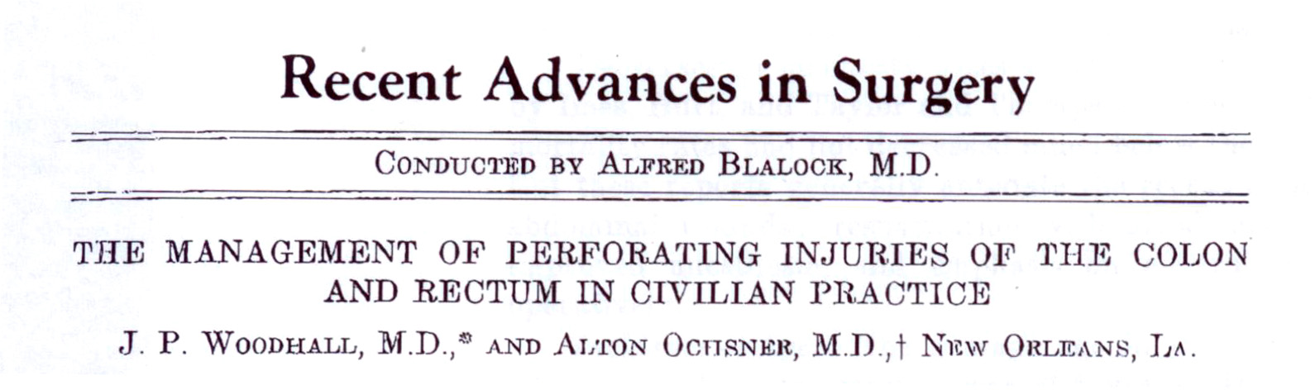
“At the Charity Hospital of Louisiana in New Orleans, 23 cases of colon injury were treated during the years 1945 and 1946. Primary suture was used in 15 of these cases, but during 1947 and 1948, the influences of war surgery became evident, because in 25 cases of colon injury, only five were treated with primary suture. Although exteriorization or proximal decompression proved valuable in the treatment of battle colon injuries, an evaluation of the results obtained in civilian practice is essential.”

Slide 10
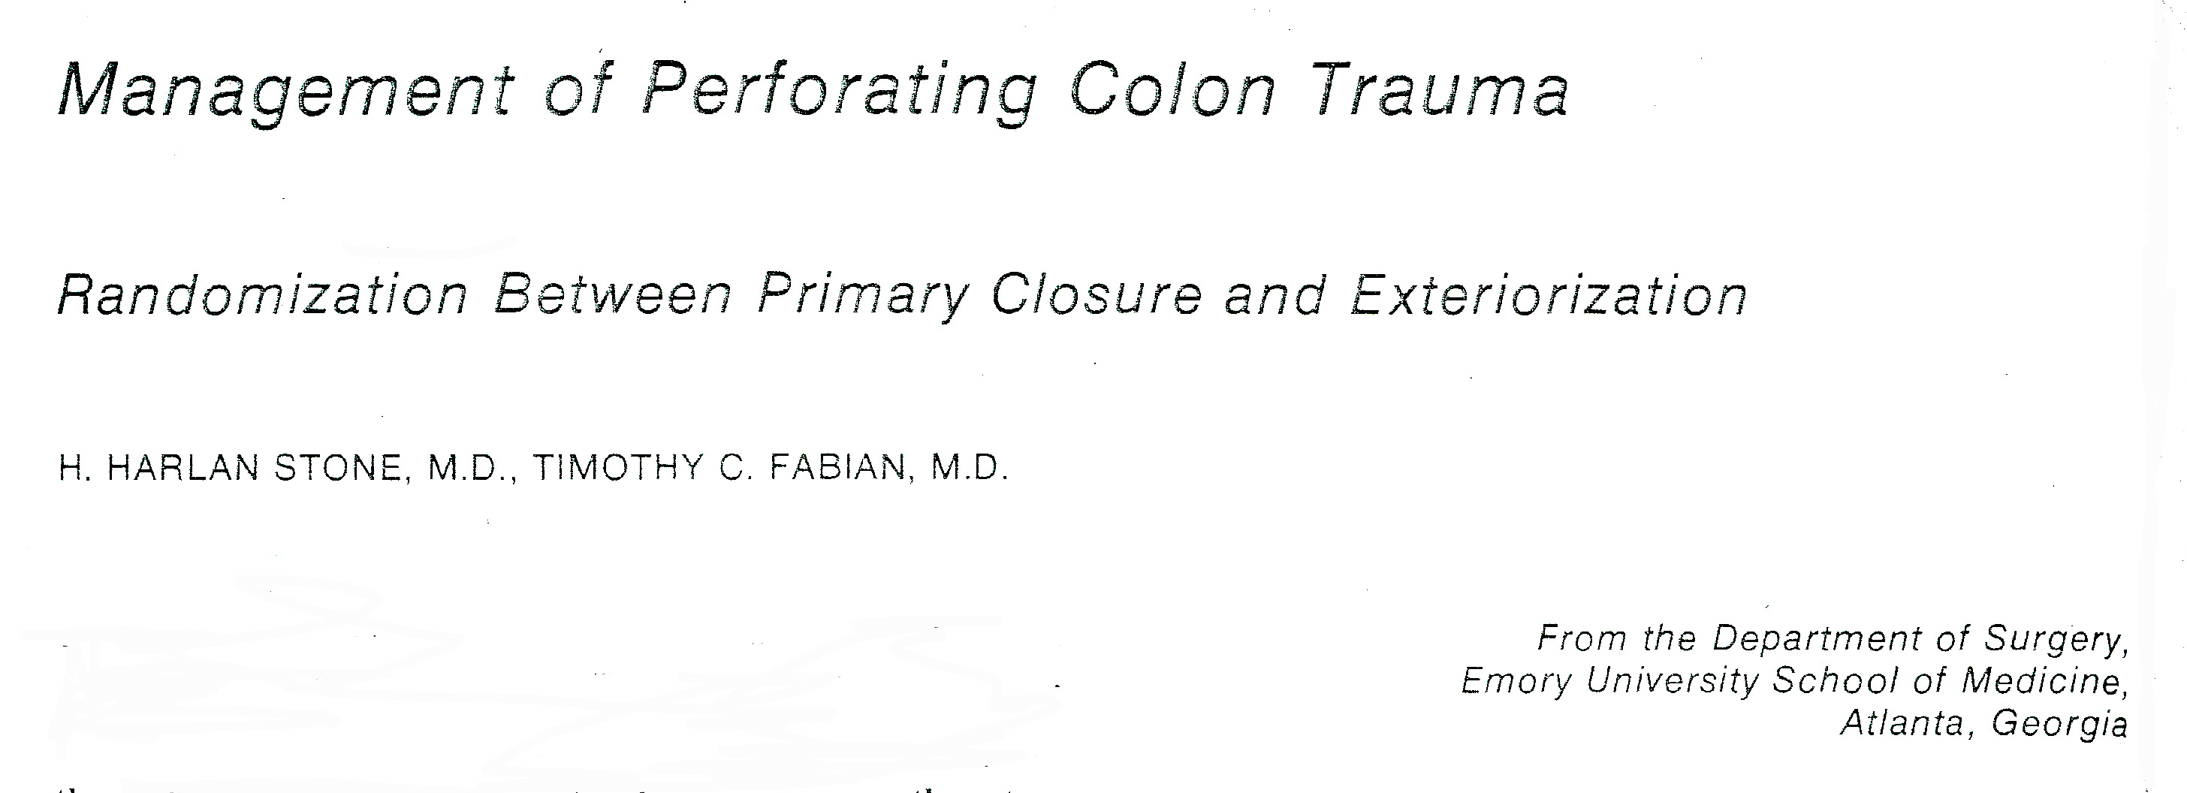
Ann Surg 1979

Slide 11
Criteria for Obligatory Colostomy
1. Preop shock (< 80 / 60)
2. Intraperitoneal hemorrhage > 1000 ml
3. > 2 intra-abdominal organ systems injured
4. Significant peritoneal contamination by feces
5. Injury to operation > 8 hours
6. Colon wound so destructive as to require resection
7. Abdominal wall major loss of substance / mesh replacement
Stone HH, Fabian TC: Management of Perforating Colon Trauma.
Ann Surg, Oct. 1979

Slide 12
Morbidity
 | Randomized Closure | Randomized Colostomy | Obligatory Colostomy | Total Patients
Patients | 67 | 72 | 129 | 268
Peritoneal Infection | 10 | 21 | 44 | 75
Infection Rate | 15% | 29% | 34% | 28%

Slide 13
Conclusions
Confirmed the safety of primary closure for colon wounds in selected cases
But what qualifies a “high risk” patient?

Slide 14
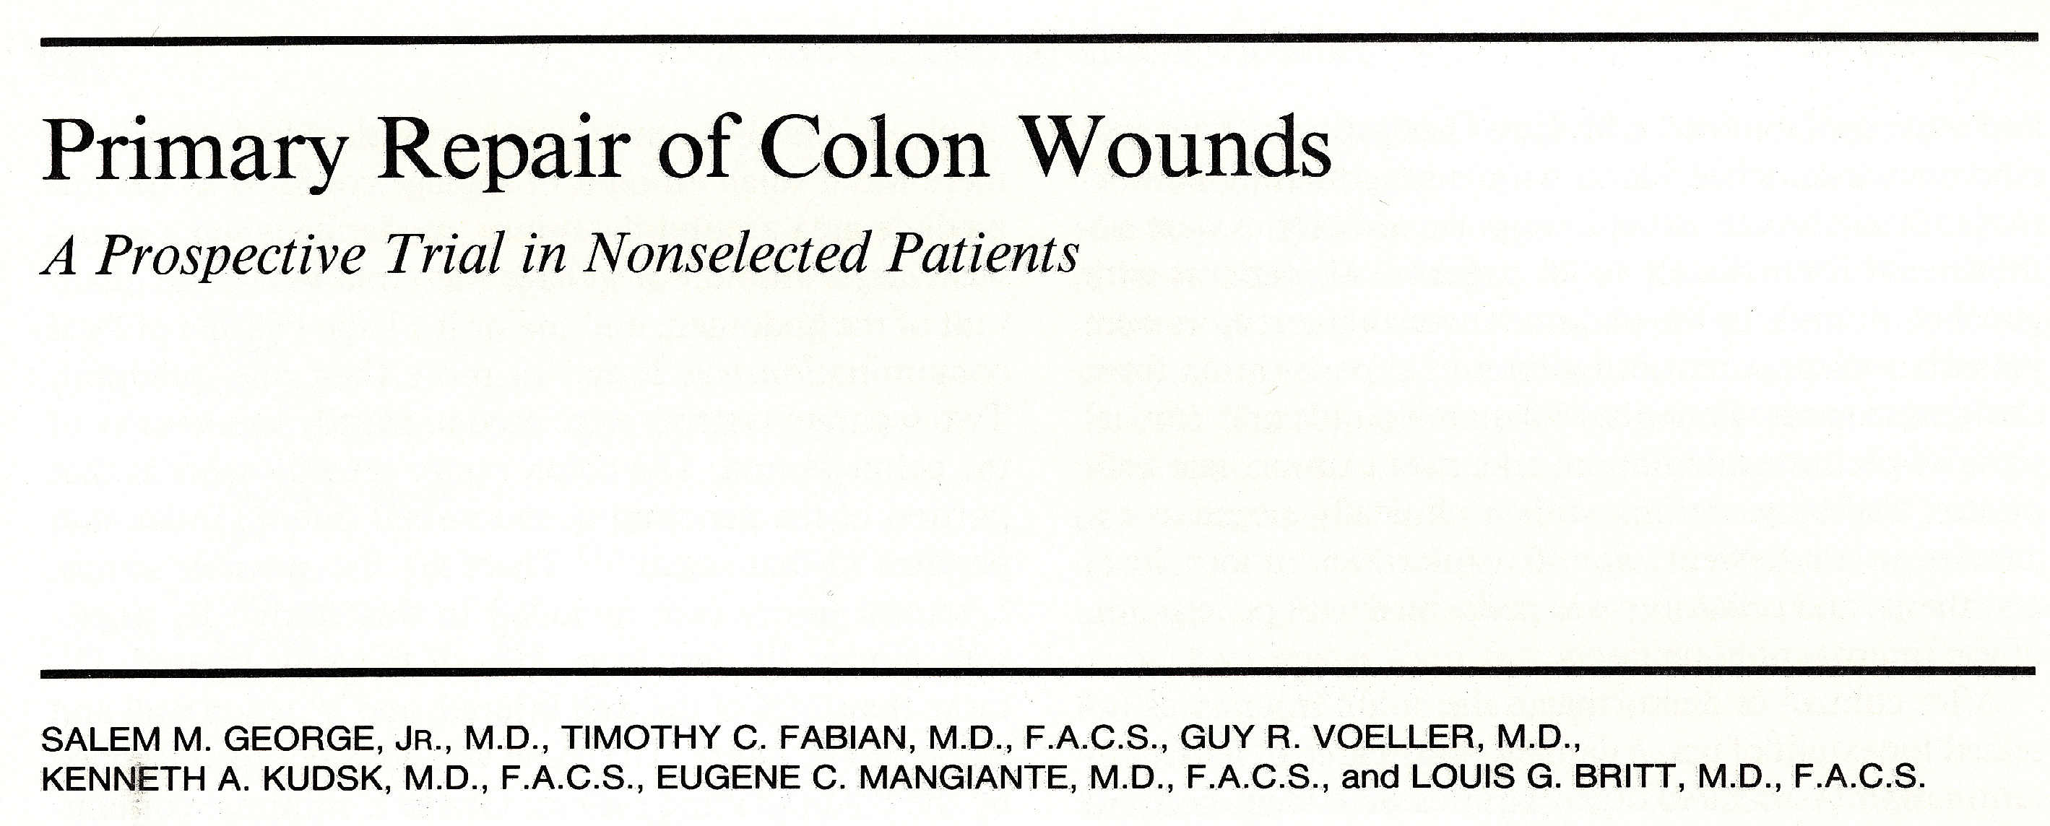
102 pts with penetrating colon injuries
Pts managed regardless of shock, contamination, or associated injuries
Management
  83 primary repair → no leaks
  12 resection & anastomosis → 1 leak
  7 end colostomy
Ann Surg 1989

Slide 15
Risk Factors
Risk factors for intra-abdominal sepsis or complication
  Transfusion > 4 units
  Significant contamination
  Increased colon injury score
Concluded nearly all penetrating injuries can be repaired primarily or with resection & anastomosis

Slide 16
To Resect or Not Resect …
Chappuis et al., Ann Surg 1991
  “…primary repair or resection & anastomosis should be considered for treatment of all patients”
  Generalization was made from a relatively small number of pts (n=11) receiving resection & anastomosis
When is resection + anastomosis appropriate over diversion?

Slide 17
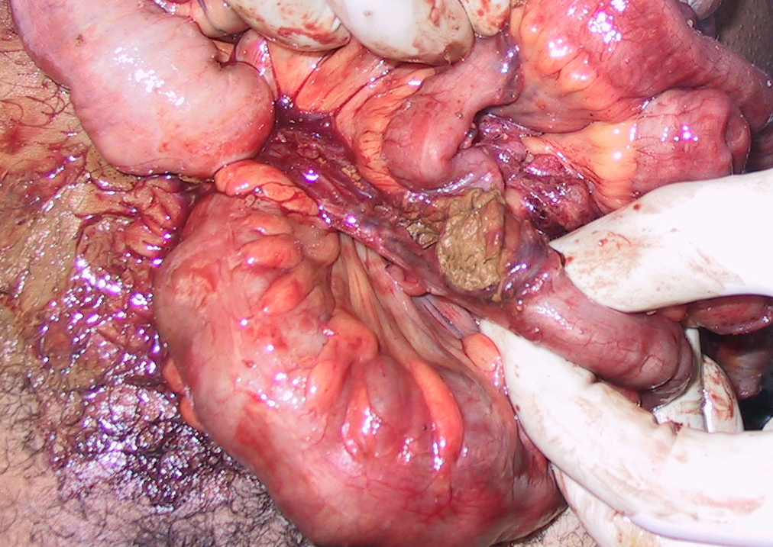

Slide 18
Destructive Colon Injuries
Wounds involving > 50% of colon wall circumference
Complete transection
Devascularized segments

Slide 19
Stewart et al
- Memphis 1994 -
60 patients with destructive colon injuries
Destructive Wounds
42% suture line failure
+
Co-morbidities / > 6u PRBCs
Destructive Wounds
3% suture line failure
+
No Co-morbidities / < 6u PRBCs

Slide 20
Significant Co-morbidities
Cirrhosis
Human Immunodeficiency Virus
Severe Diabetes
Congestive Heart Failure
Chronic Renal Failure
Patients on Chronic Steroids

Slide 21
Management Algorithm
Full-thickness Colon Injuries
Nondestructive
Destructive
Primary Repair
+Comorbidity >6 units PRBCs
-Comorbidity ≤6 units PRBCs
Diversion
Resection + Anastomosis
Notes:
This is the management algorithm. Injuries to the right of the mesenteric vessels are considered proximal and are managed with closed suction drains alone. Injuries to the left of the mesenteric vessels are considered distal. Distal injuries are evaluated at the time of explorations. Pancreas injuries that are clearly far away from the duct or have no clinical indicator of duct injury are also managed with closed suction drains alone. Injuries with obvious duct disruption (such as an observed pancreatic duct) as are managed with distal resection and closed suction drains. The remaining injuries that are indeterminate with regard to duct status are stratified into low and high probability of duct injury, Low probability injuries (such as a tangential or peripheral injuries) are managed with closed suctions drains, while high probability injuries (such as a centrally located injuries) go on to distal resection and drainage.

Slide 22
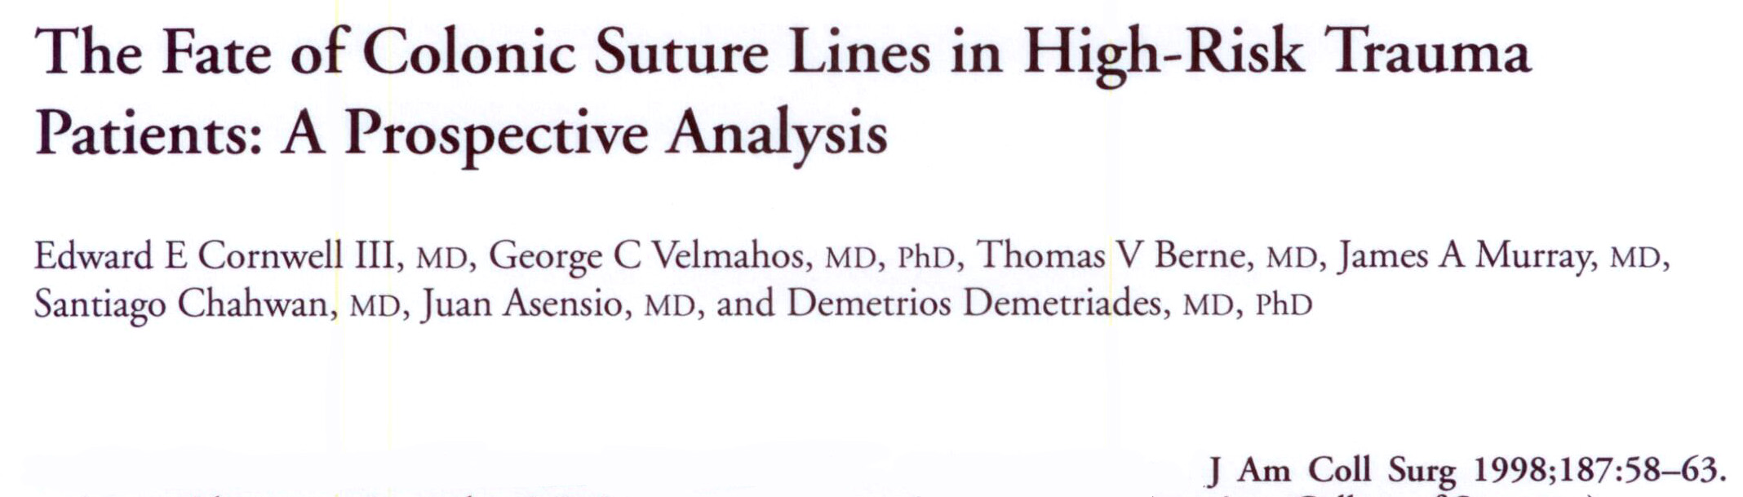
Conclusions:
  “On the basis of these data and the relative infrequency of patients in prospective randomized trials with destructive colon injuries, we believe there is still room for consideration of fecal diversion in patients in high-risk categories with destructive colon injuries requiring resection”

Slide 23
Subsequent Study
- Memphis 2002 -
56 patients with destructive colon injuries
Abscess Leak Mortality
Miller et al. 2002
1987-1993 1995-2001

Slide 24
AAST Multi-institutional Study
297 penetrating colon injuries requiring resection from 19 different centers
Regression analysis identified severe fecal contamination, transfusion > 4u RBC, single agent abx prophylaxis as independent predictors of complication
Demetriades et al., J Trauma 2001

Slide 25
AAST Study Conclusions
“In view of these findings, the reduced quality of life, and the need for subsequent operation in colostomy patients, primary anastomosis should be considered in all such patients”
Demetriades et al., J Trauma 2001

Slide 26
AAST Study Problems
Concluded # of transfusions as an independent predictor of complications
  But not recommended to use for operative decisions
19 different centers using 19 difference management schemes
  No control for selection bias

Slide 27
Re-Do Study
- Sharpe et al 2012 -
102 patients with destructive colon injuries
Abscess Leak Mortality
1987-1993 1995-2001 2001-2009

Slide 28
Characteristics
 | Original | PS | CS
Total Colon Injuries | 316 | 209 | 252
Age | 32 | 30 | 34
Male | 92% | 90% | 90%
OR PRBCs | 6 | 5 | 5

Slide 29
Characteristics
 | Original | PS | CS
Total Colon Injuries | 316 | 209 | 252
Age | 32 | 30 | 34
Male | 92% | 90% | 90%
OR PRBCs | 6 | 5 | 5
Destructive | 19% | 27% | 41%

Slide 30
Algorithm Compliance – 90%
102 Destructive Injuries
92 Followed Pathway
10 Protocol Violations
69 R+A
3 Diversion
7 R+A
2 Leaks
2 Leaks
2.9%
29%

Slide 31
Left versus Right …
Controversy persists regarding the management of left-sided colon injuries
Is it safe to perform resection and anastomosis for destructive wounds to the left colon?

Slide 32
Anatomic Distinction
Historical perception of tenuous collaterals between the left colic artery and the middle colic artery
Most previous reports only focused on right vs left-sided injuries

Slide 33
Denver – 1981
Review of 105 penetrating colon injuries over 5 years
No difference in rates of diversion, morbidity, and mortality between right & left-sided injuries
Thompson et al., Ann Surg 1981

Slide 34
Emory - 2005
- 217 Penetrating Injuries -
Location subdivided into ascending, transverse, descending, & sigmoid
Baseline characteristics, injury severity, & management were similar
No comparison of outcomes between the anatomic locations
7 suture line failures
  3 in distal transverse colon
  4 in splenic flexure
Dente et al., J Trauma 2005

Slide 35
Emory - 2005
- 217 Penetrating Injuries -
Conclusions
  “We feel, however, that a surgeon who is managing even what appears to be a simple wound to the splenic flexure should proceed with caution until better prospective data are available”
Data likely suffers from selection bias
Analysis should be obtained from an institution that manages all colon injuries the same, regardless of location
Dente et al., J Trauma 2005

Slide 36
Patients
Outcomes
Penetrating colon injuries over a 13 year-period
Exclusions
  Deaths within 24 hours
  Rectal injuries
  Partial thickness injuries
Colon-related Morbidity
  Suture line failure
  Abscess
Colon-related Mortality
Outcomes were compared between the different colon locations

Slide 37

469 Patients

Slide 38
469 Patients
33%

Slide 39
469 Patients
29%

Slide 40
469 Patients
14%

Slide 41
469 Patients
24%

Slide 42
Outcomes
Abscess
Leak
Mortality
Ascending
Transverse
Descending
Sigmoid

Slide 43
Colon-Related Morbidity
Adjusted Odds Ratios
Ascending
Transverse
Descending
Sigmoid

Slide 44
Colon-Related Morbidity
Adjusted Odds Ratios
 | Abscess
Ascending | 1.2 (0.6 – 2.2)
Transverse | 0.8 (0.5 – 1.5)
Descending | 1.5 (0.8 – 2.9)
Sigmoid | 0.5 (0.2 – 1.4)

Slide 45
Colon-Related Morbidity
Adjusted Odds Ratios
 | Abscess | Suture Line Failure
Ascending | 1.2 (0.6 – 2.2) | 1.0 (0.3 – 3.7)
Transverse | 0.8 (0.5 – 1.5) | 0.2 (0.1 – 1.3)
Descending | 1.5 (0.8 – 2.9) | 3.4 (0.9 – 12.4)
Sigmoid | 0.5 (0.2 – 1.4) | 1.4 (0.3 – 7.4)

Slide 46
Colon-Related Mortality
 | Adjusted OR
Ascending | 0.6 (0.1 – 5.9)
Transverse | 0.7 (0.1 – 6.5)
Descending | 0.6 (0.1 – 5.5)
Sigmoid | 5.5 (0.7 – 45)

Slide 47
Conclusions
Injury location did not impact morbidity or mortality following penetrating colon injuries
Non-destructive injuries should be primarily repaired
For destructive injuries, operative decisions based on a defined algorithm rather than injury location achieves an acceptably low morbidity and mortality rate and simplifies management

Slide 48
What about Blunt Injuries?
Reported incidence 0.1 – 0.5%
Little research regarding management
Wounds prone to ischemia secondary to mesenteric compromise

Slide 49
Approach
Traditional management schemes for penetrating colon injuries may not apply to blunt injuries
Controversy persists regarding the optimal management of these difficult injuries

Slide 50
Study Design
Patients
Outcomes
Blunt colon injuries over a 13 year-period
Exclusions
  Deaths within 24 hours
  Rectal injuries
Colon-related Morbidity
  Suture line failure
  Abscess
Colon-related Mortality
Outcomes were evaluated to determine if additional risk factors should be considered in the management of blunt colon injuries

Slide 51
Destructive Colon Injuries
Serosal wounds involving > 50% of colon wall circumference
Mesenteric devascularization
Full-thickness perforations

Slide 52
95% Algorithm Compliance
151 Blunt Colon Injuries
143 Followed Pathway
75 Reserosalization
44 R+A
2 Leaks
1.7%

Slide 53
95% Algorithm Compliance
151 Blunt Colon Injuries
143 Followed Pathway
8 Protocol Violations
75 Reserosalization
44 R+A
5 R+A
3 Primary Repair/ Reserosalization
2 Leaks
1 Leak
1.7%
12.5%

Slide 54
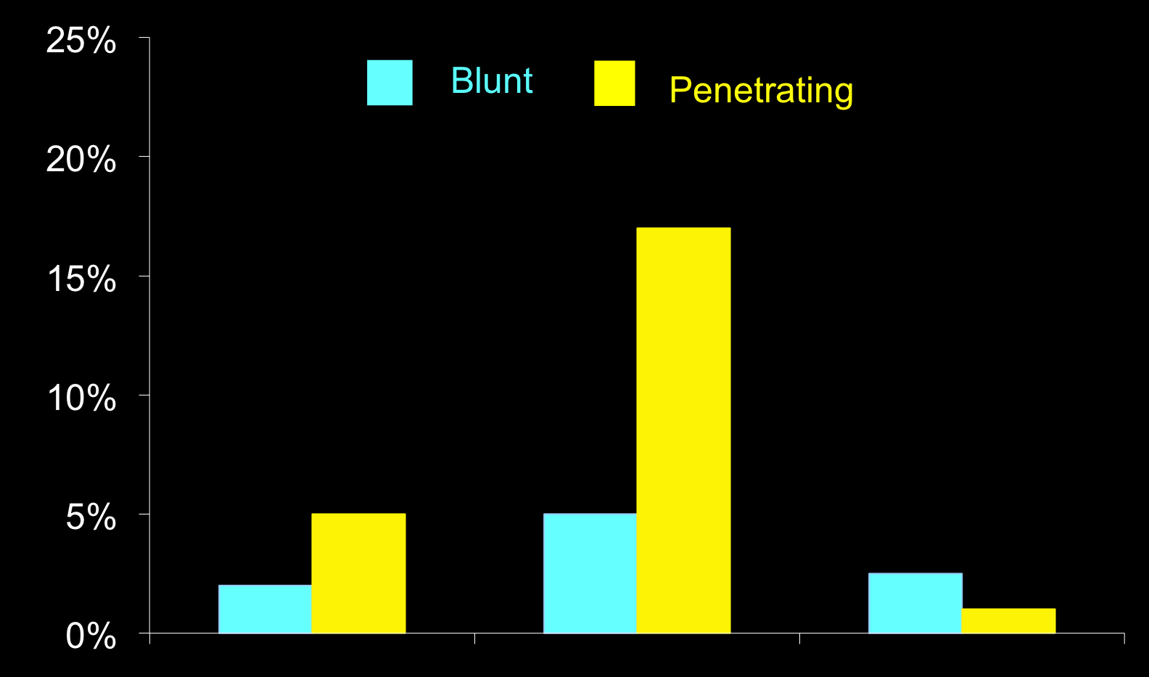
Outcomes
SLF
Abscess
Mortality
Notes:
Put names in as text boxes and change sizes of boxes above

Slide 55
Conclusions
Adherence to a defined algorithm was efficacious for the management of blunt colon injuries

Slide 56
Conclusions
Adherence to a defined algorithm was efficacious for the management of blunt colon injuries
Colon Injuries
Nondestructive
Destructive
Primary Repair
+Comorbidity
>6 units PRBCs
-Comorbidity
≤6 units PRBCs
Diversion
R+ A

Slide 57
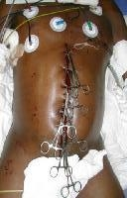
What about this situation?

Slide 58
Wake Forest – 2007
- 22 pts with open abdomen -
11 patients underwent resection with delayed anastomosis (DA)
0 leaks
“DA is safe in selected patients”
Truth: Almost half (45%) of those 11 patients died prior to hospital discharge
Miller et al, Am Surg 2007

Slide 59
Alabama – 2009
- 56 pts with open abdomen -
33 patients underwent resection with DA
12% leak rate
Colon-related morbidity for DA was larger than for anastomosis in single laparotomy
Anastomosis in the setting of an open abdomen is a “cautionary tale,” and diversion may be a safer alternative
Weinberg et al, J Trauma 2009

Slide 60
Denver – 2009
- 29 pts with open abdomen -
25 patients underwent resection with DA
16% leak rate
Concluded DA was safe in most patients managed with an open abdomen
Despite a larger suture line failure rate compared to Weinberg et al (16 vs 12%), authors have drawn different conclusions
Kashuk, Moore, Surgery 2009

Slide 61
Controversy Exists
Author | Year | # with DA | % Leak
Miller | 2007 | 11 | 0
Ordonez | 2011 | 24 | 8
Weinberg | 2009 | 33 | 12
Kashuk | 2009 | 21 | 16
Berlew | 2011 | 60 | 20
Ott | 2011 | 44 | 27

Slide 62
What about our algorithm?
Risk factors for colon injuries were defined prior to the widespread use of abbreviated laparotomy (AL) or open abdomen
Do not necessarily address the issue of performing delayed anastomosis
May place the patient at increased risk of suture line failure

Slide 63
Study Design
Patients
Outcomes
Destructive colon injuries over a 17 year-period
Exclusions
  Deaths within 24 hours
  Rectal injuries
  Single laparotomy
Colon-related Morbidity
  Suture line failure
  Abscess
Colon-related Mortality
Outcomes were evaluated to determine if additional risk factors should be considered in the management of destructive colon injuries following abbreviated laparotomy

Slide 64
Destructive Colon Injuries
Penetrating
Blunt
Wound >50% of colon wall
Complete transection
Significant tissue loss
Devacularized segments
Serosal tear >50% of colon wall
Full thickness perforation
Mesenteric devascularization

Slide 65
Study Population
149 Patients
117 Destructive
32 Nondestructive
42 DA
72 SD
2 Early deaths, 1 PR

Slide 66
Abbreviated Laparotomy
 | DA (n=42) | SD (n=72) | p
Age | 41 | 39 | 0.59
Blunt (%) | 38 | 32 | 0.54
ISS | 24 | 24 | 0.98
Abd-AIS | 4 | 4 | 0.99
24-hour PRBCs | 13.5 | 22.7 | 0.01
Adm BE | -7.5 | -8.2 | 0.63
CR Morbidity (%) | 38 | 42 | 0.84
CR Mortality (%) | 5 | 7 | 0.99

Slide 67
Suture Line Failure
 | SLF (n=7) | No SLF (n=35) | p
Age | 38 | 42 | 0.55
Comorbidity (%) | 14 | 3 | 0.31
Blunt (%) | 43 | 37 | 0.99
ISS | 25 | 24 | 0.87
Abd-AIS | 4.3 | 4.7 | 0.09
24-hour PRBCs | 17 | 12.8 | 0.47
Adm Shock Index | 1.16 | 1.0 | 0.45
Adm BE | -7.6 | -7.1 | 0.85

Slide 68
Compliance
 | ALG (n=23) | No ALG (n=19) | p
Age | 43 | 39 | 0.45
Comorbidity (%) | 0 | 11 | 0.20
Blunt (%) | 35 | 42 | 0.75
ISS | 21 | 30 | 0.01
Abd-AIS | 3.7 | 3.8 | 0.59
Intra-op PRBCs | 4.1 | 15.6 | <0.001
Adm Shock Index | 0.8 | 1.3 | 0.002
Adm BE | -4.7 | -10.6 | 0.007

Slide 69
Compliance
 | ALG (n=23) | No ALG (n=19) | p
CR Morbidity (%) | 22 | 58 | 0.03
CR Mortality (%) | 0 | 11 | 0.20
SLF (%) | 4 | 32 | 0.03

Slide 70
Conclusions
The management of destructive colon injuries in the setting of AL is not straightforward
The decision-making process is multi-factorial, relying on both objective and subjective information
Adherence to an established algorithm, originally defined and validated for destructive colon injuries following single laparotomy was efficacious for the management of these injuries in the setting of AL

Slide 71
Algorithm with AL
Colon Injuries
Nondestructive
Destructive
Primary Repair
+Comorbidity >6 units PRBCs
-Comorbidity ≤6 units PRBCs
Staged Diversion
Delayed Anastomosis

Slide 72
Summary
Primary repair is the treatment of choice for nondestructive colon wounds
Resection & anastomosis is safe in selected patients
Adherence to a defined clinical pathway results in optimal outcomes
  Destructive wounds
  Blunt injury
  Abbreviated laparotomy

Slide 73


