Slide 1
Ventilator Associated Pneumonia:
From Soup to Nuts
43rd Annual Phoenix Surgical Symposium
Scottsdale, AZ
Elvis Presley Memorial Trauma Center
Department of Surgery
University of Tennessee Health Science Center
Memphis, TN

Slide 2




I have no conflicts to disclose

Slide 3
Outline
Overview of the problem
Optimal diagnostic method
Empiric therapy
Definitive therapy
Ventilator bundle
CDC surveillance

Slide 4
Outline
Overview of the problem
Optimal diagnostic method
Empiric therapy
Definitive therapy
Ventilator bundle
CDC surveillance

Slide 5
VAP in the United States
 | VAP (n = 816) | No VAP (n = 2,243) | P
Mechanical Ventilation, mean + SD days | 14.3 + 15.5 | 4.7 + 7.0 | < 0.001
ICU stay, mean + SD days | 25.2 + 22.8 | 14.0 + 14.6 | < 0.001
Hospital charges, mean + SD dollars | 104,983 + 91,080 | 63,689 + 75,030 | < 0.001
Mortality | 30.5% | 30.4% | 0.713

Slide 6
VAP at the EPMTC
 |  |  | Mortality |  | Odds Ratio (95% CI)
 | n | VAP Incidence | VAP | No VAP
Mechanical ventilation | 1,362 | 35% | 16% | 6% | 3.41 (2.4 to 5.2)
ISS < 16 | 2,402 | 4% | 18% | 1% | 5.41 (3.5 to 7.2)
ISS 16 - 24 | 1,709 | 14% | 14% | 2% | 5.36 (3.8 to 6.9)
ISS > 25 | 1,749 | 40% | 17% | 20% | 0.98 (0.91 to 1.3)

Slide 7
Outline
Overview of the problem
Optimal diagnostic method
Empiric therapy
Definitive therapy
Ventilator bundle
CDC surveillance

Slide 8
Diagnosis of VAP
- evolution -
Sputum culture
  simple
  sensitive, not specific
  unnecessary antibiotics
Invasive techniques
  more labor intensive
  sensitive & specific
  more appropriate antibiotics
Clinical Pulmonary Infection Score
  simple
  pulmonary inflammatory response
  antibiotic duration

Slide 9
Systemic Inflammatory Response Syndrome
Temperature > 38º < 36ºC
Heart rate > 90
Respiratory rate > 20, PaCO₂ < 32
WBC > 12,000, < 4,000, > 10% bands

Slide 10
Sepsis
Temperature > 38º < 36ºC
Heart rate > 90
Respiratory rate > 20, PaCO₂ < 32
WBC > 12,000, < 4,000, > 10% bands
Infection must be present

Slide 11
Chastre & Fagon
Am J Respir Crit Care Med
2002
Clinical infection?
PSB or BAL
Signs of severe sepsis
Bacteria present?
No
Yes
Yes
Immediate antibiotics
Immediate antibiotics
Continue or adjust antibiotics
Continue or adjust antibiotics
Positive cultures?
Positive cultures?
No
No
Yes
Adjust antibiotics

Slide 12
Standard Clinical Criteria
- Problems -
SIRS
Tracheal colonization
Low sensitivity & specificity
Pulmonary contusion
ARDS

Slide 13
CPIS
Temperature
Blood leukocytes
Tracheal secretions
PaO₂ / FiO₂
Chest radiograph
Scores range 0 - 10

Slide 14
Validation of CPIS
- > 6 for VAP diagnosis -
Sensitivities of 70 - 90%
Specificities of 40 - 90%
CPIS > 6 “virtually excluded acute lung injury, pulmonary edema, atelectasis, or contusion as causes of pulmonary infiltrates in ICU patients” Singh, 2000

Slide 15
CPIS and VAP
# of Patients
% with VAP
CPIS

Slide 16
CPIS for VAP Diagnosis
- CPIS > 6 = VAP -
Sensitivity 61%
Specificity 43%
PPV 44%
NPV 62%

Slide 17
Methods
- 107 Ventilated Patients -
•
Clinical NP (fever,
WBC, sputum, x-ray)
•
Triplicate cultures:
-
Routine sputum aspirate (RS)
-
Protected specimen brush (PSB)
-
Bronchoalveolar lavage (BAL)
•
Therapy based on RS

Slide 18
Criteria for NP Diagnosis
- All Culture Methods -
RS – Presence of pathogen(s)
PSB – > 10³ cfu/mL of pathogen(s)
BAL – > 10⁵ cfu/mL of pathogen(s)

Slide 19
Incidence of Pneumonia
- 136 Cultures -
100
80
* p < .001
60
40
*
*
20
0
RS
PSB
BAL

Slide 20
Clinical Characteristics
+ VAP - VAP
Temperature 101.8 102.2
WBC 15.2 14.5
% bands 10.7 7.6

Slide 21
Methods
•
Mechanically ventilated trauma patients
•
Clinical evidence of pneumonia
-
Fever, leukocytosis, purulent sputum,
infiltrate
•
No other obvious infection
•
Concomitant antibiotics acceptable
•
FOB with BAL

Slide 22
Definitions
VAP
SIRS
False negative BAL
BAL with > 10⁵ cfu / mL
BAL with < 10⁵ cfu / mL
Previous SIRS with subsequent BAL > 10⁵ cfu / mL of same organism within 7 days

Slide 23
Study Population
- 232 Patients -
M/F
71%/29%
Mech of Injury
Age
41 years
Penetrating
ISS
30
GCS
11
Pulm Cont
58%
Smokers
59%
Blunt

Slide 24
Protocol
FOB with BAL & Gram's stain of effluent
G +
→
vancomycin
< 10⁵ cfu/mL
Antibiotics stopped (SIRS)
> 10⁵ cfu/mL
Antibiotics continued (VAP)
61%
39%

Slide 25
FOB Frequency & VAP
250
100
90
200
80
70
150
60
Number of Patients
% with Pneumonia
50
100
40
30
50
20
10
0
0
1
2
3
≥4
Number of FOB

Slide 26
Group Comparison
VAP
SIRS
N
173
270
Age
42
40
GCS
11
11
% Pulm. cont.
63
59

Slide 27
Mortality
Lived
Died
VAP
80%
20%
SIRS
84%
16%
False negative
13
4
Age
39
p < .005
48
ISS
29
32
GCS
11
11

Slide 28
False Negative BAL
- 17 patients -
False negative
True negative
Age
42
41
ISS
36
p < .04
30
GCS
10
11
% Pulm Cont
65
60
% Mortality
24
17

Slide 29
Quantitative Cultures
- diagnostic threshold -
Lower Threshold
<10⁵ CFU/ml
Higher Threshold
≥10⁵ CFU/ml
Prolonged Exposure
Unnecessary Antibiotics
↑ Untreated VAP
Treatment Delays
↑ Microbial Resistance
↑ Mortality

Slide 30
Study Population
- 1679 patients -
3202 BALs
21%
Age 44 yrs
ISS 33
79%
False-negative Rate: 2.3%

Slide 31
Study Population
 | False Negative | No False Negative
Number | 65 | 1619
Age | 39 | 44
Injury Severity Score | 35 | 32
GCS Score | 9 | 10
Admission BE | -6.4 | -4.4
24 hr RBC Transfusion | 4.5 | 3.1

Slide 32
Outcomes
 | False Negative | No False Negative | p
Ventilator Days | 29 | 19 | 0.002
ICU Days | 35 | 24 | 0.0002
Hospital Days | 49 | 36 | 0.01

Slide 33
Outcomes
 | False Negative | No False Negative | p
Ventilator Days | 29 | 19 | 0.002
ICU Days | 35 | 24 | 0.0002
Hospital Days | 49 | 36 | 0.01
Mortality (%) | 10 | 14 | 0.35

Slide 34
Charge Reduction
Antibiotic | n | Charge | Duration
Unasyn | 311 | $280 | 7 Days
Vancomycin | 94 | $210 | 11 Days
Cefepime | 125 | $210 | 11 Days
Primaxin | 31 | $1000 | 10 Days
Bactrim | 94 | $225 | 10 Days
Mean charge per VAP episode = $2500

Slide 35
Charge Reduction
968 BALs with 10⁴ CFU/ml
-
313 with VAP from another organism
=
655 episodes unnecessary antibiotics
$2500 per 10⁴ unnecessary episode
X
=
> $1.6 million antibiotic charges

Slide 36
Conclusions
The results of the current study do not support the purported benefit of a lower diagnostic threshold for VAP
The diagnostic threshold for VAP in trauma patients should be ≥10⁵

Slide 37
Conclusions
Continued adherence to this diagnostic threshold for quantitative BAL in trauma patients
  has maintained low false-negative rates
  reduced patient charges
  has not increased mortality

Slide 38
Outline
Overview of the problem
Optimal diagnostic method
Empiric therapy
Definitive therapy
Ventilator bundle
CDC surveillance

Slide 39
VAP Pathogens Over Time
100
90
80
70
60
Gram pos. & H. flu
% Pneumonia
50
Gram neg.
40
30
20
10
0
Week 1
Week 2
Week 3
ICU Stay

Slide 40
Clinical Pathway
Clinical Evidence of VAP
Fever
Leukocytosis
Purulent sputum
CXR infiltrate
Bronchoscopy & BAL
Empiric therapy based on number of ICU days
1 - 7 days
> 7 days
Ampicillin/
Sulbactam
<10⁵ cfu -
Stop tx
≥10⁵ cfu -
Continue tx
Cefipime +
Vancomycin

Slide 41
TICU Compared to National Data
 | Med TICU 2009-2010 | Med TICU 2011-2012 | MYSTIC 2009 NHSN 2008
MRSA | 52% | 46% | 56%
Cefepime resistant E.coli | 0% | 10% | 5%
Cefepime resistant Klebsiella | 4% | 7% | 7%
Cefepime resistant Pseudomonas | 4% | 1% | 10%
Cefepime resistant Enterobacter | 1% | 1% | 7%
Imi resistant Pseudomonas | 9% | 6% | 16%
Cipro resistant Pseudomonas | 9% | 9% | 17%
Imi resistant Acinetobacter | 32% | 35% | 48%

Slide 42
Outline
Overview of the problem
Optimal diagnostic method
Empiric therapy
Definitive therapy
Ventilator bundle
CDC surveillance

Slide 43
Changing Recommendations
Recent clinical studies have questioned the appropriate duration of antimicrobial therapy for VAP
Limiting therapy
  consider abbreviated therapy in non-Pseudomonal VAP if clinical signs resolve
    Chastre et al. 2003

Slide 44
Not So Fast
Resolution of clinical signs may be non-specific in trauma patients with other reasons for systemic inflammation
Potentially leading to subjectively prolonged therapy
Use of an arbitrary day cutoff or clinical signs may be suboptimal for some patients with VAP secondary to late pathogens resulting in relapse and/or antibiotic resistance

Slide 45
Objective Evidence
Use of a defined bacteriologic strategy overcomes need for arbitrary antibiotic therapy endpoints by objectively identifying patients with MR of VAP
Optimal duration
  repeat BAL could be used to guide antimicrobial duration for community-acquired VAP
    Mueller et al. 2007

Slide 46
Hospital-acquired VAP
Repeat BAL on Day 4 of Appropriate Therapy
VAP pathogens ≤10³ CFU/ml
Yes
No
Antibiotics 7 Days
Repeat BAL on Day 7-10
VAP pathogens ≤10³ CFU/ml
Yes
No
Antibiotics 10 Days
Antibiotics 14 Days
Notes:
Repeat BAL was performed on the fourth day of adequate antibiotic therapy defined as the presence of antibiotic therapy active against all pathogens on
final culture and sensitivity. Microbiological resolution was defined as <10³ CFU/ml.

Slide 47
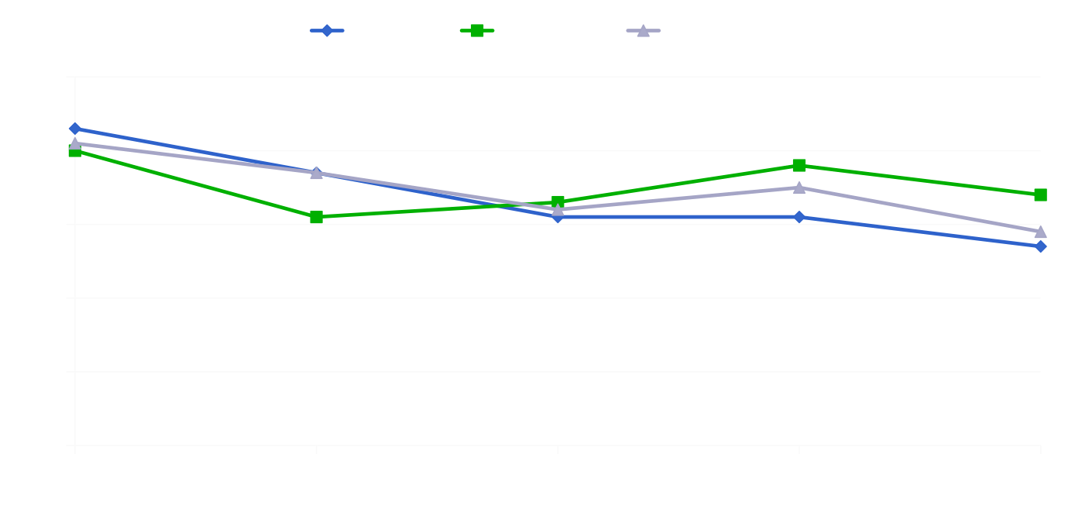
Clinical Signs
- Temperature -
Days of therapy

Slide 48
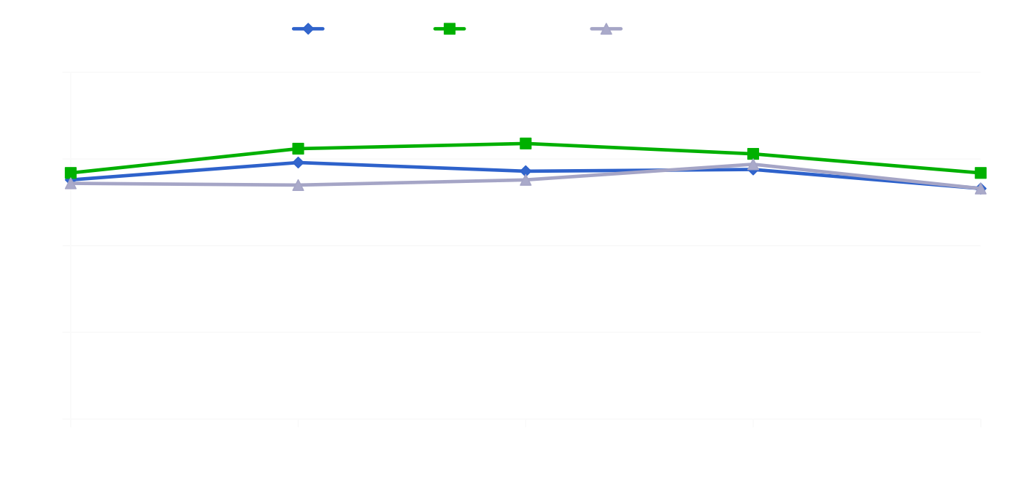
Clinical Signs
- White Blood Cell Counts -
Days of therapy

Slide 49
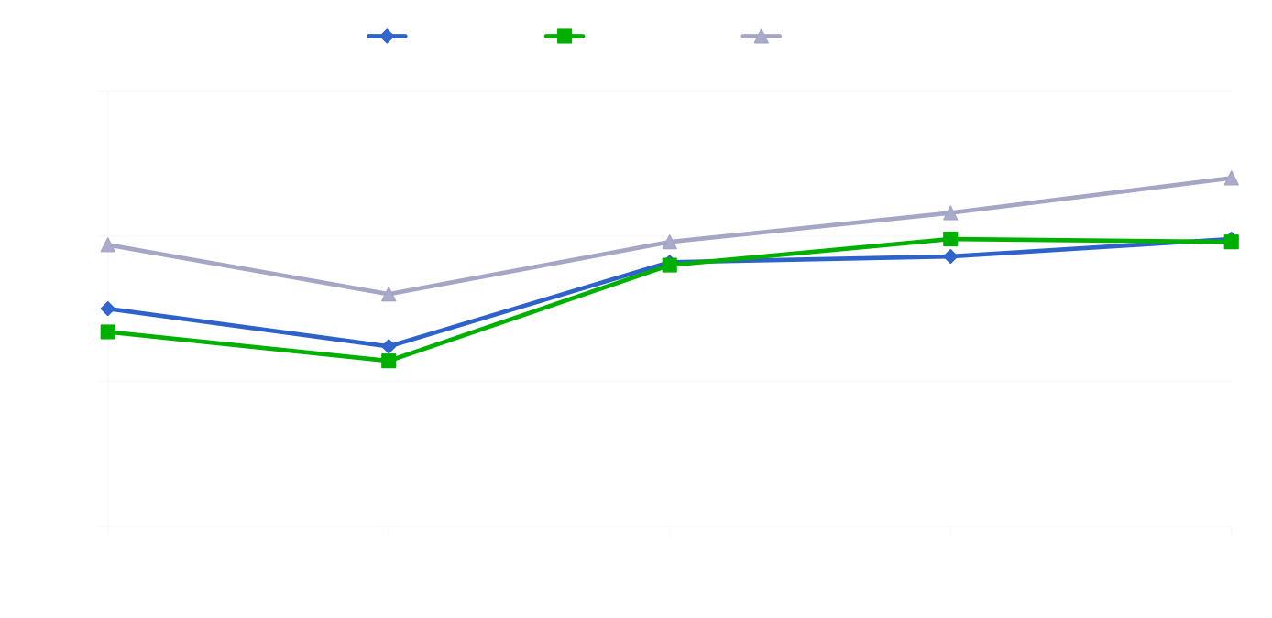
Clinical Signs
- PaO₂ / FiO₂ -
Days of therapy

Slide 50
Microbiological Resolution
MRSA
PA
AB
SM
ENB

Slide 51
Hospital-acquired VAP?
PA
AB, SM, ENB MRSA
Continue Antibiotics for 14 Days
Repeat BAL on Day 7 of Appropriate Therapy
VAP pathogens ≤10³ CFU/ml
Yes
No
Antibiotics 10 Days
Antibiotics 14 Days
Notes:
Repeat BAL was performed on the fourth day of adequate antibiotic therapy defined as the presence of antibiotic therapy active against all pathogens on
final culture and sensitivity. Microbiological resolution was defined as <10³ CFU/ml.

Slide 52
Charge Reduction
30% reduction in #BALs per patient
$1721.64 per patient (BAL + quantitative culture)
+
4.8 less antibiotic days per VAP episode
$1813.45 per patient
=
$3535.09 per patient

Slide 53
Charge Reduction
30% reduction in #BALs per patient
$1721.64 per patient (BAL + quantitative culture)
+
4.8 less antibiotic days per VAP episode
$1813.45 per patient
=
$3535.09 per patient
$1.35 million over the study period

Slide 54
Outline
Overview of the problem
Optimal diagnostic method
Empiric therapy
Definitive therapy
Ventilator bundle
CDC surveillance

Slide 55
What’s a Bundle?
“Small set of evidence based practices – generally 3 to 5 – that, when performed collectively and reliably have been proven to improve patient outcomes.”
Institute for Healthcare Improvement

Slide 56
What’s the IHI Ventilator Bundle?
Stress ulcer prophylaxis
Deep venous thrombosis prophylaxis
Head of bed elevation
Daily sedation vacation with weaning assessment
Chlorhexidine mouth care*

Slide 57
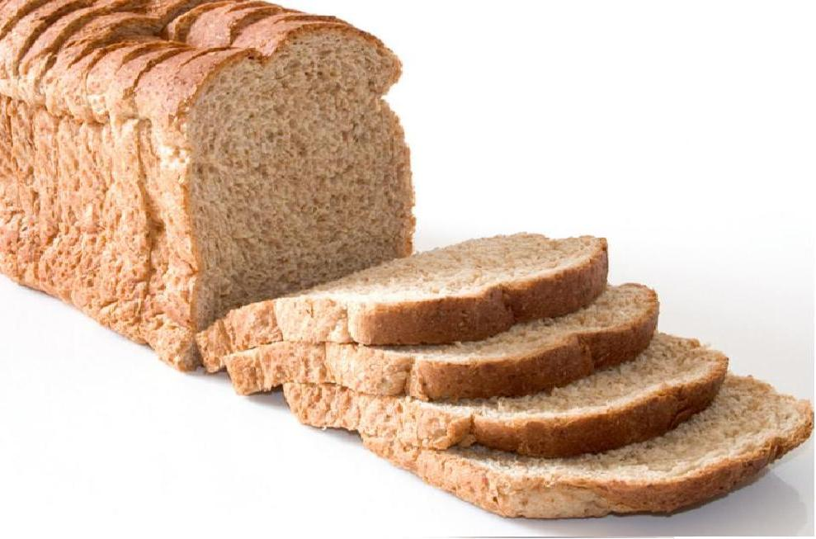
What’s the Evidence?
IHI bundle compliance
Reduced VAP by 59%
        Resar 2005
Reduced VAP by 68%
        Bird 2010
Reduced VAP by 87%
        Cachecho 2012

Slide 58
Why is the IHI Bundle Important?
Hospitals have jumped on bandwagon, boasting dramatic reductions in VAP
CMS took notice, now considering VAP as a “never event”
May result in financial penalties to hospitals with higher VAP rates

Slide 59
Problems with the Evidence
Credit for bundle compliance if component not medically indicated
No consensus on VAP diagnosis
Poorly defined patient populations
Compliance measured as a “static” as opposed to “dynamic” variable

Slide 60
Compliance Measurement
Static = Individual patient
- all patients weighted equally
- no accounting for duration or variability
Dynamic = Patient-days
- weighted according to duration
- accounts for day to day variation

Slide 61
Study Purpose
To provide evidence for use of the IHI ventilator bundle in trauma patients by evaluating compliance in a dynamic time-dependent manner

Slide 62
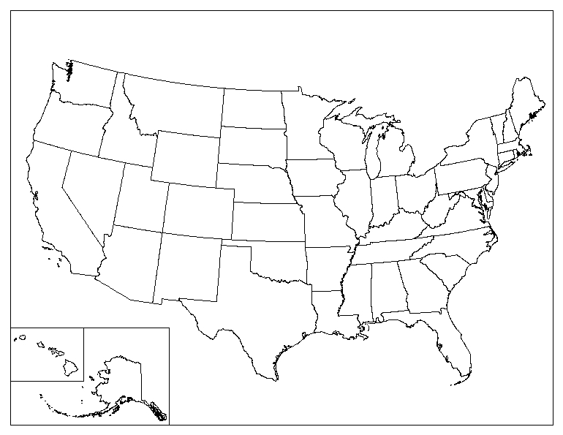
Prospective multi-institutional observational study sponsored by the National Trauma Institute

Slide 63
Study Criteria
Trauma patients with ICU admission and at least 2 days mechanical ventilation
Demographic data, markers of injury severity
Patients followed daily for bundle compliance until VAP, discharge, death
No credit for compliance if bundle component not medically indicated
Logistic regression, Cox regression

Slide 64
Study Patients
630 patients, 1,492 patient days
47 years
72% male
24 ISS
44% smokers
45% rib fractures
33% pulmonary contusion
Adm GCS 9.0
24hr GCS 8.7
48hr GCS 8.8
VAP 36%
Mortality 15%

Slide 65
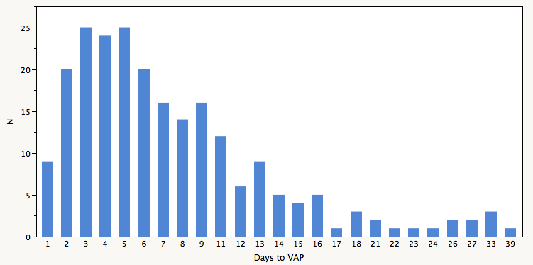
VAP Distribution
93% of all VAP

Slide 66
Early vs No VAP
 | VAP | No VAP | p value
Number | 210 | 403
Age | 46 | 47 | .64
% male | 79 | 69 | .009
Pulm cont | 40 | 28 | .002
Chest AIS | 2.1 | 1.8 | .02
ISS | 24 | 23 | .18
24hr GCS | 8.2 | 8.8 | .05
48hr GCS | 8.4 | 8.9 | .04
24hr APACHE | 18.0 | 17.4 | .38
48hr APACHE | 16.2 | 15.6 | .79
Mortality | 14 | 15 | .79

Slide 67
Early vs No VAP
 | VAP | No VAP | p value
Number | 210 | 403
Age | 46 | 47 | .64
% male | 79 | 69 | .009
Pulm cont | 40 | 28 | .002
Chest AIS | 2.1 | 1.8 | .02
ISS | 24 | 23 | .18
24hr GCS | 8.2 | 8.8 | .05
48hr GCS | 8.4 | 8.9 | .04
24hr APACHE | 18.0 | 17.4 | .38
48hr APACHE | 16.2 | 15.6 | .79
Mortality | 14 | 15 | .79

Slide 68
Early vs No VAP
 | VAP | No VAP | p value
Number | 210 | 403
Age | 46 | 47 | .64
% male | 79 | 69 | .009
Pulm cont | 40 | 28 | .002
Chest AIS | 2.1 | 1.8 | .02
ISS | 24 | 23 | .18
24hr GCS | 8.2 | 8.8 | .05
48hr GCS | 8.4 | 8.9 | .04
24hr APACHE | 18.0 | 17.4 | .38
48hr APACHE | 16.2 | 15.6 | .79
Mortality | 14 | 15 | .79

Slide 69
Early vs No VAP
 | VAP | No VAP | p value
Number | 210 | 403
Age | 46 | 47 | .64
% male | 79 | 69 | .009
Pulm cont | 40 | 28 | .002
Chest AIS | 2.1 | 1.8 | .02
ISS | 24 | 23 | .18
24hr GCS | 8.2 | 8.8 | .05
48hr GCS | 8.4 | 8.9 | .04
24hr APACHE | 18.0 | 17.4 | .38
48hr APACHE | 16.2 | 15.6 | .79
Mortality | 14 | 15 | .79

Slide 70
Logistic Regression for VAP
- individual patient -
 | OR | 95% CI
Pulmonary contusion | 1.601 | 1.110, 2.316
Male gender | 1.681 | 1.131, 2.529
Bundle compliance | 0.277 | 0.182, 0.412

Slide 71
Cox Regression for VAP
- patient-days -
 | OR | 95% CI
Male gender | 1.750 | 1.233, 2.483
Bundle compliance | 1.260 | 0.845, 1.877

Slide 72
Outline
Overview of the problem
Optimal diagnostic method
Empiric therapy
Definitive therapy
Ventilator bundle
CDC surveillance

Slide 73

Simplified CDC Criteria
Ventilator Associated Event
Ventilator Associated Condition
Infection-related Ventilator Associated Condition
Possible Ventilator Associated Pneumonia
Probable Ventilator Associated Pneumonia

Slide 74
Ventilator Associated Events (VAE)
Tier 1 – Ventilator Associated Condition (VAC)
  Episodes of sustained respiratory deterioration
  Infectious and non-infectious
  >2 days stab then >2 days increased FiO₂/PEEP
Tier 2 – Infection-related Ventilator Associated Condition (IVAC)
  VACs potentially infection related
  Abnormal WBC or temperature + new antimicrobial agent

Slide 75
Ventilator Associated Events (VAE)
Tier 3 – Possible VAP
  IVAC with purulent secretions and/or positive microbiologic tests
Tier 3 – Probable VAP
  IVAC with purulent secretions and positive (semi)quantitative microbiologic tests

Slide 76
Problems with Definitions
Mainly a measure of complications of mechanical ventilation
Not intended as definitive diagnostic criteria (wink wink nudge nudge)
Primarily reflects medical patients
No accounting for other reasons for inflammation
Requires at least 3 days mechanical ventilation for VAP diagnosis

Slide 77
VAP Distribution
Would have missed 25% with VAP

Slide 78
Rates of VAP
J Trauma, 2012

Slide 79
Who Calculates the VAP Rate?
 | VAP cases per 1000 ventilator days | p value
Trauma service | 27.5 | 0.001
Collaborative effort between trauma and other department | 19.9
Infection control | 11.9
J Trauma, 2012

Slide 80
CDC Definitions vs BAL
Number
2013 quarter

Slide 81
In Trauma Patients:
VAP associated with mortality
VAP diagnosis best made by quantitative cultures
Empiric therapy based on duration in ICU
Therapy based on organism
VAP associated with gender and chest injury severity
Surveillance math does not help prevention efforts

Slide 82
Diagnostic Algorithm for VAP
Clinical evidence of VAP
Fever
Leukocytosis
Purulent sputum
Infiltrate
FOB with BAL, Empiric therapy
ICU < 7 days
Ampicillin/Sulbactam
ICU > 7 days
Cefipime+Vancomycin
< 10⁵ cfu/ml
≥ 10⁵ cfu/ml
Stop antibiotics
Continue antibiotics

Slide 83


