Slide 1
Infection: The Achilles Heel of
Abdominal Wall Reconstruction
Robert J. Fitzgibbons MD, FACS
Harry E. Stuckenhoff Professor of Surgery
Creighton University School of Medicine
Omaha, Nebraska
Notes:
1
1
1
1
1
1

Slide 2
Faculty Disclosure
Ad Hoc Paid Consultant (In the last year)
  None
Retainer
  None
Speaker’s Bureau
  None
Grant Support (In the last 2 Years)
  None
Fellowship Support
  None
Financial interest (↑ $10,000 US)
  None
Royalty
  Cook Critical: Fitzgibbons Jenkins Catheter
I will not Discuss Off Label Use of Products

Slide 3
Healthcare-Associated Infections (HAIs)
HAIs are Those That Develop in the Hospital That Were Neither Incubating Nor Present at The Time of Admission
40 Million Persons Hospitalized Annually in US; 5% or 2M Will Develop a HAI
  Morbidity and Mortality (90,000 Deaths); 6th Leading Cause of Death in the US
  Variable Prolongation of Hospital Stay
  $5-10 Billion/Year

Slide 4
Most Prevalent
Weinstein RA. Emerg Infect Dis. 1998;4(3):416-420.
CDC, NNIS Semiannual Report, Dec 2000.
Notes:
4
[Animated slide-mouse click once]
The issues of HAI are probably already being dealt with by your organization. I would like to help you get a better grip on the economic benefits of reducing these infections. It’s best to start breaking down the picture of HAIs. According to the Centers for Disease Control, hospital-acquired infections manifest mostly as urinary-tract infections, surgical site infections, and primary bloodstream infections, with the remaining infections falling under other categories.
References
1. Weinstein RA. Emerg Infect Dis. 1998;4(3):416-420.
2. CDC, NNIS Semiannual Report, Dec 2000.

Slide 5
Among Surgical Patients:
SSIs are the Most Common (Approximately 40% of Healthcare-associated Infections )
  67% Confined To Incision
  33% Organ/Space Infections
Adds An Average of 7 Days to Each Hospitalization
Adds >$10,000 (2005 $) To Each Hospitalization
Notes:
5
Postoperative surgical site infection, or SSI, is a major cause of patient injury, mortality, and health care cost:^{1,2}
An estimated 2.6% of nearly 30 million operations are complicated by SSIs each year.
SSIs account for about 40% of all nosocomial infections among surgical patients in the United States.
Each infection is estimated to increase a hospital stay by an average of 7 days and add over $3,000 in charges (1992 data).
Appropriate preoperative administration of antibiotics is effective in preventing infection.
References
Surgical Site Infections. Institute for Healthcare Improvement. Available at: http://www.ihi.org/IHI/Topics/PatientSafety/SurgicalSiteInfections/. Accessed on February 1, 2007.
Odom-Forren J. Preventing surgical site infections. Nursing 2006. 2006;36(6):58-63.

Slide 6
Impact of Healthcare-Associated Infections

Slide 7
Abdominal Wall Hernia
Ventral Hernia = Any Fascial Defect of the Abdominal Wall
  Groin Hernia
    Inguinal, Femoral
  Non-Groin Hernia
    Primary
      Umbilical, Epigastric, Spigelian, Peristomal, Lumbar
    Secondary
      Incisional, Traumatic

Slide 8
Incidence of Wound Infection Following Hernia Repair
Groin Hernia Repair
  0 - 6%
Ventral Hernia Repair
  0 – 23% Percent

Slide 9
Incidence of Wound Infection Following Hernia Repair
Groin Hernia Repair
  0 - 6%
Ventral Hernia Repair
  0 – 23% Percent

Slide 10
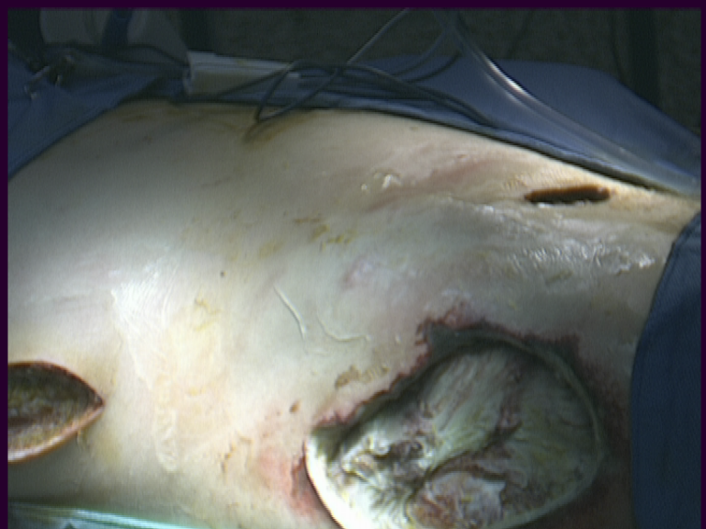
Infection Following
Groin Hernia Repair

Slide 11
Infection Following
Groin Hernia Repair
Severe Infection Rare (Protected Area)
Scattered Case Reports of Cases
Necrotizing Fascitis
  Usually Associated With Strangulated Bowel or Appendicitis (Aymand's) in The Hernial Sac
  Otherwise Group A Streptococcus Most Common

Slide 12
Incidence of Wound Infection Following Hernia Repair
Groin Hernia Repair
  0 - 6%
Ventral Hernia Repair
  0 – 23% Percent

Slide 13
Infection Following Open
Ventral Hernia Repair
8%
9%
Itani et al. Am J Surg. 2004 Dec;188(6A Suppl):22S-29S

Slide 14
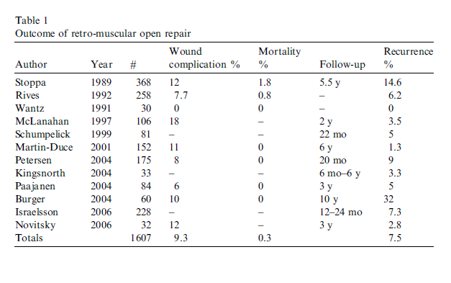
Retro-muscular Open Repair

Slide 15
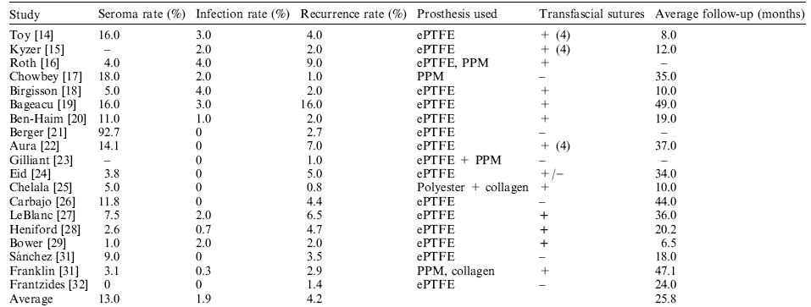
Laparoscopic Ventral Hernia Repair
Postoperative Findings

Slide 16
Laparoscopic Ventral Hernia Repair
Infection Rate

Slide 17
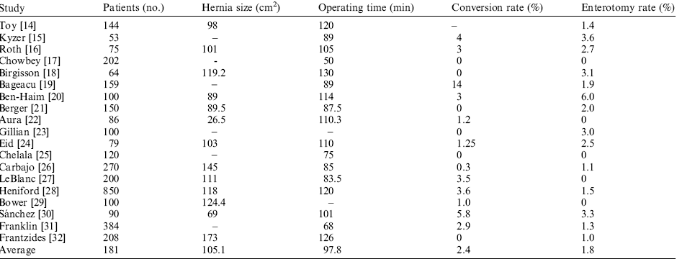
Laparoscopic Ventral Hernia Repair
Enterotomy

Slide 20
Rates of Infection Following Incisional Hernia Repair
Open | Laparoscopic
5-10 % | 0-3%
SURGICAL INFECTIONS Vol 2, Number 3, 2011 205-210

Slide 21

Wound Complications
Serious Complications

Slide 22


Slide 23
The Prevention of Infectious Complications is One of the Most Important Measures of Successful Surgery
Infect Control Hosp
Epidemiol 1999;20:250–278

Slide 24
A Current Look at the Key Performance
Measures Considered Critical by
Health Care Leaders
Dianne Love, Lee Revere, and Ken Black
J.Health Care Finance, 2008, 34, 3, 19-33

Slide 25
Health Care Quality
Performance Measures
Financial
Operating Profit Margin
Days Cash On Hand
Charity Care
Net Profit Margi
Bad Dept Expense
Days In Accounts Receivable A/R Continue
Non-financial
Physician and Employee Satisfaction
Hospital-acquired Infection Rates
Surgical Site Infection Rates
Inpatient Mortality
Infection Control Outcomes
Medication Error Rates
J.Health Care Finance, 2008, 34, 3, 19-33

Slide 26
Health Care Quality
Performance Measures
Financial
Operating Profit Margin
Days Cash On Hand
Charity Care
Net Profit Margi
Bad Dept Expense
Days In Accounts Receivable A/R Continue
Non-financial
Physician and Employee Satisfaction
Hospital-acquired Infection Rates
Surgical Site Infection Rates
Inpatient Mortality
Infection Control Outcomes
Medication Error Rates
J.Health Care Finance, 2008, 34, 3, 19-33

Slide 27
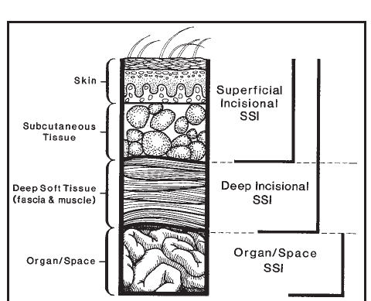
Surgical Site Infection- Definition
Infections of Tissues, Organs, or Spaces Exposed During An Invasive Procedure
Classification
  Incisional
    Superficial (Limited to Skin / Subcutaneous Tissue)
    Deep
  Organ/Space

Slide 28
SSI Infection: Definition
Infection Within 30 Days of Operation (With Implant → 1 Year)
At Least One of the Following:
  Purulent Drainage from Wound
  At Least One of the Cardinal Signs of Infection:
    Pain or Tenderness
    Localized Swelling
    Redness/
  Is Deliberately Opened by Surgeon, Unless Incision Is Culture-negative
  Organisms Isolated From an Aseptically Obtained Culture
  An Abscess or Other Evidence of Infection Involving the Space is Found on Direct Examination, During Reoperation, by Radiologic Examination or by Histopathology
  Documentation of Deep SSI by the Surgeon or Attending Physician.

Slide 29
Imaging Studies
Infected Fluid Collections around Mesh Must Be Distinguished from Non-infected Seromas
The Presence of Gas is Diagnostic
  Anaerobic Infection
  Communication With the GI Tract Hollow Viscus Is Possible.
When a Mesh Infection Is Suspected, Fluid Should Be Aspirated

Slide 30
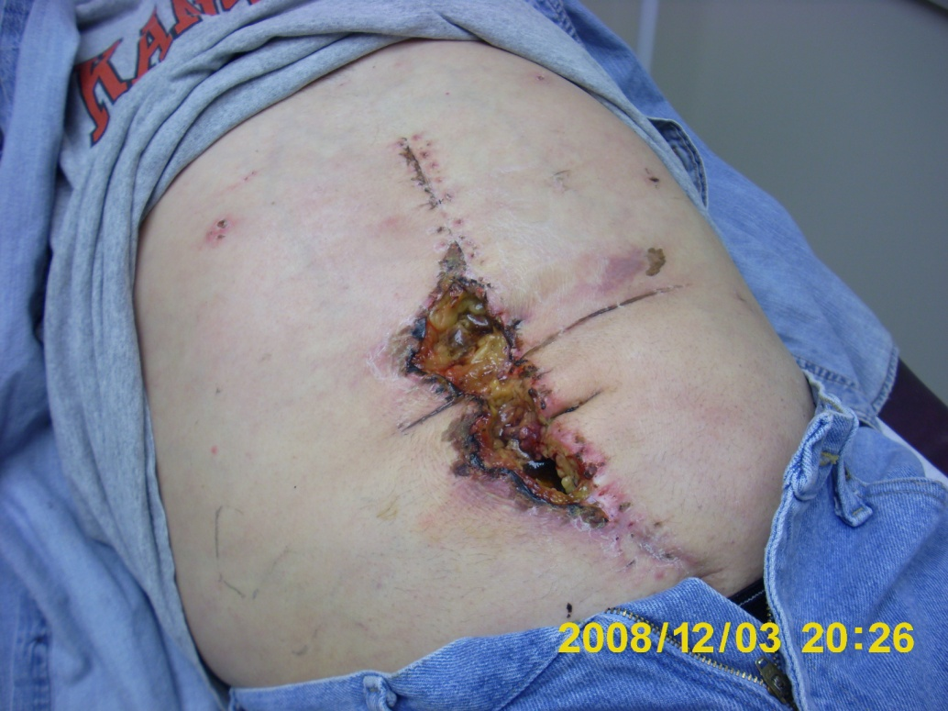
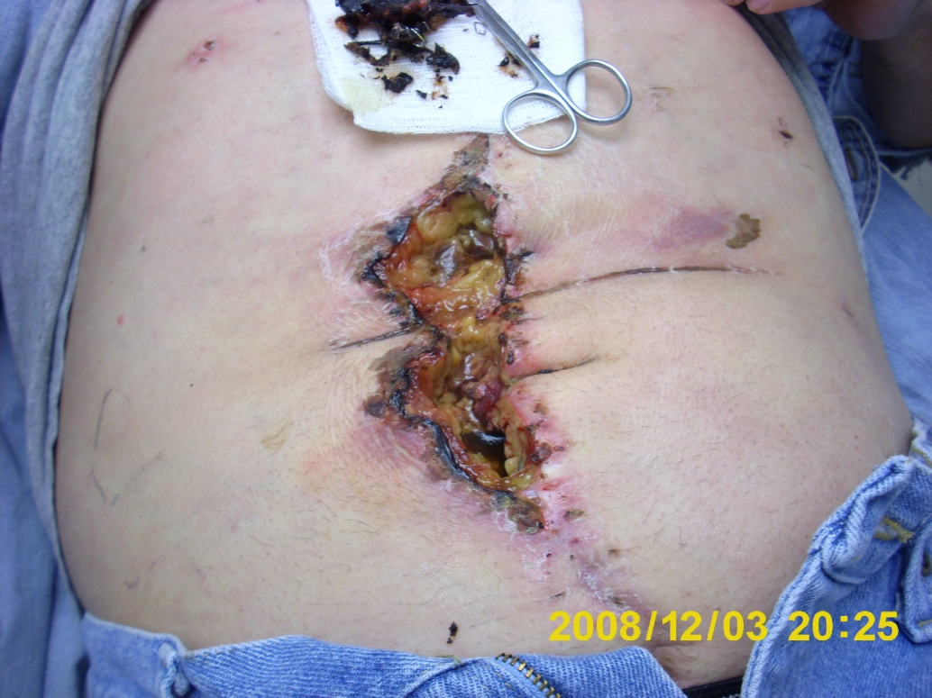
Ischemic Wound

Slide 31
Prosthesis Infection Following
Incisional Hernia Repair
Most Series Report Only Overall Surgical Site Infection (SSi) Rate
Prosthesis Rate is Not Broken Out
Lack of Consensus for a Definition of a Prosthetic Infection
Therefore Exact Incidence Difficult to Calculate

Slide 32
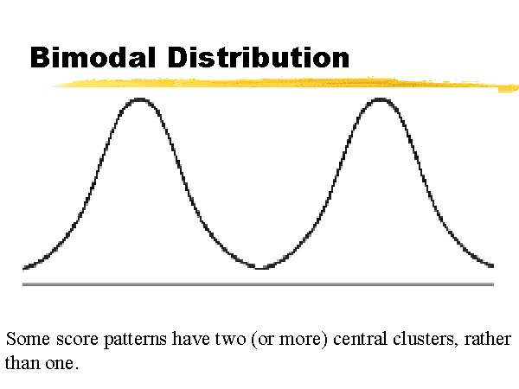
Mesh Infectiom

Slide 33
Bimodal Distribution
Early
  Usually Superficial Ssi
  May or May Not Involve Mesh
Late
  Usually Deep

Slide 34
Patient Related
Risk Factors For Infection

Slide 35
Where do They Come From?
Patient
  Endogenous Flora of Skin or Mucous Membranes
    Usually Aerobic Gram-positive Cocci (E.G., Staphylococci)
  Hollow Viscera (E.G., Enterotomy)
    Fecal Flora
      Gram Negative Bacilli (e.g., E. coli)
      Gram-positive Organisms (e.g., Enterococci)
      Anaerobes (e.g., Bacillus Fragilis)
Exogenous Sources
  Surgical Personnel
  The Operating Room Environment (Air Flow)
  Instruments Placed on the Sterile Field
  Primarily Gram-positive Aerobes (E.G., Staphylococci and Streptococci)

Slide 36
Preoperative Issues Related to Infection
Level of Evidence
High
  Hair Removal
  Identification of Colonized Surgical Personnel
Moderate
Questionable
  Antiseptic Showering
Unproven
  Choice of Patient Skin Preparation
  Choice of Personnel Skin Preparation

Slide 37
Predictors of Mesh Infection
Ventral hernia
Repair of Recurrent Hernia
Current or Recent Smoking History
Operation Time
Body Mass Index
Immunosuppression
Steroids
Coronary Artery Disease
↓Serum Albumin
Surgical Infections (2008) 9:1, 23-32

Slide 38
Patient Risk Factors for Infection
Level of Evidence
High
  Nicotine Use/COPD
Moderate
  Malnutrition
  Blood Glucose Level
Questionable
  Diabetes
  Steroids/immuno-suppressive Drugs
Unproven
  Staphylococcus Aureus Nasal Carriage
    Mupirocin Ointment
  Perioperative Transfusion

Slide 39
History of Previous SSI
The American Journal of Surgery (2012) 203, 370–374

Slide 40
NO!
The American Journal of Surgery (2012) 203, 370–374

Slide 41
Procedure Related
Risk Factors For Infection

Slide 42
Intraoperative Risk Factors Associated With SSI
Enterotomy
Bowel Resection
Emergency Procedure
Prolonged Operative Time
Perioperative Blood Transfusion
Use Of Mesh To Repair Large Ventral Hernia Defects (>10 Cm

Slide 43
Biomaterials and Infection
Material Infection Rate
Polypropylene 2.5 To 5.9%
ePTFE 0 To 9.2%
Polyester Meshes Up To 16%
Ploeg et al

Slide 44
Risk Stratification Scoring System
J Am Coll Surg. 2013 Dec;217(6):974-82.

Slide 45
Factors Associated With
Increased Odds of SSI
Variable
Mesh Implantation
Concomitant Hernia Repair *
Creation Of Skin Flaps
ASA Class 3
BMI ≥40
Wound Class 4
Points
0
2
2
2
3
7
*Hernia Repaired During a Procedure
for Another Surgical Indication
J Am Coll Surg. 2013 Dec;217(6):974-82.

Slide 46
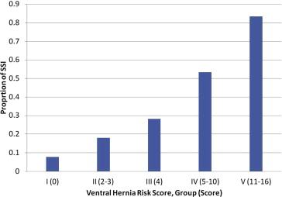
Incidence of SSI by Ventral Hernia Risk Score stratification
.
J Am Coll Surg. 2013 Dec;217(6):974-82.

Slide 47
Microbiology

Slide 48
Microbiology

Slide 49
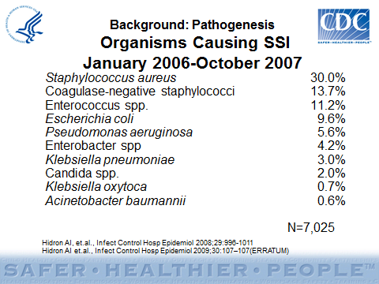
Organisms Causing SSI

Slide 50
Background: Pathogenesis
Organisms Causing SSI
January 2006-October 2007
Staphylococcus aureus 30.0%
Coagulase-negative staphylococci 13.7%
Enterococcus spp. 11.2%
Escherichia coli 9.6%
Pseudomonas aeruginosa 5.6%
Enterobacter spp 4.2%
Klebsiella pneumoniae 3.0%
Candida spp. 2.0%
Klebsiella oxytoca 0.7%
Acinetobacter baumannii 0.6%
N=7,025
Hidron AI, et.al., Infect Control Hosp Epidemiol 2008;29:996-1011
Hidron AI et.al., Infect Control Hosp Epidemiol 2009;30:107–107(ERRATUM)

Slide 51
Microbiology
↑ Proportion of SSIs Caused By Antimicrobial-resistant Pathogens i.e. Methicillin-resistant S. Aureus (MRSA) or Candida Albicans
May Reflect Increasing Numbers of Severely ill and Immunocompromised Surgical Patients and the Impact of Widespread Use of Broad-spectrum Antimicrobial Agents
Outbreaks or Clusters of SSIs Caused by Unusual Pathogens Invariably Can be Traced to Contaminated Surgical Equipment or Colonized Surgical Personnel

Slide 52
Microbiology
Classically, Contamination With >10⁵ Microorganisms Per Gram of Tissue Markedly Increases Risk
Three Factors are Additive with Abdominal Wall Reconstruction
  Foreign Material
  Extensive Skin and Subcutaneous Tissue Dissection → Seroma / Blood Supply Issues
  Biofilm Formation

Slide 53
Important Factors
Dose of Bacterial Contamination
Virulence (toxins)
Resistance of the Host

Slide 54
Microbiology
Importance of the So Called
Biofilm (‘Polysaccharide Slime)

Slide 55


Slide 56
Microbiology: The Biofilm
Bacterial Adherence to Prosthetic Material is Required to Produce an Infection
One Mechanism of Adherence is to Create a Microenvironment Called a ‘‘Biofilm’’ or ‘‘Polysaccharide Slime.’’
Different Constructs of Prosthetic Material Have Differing Abilities to Withstand Biofilm Formation
  E.G. Monofilament Devices Relatively Impervious

Slide 57
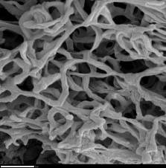
Microbiology: The Biofilm
Biofilm-dwelling Bacteria Behave Differently From Their Free Counterparts (So called Planktonic Bacteria)
The Shielding Within The Coating Confers Protection Against Antimicrobial Treatment
  Planktonic Bacteria Divide Rapidly and Thus are Susceptible to Antibacterial Agents
  Bacteria In Biofilm are Dormant and Thus Non-susceptible
  High Antibiotic Concentrations Cannot be Achieved, Because Biofilm Create A Physical Barrier To Antibiotic Penetration
    Bacteria In Biofilm Can Survive in a Tissue Antibiotic Concentration as High as 1,000–1,500 Times That Tolerated by Planktonic Bacteria

Slide 58
Treatment of Early Infection
Antibiotics Alone Sufficient for Many (Cellulitis)
I&D For Fluctuance or Radiological Evidence of Collection
Vigilance for Signs of Mesh Involvement
  May Need to Aspirate the Normal Mesh Seroma to be Sure
    Mesh Determined to be Infected
      I&D with Local Wound Management For Most
      Explant if Patient Unstable (Septic)
      ePTFE Rarely Salvegable

Slide 59
Prevention of Surgical Site Infections
William A. Rutala, Ph.D., M.P.H.
UNC Health Care System and UNC School of Medicine, Chapel Hill, NC

Slide 60
Proven Strategies to ↓SSI
Minimize Preoperative Stay
Identify and Treat Remote Site Infections
Control Glucose in a Diabetic
Address Obesity
Smoking Cessation
Correct Malnutrition
Physical Conditioning
No recommendations to taper or discontinue
steroids (Unresolved issue)
Preoperative Shower
  Chlorhexidine Probably Best
Appropriate Hair Removal
Appropriate Antisepsis for the Surgical Team
Normothermia

Slide 61

Prevention of Surgical Site Infections

Slide 62
Challenges in the Prevention and Management of Surgical Site Infections
Changing Population of Hospital Patients
  Increased Severity of Illness
  Increased Numbers of Surgical Patients Who Are Elderly
  Increased Numbers of Chronic, Debilitating or Immunocompromising Underlying Diseases
  Shorter Duration of Hospitalization
  Increased Numbers of Prosthetic Implant and Organ Transplant Operations Performed
Public Reporting of Infection Rates/Proportions
Growing Frequency of Antimicrobial-resistant Pathogens
Non-reimbursement For “Medical Errors”
Lack of Compliance With Hand Hygiene

Slide 63
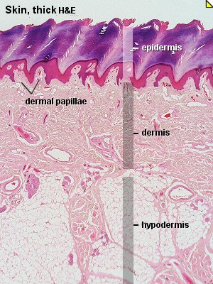
Importance of Our Skin
  Largest organ of the body
    Epidermis
    Dermis
    Subcutaneous tissue (hypodermis)
Notes:
63
The skin is the largest organ of the body, measuring about 2 square meters in adults, consisting of the epidermis and dermis.
The epidermis is divided into the following sublayers or strata:
Stratum corneum
Stratum lucidum, a layer of irregular transparent epidermal cells with traces of nuclei interposed between the stratum corneum and stratum germinativum in the thick skin of the palms and soles (not shown)
Stratum granulosum
Stratum spinosum
Stratum germinativum, also called "stratum basale"
The dermis is a connective tissue layer located beneath the epidermis that contains nerve endings, sweat and sebaceous glands, and blood and lymph vessels.
Reference
Todar K. The Bacterial Flora of Humans. Todar's Online Textbook of Bacteriology. 2004. Available at: http://www.textbookofbacteriology.net/normalflora.html. Accessed on February 5, 2007.

Slide 64
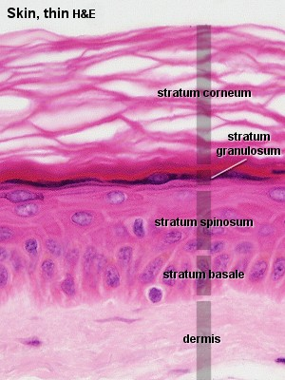
Importance of Our Skin
#1 Function:
Protective Barrier
Microorganisms
  80% in first 5 cell layers of epidermis
When skin is perforated
  Integrity is compromised
  ↑ infection risk
Notes:
64
Skin provides many types of protection, but it’s primary function is to serve as a barrier. The skin’s protective barrier function keep moisture in and microorganisms out.
When skin is perforated or incised, its barrier function is compromised. Microorganisms that migrate through a skin perforation substantially increase the risk of infection.

Slide 65
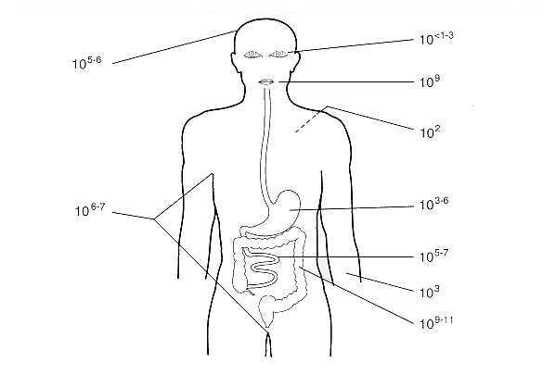
Normal Skin Micro-Flora
Numbers of bacteria that colonize different parts of the body
Numbers per square centimeter of skin surface (cfu/cm²). Counts on hands range from 3.9x10⁴ to 4.6x10⁶.
Notes:
65

Slide 66
Intervening at Points of Care

Slide 67
Postponing Elective Surgery in the Case of Symptomatic Remote Infection

Slide 68
Postponing Elective Surgery
CDC guidelines Stress Importance
However No RCTs
Mainly Case Reports and Retrospective Studies Suggest Hematogenous Origin For Total Joint Arthroplasty
Probably Not Necessary to Postpone for Asymptomatic Bacteriuria or Even Urinary Tract Infection in Nonimplant-related Surgery

Slide 69
Screening for MRSA

Slide 70
Screening for MRSA
Rationale is to Detect and Treat MRSA Skin Carriage Before Incision
Empirically Attractive
However, RCTs Inconclusive
Remains Controversial

Slide 71
Screening for Nasal
Staphylococcal Aureus

Slide 72
Screening for Nasal S. Aureus
A Study In Cardiac Surgery Found a Higher Incidence of SSI in S. Aureus Nasal Carriers Than in Noncarriers
Subsequent Studies with the Use of Intranasal Mupirocin
  ↓ Incidence Of S. Aureus Infection
  However No Difference in Overall SSIs
For General Surgery, A Large Trial And A Meta-analysis Failed To Reveal A Benefit Of Nasal Decolonization In Terms Of SSI Decrease

Slide 73
Screening for Nasal S. Aureus
A Study In Cardiac Surgery Found a Higher Incidence of SSI in S. Aureus Nasal Carriers Than in Noncarriers
Subsequent Studies with the Use of Intranasal Mupirocin
  ↓ Incidence Of S. Aureus Infection
  However No Difference in Overall SSIs
For General Surgery, A Large Trial[108] And A Meta-analysis[109] Failed To Reveal A Benefit Of Nasal Decolonization In Terms Of SSI Decrease

Slide 74
Antiseptics

Slide 75
The Ideal Skin Preparation Agent
Kills All Bacteria, Fungi, Viruses, Protozoa, Tubercle Bacilli And Spores
Non Toxic
Hypoallergenic
Safe in All Body Regions
Nonabsorbable
Has Residual Activity
Can be Used Repetitively Use

Slide 76
What’s Available?
10% Povidone-iodine (Betadine)
0.7 % Iodophor and 74 percent isopropyl alcohol (DuraPrep)
70% Isopropyl Alcohol(IPA)
4 % Chlorhexidine Gluconate (CHG) (Hibiclens)
2% Chlorhexidine Gluconate Combined with 70% Isopropyl Alcohol (Chloraprep)

Slide 77

Iodine/Iodophors
Iodine is Effective Against a Wide Range 0f Gram-positive and Gram-negative Bacteria, Tubercle Bacillus, Fungi And Viruses
Penetrate Cell Walls,Then Oxidise and Substitute The Microbial Contents With Free Iodine
Iodophors Contain a Surfactant/Stabilising Agent That Liberates Free Iodine
Iodophor Has Largely Replaced Iodine As The Active Ingredient in Antiseptics

Slide 78
Iodine/Iodophors
Iodophor Comprises Free Iodine Molecules Bound to a Polymer Such as Polyvinyl Pyrrolidine (Povidone),
So is Often Termed Povidone Iodine (PI)
Soluble In Both Water and Alcohol so Available as:
  Aqueous Iodophor Scrub And Paint
  Aqueous Iodophor One-step
  Alcoholic Iodophor with Water-insoluble Polymer (Duraprep)

Slide 79
Alcohol
Alcohol Denatures the Cell Wall Proteins of Bacteria (Hardin 1997;
Active Against Gram-Positive And Gram-negative Bacteria, The Tubercle Bacillus and Many Fungi and Viruses
Concentration, Rather Than Type, of Alcohol Is Important in Determining Its Effectiveness
Evaporates Rapidly So is Less Persistent

Slide 80
Chlorhexidine Gluconate
Aqueous or Alcoholic
Effective Against a Wide Range of Gram-positive and Gram-negative Bacteria, Yeasts and Some Viruses

Slide 81
Chlorhexidine Gluconate
Larson E.. Am J Infect Control. 1995;23(4):251-269.
Maki DG, et al. Lancet. 1991;338:339-343.
Highly Effective in Studies of
  Hand Washing
  Preoperative Showering
  IV Catheter Care
CHG Has A Broad Spectrum Of Activity
  Rapid
  Persistent
  Non-irritating
  Recommended in 15 Evidence-based Guidelines (Hand Hygiene, Catheter-related Bloodstream Infection)
Notes:
81
ChloraPrep® is a combination of 2% chlorhexidine gluconate and 70% isopropyl alcohol. It has rapid activity against both gram-positive and gram-negative bacteria and is persistent. ChloraPrep® remains active in the presence of organic material, including blood, serum, and other protein-rich biomaterials.^{1,2} Currently, chlorhexidine is recommended in 15 evidence-based guidelines, as shown on the next slide.
References
Larson EL. APIC guideline for handwashing and hand antisepsis in health care settings. Am J Infect Control. 1995;23(4):251-269.
Maki DG, Ringer M, Alvarado CJ. Prospective randomised trial of povidone-iodine, alcohol, and chlorhexidine for prevention of infection associated with central venous and arterial catheters. Lancet. 1991;338(8763):339-343.

Slide 82
2% CHG/70% IPA vs. 10% PVP-I
Hibbard JS. J Infus Nursing. 2005;28(3):194-207.
Randomized, Parallel Group, Open Label, Healthy Human Volunteers
55 Subjects
Microbial Samples: Right and Left Abdominal And Inguinal Sites
Efficacy Defined As
  ≥2.0 Log₁₀ Reduction From Baseline Cfus/Cm² On Abdominal Sites
  ≥3.0 Log₁₀ Mean Reduction From Baseline Cfus/Cm² On Inguinal Sites
Notes:
82
The efficacy of 2% CHG/70% IPA (ChloraPrep®) for preoperative skin preparation has been evaluated in several studies. A randomized, parallel-group, open label, Phase III clinical trial was conducted to compare the efficacy of ChloraPrep® to 10% povidone-iodine (Betadine®) for skin antisepsis. A total of 55 healthy subjects between the ages of 18 and 70 years were included in the study. Microbial samples were taken from right and left abdominal and inguinal sites to establish baseline measurements.
Eligible subjects were randomized to treatment with either ChloraPrep® or Betadine®. Microbial counts were taken using cylinder sampling techniques at 10 minutes, 24 hours, and 48 hours after application of antiseptic. Efficacy was defined as ≥2.0 log₁₀ mean reduction from baseline CFUs/cm² on abdominal sites and ≥3.0 log₁₀ mean reduction from baseline CFUs/cm² on inguinal sites.
Reference
Hibbard JS. Analyses comparing the antimicrobial activity and safety of current antiseptic agents: a review. J Infus Nurs. 2005;28(3):194-207.

Slide 83

2% CHG/70% IPA vs. 10% PVP-I
Abdominal
Inguinal

Slide 84
Preoperative Bathing or Showering

Slide 85
4% Chlorhexidine Gluconate (CHG) Shower -
Mean Skin Surface Concentration (N=60)
CHG Shower
Group 1A
“Evening (PM)”
Group 2A “Morning (AM)”
CHG Concentration (PPM)
Group 3A “Both (AM and PM)”
p <0.05
NS
P<0.001
MIC₉₀ = 4.8 ppm
Left
Elbow
Right
Elbow
Abdominal
Left
Knee
Right
Knee
Skin Sites
Edmiston et al, J Am Coll Surg 2008;207:233-239

Slide 86
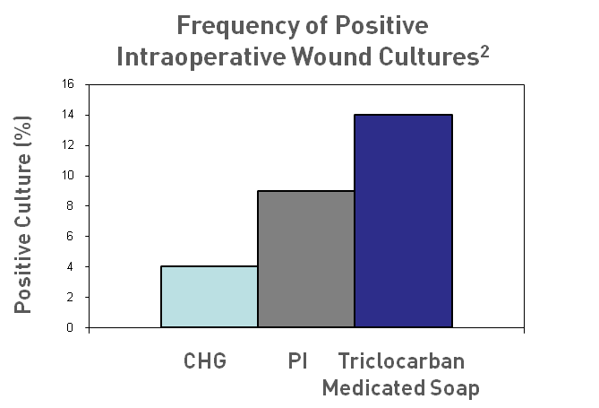
Chlorhexidine:
Preoperative Showers
CDC Recommends Preoperative Showering With Antiseptic¹
CHG More Effective Than PI And Triclocarban
1. Mangram AJ et al. Infect Control Hosp Epidemiol. 1999;20(4):250-278.
2. Garibaldi RA. J Hosp Infect. 1988;11(suppl B):5-9.
Notes:
86
The surgical site infection guidelines published by the Centers for Disease Control and Prevention recommend preoperative showering with chlorhexidine to reduce microbial colony counts on skin.¹ Studies demonstrate that chlorhexidine gluconate is more effective than povidone-iodine or triclocarban medicated soap and was associated with lower rates of intraoperative wound contamination.²
References
Mangram AJ, et al. Guideline for prevention of surgical site infection, 1999. Hospital Infection Control Practices Advisory Committee. Infect Control Hosp Epidemiol. 1999;20(4):250-278.
Garibaldi RA. Prevention of intraoperative wound contamination with chlorhexidine shower and scrub. J Hosp Infect. 1988;11(suppl B):5-9.

Slide 87
Preoperative Showers
Garibaldi R (J Hosp Infect 1988;11(suppl B):5
  Reduction in bacterial counts: Chlorhexidine 9-fold, povidone-iodine 1.3-fold
Cruse and Foord (Arch Surg 1973;107:206)
  Clean surgery
    SSI rate, no shower = 2.3%
    SSI rate, shower with soap = 2.1%
    SSI rate, shower with hexachlorophene = 1.3%

Slide 88
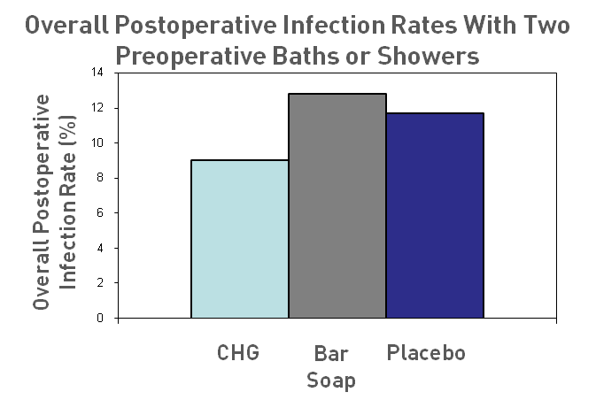
Chlorhexidine:
Preoperative Showers
Patients Who Had 2 Preoperative Showers with CHG 24 Hours Before Surgery Had Reduced Rates of Wound Infection Compared to Patients Who Showered with Soap
Hayek LJ, et al. J Hosp Infect. 1987;10(2):165-172.
Notes:
88
The effect of preoperative whole-body washing with chlorhexidine detergent on the incidence of postoperative wound infection was assessed in a placebo-controlled trial of 1989 patients. Patients bathed or showered with chlorhexidine, placebo, or conventional bar soap twice during the 24-hour period before surgery. The overall infection rate for patients treated with chlorhexidine was 9%, compared to 12.8% among patient who used bar soap and 11.7% among placebo patients.
Reference
Hayek LJ, Emerson JM, Gardner AM. A placebo-controlled trial of the effect of two preoperative baths or showers with chlorhexidine detergent on postoperative wound infection rates. J Hosp Infect. 1987;10(2):165-172.

Slide 89
Preoperative Antiseptic Skin Care
Recommend by CDC
Skin Colonization is Clearly↓
However The Evidence That SSIs are ↓ is weak;
A Cochrane Review Including Six Trials With 10,000 Participants Found No Evidence for the Superiority of Preoperative Bathing and Showering Versus Placebo

Slide 90
Hand Antisepsis

Slide 91
Surgical Hand Antisepsis
Surgical Hand Scrubs Should:
  Significantly Reduce Microorganisms On Intact Skin
  Contain a Non-irritating Antimicrobial Preparation
  Have Broad-spectrum Activity
  Be Fast-acting and Persistent

Slide 92
Alcohols
Advantages | Disadvantages
Broad spectrum Effective against: Most gram-positive Most gram-negative Fungi Viruses Rapid acting | Short persistence Potentially drying to skin Potentially flammable Spores may be resistant Not applicable for mucosal membranes
Larson EL.. Am J Infect Control. 1995;23(4):251-269.
Boyce JM, et al. MMWR Recomm Rep. 2002 Oct 25;51(RR-16):1-45.
Crosby CT, Mares AK. JVAD. 2001:1-6.
Notes:
92
Isopropyl and ethyl alcohols are most commonly used for skin antisepsis. Alcohol’s advantages for skin antisepsis include broad-spectrum activity against most gram-positive and gram-negative microorganisms and good activity against many fungi and viruses, rapid activity, and safety.¹⁻³
References
Larson EL. APIC guideline for handwashing and hand antisepsis in health care settings. Am J Infect Control. 1995;23(4):251-269.
Boyce JM, Pittet D; Healthcare Infection Control Practices Advisory Committee; HICPAC/SHEA/APIC/IDSA Hand Hygiene Task Force. Guideline for Hand Hygiene in Health-Care Settings. Recommendations of the Healthcare Infection Control Practices Advisory Committee and the HICPAC/SHEA/APIC/IDSA Hand Hygiene Task Force. Society for Healthcare Epidemiology of America/Association for Professionals in Infection Control/Infectious Diseases Society of America. MMWR Recomm Rep. 2002 Oct 25;51(RR-16):1-45.
Crosby CT, Mares AK. Skin antisepsis: past, present, and future. JVAD. 2001;1-6.

Slide 93
Iodine/Iodophors
Advantages | Disadvantages
Broad spectrum Effective against Most gram-positive Most gram-negative Fungi Viruses Some activity against spores | Diminished efficacy by organic material (e.g., blood) Variable persistence Irritates skin
Larson EL.. Am J Infect Control. 1995;23(4):251-269.
Boyce JM, et al. MMWR Recomm Rep. 2002 Oct 25;51(RR-16):1-45.
Crosby CT, Mares AK.. JVAD. 2001:1-6.
Notes:
93
Iodine and iodophors have a broad spectrum of activity. They are effective against most gram-positive and gram-negative microorganisms, fungi, and viruses and have some activity against spores.¹⁻³
The disadvantages of iodophors are that they are rapidly neutralized in the presence of organic material such as blood, their persistence varies, and they irritate skin.^{1,3}
References
Larson EL. APIC guideline for handwashing and hand antisepsis in health care settings. Am J Infect Control. 1995;23(4):251-269.
Boyce JM, Pittet D; Healthcare Infection Control Practices Advisory Committee; HICPAC/SHEA/APIC/IDSA Hand Hygiene Task Force. Guideline for Hand Hygiene in Health-Care Settings. Recommendations of the Healthcare Infection Control Practices Advisory Committee and the HICPAC/SHEA/APIC/IDSA Hand Hygiene Task Force. Society for Healthcare Epidemiology of America/Association for Professionals in Infection Control/Infectious Diseases Society of America. MMWR Recomm Rep. 2002 Oct 25;51(RR-16):1-45.
Crosby CT, Mares AK. Skin antisepsis: past, present, and future. JVAD. 2001:1-6.

Slide 94
Chlorhexidine
Advantages | Disadvantages
Broad spectrum Effective against Most gram-positive Most gram-negative Fungi Viruses Yeast Highly persistent Effective in the presence of organic material (e.g., blood) Minimally absorbed | Direct instillation can damage ears or eyes Direct contact with nerve tissue can be damaging Minimal activity against spores
Notes:
94
Chlorhexidine provides several advantages. It has broad-spectrum activity against most gram-positive and gram-negative microorganisms, fungi, yeast, and viruses; it is highly persistent; it is effective in the presence of organic material; and it’s minimally absorbed.¹⁻⁴
Disadvantages of chlorhexidine are that concentrations of 1% or higher can damage ear or eye tissue when directly instilled. Additionally, there is minimal activity against spores.^{5,6}
References
Larson EL. APIC guideline for handwashing and hand antisepsis in health care settings. Am J Infect Control. 1995;23(4):251-269.
Hidalgo E, Dominguez C. Mechanisms underlying chlorhexidine-induced cytotoxicity. Toxicol In Vitro. 2001;15(4-5):271-276.
Maki DG, Ringer M, Alvarado CJ. Prospective randomised trial of povidone-iodine, alcohol, and chlorhexidine for prevention of infection associated with central venous and arterial catheters. Lancet. 1991;338(8763):339-343.
Larson E, Bobo L, Bennett R et al. Lack of care giver hand contamination with endemic bacterial pathogens in a nursing home. Am J Infect Control. 1992 Feb;20(1):11-5.
Boyce JM, Pittet D; Healthcare Infection Control Practices Advisory Committee; HICPAC/SHEA/APIC/IDSA Hand Hygiene Task Force. Guideline for Hand Hygiene in Health-Care Settings. Recommendations of the Healthcare Infection Control Practices Advisory Committee and the HICPAC/SHEA/APIC/IDSA Hand Hygiene Task Force. Society for Healthcare Epidemiology of America/Association for Professionals in Infection Control/Infectious Diseases Society of America. MMWR Recomm Rep. 2002 Oct 25;51(RR-16):1-45.
Anders N, Wollensak J. Inadvertent use of chlorhexidine instead of balanced salt solution for intraocular irrigation. J Cataract Refract Surg. 1997;23(6):959-962.
Perez R, Freeman S, Sohmer H, Sichel JY. Vestibular and cochlear ototoxicity of topical antiseptics assessed by evoked potentials. Laryngoscope. 2000;110(9):1522-1527.

Slide 95
Combined Agents
Active Agents | Tincture of Iodine | Traditional Iodophors | CHG/ Alcohol
Broad Spectrum | X | X | X
Rapid Activity | X | X | X
Residual Activity |  |  | X
Activity in Blood/Organic |  |  | X
Non-Irritating |  |  | X
Minimal Absorption |  |  | X
Notes:
95
The combination of chlorhexidine gluconate and alcohol meets all of the criteria for an ideal antiseptic solution.

Slide 96
Summary: Surgical Hand Antisepsis
Formulations Containing 60-90% Alcohol Alone, or 50-95% When Combined CHG Lower Bacterial Counts on Skin Post-scrub More Effectively Than Other Agents
Next Most Active Agents (In Order Of Decreasing Activity) Are CHG, Iodophors, Triclosan, And Plain Soap
Alcohol-based Preparations Containing 0.5-1% CHG Have Persistent Activity But Alcohol Alone May Not

Slide 97
Antibiotic Prophylaxis

Slide 98
Antibiotic Prophylaxis
The Patient’s Need: ↓ Infection Rate
Society’s Need:
↓ Cost
↓ Bacterial Resistance

Slide 99
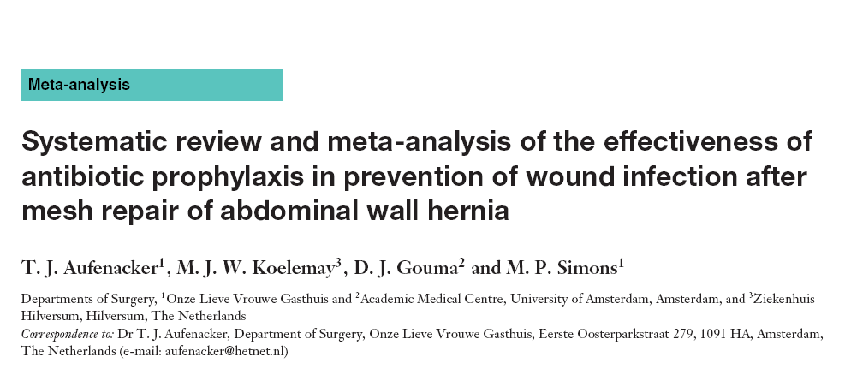

Slide 100
Randomized Placebo-controlled Trials of Antibiotic Prophylaxis In Abdominal Wall Mesh Hernia Repair
Only 2 Relevant Trials for Umbilical, Incisional or Laparoscopic
Results:
  Infection Rate Significantly Higher After Incisional Compared to Inguinal Hernia Repair
  Insufficient Data to Draw Conclusion about the Value of Prophylaxis

Slide 101
Conclusion
In the Absence of Objective Data, Antibiotics are the Standard of Care
  Larger Wounds
  More Extensive Dissection
  Greater Likelihood of Enterotomy
  Higher Risk of Seroma And Hematoma
  Need For Surgical Drains

Slide 102
Operative Skin Preparation

Slide 103
No Shaving of Hair
  Do Not Remove Hair Preoperatively Unless it Will Interfere With the Operation
  If Hair Removed, Remove Just Prior to Surgery with Electric Clippers
  Wash and Clean Incision Site Prior to Performing Antiseptic Skin Preparation

Slide 104
Preoperative Hair Removal
Cruse and Foord (Arch Surg 1973;107:206)
  SSI rate, razor-shave = 2.5%
  Manual hair clipped = 1.7%
  Electric hair clipper = 1.4%
  No shave or clip = 0.9%

Slide 105

Original Article
Chlorhexidine-Alcohol versus Povidone-Iodine for Surgical-Site Antisepsis
Rabih O. Darouiche, M.D., Matthew J. Wall, Jr., M.D., Kamal M.F. Itani, M.D., Mary F. Otterson, M.D., Alexandra L. Webb, M.D., Matthew M. Carrick, M.D., Harold J. Miller, M.D., Samir S. Awad, M.D., Cynthia T. Crosby, B.S., Michael C. Mosier, Ph.D., Atef AlSharif, M.D., and David H. Berger, M.D.
N Engl J Med
Volume 362(1):18-26
January 7, 2010

Slide 106
Wound Classification

Slide 107
Study Overview
Premise: The Skin is a Source of Infection Associated With Surgery
Multicenter, Randomized Trial
Clean-Contaminated Surgery
Results: Preoperative Application Of Chlorhexidine-alcohol Was Found To Be A More Effective Povidone-iodine For Preventing Incisional Infections

Slide 108
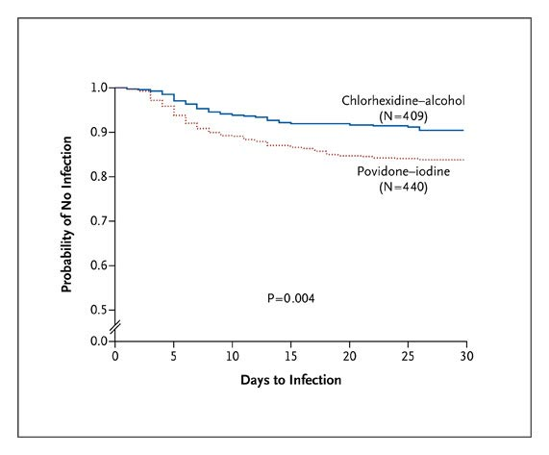
Kaplan-Meier Curves for Freedom from Surgical-Site Infection (Intention-to-Treat Population)
Darouiche RO et al. N Engl J Med 2010;362:18-26
Notes:
Figure 2. Kaplan-Meier Curves for Freedom from Surgical-Site Infection (Intention-to-Treat Population). Patients who received chlorhexidine-alcohol were significantly more likely to remain free from surgical-site infection than were those who received povidone-iodine (P=0.004 by the log-rank test). In the chlorhexidine-alcohol group, 39 patients had events (9.5%) and data from 370 patients (90.5%) were censored; in the povidone-iodine group, 71 patients had events (16.1%) and data from 369 patients (83.9%) were censored.

Slide 109
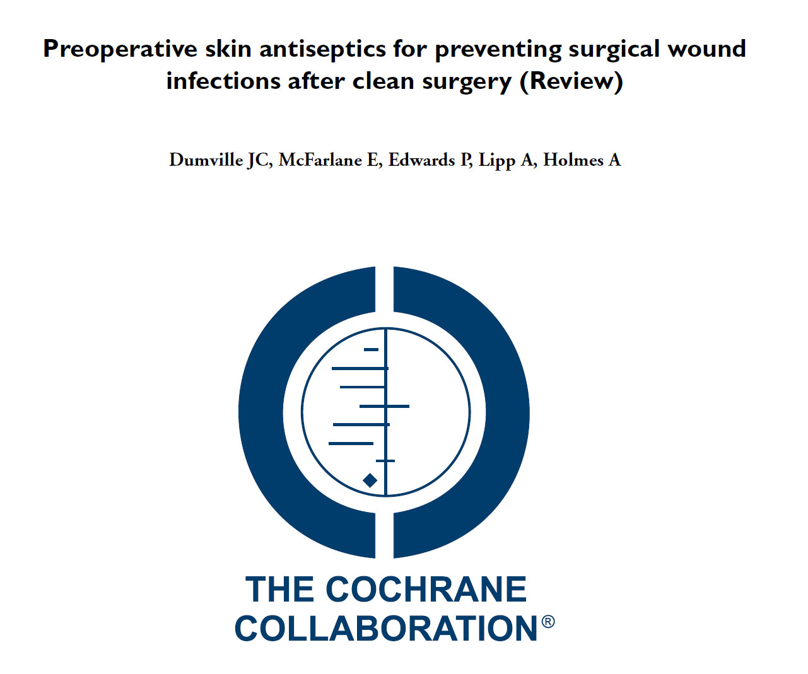
Cochrane Database Syst Rev. 2013 Mar 28;3:CD003949

Slide 110
Preoperative Skin Antiseptics for Preventing Surgical Wound Infections After Clean Surgery (Review)
Thirteen Studies / 2,623 Participants
Many Different Products Evaluated Resulting In 11 Comparisons
4% Chlorhexidine Scrub In 70% Alcohol Best
Overall Alcohol-based Solutions Better Than Aqueous-based
Chlorhexidine More Expensive

Slide 111
Conduct of the Surgery

Slide 112
Surgical Technique
Handle Tissue Gently
Maintain Effective Hemostasis
Minimize Devitalized Tissue
Minimize Foreign Bodies
Eradicate Dead Space
Active Surveillance with Feedback

Slide 113
Surgical Technique
Leave Wound Open or Delayed Primary Closure in the Face of Heavy Contamination
Surgical Drains
  Closed Suction
  Do Not Bring Out Trough the Wound
  Remove as Soon as Possible

Slide 114
Intraoperative Considerations
Surgical Gowns and Drapes That are Effective Barriers When Wet
Change Surgical Scrubs When Visibly Soiled, Contaminated and/or Penetrated by Blood
Avoidance of Intraoperative Hypothermia
Avoidance of Intraoperative Hyperglycemia

Slide 115
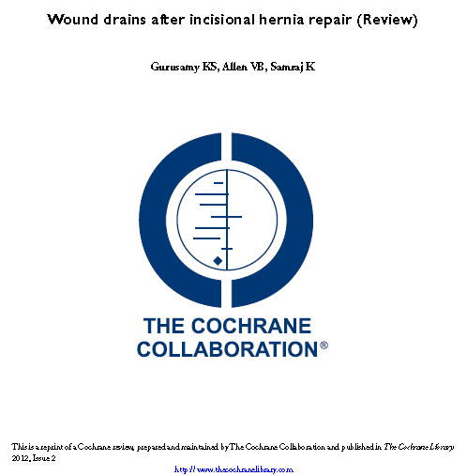
Surgical Drains

Slide 116
Authors’ Conclusions
“There is Insufficient Evidence to Determine Whether Wound Drains After Incisional Hernia Repair are Associated With Better or Worse
Outcomes Than No Drains”
Cochrane Database Syst Rev. 2012 Feb 15;2:CD005570. Review.

Slide 117
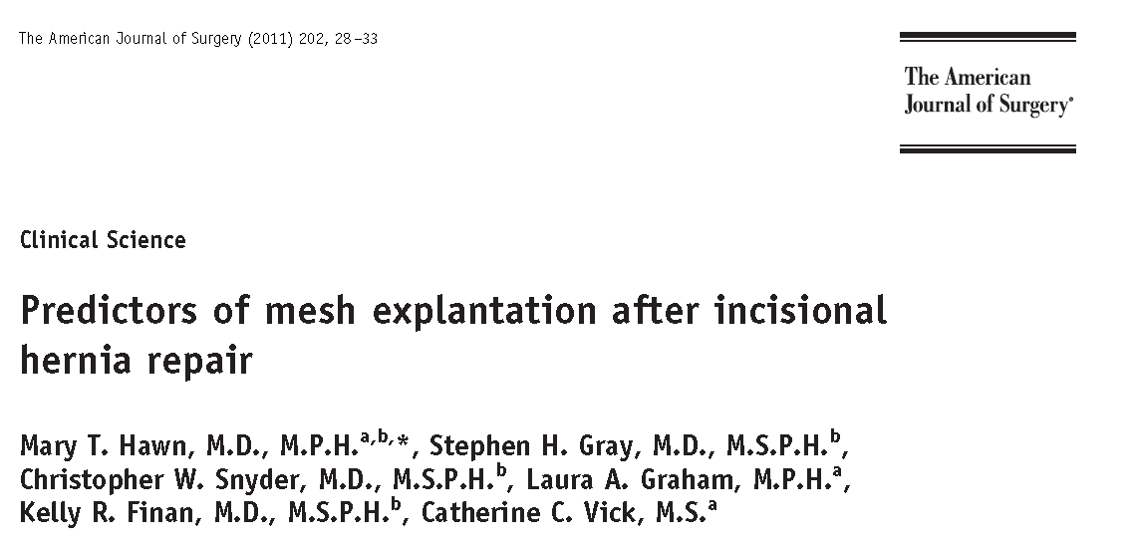

Slide 118
Conclusion
Same-site Concomitant Surgery and Postoperative Surgical Site Infection Were Associated With Mesh Explantation
Patients Undergoing Incisional Hernia Repair With Concomitant Intra-abdominal Procedures Have a Greater Than 6-fold Increased Rate of Subsequent Mesh Explantation
Permanent Prosthetic Mesh Should be Used With Caution in This Setting
The American Journal of Surgery (2011) 202, 28–33

Slide 119
Supplemental O2
Hyperoxia and infection. Hopf HW, Holm J. BestPract Res Clin Anaesthesiol. 2008 Sep;22(3):553-69
Rationale: ↑Oxygen Partial Pressure (Tension) In Surgical Wounds and Enhance Oxidative Killing of Leukocytes
Once Perfusion is Assured, Addition of Increased Inspired Oxygen Substantially Reduces Surgical Site Infection in at Risk Patients

Slide 120
Strategies With Limited Data
Double-gloving or Glove-changing
  A Cochrane Review of 26 Trials Conducted Double Gloving Was Inconclusive In Terms Of SSI Reduction
Use of Adhesive Drapes
Use of Iodine-impregnated Occlusive Skin Barriers
Ear and Neck Caps
Laminar Airflow
Staples Vs Sutures

Slide 121
Conclusions
Surgical Site Infections Result in Significant Patient Morbidity and Mortality and Increased Hospital Cost for Abdominal Wall Reconstruction
Reduction in the Incidence Can Be Achieved By Strict Adherence to Standard Surgical Guidelines
Observations Have Revealed Failure To Follow Standard Guidelines
Strict Adherence To Standard Guidelines Crucial

Slide 122
Infection: The Achilles Heel of
Abdominal Wall Reconstruction
Robert J. Fitzgibbons MD, FACS
Harry E. Stuckenhoff Professor of Surgery
Creighton University School of Medicine
Omaha, Nebraska
Notes:
1
1
1
1
1
1

