Slide 1
Hyperinsulinism and the Surgeon
Clive Grant
Mayo Clinic

Slide 2
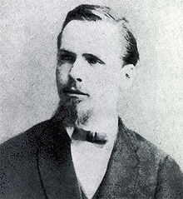
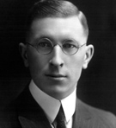
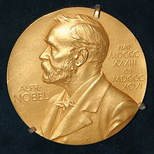
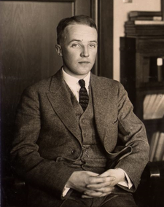
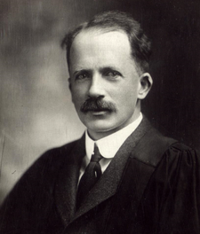
“These cells lie together generally in considerable numbers scattered diffusely in the parenchyma of the gland…I must refrain from making any hypothesis to the nature and significance of our cells.”
Paul Langerhans, 1869
Frederick Banting
Nobel Prize
Medicine, 1923
Charles Best
JJR Macleod

Slide 3
Insulinoma Evolution History
1924 Seale Harris, Birmingham, AL: 5 pts spontaneous hypoglycemia
1927 Russel Wilder, William Mayo: 1st pt (surgeon) with insulinoma
1929 Roscoe Graham: 1st successful removal insulinoma
1935 Allen Whipple: 62 pts islet cell tumors; 32 with hypoglycemia
1938 Whipple: Triad

Slide 4
Insulinoma Evolution History
1950 Jonathan Rhoads, Philadelphia
400 cases reviewed
90% benign
13% multiple
2.5% ectopic
9% op mortality
1/3 not found at operation
20% tumor never found

Slide 5
Insulinoma Early Angiography
1966, 1973 University of Michigan
38% identified
1975 Mayo Clinic
24 pts
21/24 (87%) positive angio
12/24 (50%) benign, pancreatic, preop

Slide 6
Insulinoma Localization 1970s: State of Art, Consequences
Stefanini, 1974
1,067 cases
24% unsuccessful 1st operations—inadequate localization
Recommendation: Sequential resection pancreas, L → R; frozen section pathology, intraop glucose monitoring; proceed to ~ 90% resection

Slide 7
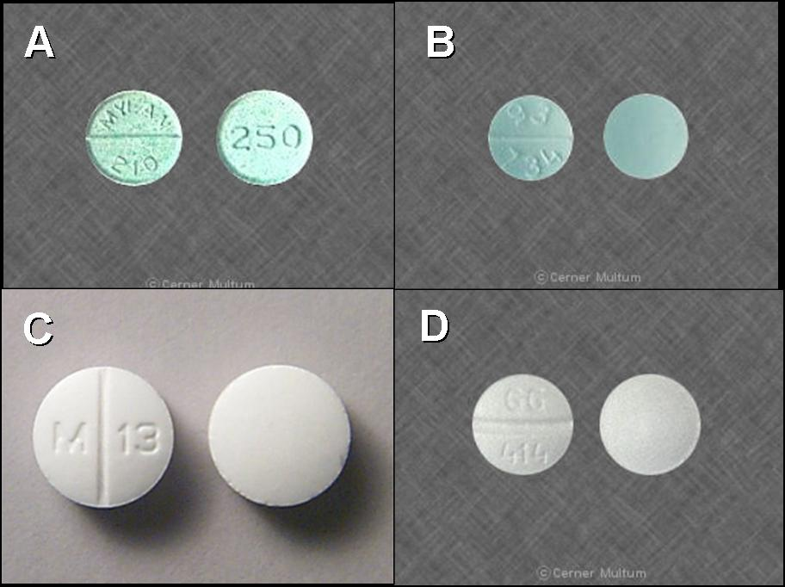
Classification of Hypoglycemia In Adults
Diseases
Insulinoma
Factitial
Exogenous insulin
Sulfonylurea*
Insulin autoimmune
Noninsulinoma pancreatogenous hypoglycemia syndrome
*Most common—inadvertent medication error
Notes:
A. Chlorpropamide (Tolinase™); used in type 2 diabetics to stimulate insulin release from the pancreas to lower blood sugar
B. Metoprolol (Lopressor™) 100 mg tablet, used for blood pressure regulation
C. Tolbutamide (Orinase™), used in type 2 diabetics to stimulate insulin release from the pancreas to lower blood sugar.
D. Metoprolol (Lopressor™) 50 mg tablet, used for blood pressure regulation

Slide 8
Hyperinsulinism
Multiple Subtypes
Insulinoma, sporadic, single
Insulinoma, sporadic, multiple
Insulinoma, MEN-1
Insulinoma, cancer
Noninsulinoma Pancreatogenous Hyperglycemia Syndrome
Roux-Y gastric bypass
Prior gastric, vagal surgery
De novo

Slide 9
Insulinoma Incidence--Implications
Most common islet cell tumor
Four cases per 1 million person-years
Few institutions with ≥10 cases/yr
“Learning curve” implications

Slide 10
Insulinoma Whipple’s Triad
Sxs of
Hypoglycemia
Glucose < 50 mg/dl
Relief of Sxs
with Glucose
Administration
Dx

Slide 11
Insulinoma Symptoms: 2 Classes
CNS Dysfunction
Neuroglycopenia
Glucose < 50 mg/dL
Neuroglycopenia
Symptoms
Autonomic
Sweating, ↑ pulse
Glucose < 55 mg/dL

Slide 12
INSULINOMA Clinical Presentation
Visual disturbances
Palpitations
Sweating
Profound weakness
85%
Confusion
Abnormal behavior
80%
Amnesia
Coma
53%
Seizures
12%

Slide 13
Insulinoma Diagnosis
Glucose < 50 mg/dl
Dx
Insulin ≥ 3 μU/ml
C-peptide ≥ 0.2 nmol/l
Sulfonylurea neg

Slide 14
Duration Until Positive Fast 170 Patients
Supervised Fast
Hours %
≤12 33
≤24 65
≤36 84
≤48 93
≤72 99

Slide 15
Insulinoma Localization
“Ideal Method”
Accurate
Simple
Independent of operator expertise
Safe
Non-invasive
Inexpensive
Preoperative

Slide 16
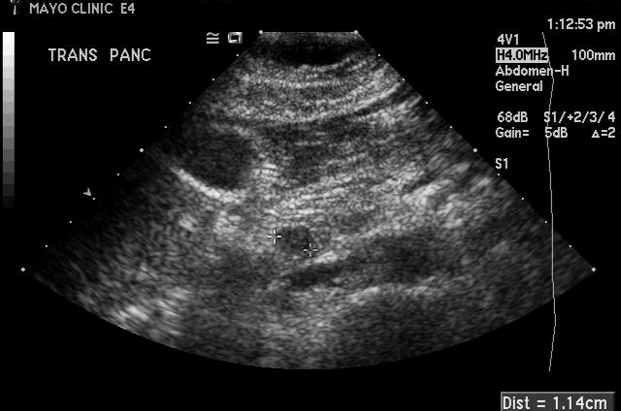
Localization: Transabdominal US
Insulinoma
IVC

Slide 17
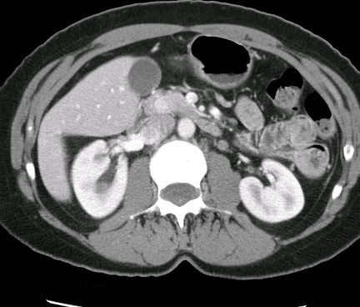
Case CT: Head Pancreas

Slide 18
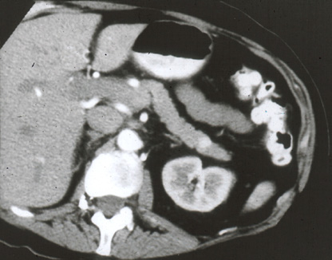
Spiral CT Body Pancreas
Spiral (helical) CT with triple-phase contrast
demonstrating islet cell tumor in pancreatic tail

Slide 19
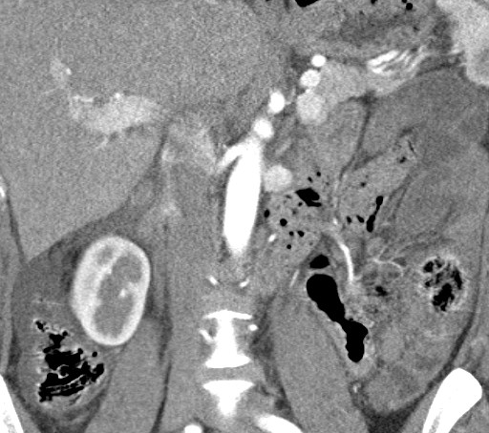
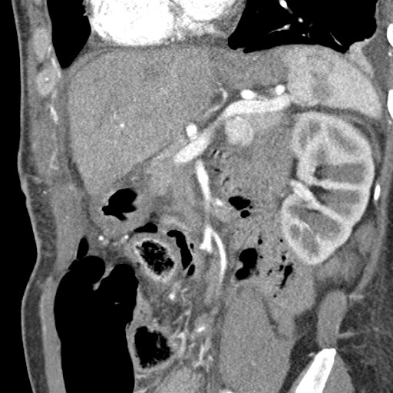
Imaging: Computed Tomography
Coronal
Sagittal

Slide 20
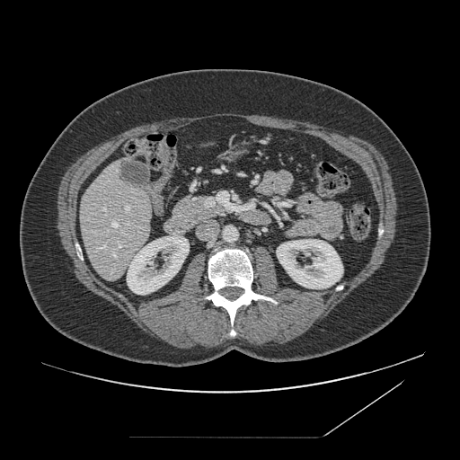
Localization: Triple Phase CT

Slide 21
Localization: Endoscopic US
Islet cell tumor (hypoechoic) body of pancreas
-- endoscopic ultrasound
Notes:
Juday, Krista:
5-413-670
12/13/00
MEN-I syndrome
Non-functioning pancreatic tumors

Slide 22
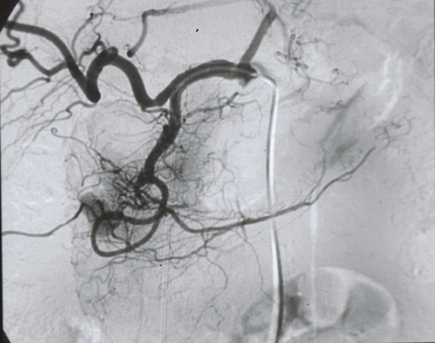
Localization: Angiography
Angiographic blush on GDA injection during Calcium Stimulation Test

Slide 23
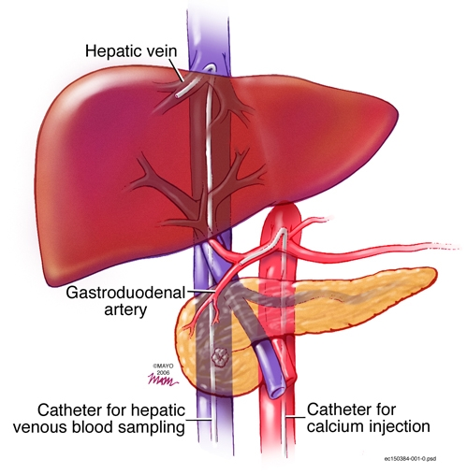
Localization: SACS

Slide 24
SACS: + Head of Pancreas
GDA
Right hepatic vein insulin as a multiple of basal
4x
3x
2x
1x
SMA
Splenic
30
60
90
30
60
90
30
60
90
Seconds

Slide 25
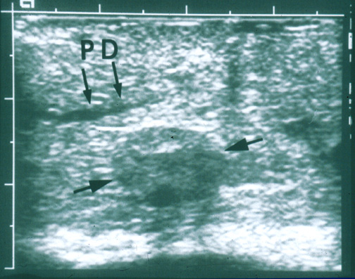
IOUS: Anatomy
Hypoechoic islet cell tumor 3 mm away from main PD, demonstrated by IOUS

Slide 26
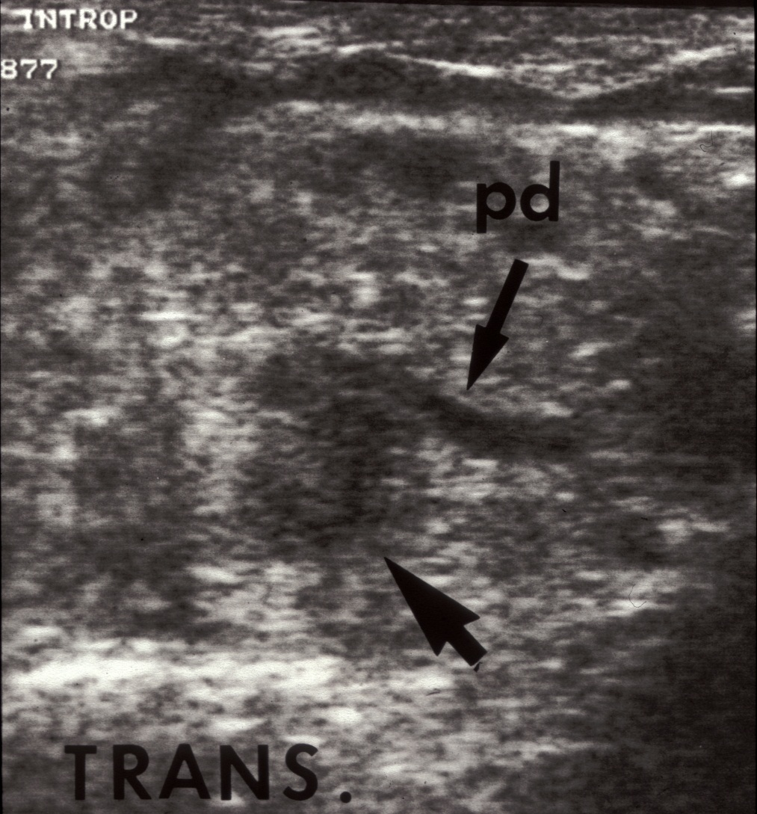
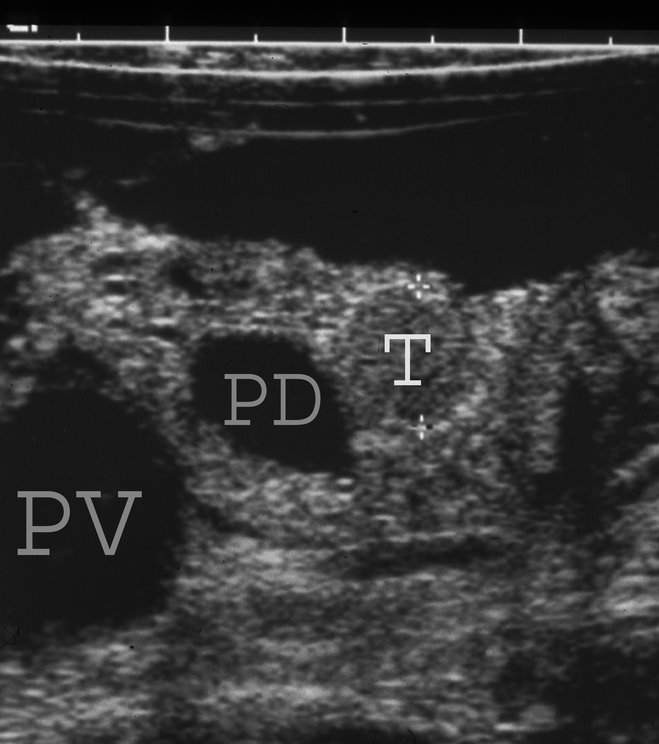
IOUS Localization, Anatomy

Slide 27
Insulinoma Intraoperative Management
Glucose Monitoring
Admission preoperative night
10% glucose IV overnight
D/C glucose on call to OR
Allow serum glucose to drop: ~ 40-50 mg/dL
Rebound hyperglycemia following excision of islet cell tumor

Slide 28
Insulinoma Operative Management
Surgical Technique
Generous incision
Assess for metastases
Expose, mobilize pancreas
IOUS
Localize tumor
Define anatomy--pancreatic duct
Enucleate, resect (esp if cancer)
NO blind distal resection

Slide 30
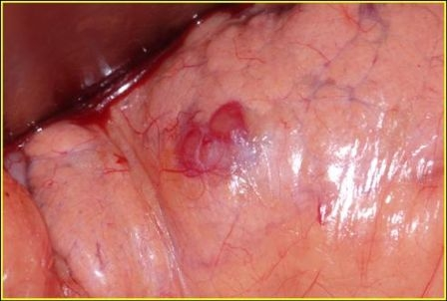
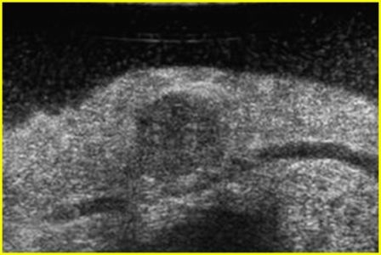
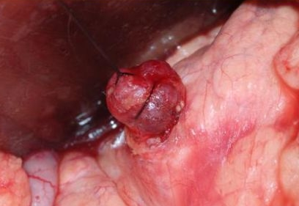
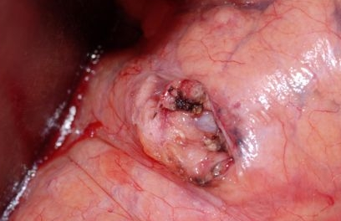
Insulinoma Enucleation

Slide 31
Mayo Clinic Hypoglycemia Totals: 420 Pts, 425 ops, 1982–12/12
MEN Syndrome 19
Insulinoma
Nesidioblastosis
Sporadic
406
93
Reoperation 33
332
Primary Op
392

Slide 32
Sporadic, Initial Operation Mayo: 1982-12/2012
291 patients
Age: 52 (range 12-86)
119
41%
171
59%

Slide 33
Insulinoma--Mayo Series Tumor Size
57%
pts
cm

Slide 34
Insulinoma Mayo Localization: Sensitivity

Slide 35
Insulinoma Mayo Localization: Pos Pred Value

Slide 36
Insulinoma Location in Pancreas (%)
8.6% non-palpable
29
24
8
27
10 uncinate

Slide 37
Insulinoma Surgical Procedures--Open
6
80
185

Slide 38
Insulinoma Surgical Procedures—Lap (12)
Whipple
Distal Resection
Enucleation
Conversions: 4

Slide 39
Insulinoma Outcome
Cured: 287/291 (99%)
Excluding NIPH, reoperative, MEN patients
Not Cured: 1 each
Multiple tumor X2—cured with reop POD 3
Multiple tumors; non-MEN
Tumor not found
Wrong diagnosis

Slide 40
Insulinoma Operative Complications
Pancreas-Related
Non-Pancreas Related
Pancreatic
17.5%
Complications
None
91%
None
Laparoscopic
Pancreatic 50%
Non-Pancreatic 8%

Slide 41
Survival After Dx of Insulinoma Mayo Clinic Patients − 1927-1986
Survival (%)
Expected
Observed
Pt (no.)
(224) (186) (137) (89) (61) (45) (32) (23) (15) (4)
Yrs after diagnosis

Slide 42
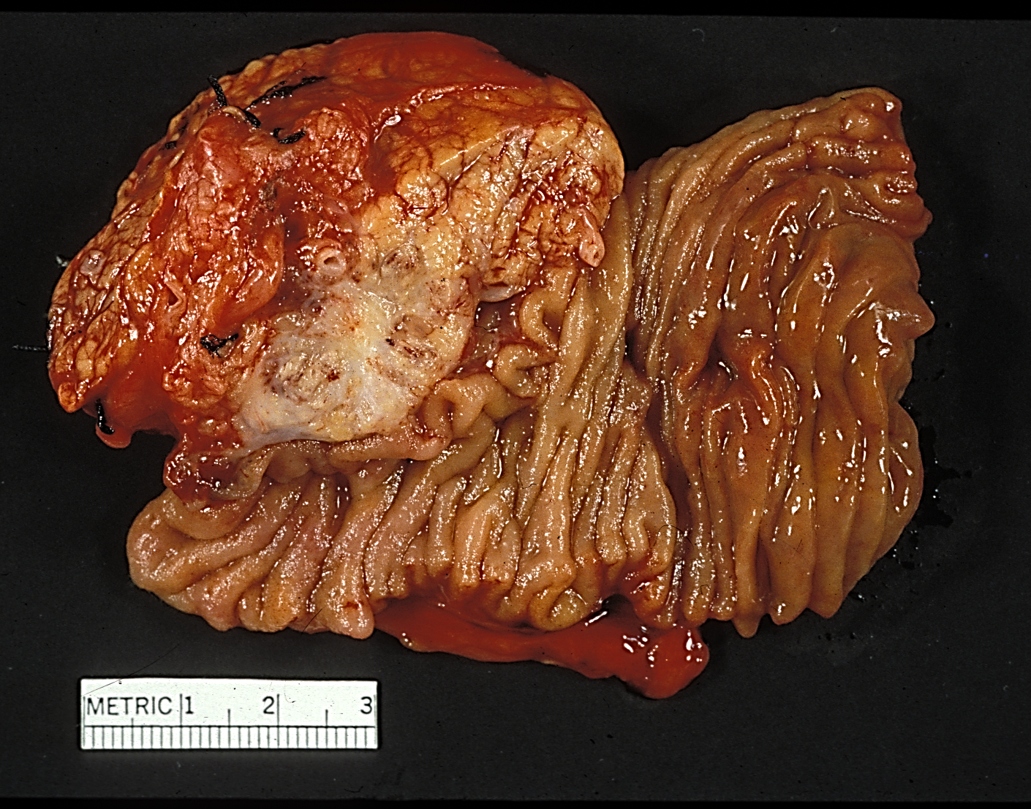
Islet Cell Carcinoma Head of Pancreas
Notes:
This tumor proved to be a malignant insulinoma, resected with a Whipple procedure. As with many other malignancies, in addition to traditional chemotherapy, targeted therapy has been introduced.

Slide 43
Survival After Dx of Insulinoma Mayo Clinic Patients − 1927-1986
Survival (%)
Benign
Malignant
Pt (no.)
Benign (211) (180) (134) (89) (61) (45) (32) (23) (15) (4)
Malignant (13) (6) (3)
Years after diagnosis of insulinoma

Slide 44
MEN 1: Insulinoma
Complex, multiple considerations
Multiplicity
Insulinomas (synchronous, metachronous?)
Associated PNETs
Malignancy
Insulinoma—rare
Assoc PNETs—eventually ↑ risk death
Curability—at least long-term DFS
Insulinoma—very good
Assoc PNETs, ZES—unpredictable, worrisome

Slide 45
MEN 1: Insulinoma
Considerations (2)
Medical treatment
New agents—incomplete benefit
Morbidity (median age 24; 80% ≤ 30 y/0)
Total pancreatectomy
Immediate consequences: juvenile onset diabetes, exocrine insufficiency
Diabetes—premature death
Many MEN 1 pts long-term surv even with PNETs

Slide 46
MEN 1: Insulinoma
Considerations (3)
Distal subtotal panc, enucl head PNETs
Preserves endocrine/exoc function (if nl pre-exist body habitus and not xs resection)
Leaves existing/evolving PNETs head of pancreas
Usual morbidity of pancreatic surgery
Individually tailored operation accounting for all of the complexities, unpredictability

Slide 47
Insulinoma Recent Technical Development
US-guided ethanol ablation*
8 pts reported; many more treated subsequently
Minor complications (bleed, pseudocyst) none req operation
EUS, US-directed intraoperatively
Tumor not disappeared as of yet
Secondary but valuable option now
*Levy. GI Endoscopy 75: 200-206, 2012

Slide 48
NIPHS Initial Report*
Noninsulinoma pancreatogenous hypoglycemia syndrome: An update in 10 surgically treated patients
Geoffrey B. Thompson, MD; F. John Service, MD, PhD; James C. Andrews, MD; Ricardo V. Lloyd, MD, PhD; Neena Natt, MD; Jon A. van Heerden, MD; Clive S. Grant, MD
Division of Gastroenterologic and General Surgery, Division of Endocrinology and Metabolism, Department of Radiology, and Department of Pathology, Mayo Clinic and Foundation, Rochester, Minnesota 55905
*Surgery 2000; 128:937-45.

Slide 49
Noninsulinoma Pancreatogenous Hypoglycemia Syndrome (NIPHS)
Features
Postprandial hyperinsulinemic hypoglycemia
Negative 72-hour fast—instead, use test meal with 3 hr glucose monitoring
Negative preop radiologic localization studies
Positive selective arterial calcium stimulation test
Relief of symptoms by gradient-guided partial pancreatectomy
Histology: islet hypertrophy and nesidioblastosis

Slide 50
Hyperinsulinemic Hypoglycemia with Nesidioblastosis after Gastric-Bypass Surgery
Geoffrey J. Service, Geoffrey B. Thompson, F. John Service, James C. Andrews, Maria L. Collazo-Clavell, Ricardo V. Lloyd
353(3): 249-54, July 21, 2005

Slide 51
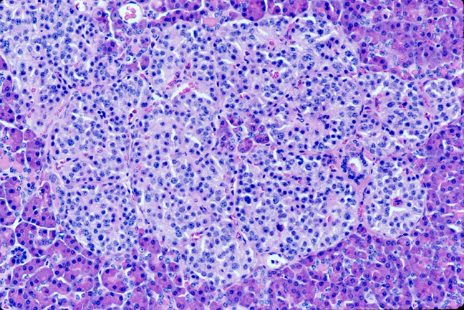
Hypertrophied Islet

Slide 52
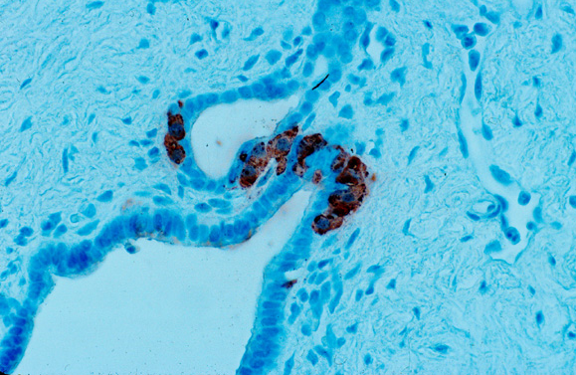
Nesidioblastosis

Slide 53
Glucagon-Like Peptide 1 (GLP-1)
Gastric Bypass—Theory of Mechanism
Rapid delivery of nutrients to distal ileum—L cells (source of GLP-1)
 GLP-1 secretion
Stimulates islet cell neogenesis and proliferation → ↑ islet cell mass
Inhibits apoptosis of β-cells

Slide 54
NIPHS Mayo Clinic
Total pts: 85
Age 46 (15-78 yrs)
23
27%
62
73%

Slide 55
NIPHS Surgical
Prior Operations
Gastric bypass 57
Other gastric, vagal 12
None 16
Operations for NIPHS
Distal panc 80
Whipple 2
Open/Close 1
GB reversal 1
Feeding tube 1

Slide 56
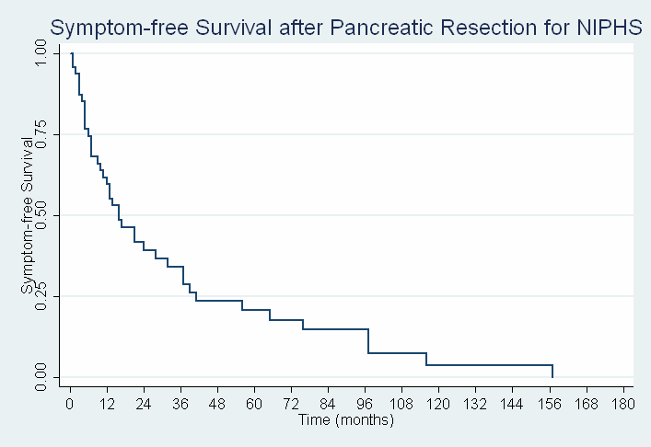
Symptom-Free Survival NIPHS
Median follow-up:
52 mo.
Median time
to relapse:
16 mo.
87% reported
recurrent
symptoms

Slide 57
Overall Surgical Success 4-Tier Assessment
Category | Criteria
I – High | Significant reduction in sx No long-term complications
II – Moderate | Moderate reduction in sx Few long-term complications
III – Minimal | Reduction in sx Significant complications
IV – Failure | No reduction of sx Overall worse quality of life Further surgery required
10 (21%)
13 (27%)
13 (27%)
12 (25%)

Slide 58
Endogenous Hyperinsulinism: Insulinoma
Positive Biochemical
Parameters
Fasting ↓ glu
US, Spiral CT, EUS
⊕ Study (85%)
 Study (15%)
To O.R. with IOUS
Enucleation vs Resection
See Next Slide

Slide 59
Endogenous Hyperinsulinism: Insulinoma
Negative Anatomic Localization
⊕ Biochemical Parameters
SACST
O.R. with IOUS
(cost-effective but anxiety-provoking)
O.R.

Slide 60
Insulinoma: Teamwork

Slide 61
Hyperinsulinism: Conclusions
Dx--Insulinoma
Think of it!--neuroglycopenia
Big 4: glucose, insulin, C-pep, Sulf screen
Imaging
US, CT, EUS, SACS – order of use
Operation
Head: enucleation
Body, tail: enucleation, distal pancreatectomy
Laparoscopic approach supplanting open

Slide 62
Hyperinsulinism: Conclusions (2)
Remaining Challenges
Insulinoma
Enhanced technology
Lap enucleation
Safe, secure, no-leak pancreatic resection
Malignancy
Continued drug innovation
NIPHS
Elucidation mechanism → evolve avoidance and/or improved treatment

