Slide 1

Papillary Thyroid Cancer:
Strategies for Optimal Individualized Surgical Management
Clive Grant
Mayo Clinic

Slide 2
Surgical Management Tx Cancer
Scope of the Topic

Slide 3
Thyroid Cancer Incidence and Mortality
1973-2002
Incidence
Rate/100,000
Mortality
JAMA 295:2166, 2006
Year

Slide 4
Trends: Incidence of Tx Cancer (73-02) in U.S.
All Thyroid Cancer
All
Papillary
Follicular
Poorly differentiated
Incidence rate/100,000
JAMA 295:2166, 2006
Year

Slide 5
Trends in Papillary Tumors by Size (88-02) in U.S.
Papillary Thyroid Cancer
0-1.0 cm
1.1-2.0 cm
2.1-5.0 cm
>5.0 cm
Incidence rate/100,000
JAMA 295:2166, 2006
Year

Slide 6
Papillary Thyroid Cancer per Year
Patients in United States, 1973-2006
>45 years old
New cases of papillary thyroid
cancer in the U.S. by age
<45 years old
Year

Slide 7
Papillary Thyroid Cancer per Year
Pts Age <45 in United States, 1988-2003
0.1-1.0 cm
1.1-2.0 cm
2.1-4.0 cm
>4.0 cm
New cases of papillary thyroid
cancer in the U.S. (no.)
Year

Slide 8
Papillary Thyroid Cancer per Year
Pts Age >45 in the United States, 1988-2003
0.1-1.0 cm
1.1-2.0 cm
2.1-4.0 cm
>4.0 cm
New cases of papillary thyroid
cancer in the U.S. (no.)
Year

Slide 9
Surgical Management
Papillary Thyroid Cancer
Guiding Principles
Notes:
Regarding the surgical management, let’s start with some guiding principles.
Next is Cady slide.

Slide 10
Surgical Management: PTC
Framing the Discussion
Tumor Biology According to Cady*
  Biology is King
  Patient selection is Queen
  Technical details of surgical procedures are the Princes and Princesses of the realm who frequently try to overthrow the powerful forces of the King and Queen, usually to no long-term avail, ...technical wizardry cannot overcome biological restraints.
Cady. Presidential address, NESS. Arch Surg 132:338, 1997
Notes:
One of the keenest insights into tumor biology including PTC, was delivered in a Presidential Address by Blake Cady. From slide…

Slide 11
ATA Guidelines
Overall Goals of Treatment
Cooper (’09)
  Remove tumor, met nodes, involved structures
  Minimize morbidity
  Staging ⇒ further management, F/U
  Facilitate RAI; later surveillance
  Minimize disease recurrence: local, DM
Notes:
The American Thyroid Association has enumerated multiple reasonable overall goals of treatment of PTC.

Slide 12
Initial Surgical Management: PTC
Surgical Goals of Therapy
ATA Guidelines (2009)*
  Tx Ca >1 cm → TTx or NTTx. Lobectomy OK for <1 cm if low risk, unifocal, intratx PTC w/ no nodes or prior radiation. (A)
  Therapeutic clearance of C-VI or lateral neck LNMs. (B)
  Prophylactic clearance of C-VI may be performed. (C)
  No C-VI may be approp T1-2 PTC. (C)
*These recs should be interpreted in light of available surgical expertise.
Notes:
(Emphasize levels of evidence as going through slide)

Slide 13
ATA Guidelines
Surgical Goals
Recommendation 15
  “To remove the primary tumor, disease that has extended beyond the thyroid capsule, and involved cervical lymph nodes. Completeness of surgical resection is an important determinant of outcome, while residual metastatic lymph nodes represent the most common site of disease persistence/recurrence.”
  “To minimize the risk of disease recurrence and metastatic spread. Adequate surgery is the most important treatment variable influencing prognosis,…”
Notes:
Just to emphasize the Surgical Goals, Recommendation 15 includes the following:…

Slide 14
Surgical Management: PTC
Why Any Controversy?
Discrepancies
  Extent of thyroidectomy (T >1 cm)
    TTx or NTTx accepted as standard (Western)
      Bilimoria (NCDB, 2007)
        Recurrence ↑(9.8% vs 7.7%), survival ↓ (97.1% vs 98.4%) with lobectomy
      Lobectomy ≡ TTx in unilat T1-2 N0*#
*MSKCC, Mayo, Lahey publications
#Abdelgadir. Ann Surg 2014; 260:601-7
Notes:
NT and TTx are accepted as standard treatment for PTC >1cm in the Western world. This is based at least in part on a study published in 2007 by Bilimoria based on the NCDB database, which showed recurrence was slightly but statistically higher and survival slightly lower in lobectomy patients vs. bilateral resection. However, lobectomy as been shown to be equivalent in survival in T1-2 N0 patients in publications from Memorial, Lahey, and our institution. In fact, this was a major point of surgical debate for nearly 3 decades—I’m not sure we settled it—maybe we just wore out talking about it.

Slide 15
Surgical Management: PTC
Current Hot Topic: Lymph Nodes!
Lymph Node Metastasis (LNM)
  No level I evidence available
  LNM behavior mirrors the virulence of the primary tumor
  If LNs are + ⇒ LN dissection intended to:
    Prevent further dissemination (Koo, ’09)
    Prevent local complications
    “All endocrine surgeons agree—compartment oriented therapeutic dissection” (Udelsman)

Slide 16
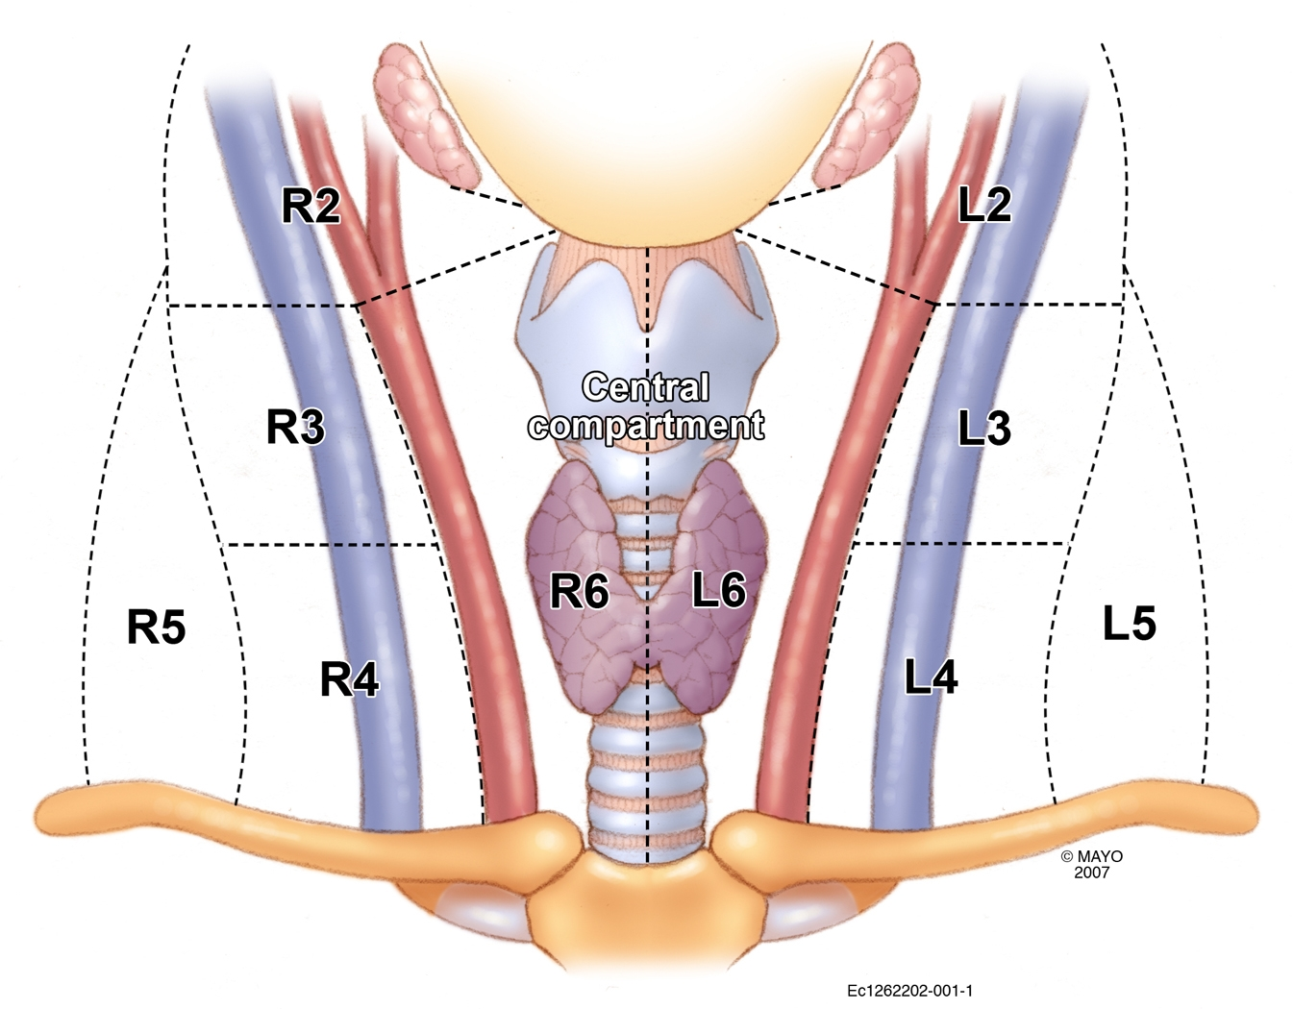
Compartments of Neck

Slide 17
PTC: Rationale for C-VI Dissection
Sequential Logic (1)
  Shift emphasis: survival → recurrence
  “Recurrence”: >90% LNMs (persistence)
  LNMs common, initially C-VI
  US markedly limited in detecting LNMs in C-VI prior to initial operation
  Surgeons poor distinguishing benign from malignant LNs

Slide 18
PTC: Rationale for C-VI Dissection
Sequential Logic (2)
  When relapse occurs, 50% in C-VI
  Investigation for relapse—small volume
    US sensitive to ≤ 3 mm
    Tg ≥ 2 prompts further investigation
  Relapse detected → intervention
    Risk
    Angst
    Cost

Slide 19
PTC: Rationale for C-VI Dissection
Sequential Logic (3)
  Known: not all LNMs progress
  Unknown: size/virulence thresholds for LNMs to progress to relapse*
  Principal alterable strategy—completeness of surgery
*Randolph et al. Thyroid 22:1144, 2012
  Micro: 0.2 – 2 mm
  Small: 2 mm – 1 cm

Slide 20
Surgical Management: PTC
Factors to Consider: LNMs in PTC
  PTC LNMs: frequency vs recurrence
  Value of prophylactic C-VI dissection
  Related risk of death
  Efficacy/limitations of RAI
  Safety/value of C-VI dissection

Slide 21
Lymph Node Metastases
Papillary Thyroid Cancer
LN Spread
Patterns, Frequency

Slide 22
PTC LNMs
Frequency of Spread
Noguchi*
  57 pts systematic node dissection
    90% LNMs
    57% of mets, <3 mm
    Initial mets VI, later III-IV
    80% LNMs misjudged to be neg by surgeon
    In 300 pts subsequently, no diss, no recurrence
*Cancer 20: 1053-1060, 1970; SCNA 67:251-261, 1987

Slide 23
MSKCC PTC: Recurrence
Tuttle (’10); 588 pts; TTx, LN Diss, RRA
Structural % | ↑Tg % | Total %
3 | 11 | 14
21 | 22 | 43
68 | 18 | 86
Freq %
∼25
50
∼25
Risk Rec Classification
Low: No local or DM, invasion, agg histo; R0 resection; no 131I outside Tx bed
Intermediate: Microinv, 131I or LNM outside Tx bed; agg histo; vasc inv
High: Macroinv, incom resect—gross residual, DM

Slide 24
MSKCC PTC: Recurrence
Tuttle: Overall Results
After Addn’l Rx → Final F/U (median 7 yrs)
  NED: 67%
  Persist/rec#: 28%
  DOD 5%*
#True LR only 1-2%
*26/28 pts initially stage IV

Slide 25
Surgical Management: PTC
Ambiguities/Contradictions of LNMs in PTC
  PTC LNMs: frequency vs recurrence
  Value of prophylactic C-VI dissection
  Related risk of death
  Value/limitations of RAI
  Safety/value of C-VI dissection

Slide 26
PTC
OS, DFS, DDFS?
New Millennium Goal
  Eradicate all biochemically or structurally detectable disease
New Measures
  Imaging—down to mm size (usually negative until stim Tg ≥ 4 ng/mL)
  Tg
    With stimulation, further investigation at 2 ng/mL
Notes:
From slide…
(Then) The national medical cost to manage thyroid cancer with these goals and measures of surveillance is outside the scope of this presentation, but let me diverge for just 1 slide…

Slide 27
PTC
Economic Burden
Medical Bankruptcy*
  232,000 cancer cases
  Adults >20 yrs; 1995-2009
  Conditional probability, 5 years
    Lung 7.7%
    Thyroid 4.8%
    All Ca 2.1%
*Ramsey et al. J Clin Oncol, 2011. ASCO Meeting. 29:No 15 suppl 2011:6007
Notes:
A recent publication assessed the economic burden of cancer in terms of medical bankruptcy. Of 232,000 cancer cases over a recent 15 year period, thyroid cancer was 2nd only to lung cancer in the probability of medical bankruptcy. So the investigations and interventions that we consider and implement can have a major economic impact on our patients.

Slide 28
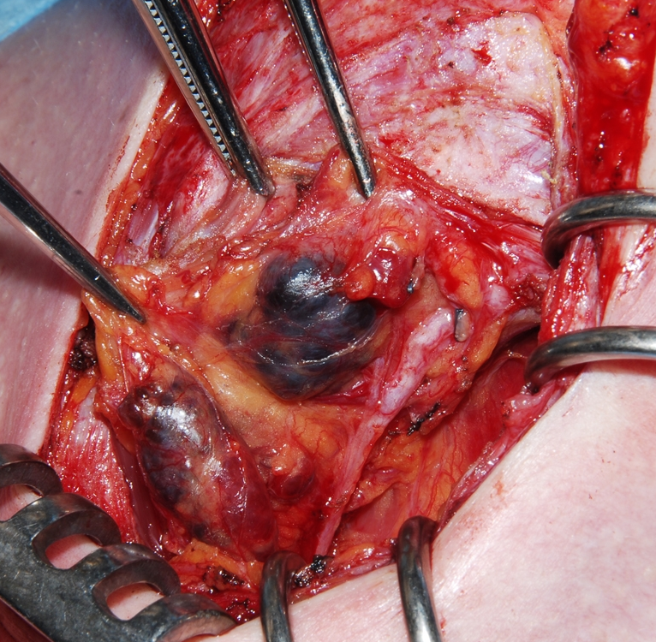
Surgical Response
Compartment VI Lymph Nodes
Surgeon is Responsible
  Preoperative US is nearly blind for LNMs in C-VI at initial operation
  Surgeons cannot reliably distinguish benign from positive LNMs
  LNMs occur in 50+%
  Missed LNMs typically along RLN in TEG-most dangerous at reoperation
Notes:
Now, back to the impact of the new goals and measures of PTC.
Our response as surgeons regarding compartment VI was that we should be responsible for the nodes.
Preop US has been nearly blind for LNMs in C-VI at the initial operation.
Surgeons are relatively ineffective at discriminating benign from malignant central neck lymph nodes.
This is a reoperative case. The patient had undergone TTx and a left modified radical neck dissection, so the surgeon obviously was aware and took action for the lateral neck nodes.
Were these nodes inapparent at the 1st operation? I don’t think so. There is a difference between inapparent and ignoring.

Slide 29
Compartment VI LNMs
Surgeon Response (cont’d)
Arguments Favoring Dissection
  Reduces relapse/reoperation in era of highly sensitive Tg, US
  Can be done safely…….
  Staging ⇒ additional Rx
  RAI unreliably effective at “cleaning up”

Slide 30
CLND: Safety, Efficacy
Surrogate Endpoint: Tg
Sywak et al*
  Retrospective, 447 pts, clinically LN neg
    T size, MACIS scores, morbidity, RAI equivalent
    TTx, ipsilat CLND: 56
    TTx alone: 391
  Tg with CLND vs TTx alone
    Lower Tg with CLND (p = 0.02)
    Undetectable Tg: CLND, 72%; TTx, 43%
*Sywak et al. Surgery 140:1000, 2006
Notes:
From slide
(Then) This is from a highly respected surgical group, worldwide. They demonstrated an increase in undetectable Tg level with the addition of CLND. But equally important is the converse, that detectable Tg was found in more than 50% of patients without CLND which would stimulate further investigation and perhaps intervention.

Slide 31
C-VI Recurrence-Free Survival
Multi-Institutional Study (n=606)
TTx, CLND (n=259)
TTx only (n=347)
P<0.05
T >1cm; cN0; retrospective; 98% RAI
Stim Tg lower with TTx, CLND
Any recurrence:
TTx 27%
TTx, CLND 20%
Analysis time (months)

Slide 32
Disease-Specific Survival (n=640)
TTx, CLND
TTx only
Survival probability
P=0.034
T >1cm; cN0; 48% RAI
Tg lower with TTx, CLND
Any recurrence:
TTx 13%
TTx, CLND 4%
Time after surgery (years)
No. at risk
TT 282 280 275 269 263 258 248 245 240 236 233
TT+CND 358 355 350 344 339 334 331 328 326 322 320

Slide 33
Rate C-VI Reoperation
After Initial Surgery (n=246)
T >1cm; cN0; 100% RAI
Lower with TTx, CLND:
Tg
Overall reintervention
P=0.0005
TTx
TTx, CLND
Years
At risk
155 151 124 87 62 40
91 80 62 43 27 19

Slide 34
Prophylactic C-VI Dissection
Meta-analysis*
14 Studies: 3,331 pts
  TT + pCND (A): 1,592 pts
  TT alone (B): 1,739
  Group A 35% ↓ LRR compared to group B
  Group A 26% temporary hypocalcemia vs Group B 10.8%
  All other morbidity equivalent
  RAI and other bias may have influenced
*Lang. Thyroid 23:1087-1098, 2013

Slide 35
Surgical Response
Conservative Approach
Arguments Against Routine Dissect
  Added risk to RLN, hypopara; OR time
  Known 80-90% frequency of LNMs central, even lateral compartments yet DFS, OS excellent
  Most PTC-specific prognostic scores do NOT include LNMs
  “As long as postoperative RAI is planned, dissection of nonpalpable lymph nodes is probably not essential”*
*Pearce, Braverman. J Clin Endocrinol Metab 89:3711, 2004

Slide 36
Optimized Surgical Approach
Moderate Surgical Approach
Components
  Routine preop neck US: +/susp for PTC
    Assess lateral compartments — LNM
  Bilateral TTx or NTTx
  Routine bilateral VI dissection
  Lateral dissection (III, IV) if US +
    Add compartment II if indicated
    Carotid, IJ, thoracic duct, vagus, phrenic, XI, brachial and cervical plexus preserved

Slide 37
Surgical Response
Aggressive* Surgical Approach
Components
  Total Tx
  Routine level VI dissection
  Routine III, IV dissection ± II-V LN diss
    T <2 cm; LNMs in 42%; ⇒ 58% neck diss with no benefit; FN US ~25%
    RAI reduced by 30%
    Tg undetectable in 97% at 1 yr
*Bonnet et al. J Clin Endocrinol Metab 94:1162, 2009

Slide 38
Surgical Response
Aggressive* Surgical Approach
Clinically N0
  Operation
    Total Tx
    Routine bilateral C-VI; bilat C III-IV ± II
    Routine RAI, 100 mCi
  Histology: 23% N1
    19% in C-VI
    8% C II-IV
  Recurrence: 4%
  Complic: perm RLN 0.5%; hypopara 4%
*Ducoudray World J Surg 37:1584, 2013

Slide 39
Surgical Management: PTC
Ambiguities/Contradictions of LNMs in PTC
  PTC LNMs: frequency vs recurrence
  Value of prophylactic C-VI dissection
  Related risk of death
  Value/limitations of RAI
  Safety/value of C-VI dissection

Slide 40
LNMs Prognostic Factor for Death
Lundgren Study (>5,000 pts)
LNM is significant prognostic factor for death*
  Derived from death registry: all pts dead of tx cancer
  582 pts (only 303 PTC)
  <50% had tumor completely resected
  Stage 1: only max 27/582 (4.6%) could have had LNMs; all other pts with LNMs must be at least stage III
*Lundgren. Cancer 106:524, 2006

Slide 41
Papillary Thyroid Cancer
Survival by MACIS Score
<6 (1,552:84%)
6-6.99 (155:8%)
Surviving papillary thyroid carcinoma (%)
7-7.99 (60:3%)
n=1,851
1940-90
P<0.001
MACIS score
≥8 (84:5%)
Years after surgery Hay, Grant. Surgery 1993;114:1050

Slide 42
Papillary Thyroid Cancer
Risks Groups
Expected
Observed
4+ (n=121)
Cumulative % dead
0-3.99 (n=739)
Years after surgery Hay, Grant. Surgery 1987; 102:1088

Slide 43
Cumulative Risk of Death Due to
Papillary Thyroid Carcinoma
Distant metastasis (84)
Dying of papillary carcinoma
(cumulative %)
Local recurrence (52)
Nodes as first event (54)
Years after diagnosis of occurrence

Slide 44
PTC
Stage III*
Cause-Specific Mortality
Distant Metastasis
T₁₋₃N₁ (139)
T₄N₀
T₁₋₃N₁
T₄N₀ (92)
Surviving (%)
T₄N₁ (69)
T₄N₁
n=300
P=0.0001
pTNM stage III
P=0.0002
Years after initial surgery

Slide 45
Surgical Management: PTC
Ambiguities/Contradictions of LNMs in PTC
  PTC LNMs: frequency vs recurrence
  Value of prophylactic C-VI dissection
  Related risk of death
  Value/limitations of RAI
  Safety/value of C-VI dissection

Slide 46
LNMs
Alternatives to LN Dissection
RAI*
  95 pts, persistent LNMs on 131-I
  Rec’d 1-3 doses, RAI, median 235 mCi
  Persistent LNMs 9/95 (9%)—excised
  Subsequent relapse 9%
  At 6.8 yrs F/U
    98% A, NED
    82% w/ LNMs p-op rendered NED w/ RAI only
*Creach, Moley Surgery 148:1198-206,2010

Slide 47
PTC
Radioactive Iodine
Nat’l Tx Ca Rx Coop Study Group#
  RAI
    ∼3,000 pts; 73% stage 1, 93% PTC
    Survival not improved with RAI, stage I
    Stages II-IV, RAI ↑ survival
Hay (Mayo Clinic) ’02
  CSM, LR rates not changed in 50 yrs despite ↑ use RAI in low risk patients
#Jonklaas et al. Thyroid 16:1229, 2006

Slide 48
Surgical Management: PTC
Ambiguities/Contradictions of LNMs in PTC
  PTC LNMs: frequency vs recurrence
  Value of prophylactic C-VI dissection
  Related risk of death
  Value/limitations of RAI
  Safety/value of C-VI dissection

Slide 49
Papillary Thyroid Cancer
Lymph Node Metastasis
Thyroidectomy
Parathyroid Safety

Slide 50
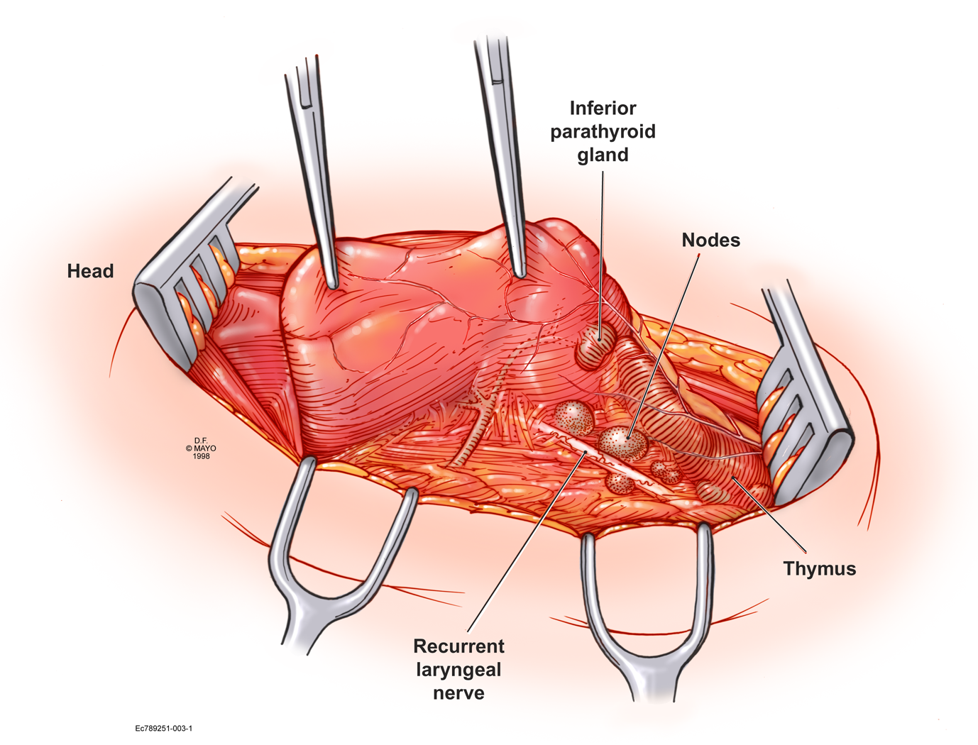
Thyroidectomy Technique
RLN, LNs, Parathyroids

Slide 51
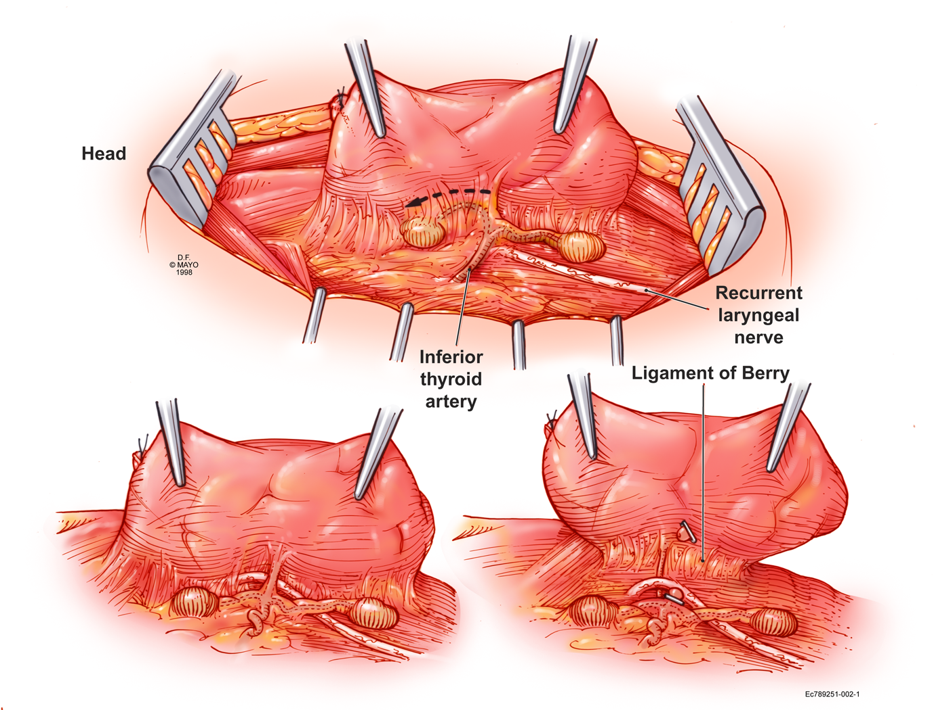
Thyroidectomy Technique
RLN, Parathyroids, TTx
Notes:
A total lobectomy can be performed when the parathyroid anatomy is favorable. The vessels to both of the parathyroid glands usually originate from the inferior thyroid artery, and enter from the top or mid-portion of the glands. They specifically do not enter from the posterior side. This means that the glands need to be mobilized very carefully with their blood supply. If this can be accomplished, protecting the RLN, then the entire lobe can be removed.
A small but important artery regularly courses behind the RLN at the ligament of Berry. This can be identified, clipped or tied, but by virtue of being an artery, needs to be controlled.

Slide 52
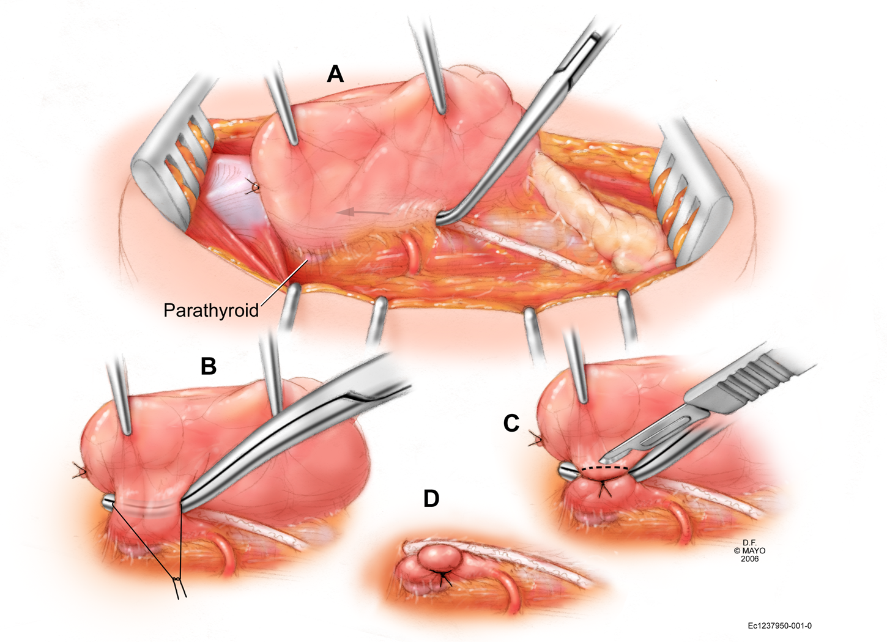
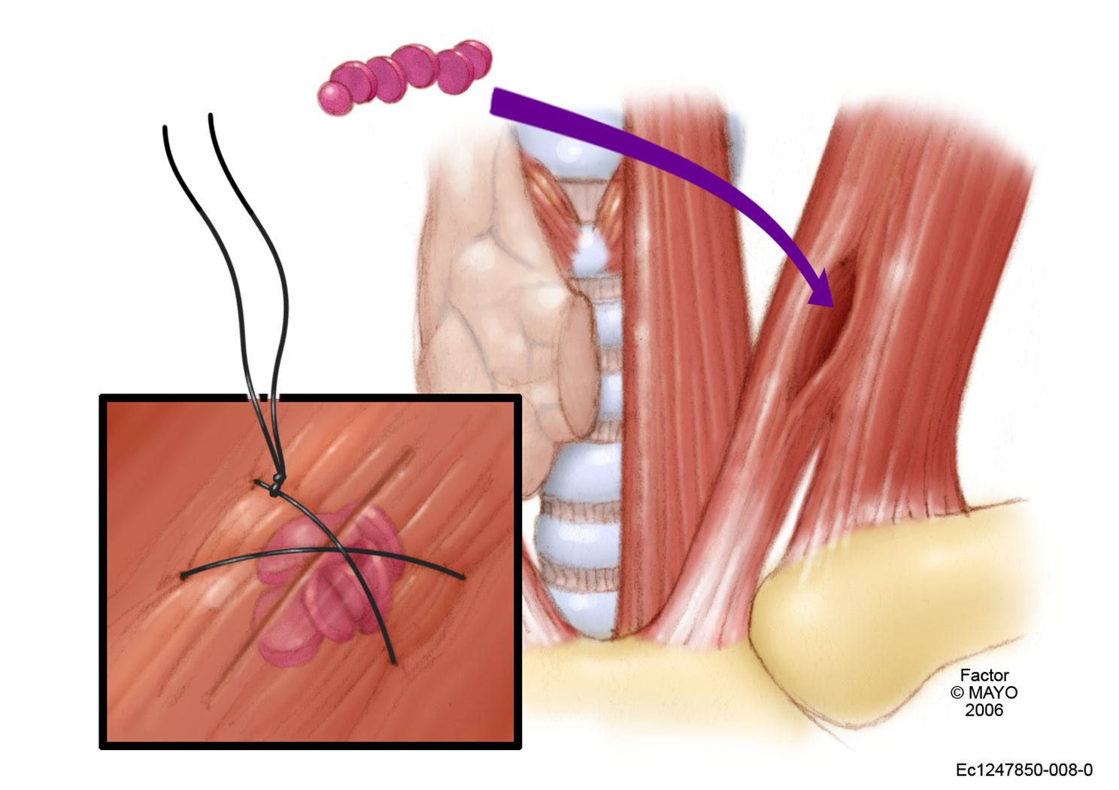
Thyroidectomy Technique
NTTx
Notes:
More commonly from my perspective, a near-total lobectomy is preferred. The superior parathyroid gland is more easily saved than the inferior, especially in a cancer operation. It resides along the posterior margin of the upper thyroid lobe, usually just overlying or posterior to the RLN. By opening the areolar space that accompanies the RLN behind the upper aspect of the thyroid lobe, a small amount—perhaps 200 mg—of thyroid tissue can be preserve just anterior to the superior parathyroid gland, protecting its blood supply.
The technique illustrated still allows complete visualization of the RLN.

Slide 53
PTC: C-VI Lymphadenectomy
Individualization: Surgeon and Pt
C-VI Dissection Safety
  Most common reported complication, temporary hypoparathyroidism
  1 well-vascularized parathyroid in situ adequate for normal Ca regulation
  50-75% of all thyroidectomies in the US are performed by surgeons who do ≤ 5 Tx per year.
  Compromise……….
Notes:
Having reviewed all of that, I think there is certainly room for individualization, both for the surgeon and the patient.

Slide 54
Plan “B”
No C-VI Dissection
No relapse
Relapse
Avoid Hypopara
Refer for reoperation

Slide 55
Lymph Node Metastases
Papillary Thyroid Cancer
Mayo Clinic Approach
Results
Initial Operation
Notes:
I think it is important to back up what you say with what you have actually done. So these are our results, previously published in more complete form.

Slide 56
Mayo Clinic: PTC Initial Operations
1999-2006
Overall
N = 773
“Optimized”
N = 420 (54%)
≠ Criteria
N = 353

Slide 57
Optimized Surgical Approach
Moderate Approach
Components
  Routine preop neck US: +/susp for PTC
    Assess lateral compartments — LNM
  Bilateral TTx or NTTx
  Routine bilateral VI dissection
  Lateral dissection (III, IV) if US +
    Add compartment II if indicated
    Carotid, IJ, vagus, phrenic, XI, brachial and cervical plexus preserved
Notes:
Routine bilateral C-VI dissection could not be separated into “prophylactic” or therapeutic.

Slide 58
Optimized Surgical Approach
Mayo Clinic Demographics
Pts: 420
Median age: 46
range (9 – 89)
129 (31%)
291 (69%)

Slide 59
Operation
Thyroidectomy
  Total 212 51%
  Near-total 208 49
Lymph Nodes (Overall +: 223, 53%)
 | Central | Lateral
Pts w/ LNM | 213 (51%) | 85 (20%)
Mean removed | 10 | 28
Mean positive | 3 | 6
Compart III-IV |  | 70%
Compart II-IV |  | 30%

Slide 60
Optimized Surgical Approach
Mayo Clinic Results
Surgical Complications
  Permanent hypoparathyroidism
    5 (1.2%)
  Recurrent laryngeal nerve
    Unintentional paralysis: 1 pt
    Intentional sacrifice: 5 (1%)

Slide 61
Optimized Surgical Approach
Mayo Clinic Results
Patient Status
  A, NED 378 91%
  AWD 15 4
  D, unrelated 18 4
  DWD 2 <1
  Dead of disease 1 <1

Slide 62
Optimized Surgical Approach
Summary
Disease Recurrence
  Prevented in 94% of pts
    Potentially curable
    Accurately define preoperatively (US)
    Independent of RAI ablation in 60% of pts
These results depend on an integrated team of endocrinologists, radiologists, pathologists, nuclear medicine specialists, and
SURGEONS

Slide 63
Conclusion: Optimal Operation
Design
Surgically Complete
Safe, Non-Morbid

