Slide 1
Strategies for Treatment of Complex Malignancies
Patrick C. McGrath, M.D., F.A.C.S.
Professor of Surgical Oncology
Ward O Griffen Endowed Chair of Surgery
Chief of General and Vascular Surgery
University of Kentucky Chandler Medical Center

Slide 2
Strategies for Treatment of Complex Malignancies
Discuss a series of scenarios where it may be beneficial to not proceed with surgery upfront
Discuss value of multidisciplinary planning for complex malignancies prior to surgery

Slide 3
GIST
59 y/o BF 15cm LUQ mass, lesser sac possibly involving pancreatic body/tail
CT staging
EUS to see origin of tumor and involvement of pancreas
Presented at Multidisciplinary GI Oncology Conference
Gleevec (TK inhibitor) neoadjuvantly
Notes:
My objectives today include the following

Slide 4
How long on Gleevec preop?
Until point of maximal radiographic response.
Notes:
My objectives today include the following

Slide 5
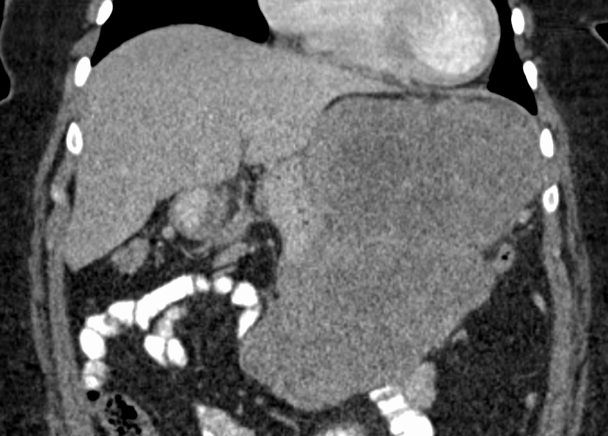
Presentation:18 x 14 x 8cm
Notes:
My objectives today include the following

Slide 6
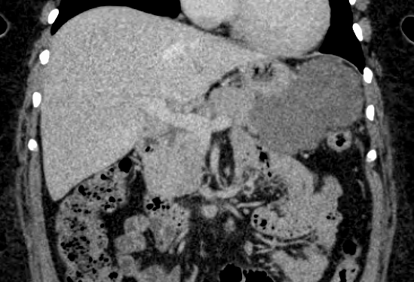
6 Months Later: 13 x 9 x 7cm
Notes:
My objectives today include the following

Slide 7
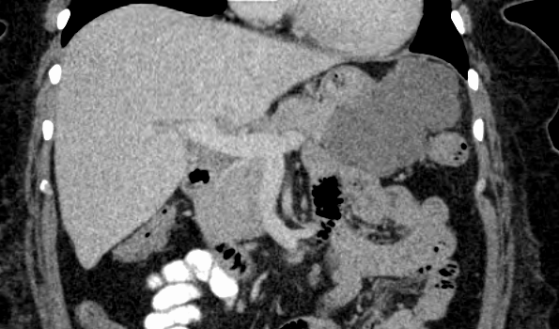
9 Months Later: 12 x 9 x 7cm
Maximal response:
2 scans in a row similar size
Notes:
My objectives today include the following

Slide 8
OR
Open partial gastrectomy (posterior wall) with en bloc resection of GIST
Primary repair of stomach wall
Able to dissect tumor off the pancreas capsule (no invasion on EUS)
Notes:
My objectives today include the following

Slide 9
Pathology Picture
Notes:
My objectives today include the following

Slide 10
Pathology
GASTRIC MASS, RESECTION AND PARTIAL GASTRECTOMY (A):
- HYALINIZATION AND OLD HEMORRHAGE, NO RESIDUAL VIABLE TUMOR IDENTIFIED,
ypT0, yN0.
- MARGINS OF RESECTION NEGATIVE FOR TUMOR.
Notes:
My objectives today include the following

Slide 11
Gastrointestinal Stromal Tumors (GIST)
Rare sarcoma
Gain of function mutation in tyrosine kinase (c-KIT proto-oncogene)
Gleevec- tyrosine-kinase inhibitor
Prognosis
Mitotic rate
Tumor size
Tumor location

Slide 12
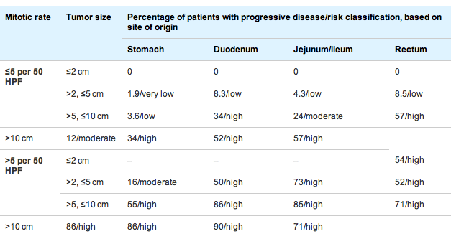
GIST- risk assessment

Slide 13
GIST, Tx
Primary Dz
Surgery – all lesions > 2 cm
Gleevec
Initially used for metastatic dz only
Well-tolerated
GIST – high incidence of recurrence
Neoadjuvant- shrink tumor, tx to max response on CT
Adjuvant- decrease recurrence (1,2,5 years)
Recurrence free survival, 2 y= 83%

Slide 14
Pancreatic Ductal AdenoCa
34 HF presented w epigastric pain, no jaundice, but lap chole 6mo before…
CT found panc head mass
EUS confirmed dx
CT staging: no mets, PV-SMV encasement
GI Onc MDC: Borderline Resectable PDAC
Pre-Therapy Procedures: metal stent
Neoadjuvant Therapy before Surgery
Notes:
My objectives today include the following

Slide 15
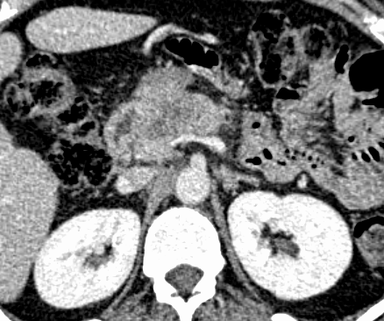
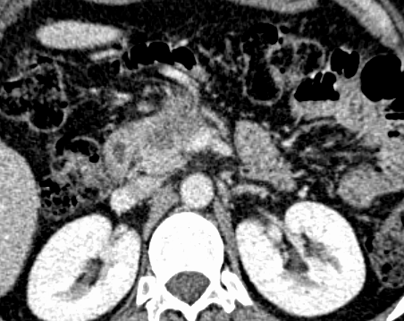
Presentation
Notes:
My objectives today include the following

Slide 16
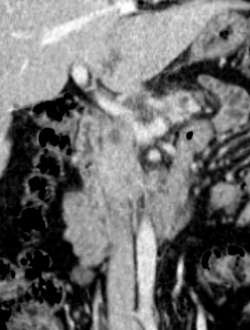
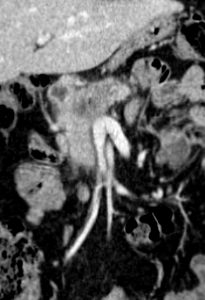
Presentation
Notes:
My objectives today include the following

Slide 17
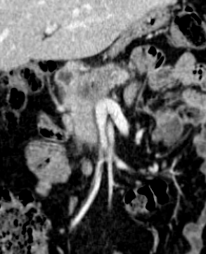
Before and After NT
Notes:
My objectives today include the following

Slide 18
BR PDAC Doesn’t Radiographically Respond - Can Use CA 19-9
Notes:
My objectives today include the following

Slide 19
This Patient’s CA 19-9: 191 to 39 Preop
Notes:
Post-NT CA 19-9 offers a view of tumor biology that is far better than the starting value of CA 19-9. Pts can be low, medium, or high producers at baseline.
Shown graphically, you can see that among resected pts, those who had CA 19-9 normalization, not just a random cutoff and not just an absolute decrease, had better survival than their resected counterparts who never normalized. The difference in median OS is 38 vs. 26 mo. This suggests that CA 19-9 normalization stratifies pts based on their tumor biology and response to cytotoxic therapy.
Interesting this marker of tumor biology is even useful for unresected patients, in which CA 19-9 normalization was associated with a median OS of 15 mo vs. 11 mo. Of note, 15 months median OS for borderline resectable PC is probably as good as or better than surgery alone without multimodality therapy.

Slide 20
CA 19-9 Normalization and Survival
Tzeng HPB 2013
Notes:
Post-NT CA 19-9 offers a view of tumor biology that is far better than the starting value of CA 19-9. Pts can be low, medium, or high producers at baseline.
Shown graphically, you can see that among resected pts, those who had CA 19-9 normalization, not just a random cutoff and not just an absolute decrease, had better survival than their resected counterparts who never normalized. The difference in median OS is 38 vs. 26 mo. This suggests that CA 19-9 normalization stratifies pts based on their tumor biology and response to cytotoxic therapy.
Interesting this marker of tumor biology is even useful for unresected patients, in which CA 19-9 normalization was associated with a median OS of 15 mo vs. 11 mo. Of note, 15 months median OS for borderline resectable PC is probably as good as or better than surgery alone without multimodality therapy.

Slide 21
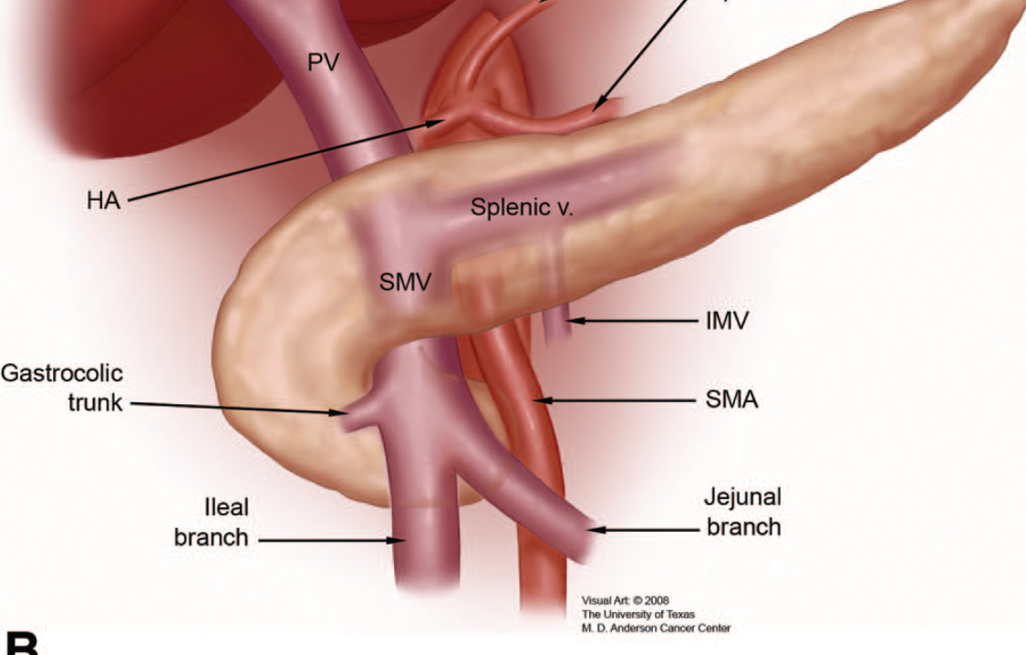
OR
Whipple with PV-SMV-SV junction resection
Preserved ileal/jejunal trunks of SMV and IMV
Coronary vein saved since it entered high in PV
Notes:
My objectives today include the following

Slide 22
Ready to Clamp PV-SMV
SMV-Ileal
SMV-Jejunal
IMV
Splenic
Notes:
My objectives today include the following

Slide 23
End-to-End PV-SMV
SMV-Ileal
SMV-Jejunal
IMV
Notes:
My objectives today include the following

Slide 24
Pathology
HEAD OF PANCREAS, STOMACH, DUODENUM AND SUPERIOR MESENTERIC VEIN, WHIPPLE
RESECTION (A):
- PANCREATIC DUCTAL ADENOCARCINOMA, STATUS POST NEOADJUVANT THERAPY
(yPT3,yN0) - TUMOR EXTENDS INTO PERIPANCREATIC SOFT TISSUE AND INTO DUODENUM.
- MARGINS OF RESECTION FREE OF TUMOR - EXTENSIVE PERINEURAL INVASION.
- NO TUMOR SEEN IN TWENTY LYMPH NODES (0/20).
OMENTUM, EXCISION (C):
- NO TUMOR SEEN.
LYMPH NODE, AORTO-CAVAL, EXCISION (D):
- NO TUMOR SEEN IN ONE LYMPH NODE (0/1).
Notes:
My objectives today include the following

Slide 25
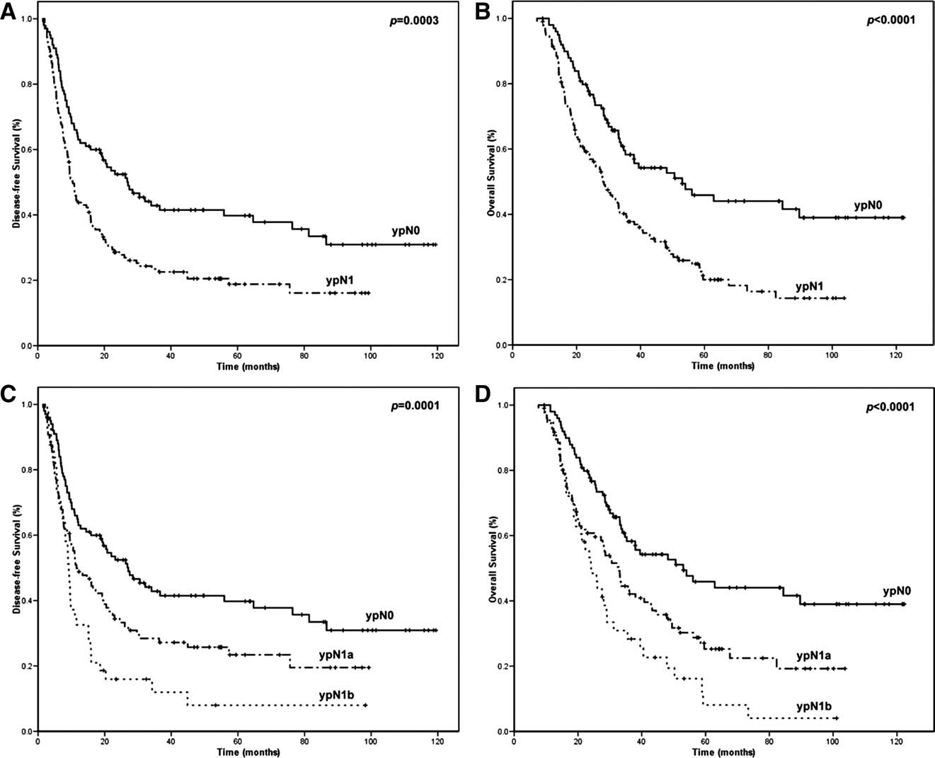
NT Provides Prognostic Info
DFS
OS
1-3 LN
4+ LN
Estrella CANCER 2013
Notes:
Again, we need accurate CT staging and comprehensive clinical staging
Individualized sequencing depends on the above
Remember your goal as a surgeon is to help the patient complete MM tx, not just resection.

Slide 26
OS for Patients with PR PDAC: MMT vs. No MMT Completion
Median 36 months
Median 11 months
Tzeng JOGS 2013

Slide 27
OS Stratified by Sequencing and Postop Major Complications
Tzeng JOGS 2013
Notes:
When resected NT patients suffered PMC, there was no significant decrease in median OS (no PMC 35.6 mo, 95% CI 29.5-41.7, vs. PMC 30.1 mo, 95% CI 24.1-36.1, p=0.936), in contrast to the negative effect of PMC in SF patients (no PMC 33.0 mo, 95% CI 20.8-45.2, vs. PMC 9.6 mo, 95% CI 0.001-22.6, p<0.001) (Figure 3). SF patients who had PMC had OS durations comparable to patients receiving only chemotherapy and/or chemoradiation without resection.

Slide 28
Siewert II GE Junction Cancer (Gastric Cardia Cancer)
66wm with “GEJ” mass – bx cancer
Staging: T3/4 N1 by CT scan with proximal stomach totally involved
GI Onc MDC Treatment Planning
Neoadjuvant Therapy before planned resection after re-staging
Chemo and XRT
Notes:
My objectives today include the following

Slide 29
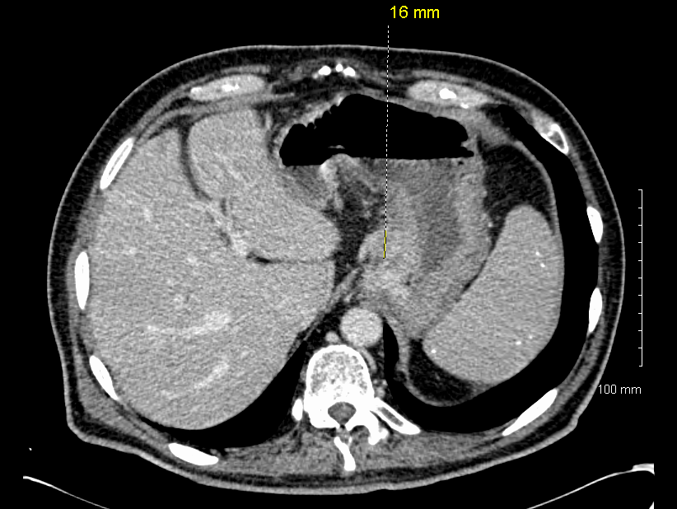
Gastric Cardia Cancer Presentation
Cardia origin
T3/4 N1 by CT
Notes:
My objectives today include the following

Slide 30
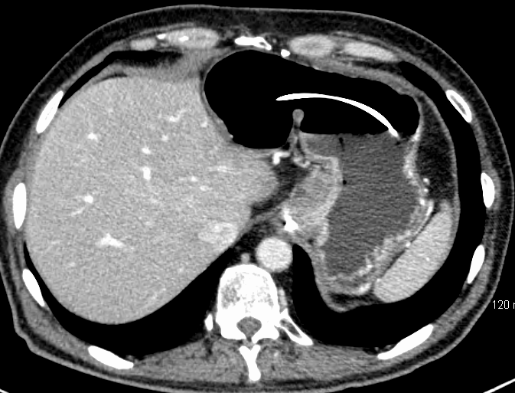
Gastric Cardia Cancer Re-Staging
Less thickening in proximal stomach
Notes:
My objectives today include the following

Slide 31
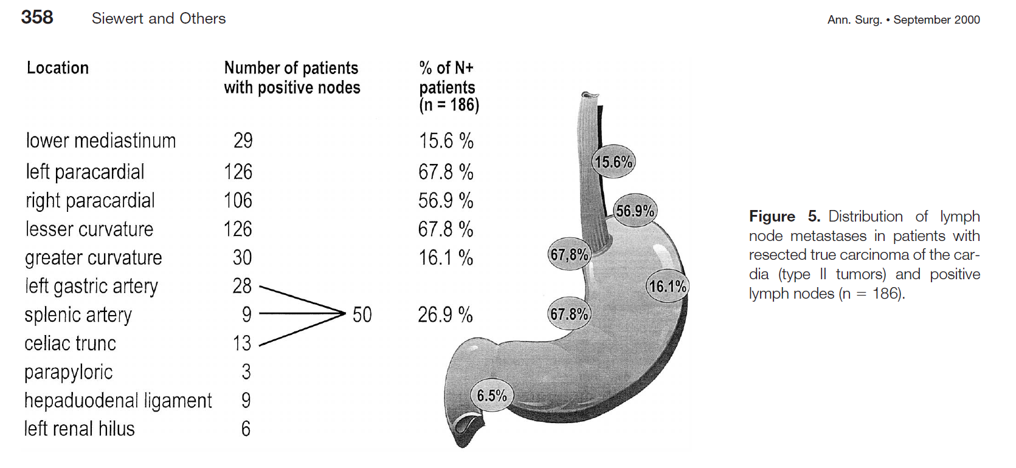
Esophagectomy vs. Total Gastrectomy?
Notes:
My objectives today include the following

Slide 32
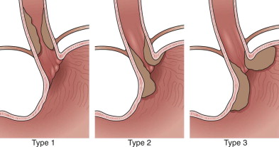
Introduction
Adenocarcinoma of the Esophagogastric Junction
Results of Surgical Therapy Based on Anatomical/Topographic Classification in 1,002 Consecutive Patients
Siewert, Feith, Werner, Stein Ann Surg. 2000 Sep;232(3):353-61
Type I
Esophagectomy
Type II / III
Extended gastrectomy
Postoperative mortality highest for esophagectomy
Surgical approach did not influence survival
Notes:
IMAGE
Diagnosis and Staging of Esophageal Carcinoma
Clinical Gastrointestinal Endoscopy.
Penman, Ian D.; Church, Nicholas I.. Published January 1, 2012. Pages 305-320. © 2012.

Slide 33
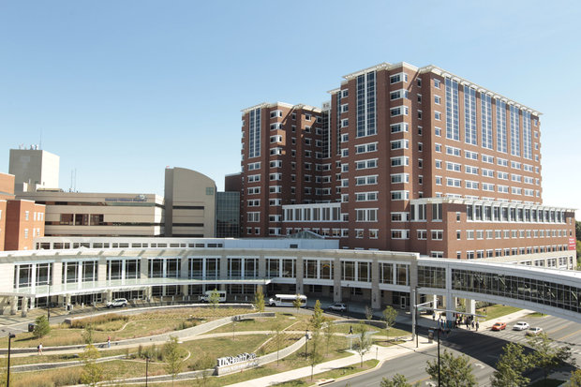
Should Gastric Cardia Cancers Be Treated with Esophagectomy or Total Gastrectomy: A Comprehensive Analysis of 4,996 NSQIP/SEER Patients
Jeremiah T. Martin, MBBCh, FRCSI, FACS
Angela Mahan, MD Joseph B. Zwischenberger, MD, FACS Patrick C. McGrath, MD, FACS Ching-Wei D. Tzeng, MD
Southern Surgical Association December 2014
Department of Surgery The University of Kentucky, Lexington, Kentucky

Slide 34
Results - NSQIP
 | Gastrectomy | Esophagectomy | p-value
Operative Time mins, median (IQR) | 299 (231-405) | 339 (238-446) | 0.168
LOS days, median (IQR) | 10.5 (8-16) | 10.0 (8-15) | 0.409
Morbidity | 71 ( 33.2) | 73 ( 34.1) | 0.838
Mortality | 8 ( 3.7) | 4 ( 1.9) | 0.242

Slide 35
Conclusions
Choice of operation for Siewert II Gastric Cardia Cancer Esophagectomy vs Total Gastrectomy
Tumor anatomy (proximal / distal extent)
Surgeon and Hospital M/M Rate
Cancer Center MMT completion rate

Slide 36
Workup and Deciding Surgical Approach
Tumor board with both Thoracic and Abdominal Surgeons
CT C/A/P– gastric distention protocol
Repeat endoscopy (if referred from outside) to identify true location of tumor
Use EUS if needed to identify proximal/distal extent
Staging laparoscopy with peritoneal washings
Decide intended surgical approach after neoadjuvant therapy

Slide 37
Lymphadenectomy: E vs. TG
For Siewert II (true GCC), highest yield LND would be para-esoph, peri-cardial, lesser curve, and left gastric
But LN’s also along greater curve (D1) and splenic artery (D2)
Esoph: misses the greater curve (preserved as conduit) and no splenic artery LND
Total Gastrectomy: misses chest LN
Our bias for GCC: combined approach using MIS technology – R VATS esoph mobilization (to get chest LN) plus extended TG (e.g. total gastrectomy + 6-8cm of esophagus)

Slide 38
OR
R VATS mobilization of esophagus and dissection of LN
Extended gastrectomy with R-Y E-J
Extended regional LND (distal esoph + modified D2)
Notes:
My objectives today include the following

Slide 39
Pathology Picture
Notes:
My objectives today include the following

Slide 40
Pathology Picture
Residual Primary
Notes:
My objectives today include the following

Slide 41
Pathology
- RESIDUAL INVASIVE ADENOCARCINOMA (STATUS POST CHEMOTHERAPY AND
RADIATION) WITH EXTENSION INTO THE SUBSEROSAL SOFT TISSUE [yPT3, pN0].
- MARGINS FREE OF TUMOR
- PERINEURAL INVASION IDENTIFIED.
- NO VIABLE TUMOR SEEN IN 20 PERIGASTRIC LYMPH NODES (0/20)
, CELIAC, EXCISION (F): NO TUMOR SEEN IN SIX LYMPH NODES (0/6).
total 0/27 LN – good lymph node sampling from chest to pylorus
Notes:
My objectives today include the following

Slide 42
53 y/o WF with 6 month history of N&V, epigastric fullness and 30lb wt loss
Endoscopy – large mass like lesion distal antrum, circumferential, significant necrosis
Biopsy – inflammation, necrosis
Flow cytometry done to r/o lymphoma however cytology from that suggested signet ring cells and OSH rendered dx of PD Gastric Cancer

Slide 45
Multidisciplinary Review
Pathology review of OSH slides at UK could not confirm dx of malignancy
Repeat endoscopy and bx again revealed only inflammation/necrosis
Subtotal Gastrectomy

Slide 46
Pathology
Peptic ulcer with involvement of muscularis propria

Slide 47
Breast Cancer during Pregnancy

Slide 48
Breast Cancer during Pregnancy
VW 25 y/o WF presents 15 weeks pregnant with breast mass RUOQ
Core needle bx: PD invasive ductal CA

Slide 49
Breast Cancer during Pregnancy

Slide 50
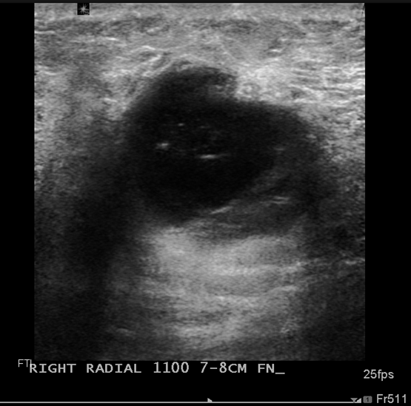

Slide 51
Breast Cancer during Pregnancy
Lumpectomy/SLN biopsy/port placement (2nd trimester)
3 cm invasive PD ductal CA, node negative, margins clear
ER - , PR - , Her2 +++
Chemotherapy: AC x 4 (q 3 weeks)
Delivered healthy baby 34 weeks
Adjuvant radiation therapy
Herceptin post-partum - 1 yr

Slide 52
Breast Cancer during Pregnancy
44 yo WF presents with mammographic architectural distortion
Well differentiated inv ductal ca with lobular features
ER/PR +, Her2 neg
US of axilla negative
Dense breast tissue with findings worrisome for multifocal disease
Recommend MRI

Slide 53
Breast Cancer during Pregnancy
Pregnancy test prior to MRI +
Pt desires pregnancy
High risk for miscarriage
Pt elected to have total mx + sln bx in beginning of 2nd trimester
T1N0 multifocal WD inv ductal CA
Tamoxifen after delivery

Slide 54
NCCN- 2nd trimester
Mastectomy or BCS + axillary staging
Neo/Adjuvant chemo
+/- radiation post partum
+/- endocrine therapy post partum

Slide 55
Breast Cancer during Pregnancy
Majority poorly differentiated, late stage
W/U
MMG ok
MRI avoided in 1st trimester
Gadolinium contrast contraindicated

Slide 56
Breast Cancer during Pregnancy
No chemo in 1st trimester
Ok for chemo in 2nd, 3rd trimester
No radiation during pregnancy
No blue dye, ok for radiolabeled sulfur colloid
No Herceptin
OK for mastectomy + Ax staging any trimester but prefer 2/3
OK for BCS + Ax staging 2/3 with XRT post partum

Slide 57
Neoadjuvant Endocrine Therapy in Breast Cancer
69 y/o W/F presents with 10 year hx of breast mass and axillary masses

Slide 58
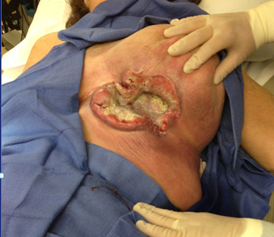

Slide 59
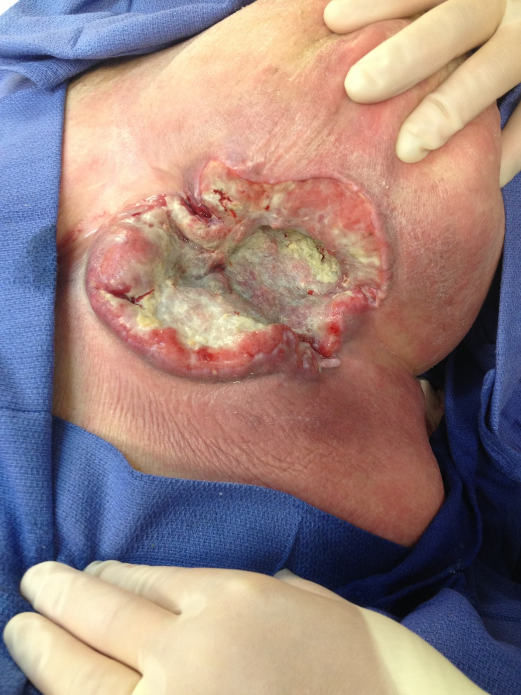

Slide 60
Neoadjuvant Endocrine Therapy
MWD invasive ductal carcinoma
Strongly ER/PR +
Clinically positive nodes
No evidence of distant mets
Debrided wound
Started Aromatase Inhibitor x 8 months

Slide 61
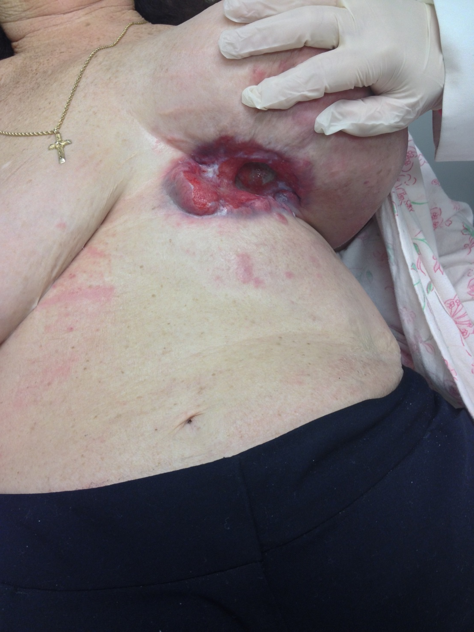

Slide 63
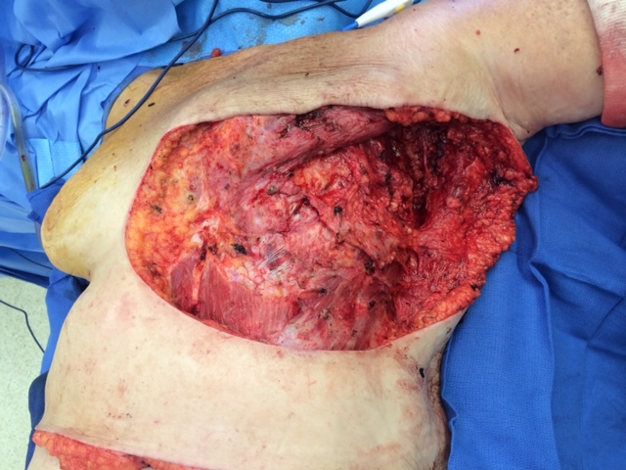

Slide 64
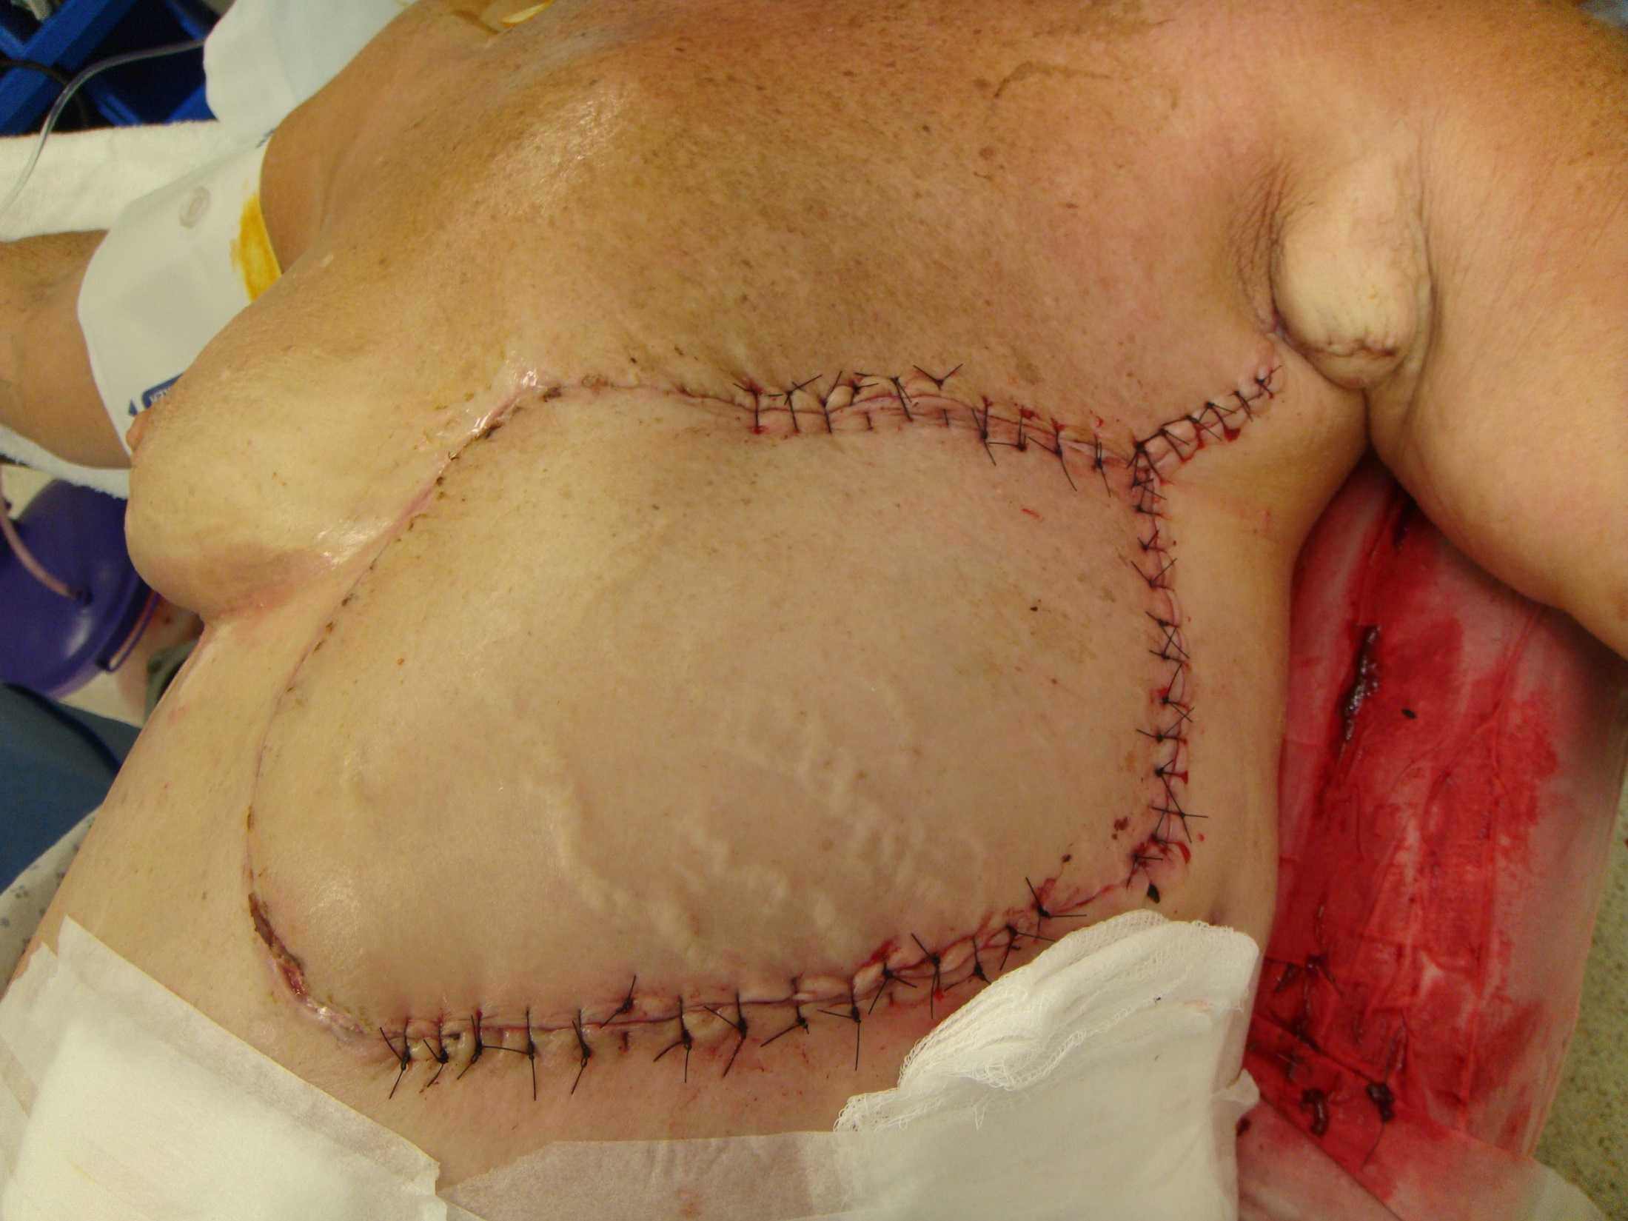

Slide 65
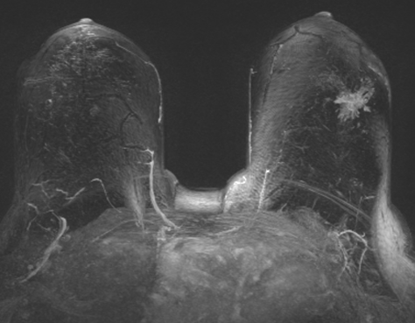

Slide 66
Neoadjuvant Endocrine Therapy
Effective strategy for management of locally advanced ER+ tumors
pCR rare
Downstage tumors and increase rates of breast-conservation therapy
Aromatase Inhibitors superior to Tamoxifen
Ki-67 useful tool for assessing clinical benefit
Treatment of at least 6 months most beneficial

