Slide 1
Surgical Oncology
Lessons Learned
Patrick C. McGrath, MD, FACS
Ward O. Griffen Endowed Chair in Surgery
Professor & Chief
Division of General Surgery
University of Kentucky

Slide 2


Slide 3
Starting Out
During the tedious months of waiting for laboratory research to mature find a clinical project
Identify clinical topic which is not rare but relatively uncommon with sparse reported literature

Slide 4
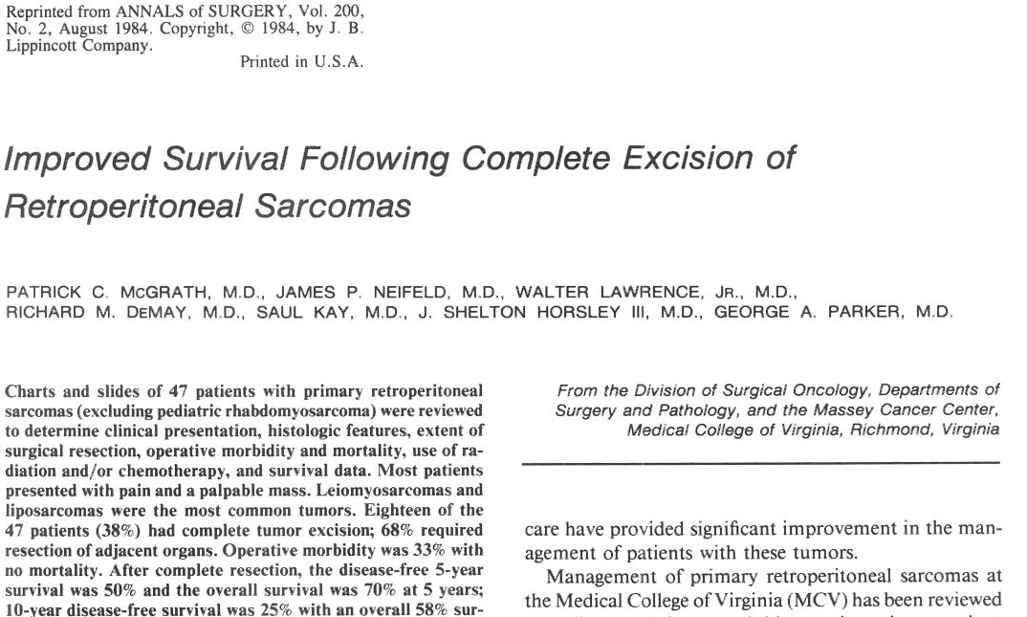

Slide 5
Retroperitoneal Sarcomas: MCV Experience
1964-1982 – 47 patients
  38% complete resection
  68% required resection of adjacent organs
  33% morbidity
  0% mortality

Slide 6
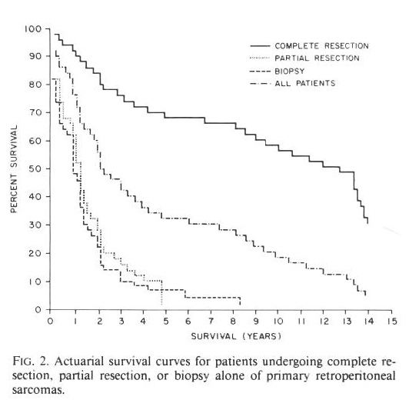
Retroperitoneal Sarcoma
MCV Experience

Slide 7
Retroperitoneal Soft-Tissue Sarcoma
Lewis, et.al.: 278 primary @ MSKCC
  74% resectable
  41% local recurrence
  54% 5 yr DFS (all patients)
  79% 5 yr DFS (completely resected)
Poor prognostic factors
  High histologic grade
  Unresectable
  Positive margins

Slide 8
Presentation – T.S.
52 y/o w/m 2 yrs s/p excision of a 21 cm intramuscular lipoma (elsewhere), left inguinal region, now with recurrent large soft tissue mass left pelvis
CT scan – 20 cm pelvic mass fixed to iliac wing with extension down to lesser trochanter
Review of previous pathology indicated that only 4 sections taken of intramuscular lipoma
Pt had no f/u scans after orginal resection

Slide 9
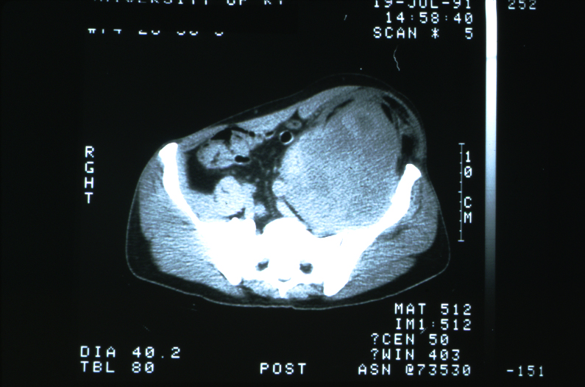

Slide 10
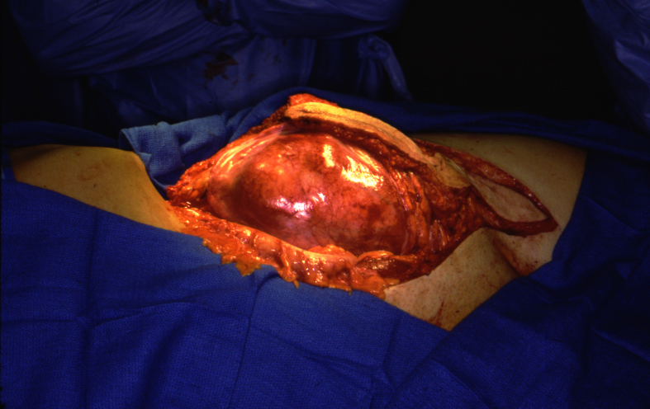

Slide 11
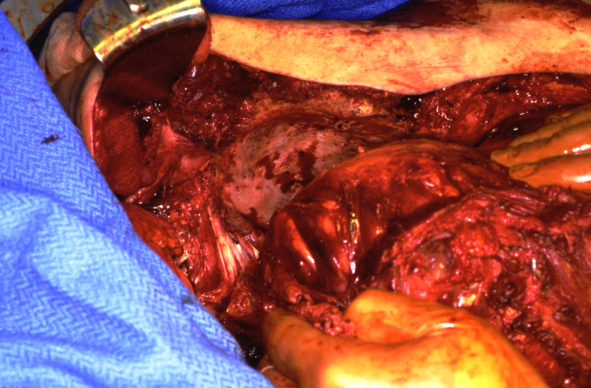

Slide 12
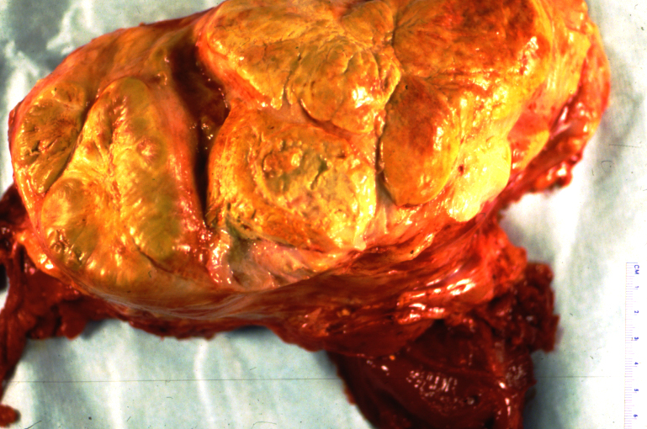

Slide 13
Hospital Course – T.S.
Hemipelvectomy with posterior flap closure
Pathology: High grade liposarcoma - margin of resection clear
Post-op adjuvant chemotherapy - CAV

Slide 14
Follow-up – T.S.
3 ½ years s/p left hemipelvectomy and chemotherapy for high grade liposarcoma
Recent onset of jaundice
CT scan & U/S: 4 cm mass in head of pancreas, no gallstones

Slide 15
Hospital Course – T.S.
Pancreaticoduodenectomy (Whipple Procedure)
Pathology: metastatic dedifferentiated liposarcoma involving head of pancreas and peripancreatic tissues, margins clear

Slide 16
Follow-up – T.S.
5 months later, patient presents with soft tissue mass lateral aspect right thigh
Wide local excision, preserving limb function
Pathology: inflammatory malignant fibrous histiocytoma, margins clear
Post-op adjuvant radiation therapy

Slide 17
Follow-up – T.S.
5 ½ yrs s/p hemipelvectomy & 2 yrs s/p Whipple Procedure & 1 ½ yrs s/p WLE right leg
Presents w/ mass between SMV & SMA and right iliac region & 2 pulmonary nodules
2 cycles chemotherapy with partial response, no progression

Slide 18
Follow-up – T.S.
Exploratory laparotomy – resected soft tissue sarcoma right iliac region & between SMA & SMV
Thoracotomy – metastatic high grade sarcoma RUL extending to interlobar fissure would require pneumonectomy – not pursued
Palliative care – expired 8 months later

Slide 19
Key Points
Atypical lipomas or intramuscular lipomas act like low grade liposarcomas with high rates of local recurrence
Require ongoing surveillance
Excision of metastatic sarcomas (selected cases) can extend survival
Hemipelvectomy not as morbid & disabling

Slide 20
Be Wary of Old Data

Slide 21
Case Presentation
“Dance” Rounds
65 y/o male admitted with obstructive jaundice
CT scan revealed mass in head of pancreas and associated biliary ductal dilitation as well as liver metastases
Plan: Choledochojejunostomy and gastrojejunostomy (double bypass)

Slide 22
WRONG
Attending Surgeon: pointed out that mortality in that group of pts was 25%
Chief Resident: questioned data

Slide 23
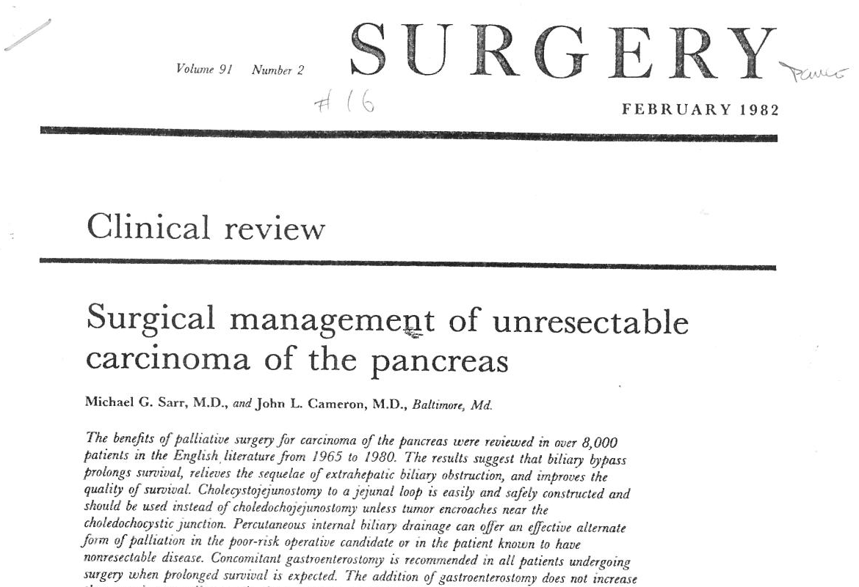

Slide 24
Cameron Paper
Review of 8,000 pts with unresectable carcinoma of pancreas from 1965-1980
Operative Mortality 20-25%
Addition of gastrojejunostomy did not increase mortality

Slide 25
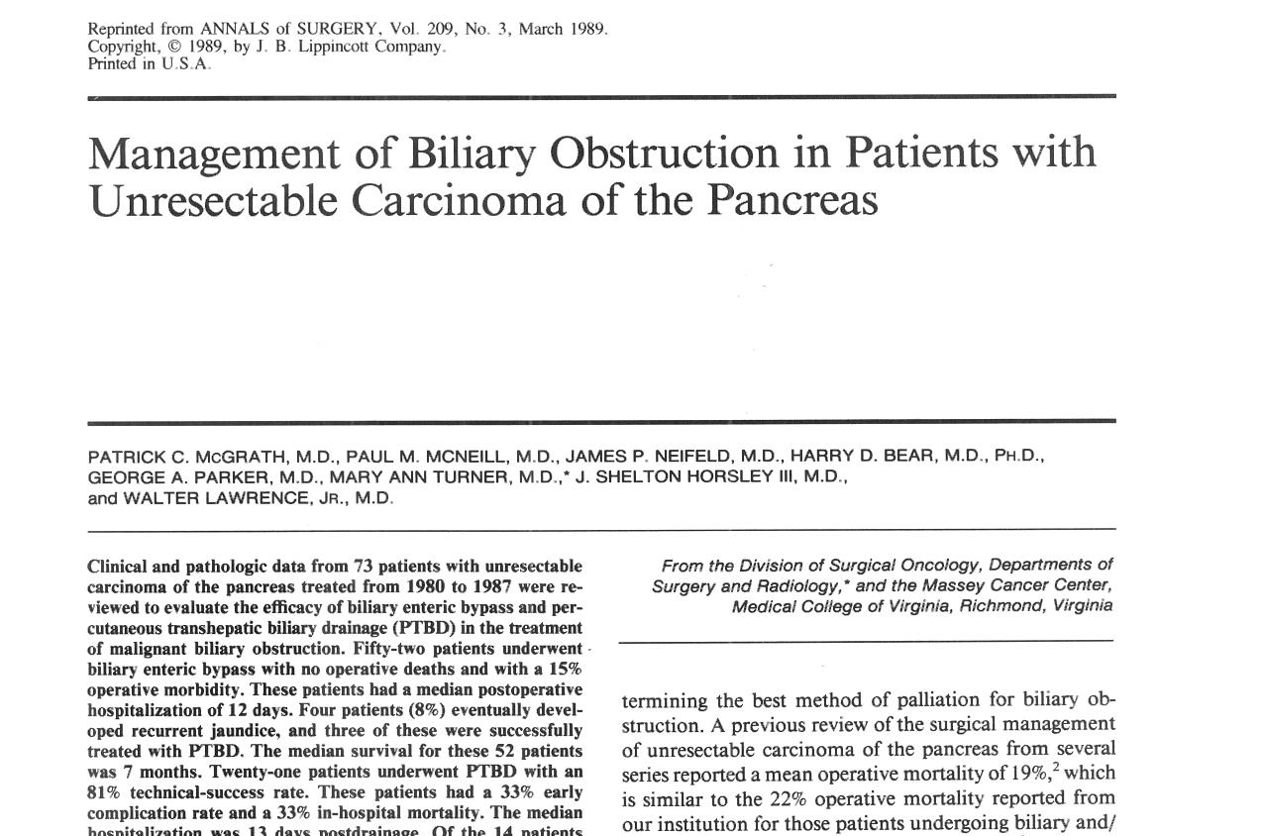

Slide 26
Unresectable Carcinoma of Pancreas: MCV Experience
73 patients (1980-1987)
52 patients biliary enteric bypass
  0% mortality
  15% morbidity
21 patients PTBD
  33% mortality
  33% morbidity
  86% late complication rate

Slide 27
WELCOME TO THE NFL

Slide 28
Presentation – J.C.
57 y/o w/m admitted to GI medicine for evaluation of obstructive jaundice
Asymptomatic, no weight loss
11 yrs s/p J-I bypass for morbid obesity
7 yrs s/p takedown J-I bypass conversion to roux-en-y gastric bypass
2 yrs s/p lysis adhesions
Bilirubin 12.1 mg/dl to external drainage Alk phos – 1220 u/L

Slide 29
Radiologic Evaluation – J.C.
U/S – dilated CBD & intrahepatic ducts – no gallstones
CT scan – no mass in pancreas or CBD
PTC – obstruction of distal CBD by stone or tumor
PTC catheter left to external drainage

Slide 30
Hospital Course – J.C.
2 days later PTC catheter stops functioning pt develops acute abdomen with ileus
Contrast study: dislodged catheter with resultant bile leak & sepsis

Slide 31
Hospital Course – J.C.
Emergent surgery – 500 cc bile with associated peritonitis
Cholecystectomy, CBDE, choledochoscopy & bx, t-tube drainage

Slide 32
Hospital Course – J.C.
Pancreaticoduodenectomy
Take down of jejunojejunostomy, re-create new Roux-en-y pancreatojejunostomy and choledochojejunostomy
Post-op numerous infectious complications as well as leak from choledochojejunostomy and fascial dehiscence
Subsequent colocutaneous fistula eventually requiring right colectomy
Discharge home POD #67

Slide 33
Follow-up – J.C.
Pathology: well-differentiated adenocarcinoma distal CBD
20 yr f/u – alive, NED

Slide 34
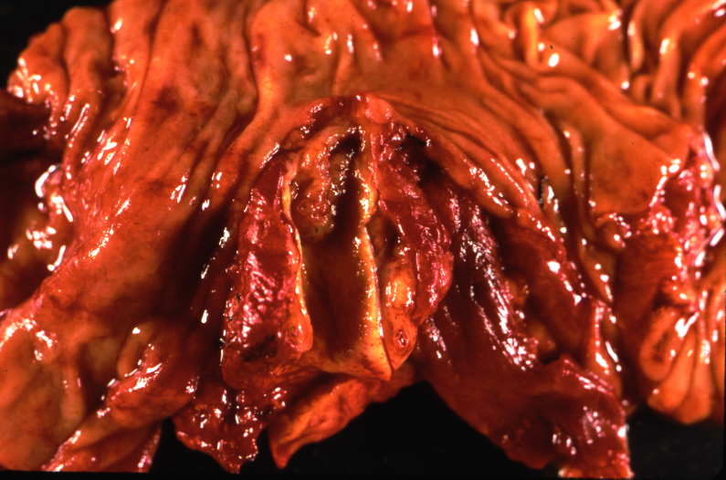

Slide 35
Key Points
Pre-operative drainage of malignant biliary obstruction increases complications (infectious)
In emergency setting, take care of immediate problem, return for definitive oncologic surgery
Tincture of time
Distal CBD malignancies often present early and can have excellent prognosis

Slide 36
H.P.I.
61 y/o w/m attorney presents with:
N & V for 5 weeks
Significant Weight Loss
No Significant Abdominal Pain

Slide 37
PMH
HTN
No Meds or Allergies
S/P Open Cholecystectomy
20 pack year hx smoking

Slide 38
Hospital Course
Upper endoscopy performed by Gastroenterologist
Findings: Large tumor mass with near complete obstruction at 3rd portion of duodenum
Plan: Dilate obstructing tumor mass to allow placement of nasoenteral feeding tube past obstruction

Slide 39
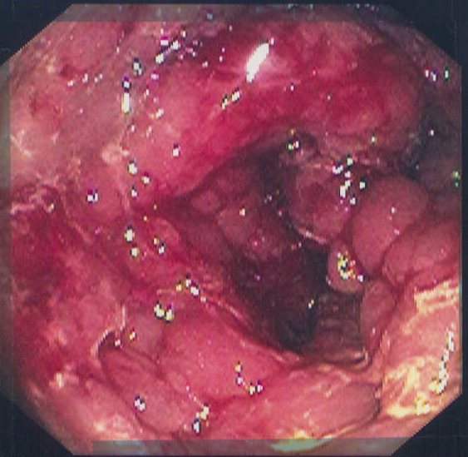

Slide 40
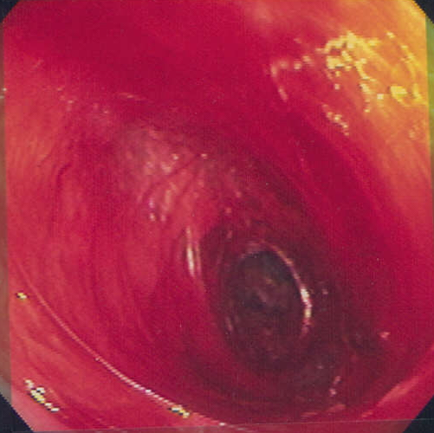

Slide 41
Hospital Course
Result: Perforation of duodenum at distal portion of obstructing tumor
Plan: Surgical consultation

Slide 42
Physical Exam
Tachycardic, mild distress due to abdominal pain
Abdomen: Distended, tympanitic, tender with guarding & peritoneal irritation

Slide 43
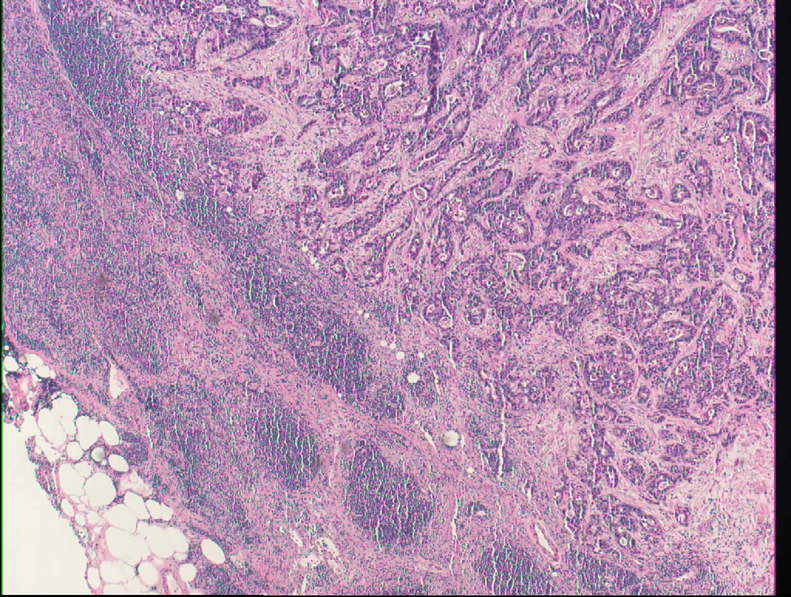
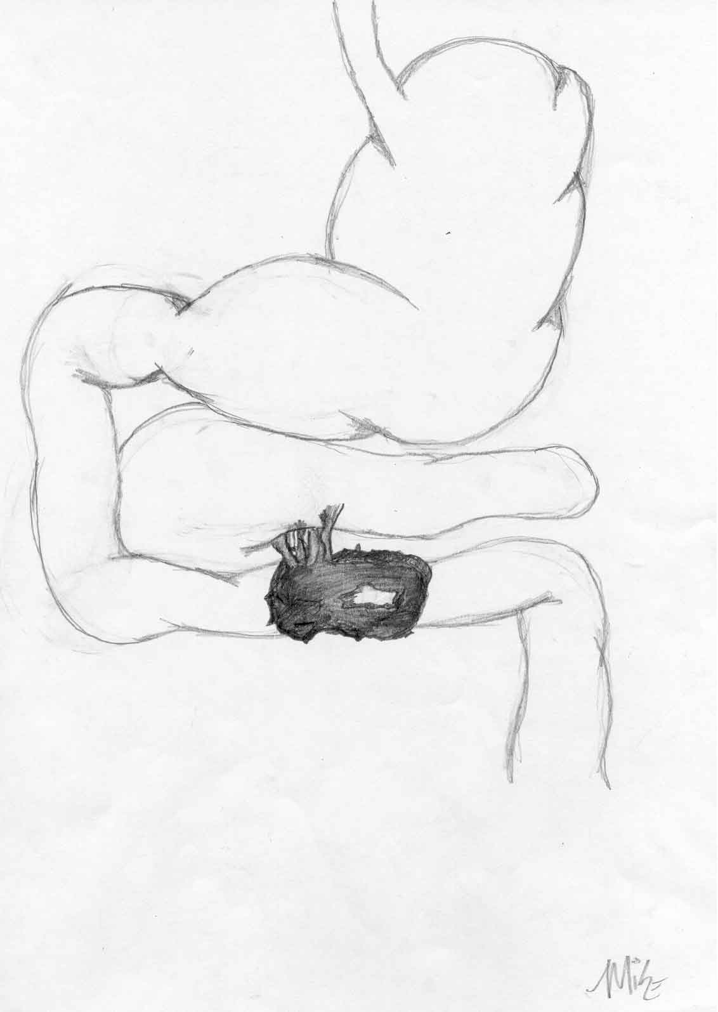
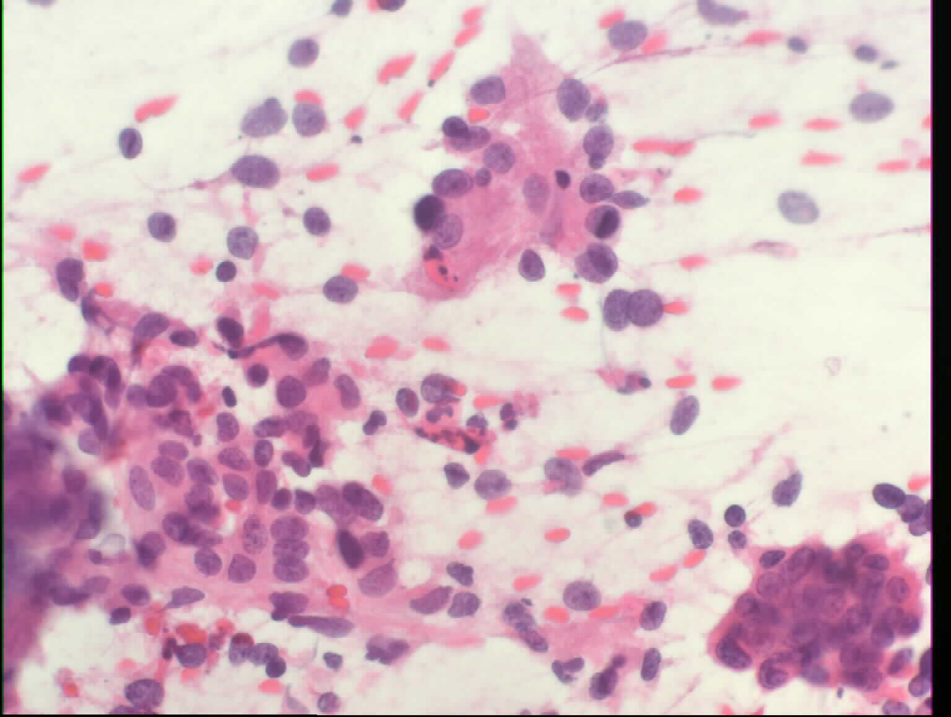

Slide 44
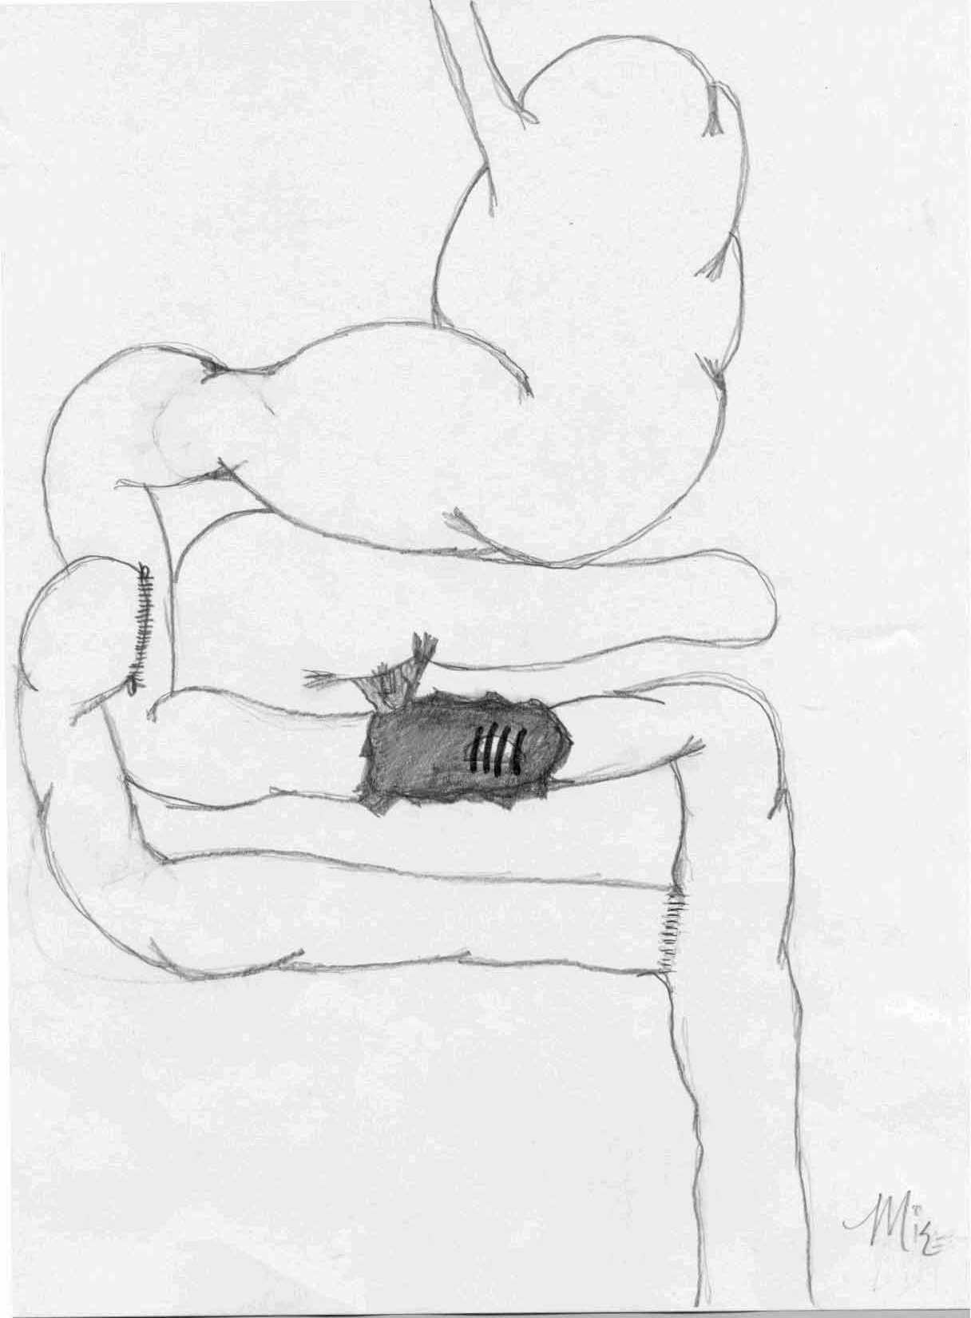

Slide 45
Hospital Course
D/C POD#11 tolerating diet
CT Scan: Large obstructing tumor mass D3 with associated lymphadenopathy. No obvious distant mets.
Retroperitoneal abscess percutaneous drainage

Slide 46
Treatment Plan
Phase I/II Protocol: Radiation and Gemcitabine in locally advanced tumors of GI Tract
Radiation: 5,940 cGy
Chemotherapy: Gemcitabine 100 mg/m² q. week

Slide 47
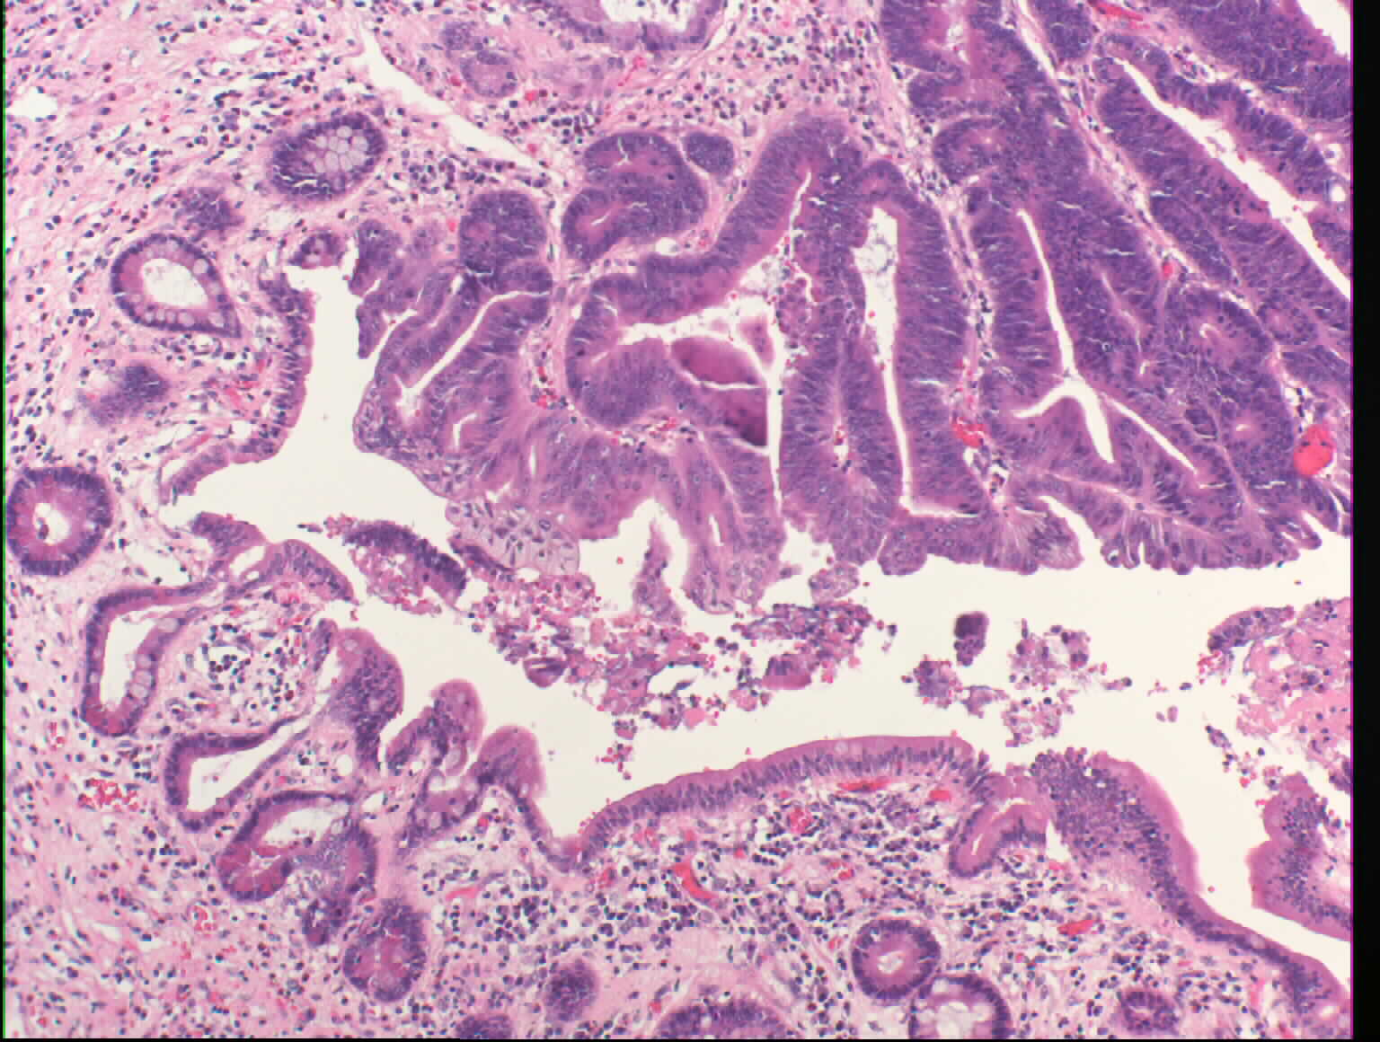
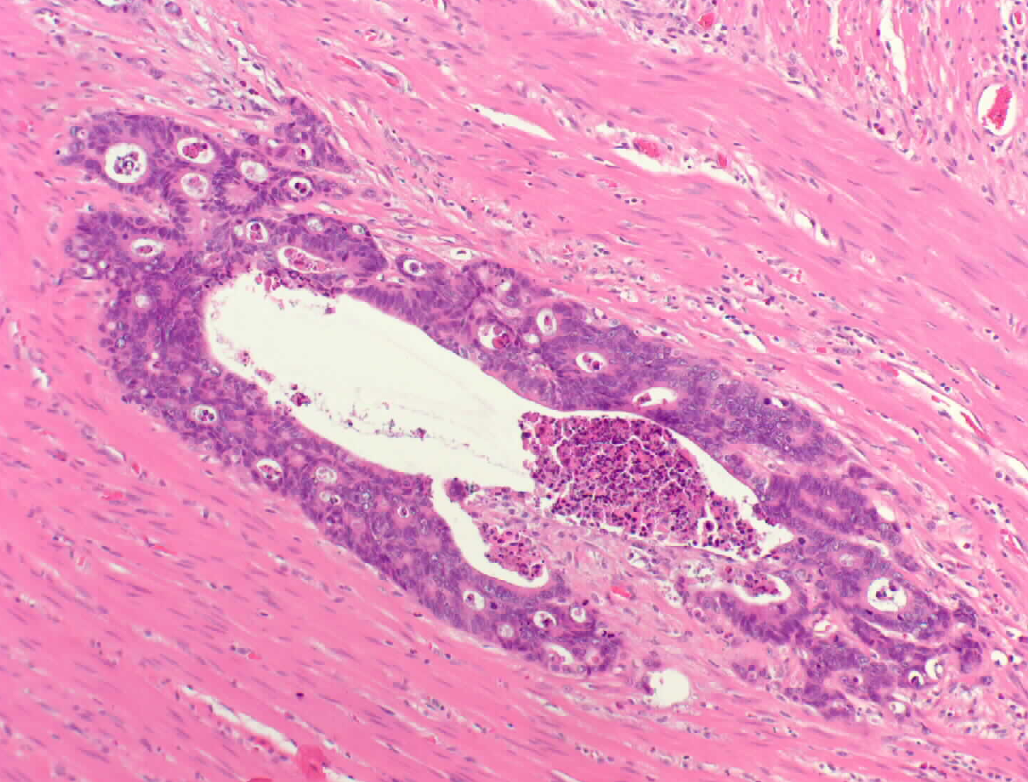

Slide 48
Follow-up
Duodenal resection pathology: Adenomatous changes & ulceration of mucosa
Residual microscopic tumor in wall of duodenum extending to serosa
Radial margins free
Nodes negative

Slide 49
Follow-up
Stricture at duodenojejunostomy dilated by endoscopy
Vaccine Protocol: Anti-id-CEA vaccine subcutaneous injection q. month
3 years from diagnosis when vaccine went to q. 2 months a small stable nodule LLL increased in size.
CT guided bx: Positive for malignancy

Slide 50
Follow-up
Underwent wedge resection of poorly-differentiated adenocarcinoma LLL c/w duodenal primary
No other metastatic lesions noted
Remained free of disease at 6 yrs

Slide 51
Follow-up
Over six years from original diagnosis, pt developed vague neurological symptoms
CT scan head – several metastatic lesions throughout brain
Whole brain RT
Palliative care

Slide 52
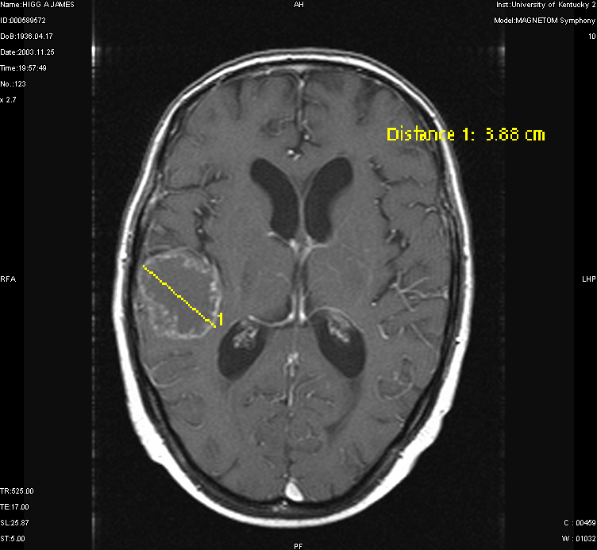

Slide 53
Duodenal Carcinoma
Median age: 61 yrs (31-100)
91% symptomatic: Abdominal pain and weight loss
Less common: Vomiting, GI bleed, jaundice

Slide 54
Duodenal Carcinoma
Pathology of resectable tumors
  Mean tumor diameter: 4 cm
    74% D2, half periampullary
    13% D3
    9% D4
    4% D1
    60% MWD, 40% PD

Slide 55
Duodenal Carcinoma
68 pts curative resection
  44% Whipple
  27% Pylorus Sparing Whipple
  7% Total Pancreatectomy
  27% Segmental Resection

Slide 56
Duodenal Carcinoma
Survival
  5 yr survival all pts – 37%
  5 yr survival resectable pts – 54%

Slide 57
Duodenal Carcinoma
Prognostic Factors
  Decreased survival: Older age, weight loss, node +, margin +, depth, higher stage
  Extent of resection did not affect survival. Tumor location dictated procedure

Slide 58
Find a Basic Scientist with Surgical Personality With Whom
You Can Collaborate

Slide 59
Importance of Collaboration with Basic Scientist
Jim Freeman, PhD identified and characterized a nucleolar proliferation antigen P-120
Access to a bank of breast cancer tissue with complete clinical information and outcomes
Collaboration ensured that the most significant clinically pertinent questions be asked

Slide 60
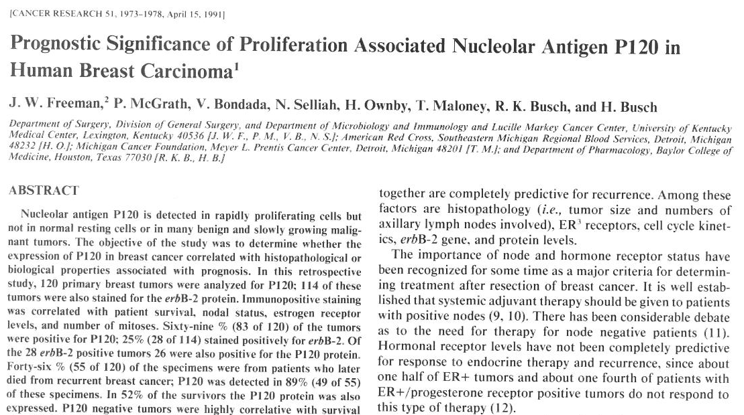

Slide 61
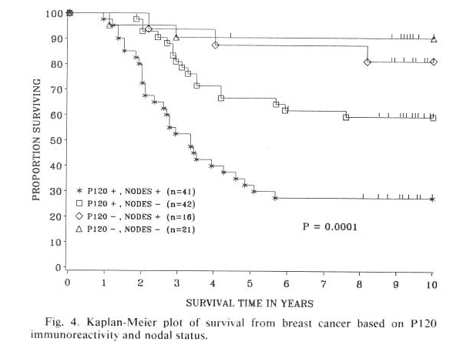

Slide 62
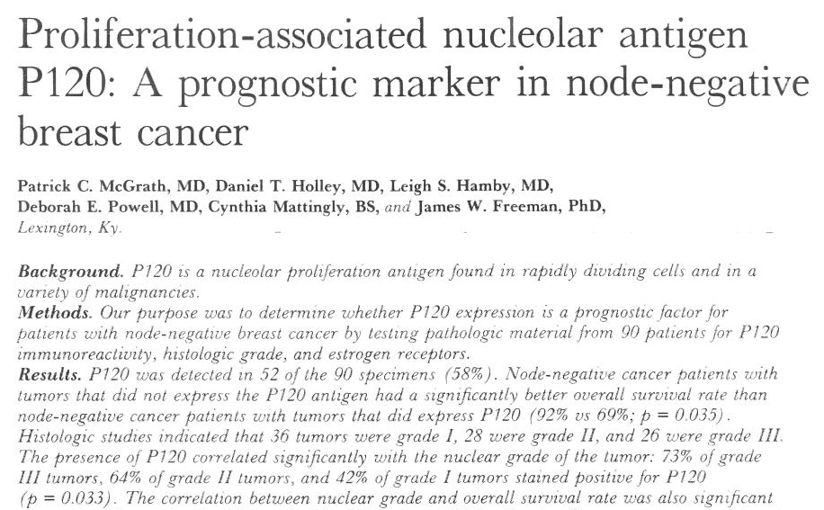

Slide 63
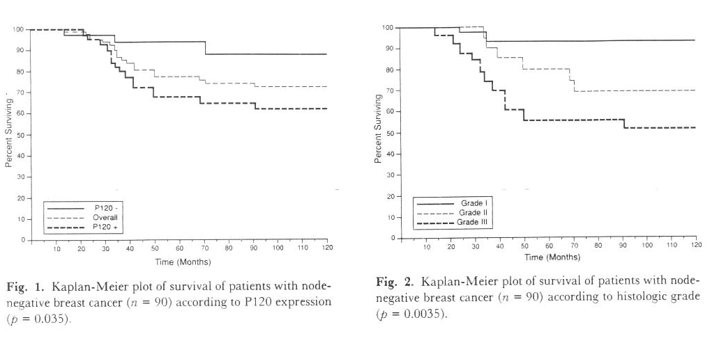

Slide 64
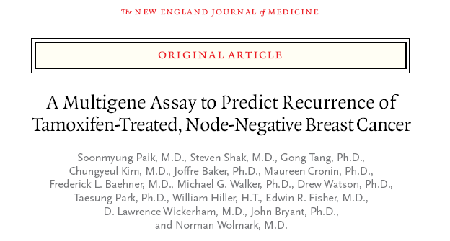

Slide 65
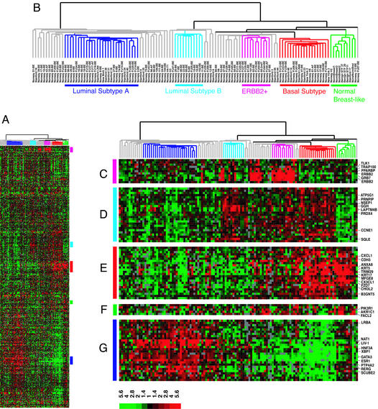
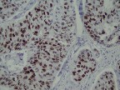
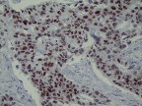
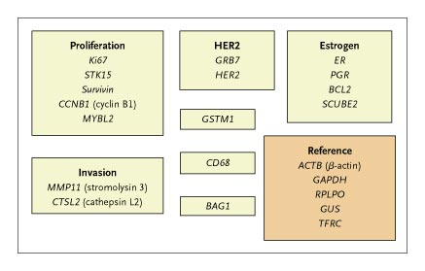
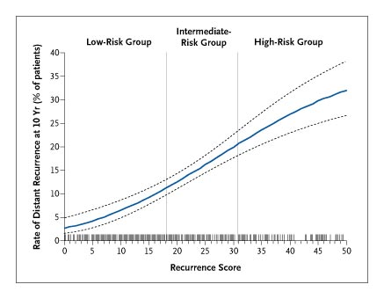
T= Any size
N = 0 – 1a
ESTROGEN RECEPTORS +
PROGESTERONE RECEPTORS +/-
Clinical Decision for Chemo other than Hormonal Therapy
ONCOTYPE
Notes:
Oncotype DXTM (offered by Genomic Health Inc, Redwood City, CA) is a multi-analyte reverse transcriptase polymerase chain reaction (RT-PCR) genomic test available for predicting recurrence of breast cancer in tumors that are estrogen receptor positive and node negative. The assay is performed on RNA pooled from formalin fixed paraffin embedded tissue. A 21 gene panel is evaluated for the expression of sixteen cancer-related genes and five reference genes generating a Recurrence ScoreTM (RS). Patients are divided into low (RS <18), intermediate (RS ≥18, <31) and high risk (RS ≥31) groups based on RS. RS is used to guide further therapy. Patients who fall into the high risk category have been shown to benefit from chemotherapy; whereas, patients who fall into the low risk category have been shown not to benefit from chemotherapy. It is unclear whether patients who fall into the intermediate risk category will benefit from chemotherapy.1,2,3,4,5

Slide 66
Score | 1 | 2 | 3 | 4 | 5
ER | 90-100 % | < 90 %
PR | 90-100% | 70-90% | 30-70% | 1-30% | 0%
Mitotic Index | 1 | 2 | 3
Grade | I | II | III

Slide 67
Anytime you embark on new technique that may alter subsequent management of patients keep prospective data

Slide 68
University of Kentucky
Sentinel Node Experience
> 1000 pts over 15 years
6 publications, 15 Abstracts
Develop & refine approach to axilla in clinically node negative pts
Notes:
> 1000 pts over 15 years
6 publications, 15 Abstracts
Develop & refine approach to axilla in clinically node negative pts

Slide 69
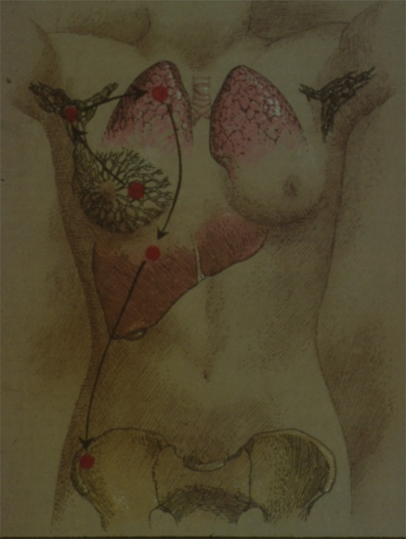
BREAST RESEARCH
Surgical management of the axilla in patients with clinical node negative nodes in the sentinel node era (1998 – 2000)
  Definition of sentinel nodes
  Need for axilary dissections in patients with micrometastasis
  Predictors of non-sentinel node positivity (pN1a versus pN2 -3)

Slide 70
BREAST RESEARCH
Preoperative staging of the axilla in patients with clinical node (-) disease (2000 – 2005).
  - Utilitiy of Ultrasound and Fine Needle Aspiration Cytology for detecting axillary disease.
  Correlation of sonographic patterns of lymph node metastases with pN1a versus pN2-3 diesease
  Role of US-FNA in preoperatively staging the axilla

Slide 71
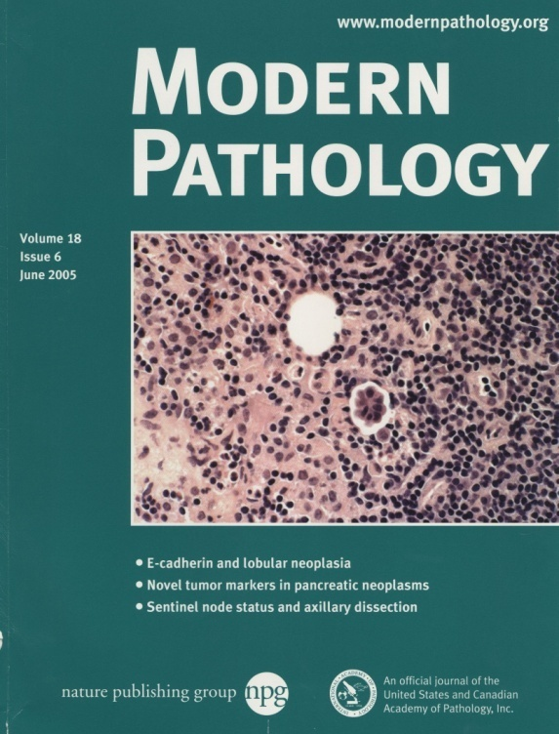

Definition of SN according to our practice ( No need to treat every hot node as a SN).
SN micrometastatic disease not an indication for Complete Axillary dissection.
Risk of NSN positivitiy increases with the size of the SN metastatic desposit.
Metastatic deposits < 5mm correlate with N1a disease
Patients with SN metastatis >5mm have a statistically signifcant higher risk for NSN (+) and pN2-3

Slide 72
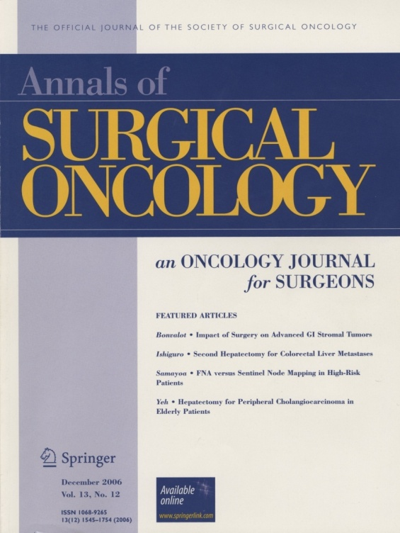
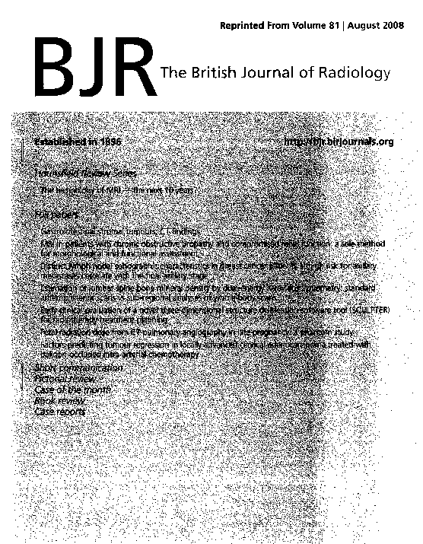
Cost effective method for staging the axilla: identification of all patients with pN2 – 3 disease
Patients with (+) US-FNA axilla probably not candidates for immediate reconstruction (need for radiation to the axilla)
Sonographic LN Cortical abnormalities correlate with pN1a disease
Sonographic LN abnormalities suggesting complete LN replacement even in a single node correlate with pN2 -3 disease

Slide 73
Patients who are clinically node (-)
Low risk for axillary metastasis*
High risk for axillary metastasis**
85% = SN (-)
5-10% = N1a micromet SN (+) only
5% = N1a macromet SN (+) only
Axillary US
US (-)
US (+)
US-FNA
27% = SN (+)
70% = 1 SN (+)
US-FNA (-)
US-FNA (+)
100% = N1a
37% = SN (+)
All N2 disease found here.
* Low Risk (LR) Patients: GI&II tumors < 1.5 cm.
** High Risk (HR) Patients: GII tumors > 1.5 cm
and GIII tumors > 1 cm.
30% = 1 (+) SN
100% = N1a
Samayoa et al. : 1. Br J Radiol. 2008 Aug;81(968):630-6. 2. Ann Surg Oncol. 2008 Jan;15(1):250-5. 3. Ann Surg Oncol. 2007 Aug;14(8):2221-7. 4. Ann Surg Oncol. 2006 Dec;13(12):1545-52.

Slide 74

Patients with suspicious radiographic findings and clinically negative axilla
Breast US-FNA
Negative Atypical or Suspicious
Immediate evaluation
Core Biopsy
Positive
Extent of Primary Disease
Risk of Axillary Metastasis
Unifocal
Multifocal
Low risk
High Risk*
SN Mapping only
Axillary US
Breast Conservation
Mastectomy
Normal
Abnormal
Less aggressive axillary dissection (SN and nodes in close proximity to SN)
Axillary US-FNA
* > 1.5 cm. Breast primary with high nuclear grade
Negative
Positive
Complete Axillary Dissection

Slide 75
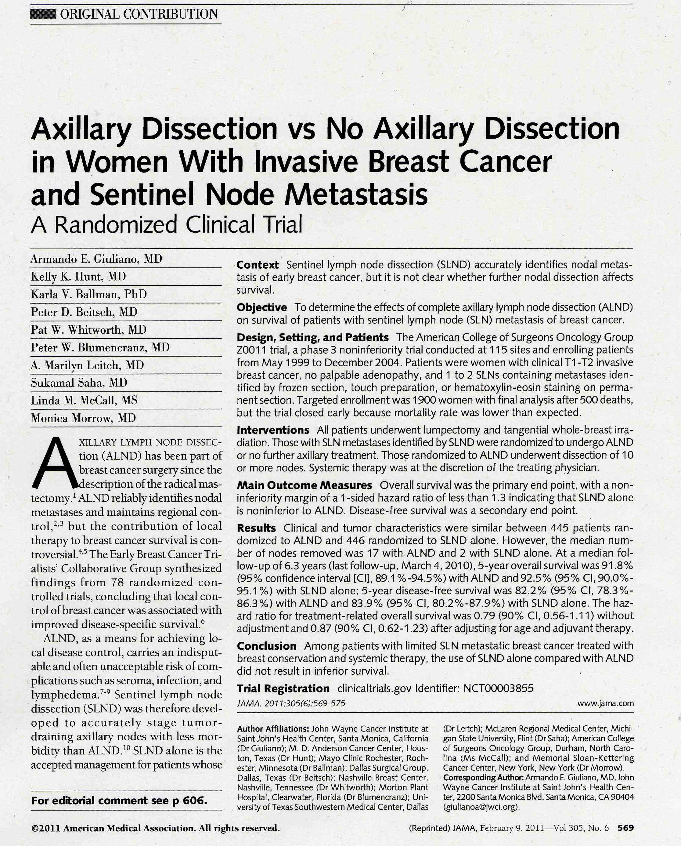
Notes:
These are the patients that will probably benefit the most if we could preoperatively identified
And also if er (+); her2 (-) candidates for Oncotype and therefore determine need for Chemotherapy

Slide 76
Don’t Rely on The Today Show for your Medical Information

Slide 77
ACOSOG Z-0011
Determine the effects of ALND on overall survival in pts with SLN metasteses treated in the contemporary era of breast conservation

Slide 78
ACOSOG Z-0011
Phase III randomized trial
  Pts with positive SLN randomized to standard ALND vs SLNB only
115 sites
1999-2004
Targeted enrollment 1900 final analysis after 500 deaths

Slide 79
ACOSOG Z-0011
Inclusion criteria:
  Invasive breast cancer ≤ 5 cm
  Clinically negative nodes
  (no palpable adenopathy)
  Lumpectomy with sentinel node biopsy, radiation Rx
  Metastatic carcinoma in sentinel node

Slide 80
ACOSOG Z-0011
Exclusion criteria
  3 or more positive SLNs
  Matted lymph nodes
  Gross extranodal disease
  Neoadjuvant therapy
  No mastectomy

Slide 81
ACOSOG Z-0011
Primary endpoint
  Overall survival
  Surgical morbidities
Secondary endpoint
  DFS (locoregional, distant)

Slide 82
ACOSOG Z-0011
Statistical analysis
  Assumed 80% OS @ 5 years
  Needed 500 deaths to confirm non-inferiority
  Planned enrollment 1900 pts in 4 years with minimum f/u 5 years

Slide 83
ACOSOG Z-0011
Closed early due to
  Low accrual 891/1900
  Low mortality rate
  Even with 1900 pts accrued
  would take > 20 years to observe 500 deaths

Slide 84
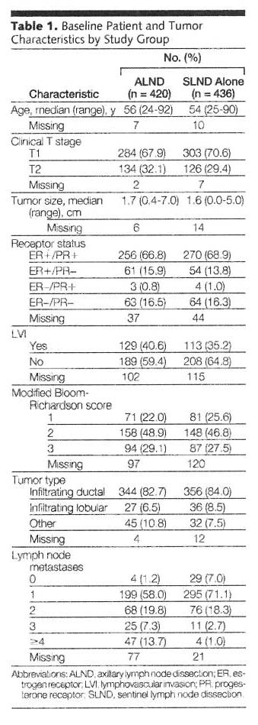
Giuliano, A., et.al. Axillary Dissection vs No Axillary Dissection in Women with Invasive Breast Cancer and Sentinel Node Metastasis A Rendomized Clinical Trial. JAMA, February 9, 2011 – Vol 305, No. 6, pp 571

Slide 85
ACOSOG Z-0011
Treatment Results
 | ALND | SLND – alone
Median # nodes removed | 17 (13-22) | 2 (1-4)
Median # nodes positive | 1 | 1
Micromets | 37% | 45%
≥ 3 nodes | 21% | 4%
≤ 4 nodes | 14% | 1%

Slide 86
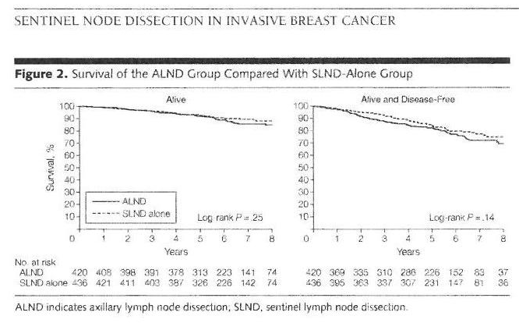
Giuliano, A., et.al. Axillary Dissection vs No Axillary Dissection in Women with Invasive Breast Cancer and Sentinel Node Metastasis A Rendomized Clinical Trial. JAMA, February 9, 2011 – Vol 305, No. 6, pp 572

Slide 87
ACOSOG Z-0011
Survival
  5 yr OS ~ 92% substantially higher than anticipated
  No difference if grouped by hormone receptor status
  5 year DFS ~ 83%
  5 year LR 3.1% (ALND) and 1.6% SLND - alone

Slide 88
ACOSOG Z-0011
Conclusion
  ALND may no longer be justified
  for patients with
    T1-T2 tumors
    SLN metastasis 1-2 nodes
    Breast conservation whole breast RT
    Adjuvant systemic Rx

Slide 89
ACOSOG Z-0011
Conclusion (cont)
  Study did not include pts
    Mastectomy
    Partial breast RT
    Lumpectomy w/o RT
    Neoadjuvant therapy
    Whole breast radiation in prone position
    *in these patients ALND remains standard practice

Slide 90
Recommendation for Management of Axilla in Breast Cancer Patients with Clinically Negative Nodes:
Pre-op ultrasound for high risk lesions
FNA biopsy suspicious nodes
SLN bx: determine size of metastatic deposit
Remove few additional nodes if deposit > 5 mm
Important to thoroughly palpate surrounding nodes
Avoid return to OR for completion ALND

Slide 91
Take Advantage of Forced Changes in Treatment Plan

Slide 92
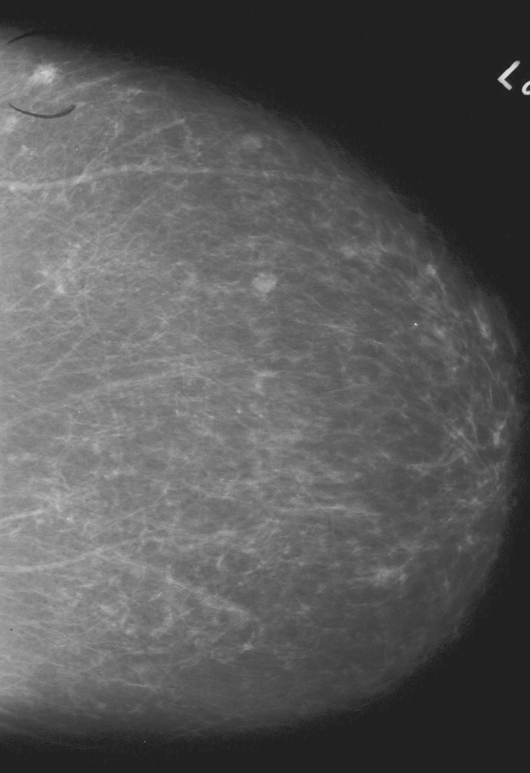
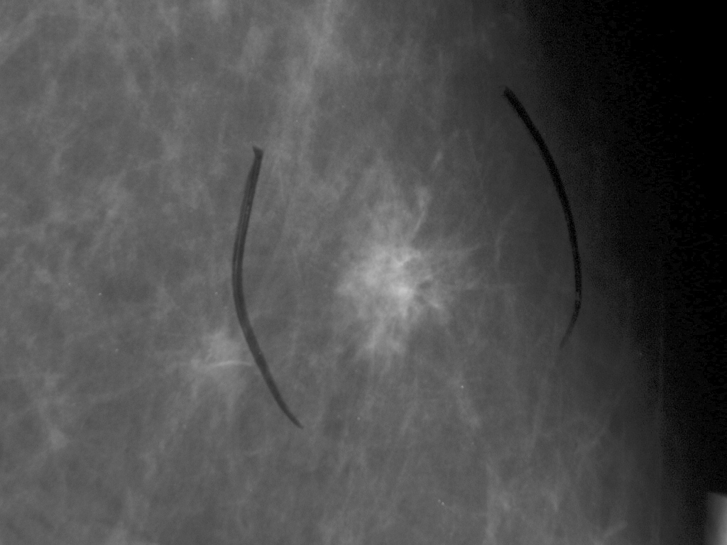

Slide 93
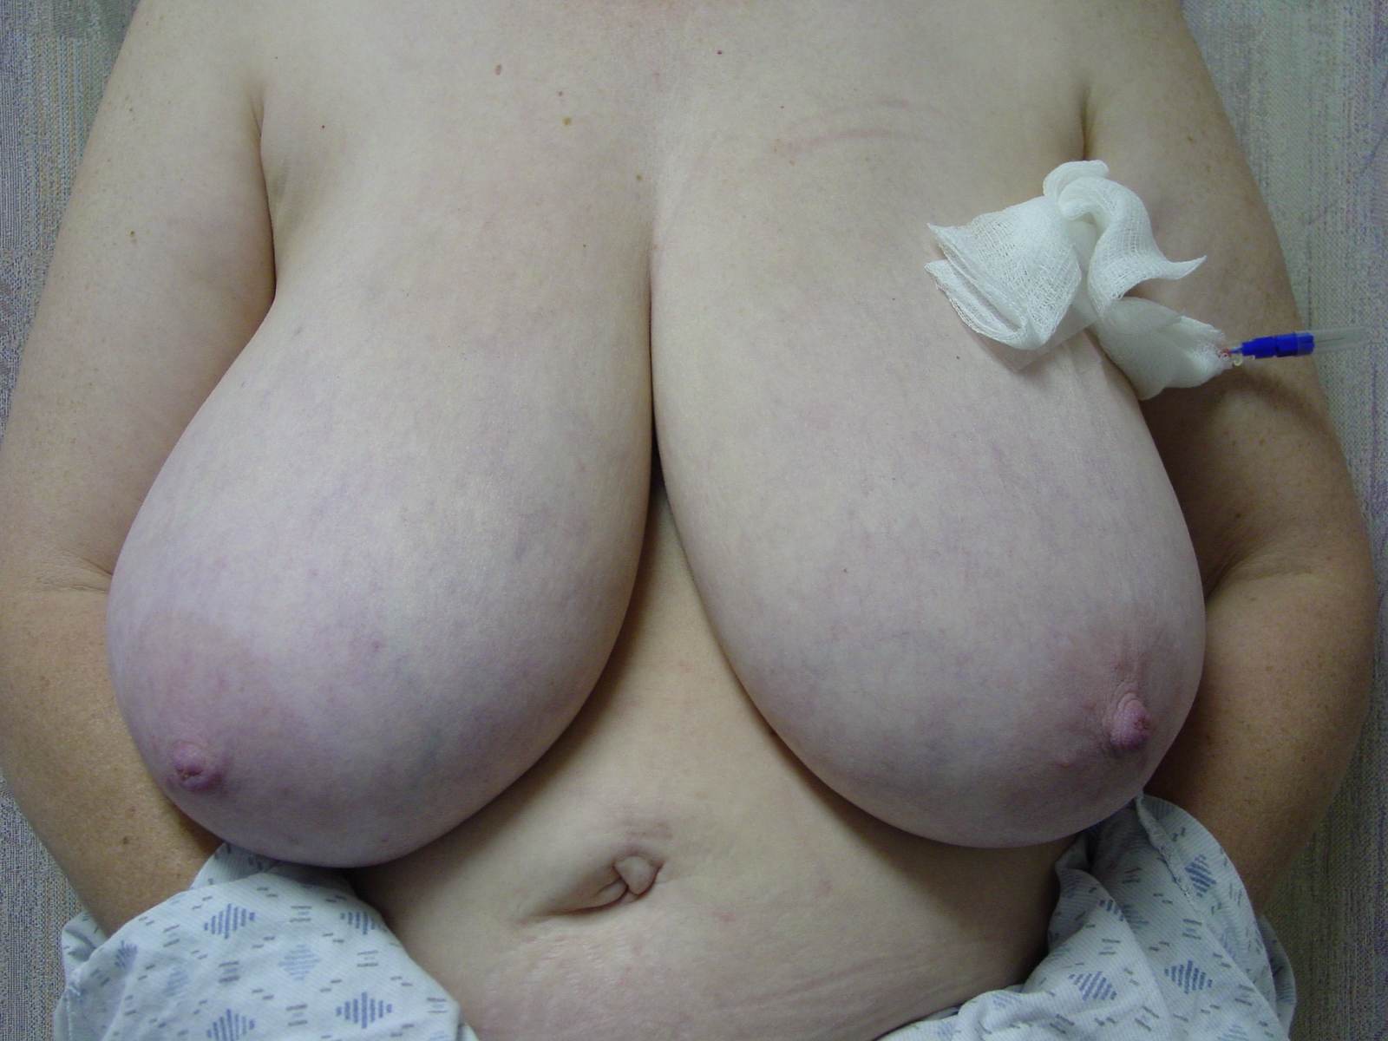

Slide 94
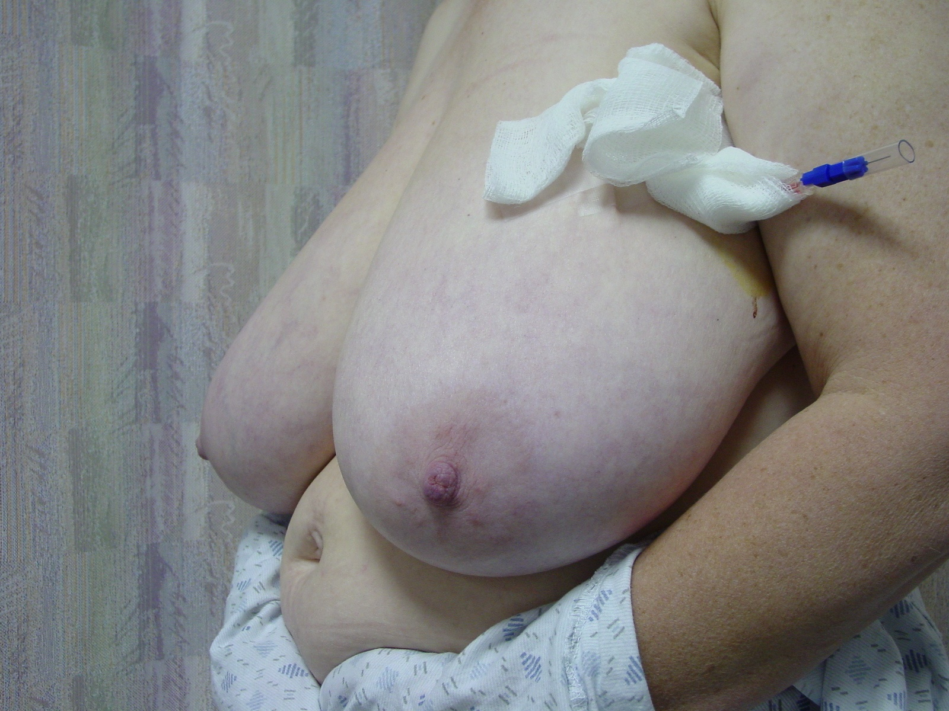

Slide 95
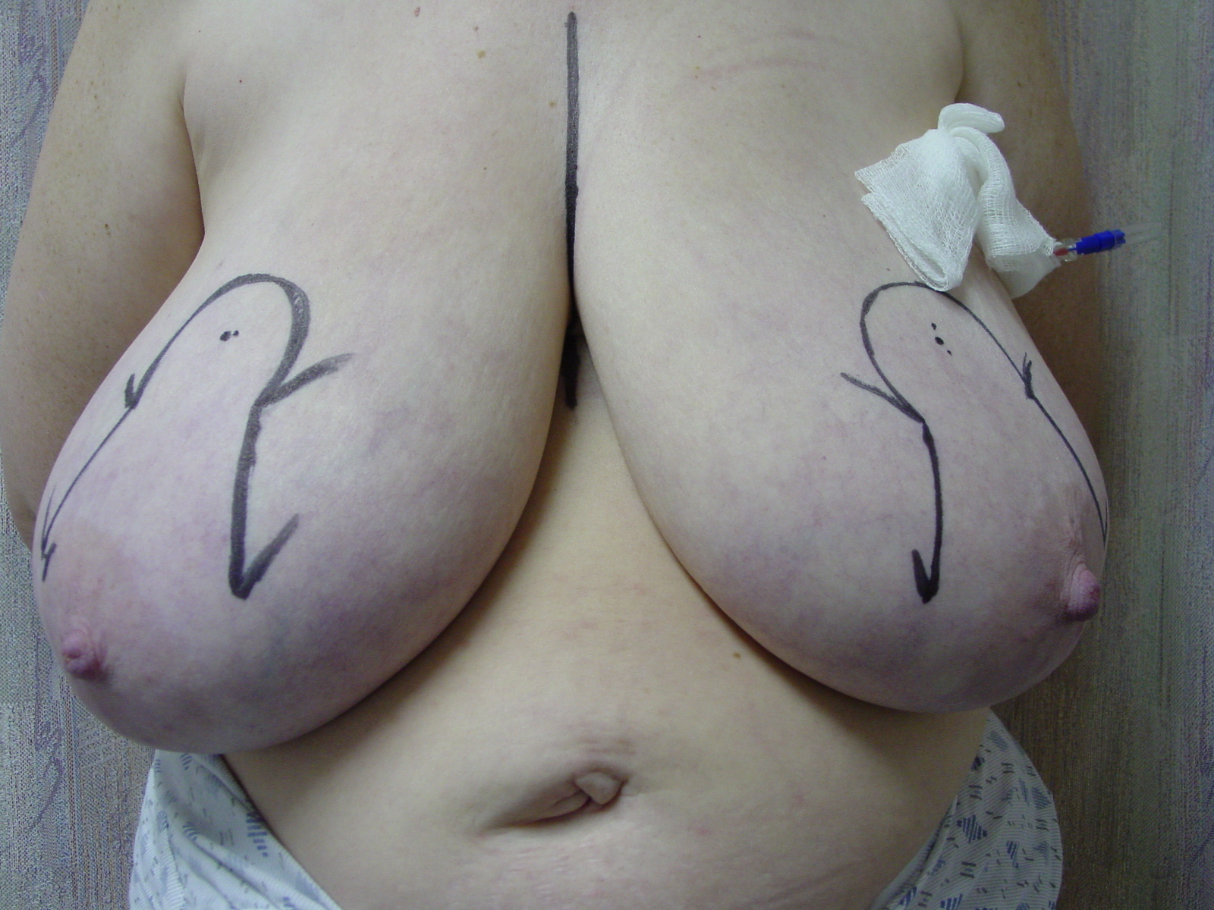

Slide 96
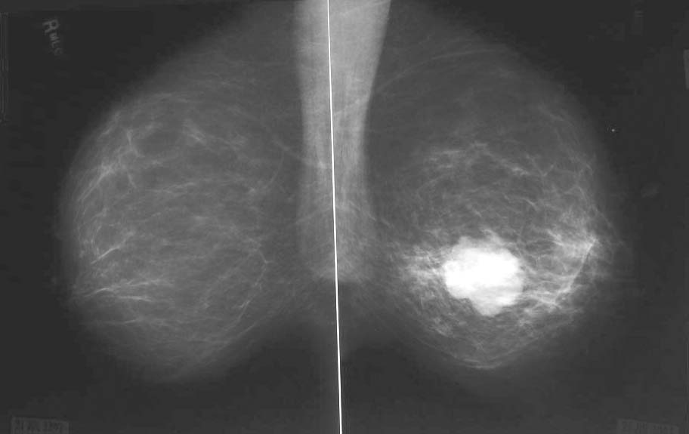

Slide 97
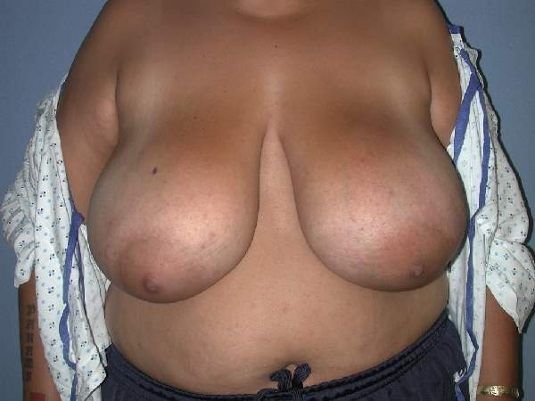

Slide 98
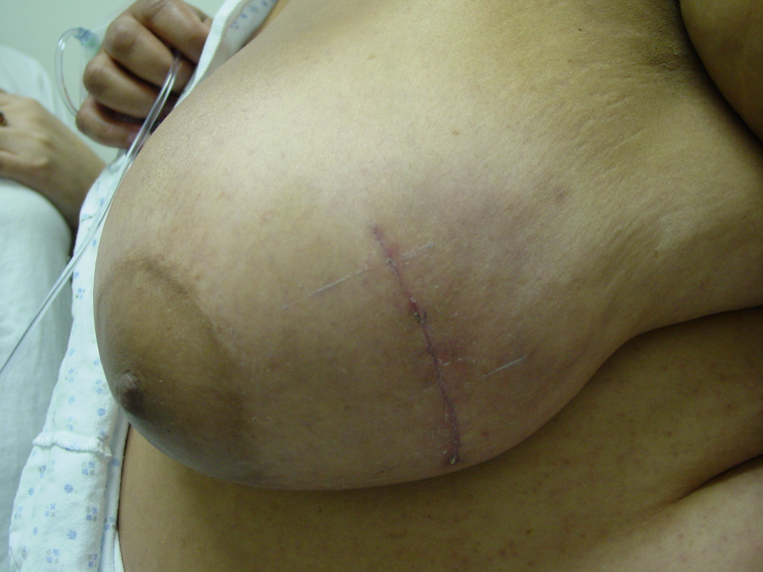

Slide 99
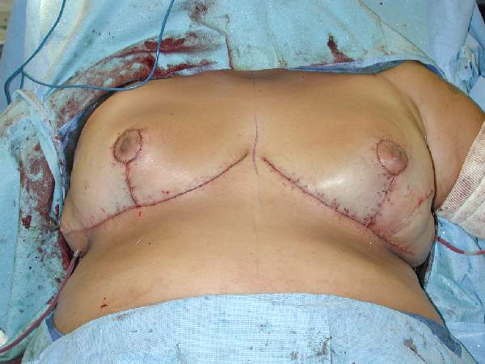

Slide 100
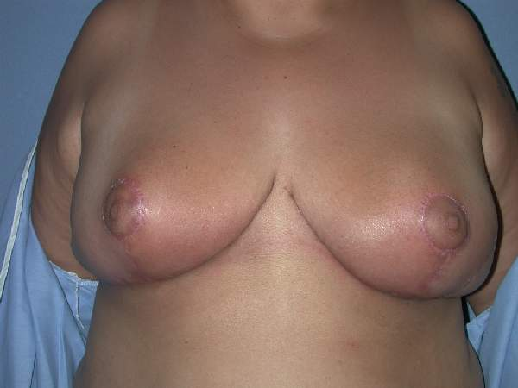

Slide 102
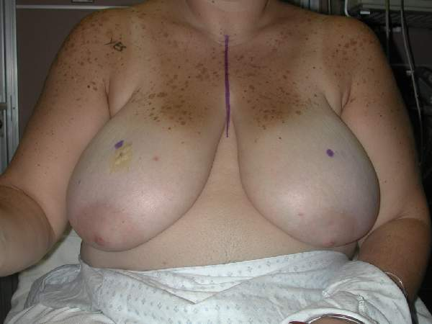

Slide 103
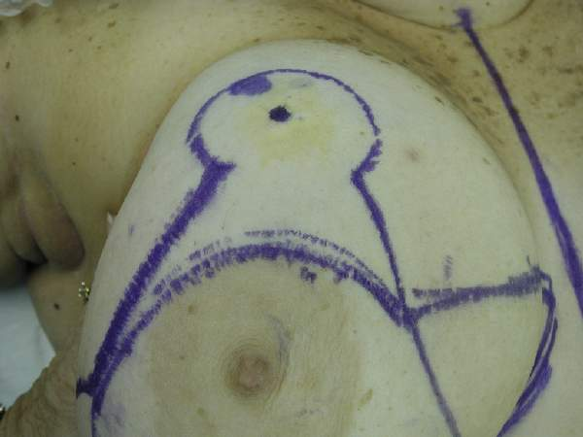

Slide 104
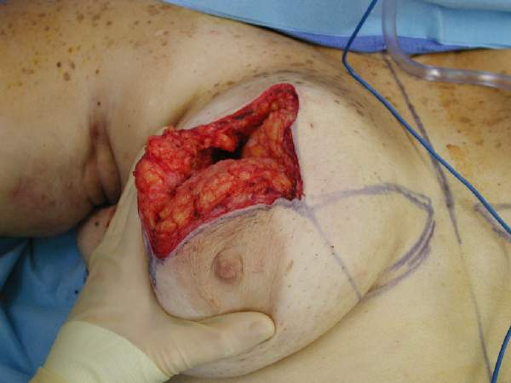

Slide 105
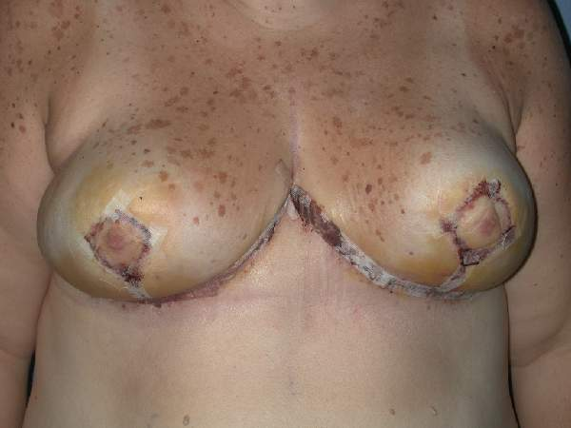

Slide 106
Pay Attention at Tumor Board

Slide 107
Tumor Board Presentation – T.D.
72 y/o w/m 6 months s/p diverting colostomy for “unresectable” carcinoma splenic flexure
15 cm tumor w/ involvement of spleen and significant portion of greater curvature of stomach
Rx’d with 5-FU & Interferon with dramatic response

Slide 108
There is nothing in the LUQ that can’t go

Slide 109
Hospital Course – T.D.
Left colectomy, splenectomy & partial gastrectomy
Pathology: MWD adenocarcinoma of colon with extension into spleen & stomach 0/27 nodes, margins clear
2 months 5 FU & Interferon
5 year NED

Slide 110
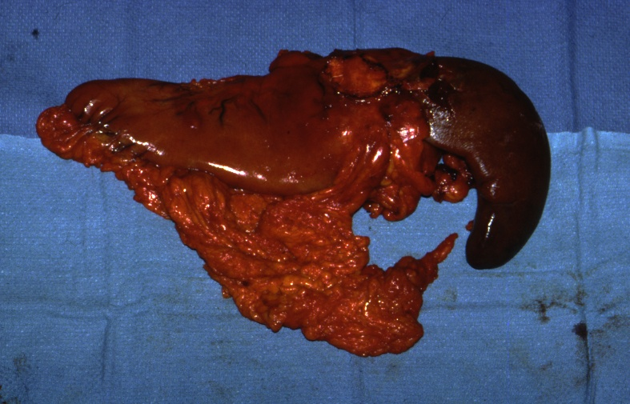

Slide 111


Slide 112


Slide 113


Slide 114


Slide 115


Slide 116


Slide 117
Be Aware of Changes in Treatment Plans

Slide 118
Presentation – W.M.
18 y/o w/m presents LLQ abdominal pain, abdominal distention & 20 lb weight loss
CT scan: 9 cm pelvic mass w/ colonic obstruction
Biopsy: Adenocarcinoma of rectum 7 cm from anal verge

Slide 119
Treatment Summary – W.M.
Diverting colostomy
RT – 5940cGy & continous infusion 5-FU
Significant clinical response
Definitive surgical resection: LAR w/ EEA stapled anastomosis
Path T3N0M0

Slide 120
Subsequent Course – W.M.
Anastomotic leak w/ pelvic abscess
Diverting transverse colostomy: mucous fistula drainage of abscess
Tumor board presentation

Slide 121
Long Term Follow-up – W.M.
Developed significant retroperitoneal fibrosis with ureteral obstruction 6 years post-op
Planned ileal conduit
Patient requested colostomy takedown
Extensive evaluation of rectum indicating normal compliance & function
Combined procedure: uneventful

Slide 122
Long Term Follow-up – W.M.
Two months s/p colostomy takedown patient presented with BRBPR
OR: permanent colostomy
Termination of case – pt had massive bleed from rectum
Angio: iliac artery – rectal fistula coiled successfully
Pt remain NED 15 yrs from original dx

Slide 123
Find A Good
Plastic Surgeon

Slide 124


Slide 125


Slide 126


Slide 127


Slide 128


Slide 129


Slide 130


Slide 131


Slide 132


Slide 133


Slide 134


Slide 135
Sometimes you get lucky

Slide 136


Slide 137
Surgical Oncology
Lessons Learned
Starts with Good Mentors
Wide Variety of Operations
Fascinating Biology
More Successes than Failures
Hard to Say “No”
Rewarding Physician-Patient Relationship

