Slide 1


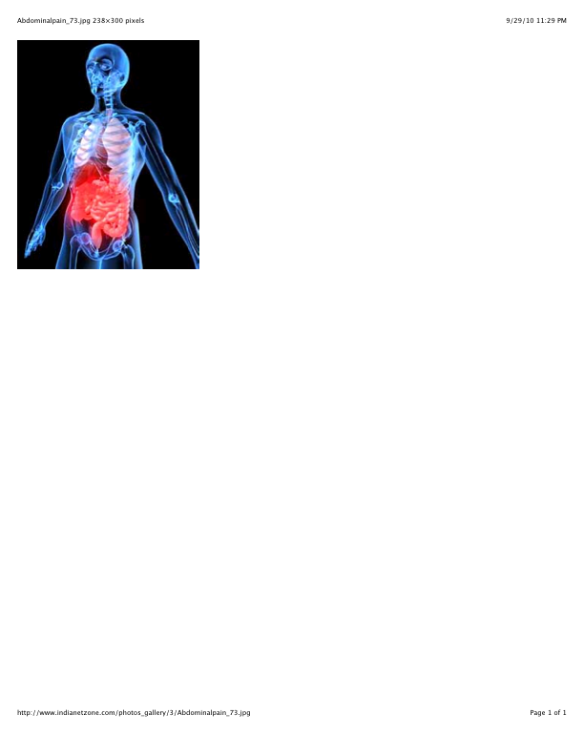
Surgeon-Performed Ultrasound
Amy C. Sisley, MD, MPH, FACS
Banner University Medical Center
University of Arizona College of Medicine - Phoenix
Notes:
Consider increasing focus by adding management questions or summary of management at end of each section

Slide 2
Ultrasound
F
A
S
T
OCUSED
BDOMINAL
ONOGRAPHY IN
RAUMA

Slide 3
FAST EXAM
RAPID
Assessment For
Pericardium
Dependent Portions of Abdomen
FLUID

Slide 4
SUREGEON – PERFORMED ULTRASOUND
I. Moving beyond the FAST examination:
Paracentesis
Thoracentesis
Central Line Placement
Soft Tissue
III. Cardiac Ultrasound

Slide 5
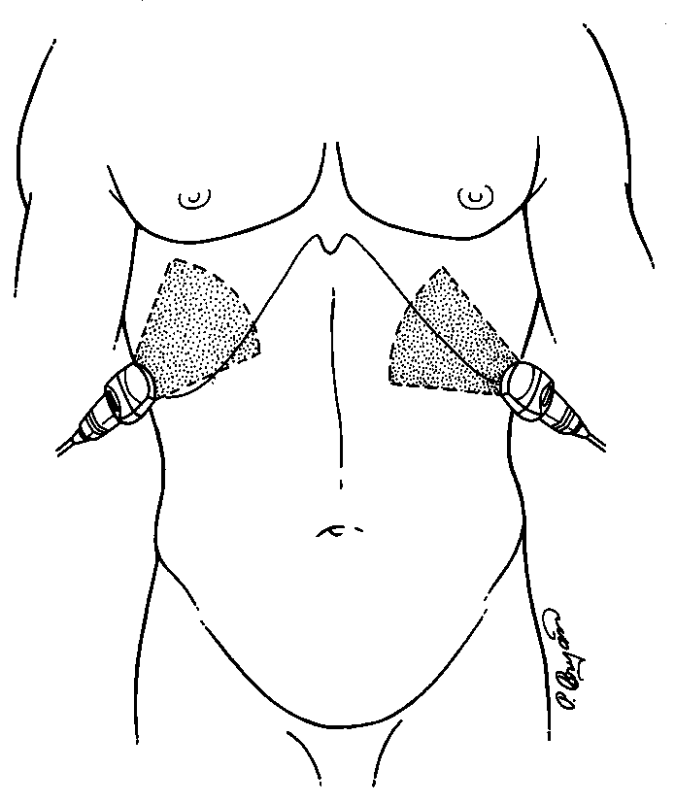
Ultrasound Evaluation of Pleural Fluid
“FAST plus TWO”

Slide 6
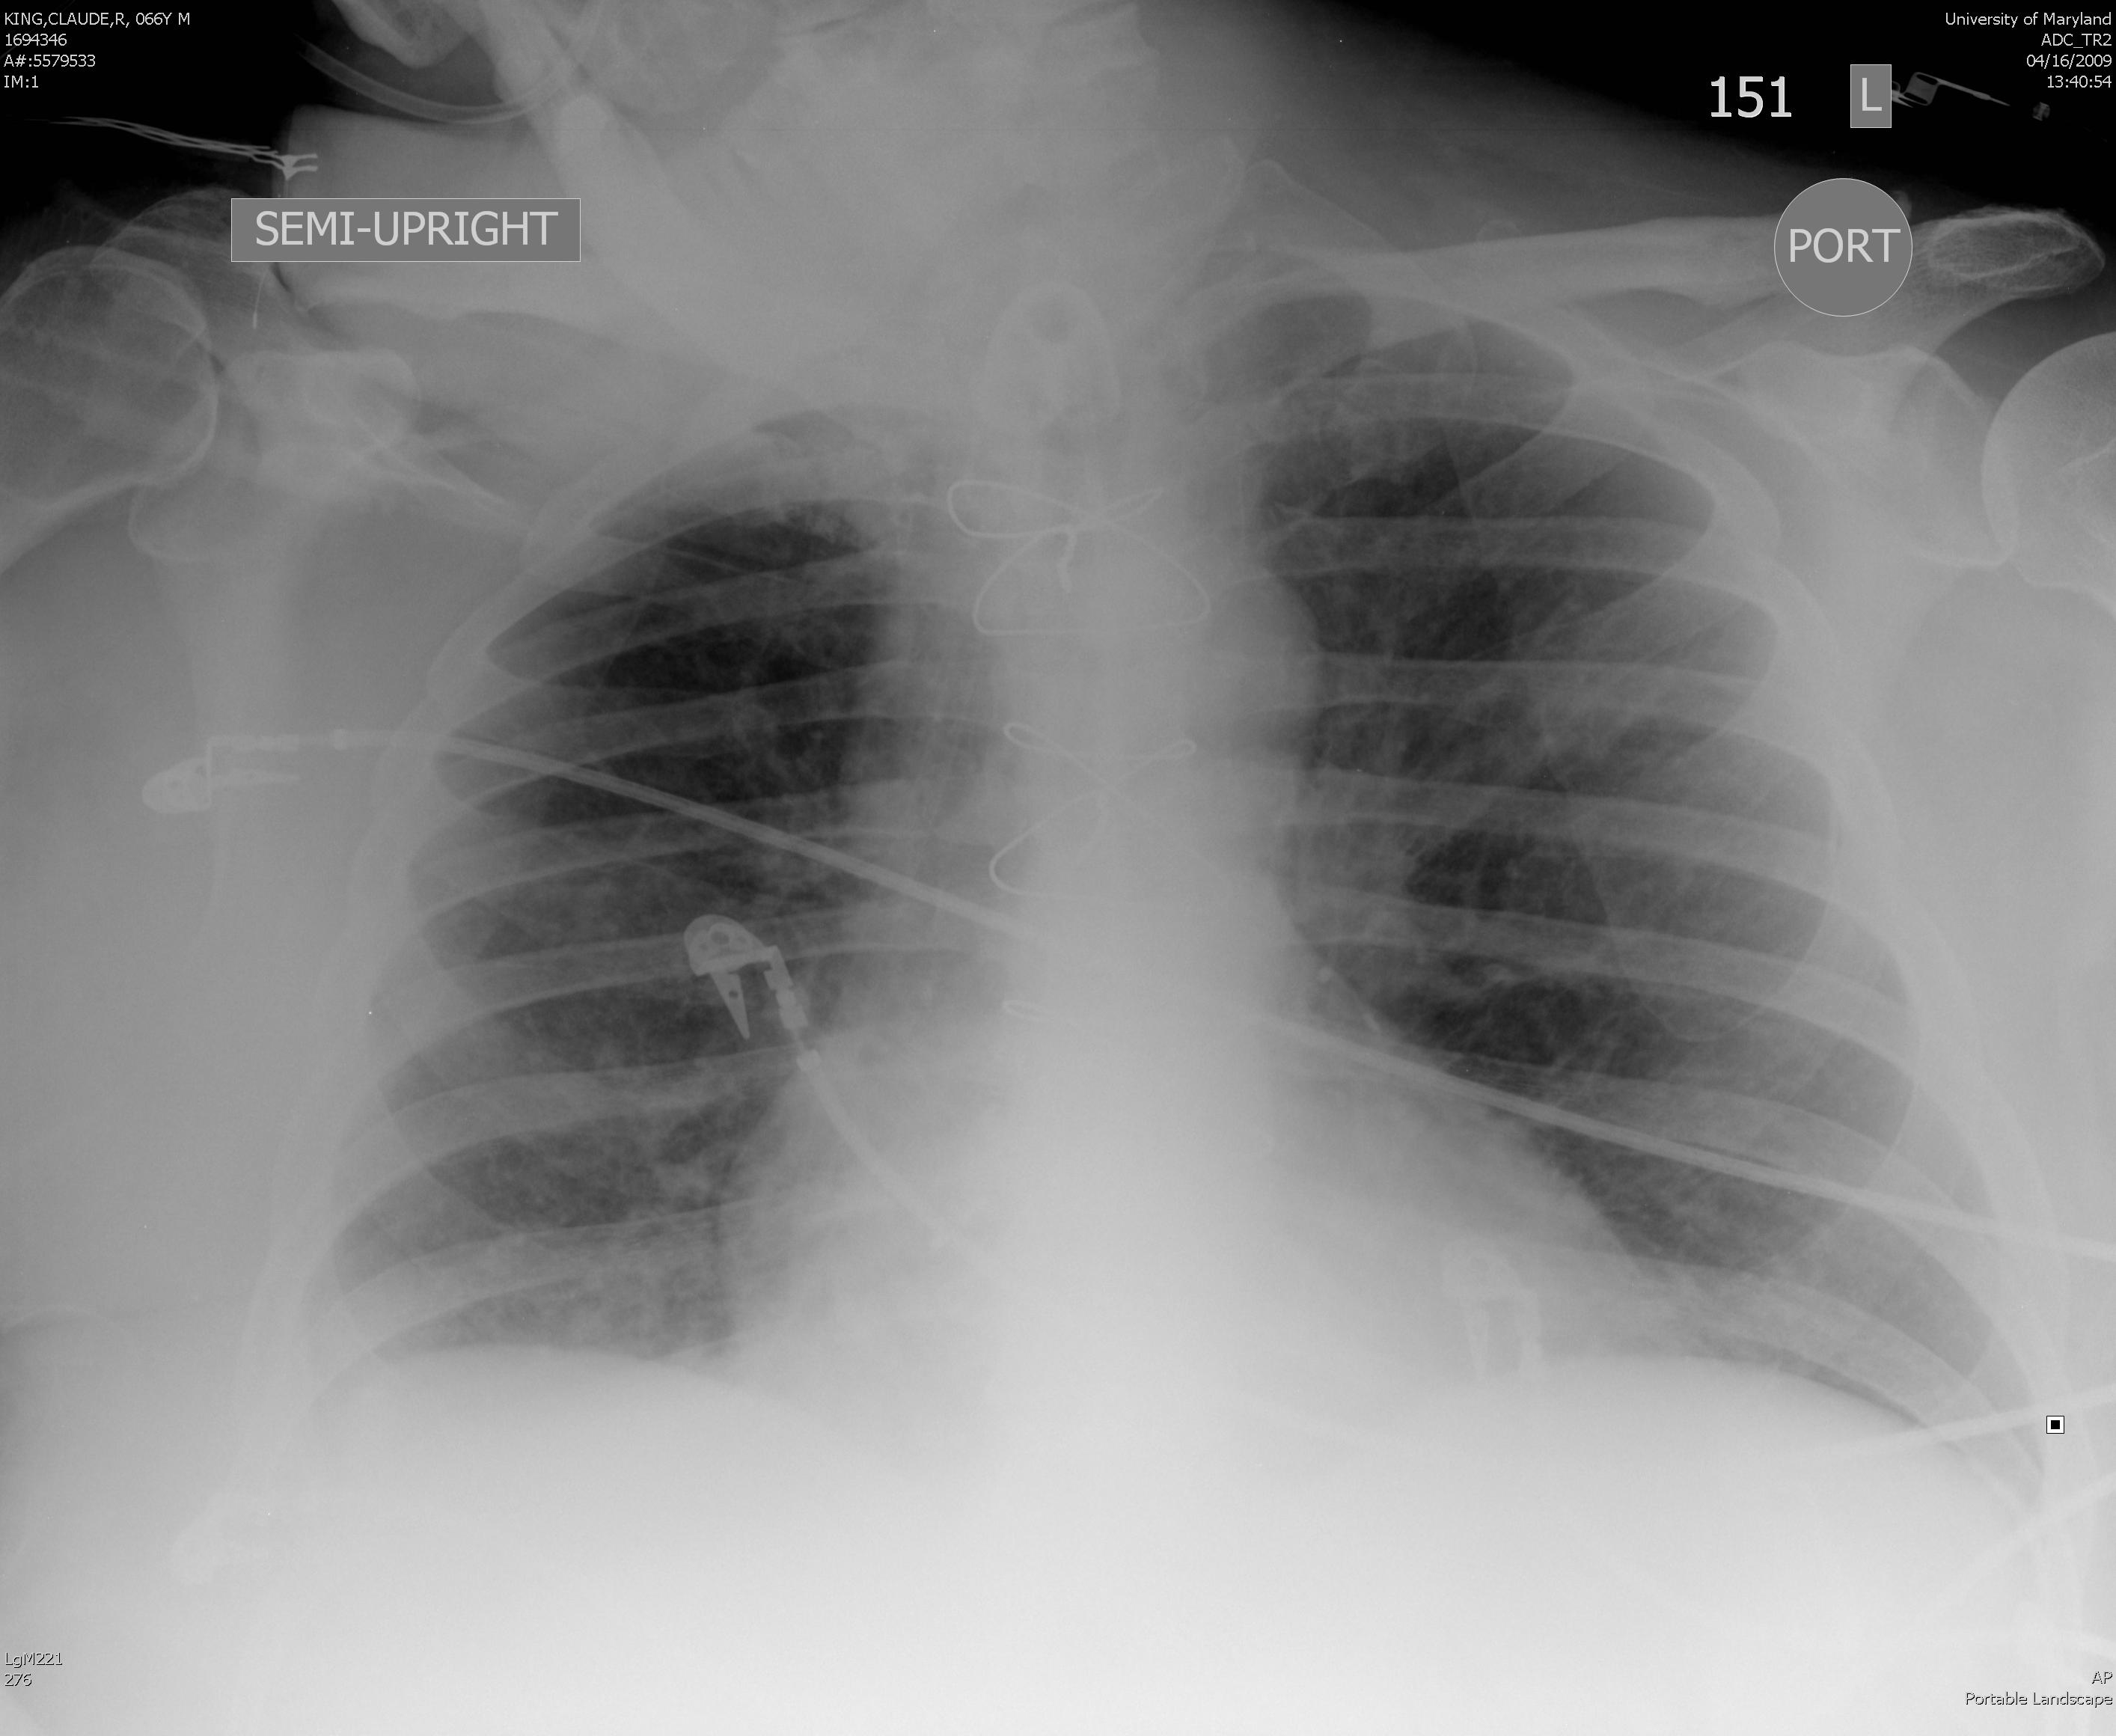
Notes:
Figure!!: Supine portable CXR with haziness

Slide 7
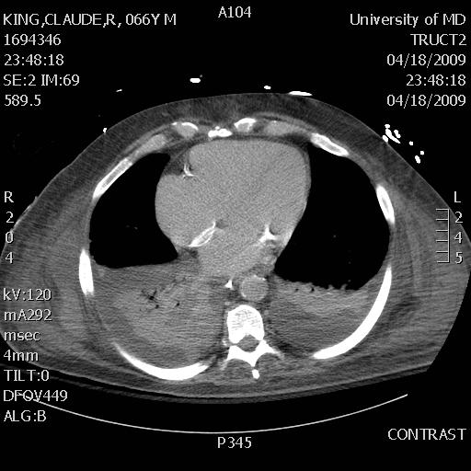
Notes:
Figure III: CT scan of patient in Fig II: Shows lung consolidation with pleural effusion

Slide 8
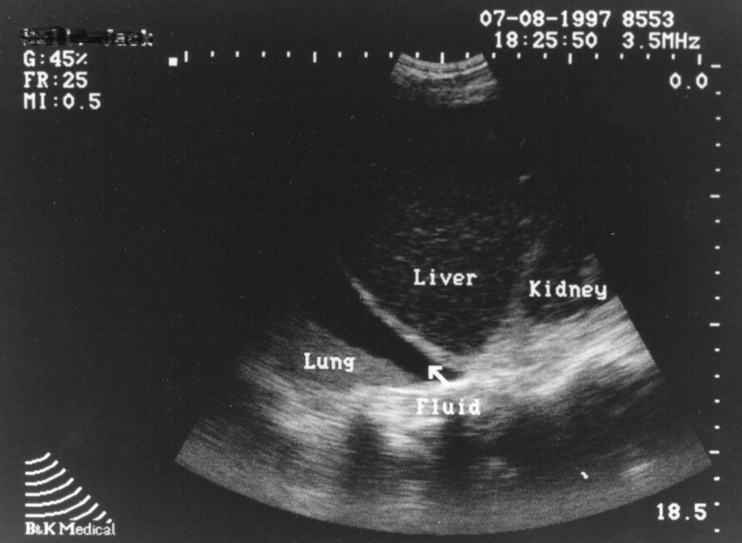
Hemothorax/Effusion

Slide 9
Ultrasound Beyond the FAST
Ultrasound is BOTH Diagnostic and Therapeutic
    Visualization in real time imaging
    Portable
      Performed at bedside
      Avoid transport of the critically ill
      patient
    Repeatable, if necessary

Slide 10
Interventional Ultrasound in the Acute Setting
Thoracentesis
Paracentesis
Central Line Placement

Slide 11
Interventional Ultrasound in the Acute Setting
Thoracentesis
Paracentesis
Central Line Placement

Slide 12
Thoracic Imaging
Sisley, et al. Rapid Detection of Traumatic Effusion Using Surgeon-Performed Ultrasonography. J Trauma 1998.

Slide 13
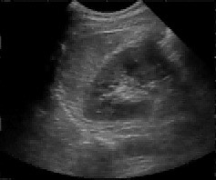

Slide 14
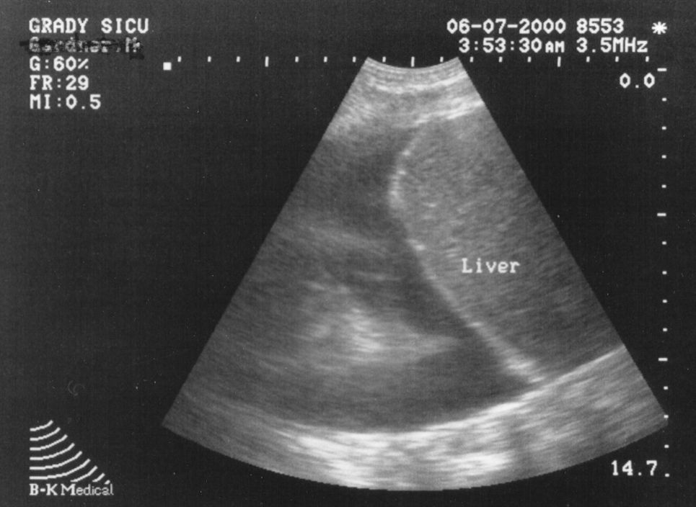
Pleural Effusion
Diaphragm
Lung
Fluid

Slide 15
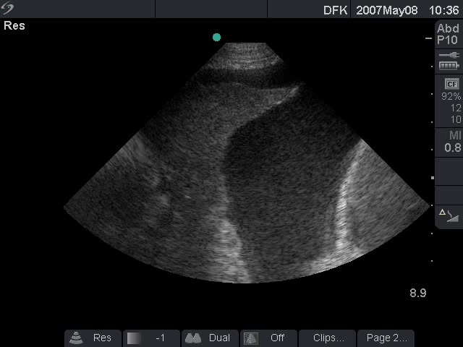
Large Pleural Effusion

Slide 16
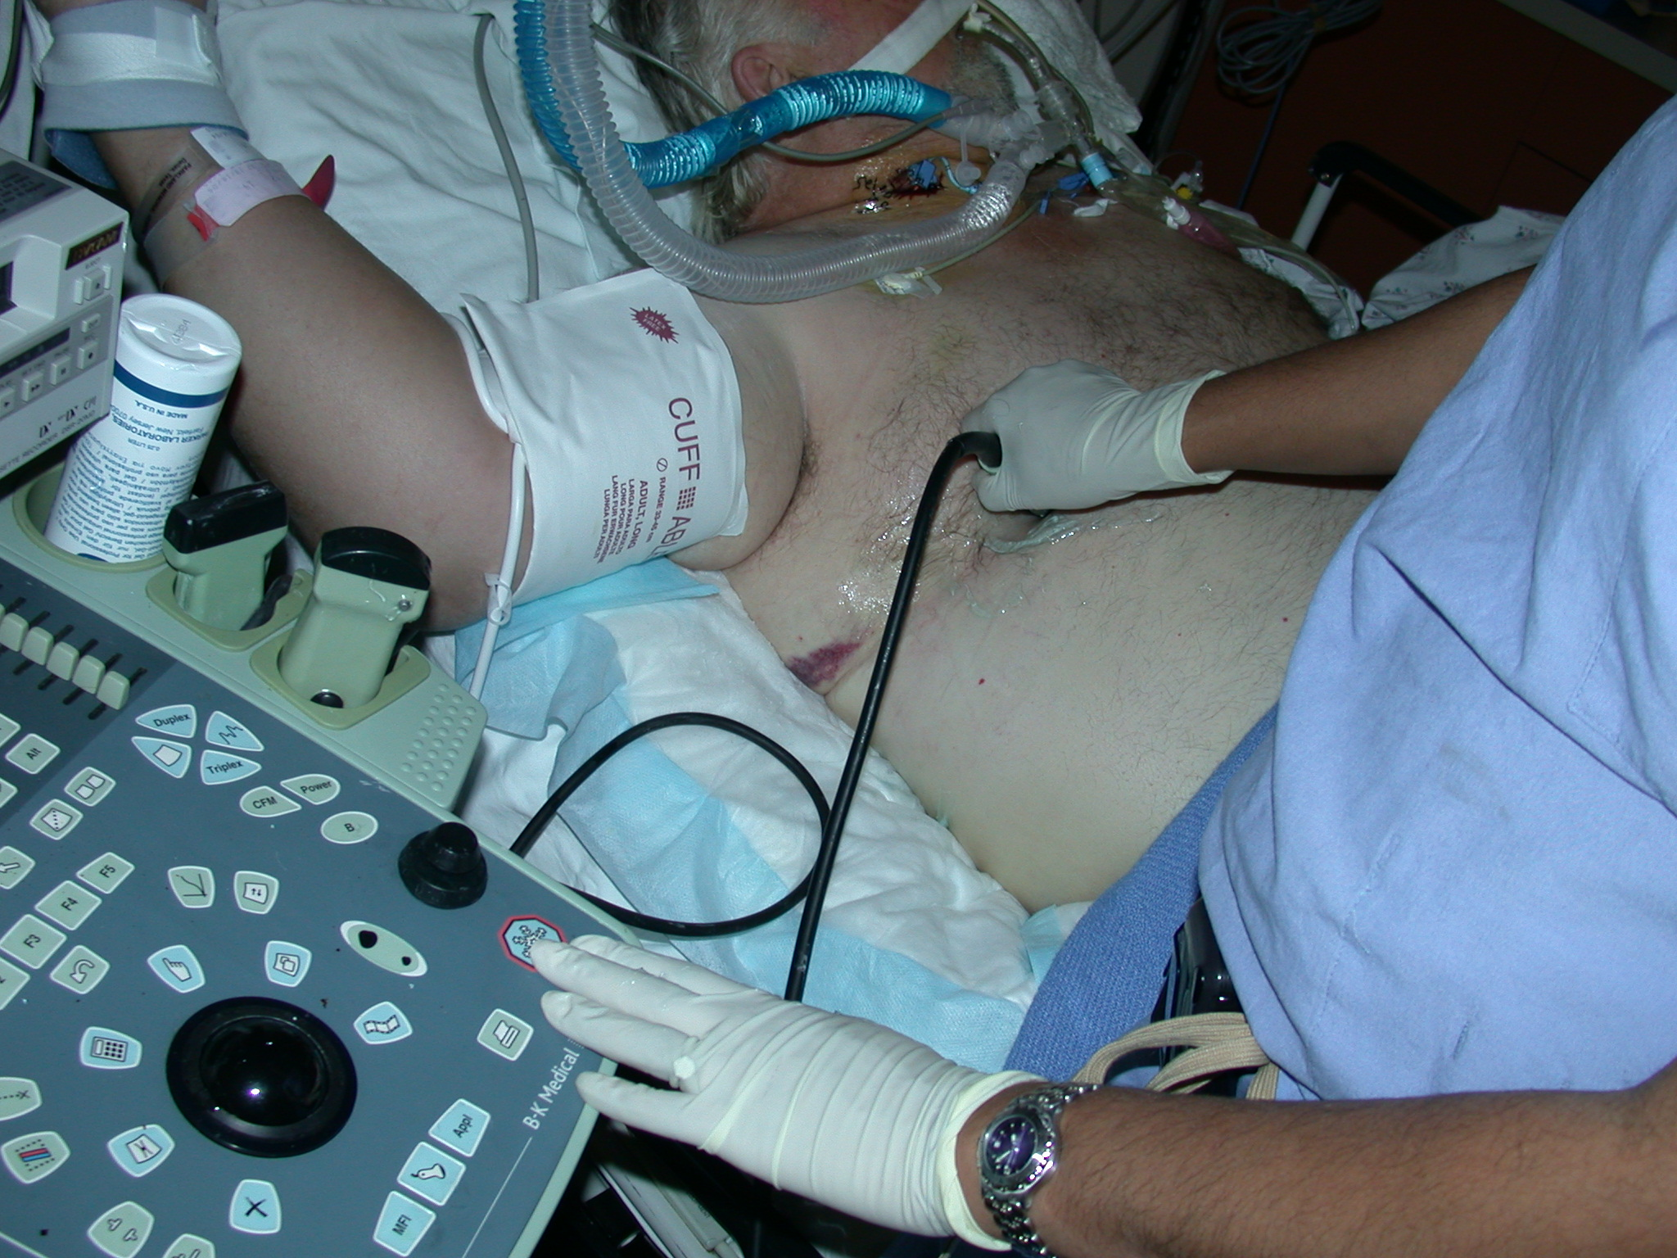

Slide 17
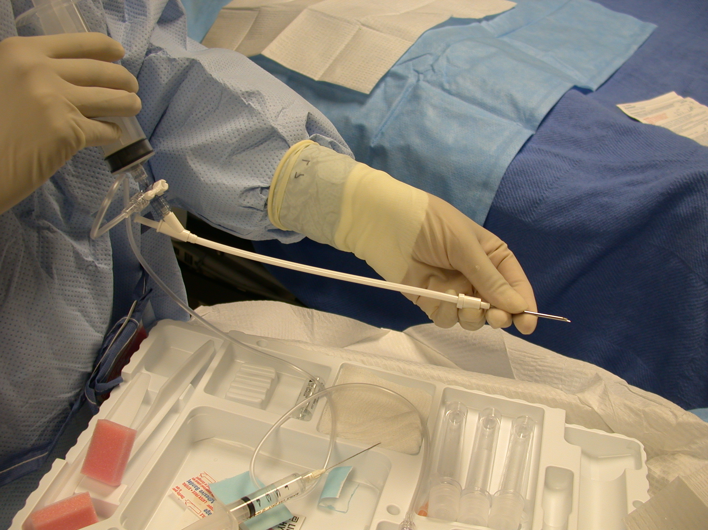

Slide 18
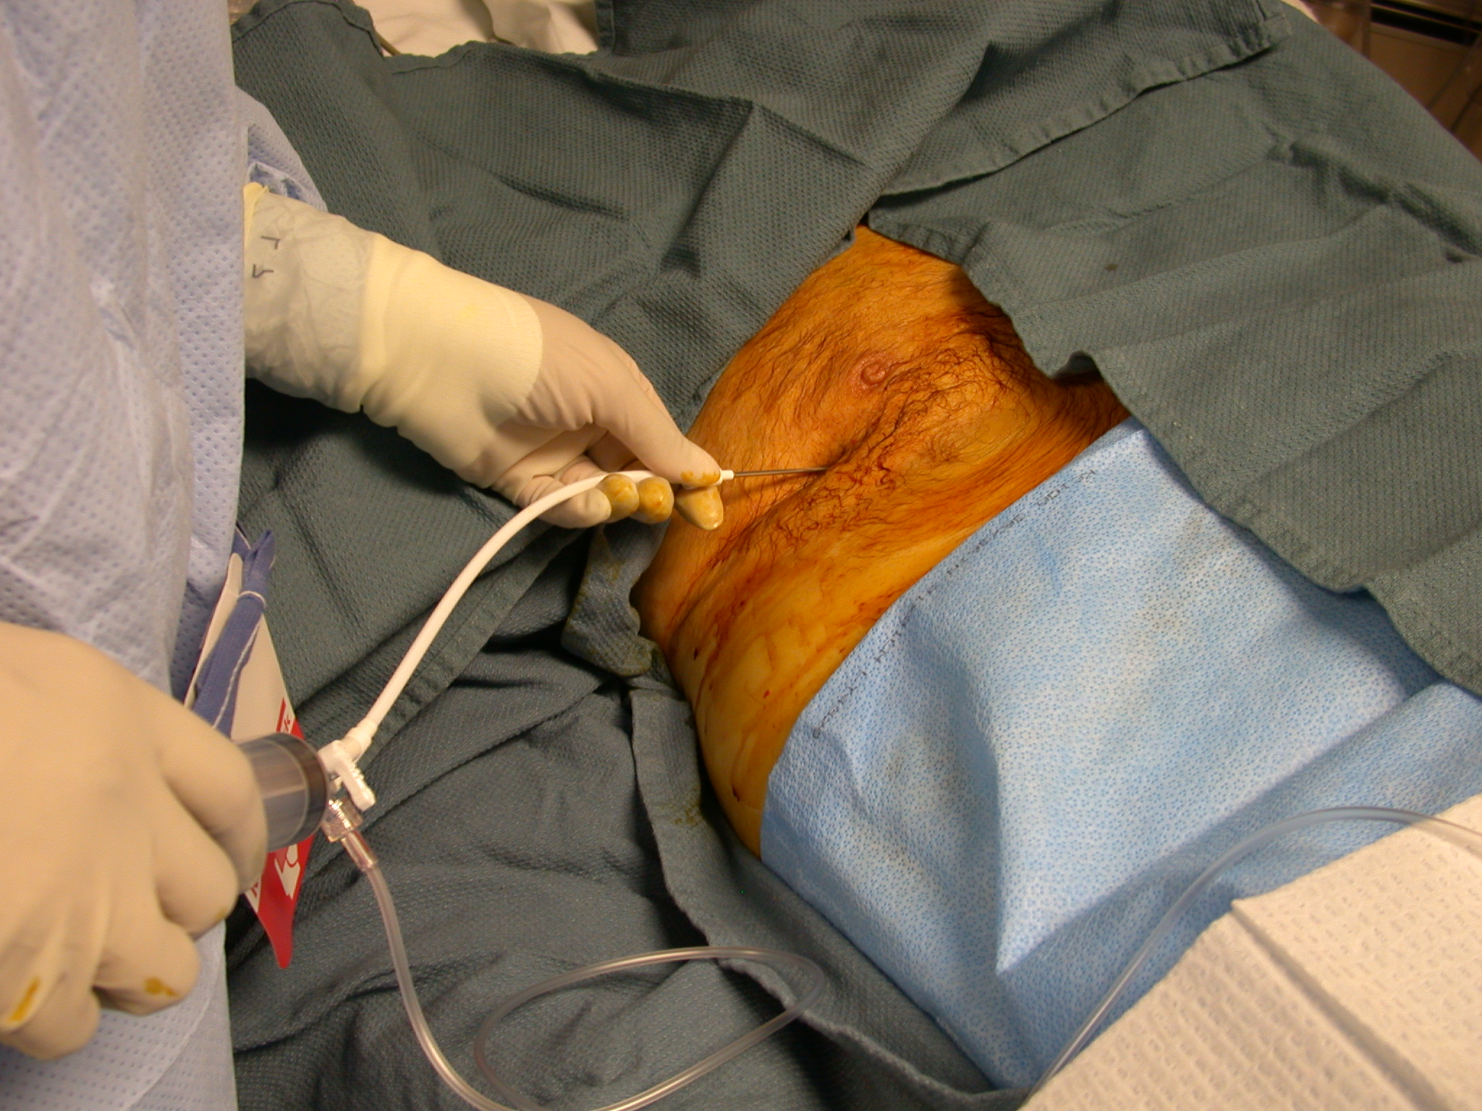
Nipple

Slide 19
Interventional Ultrasound in the Acute Setting
Thoracentesis
Paracentesis
Central Line Placement

Slide 20
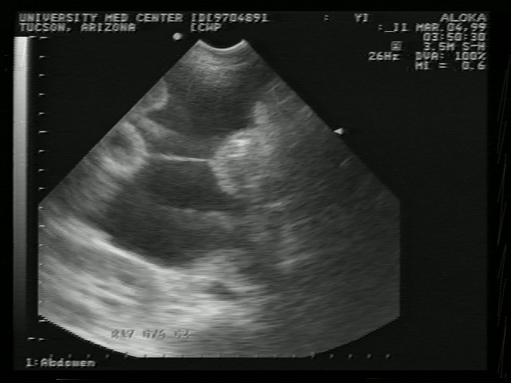

Slide 21
Interventional Ultrasound
Ultrasound Evaluation for
Intraperitoneal Fluid/Blood
Indications:
1. Assessment of sudden hypotension
2. Persistent metabolic acidosis
  3. Follow-up of patient with solid organ injury (nonoperative management)
  4. Detection of ascites
  5. Detection of intraabdominal abscess

Slide 22
Interventional Ultrasound in the Acute Setting
Thoracentesis
Paracentesis
Central Line Placement

Slide 23
Ultrasound Guidance
Allows exact identification and location of artery and vein
Prevents inadvertent artery injury
Decreases risk of hemo/pneumothorax
Allows assessment of patency
Increases efficiency
Decreases time for line placement
Allows post-procedure imaging
Randingdranath, et. al., Cochrane Database Syst Rev, 2011

Slide 24
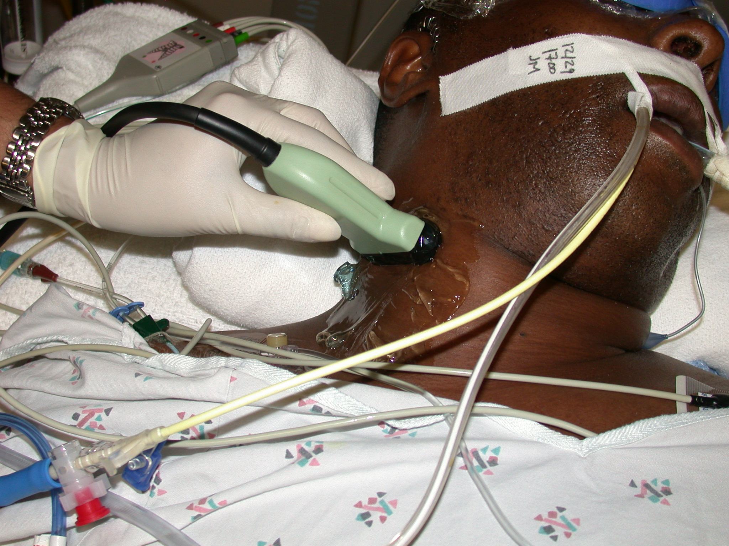

Slide 25
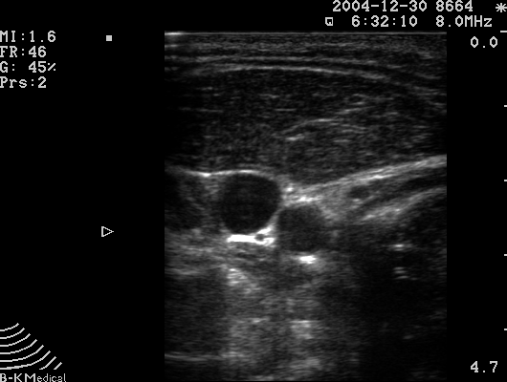
IJ Vein
Carotid Artery

Slide 26
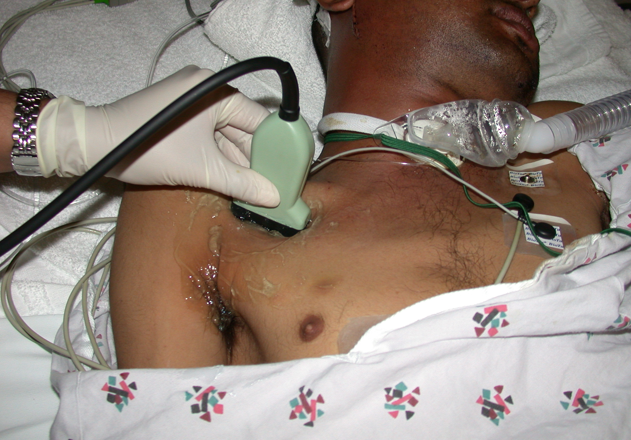

Slide 27
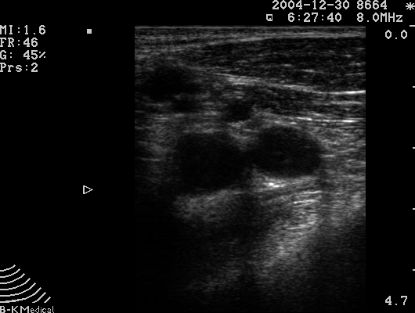
Subclavian Vein
Subclavian Artery

Slide 28
Ultrasound in the Acute Setting
Thoracentesis
Paracentesis
Central Line Placement
Soft Tissue

Slide 29
Ultrasound in the Acute Setting
Soft tissue infections
difficult to assess by physical examination:
  Presence, depth, and extent of infection are better defined with ultrasound
  Surgical decision making is streamlined
        superficial
        loculated
        subfascial

Slide 30
Ultrasound in the Acute Setting
Advantages of ultrasound-directed
needle aspiration of a soft tissue infection
  Localize the collection
  Ensure its complete drainage,
  Delineate fascia precisely
    Fascial dehiscence
    Subfascial abscess
  Identify and remove foreign body*
*Fry, et al. Arch Surg 1995
Hill, et al. Ann Emerg Med 1997)

Slide 31
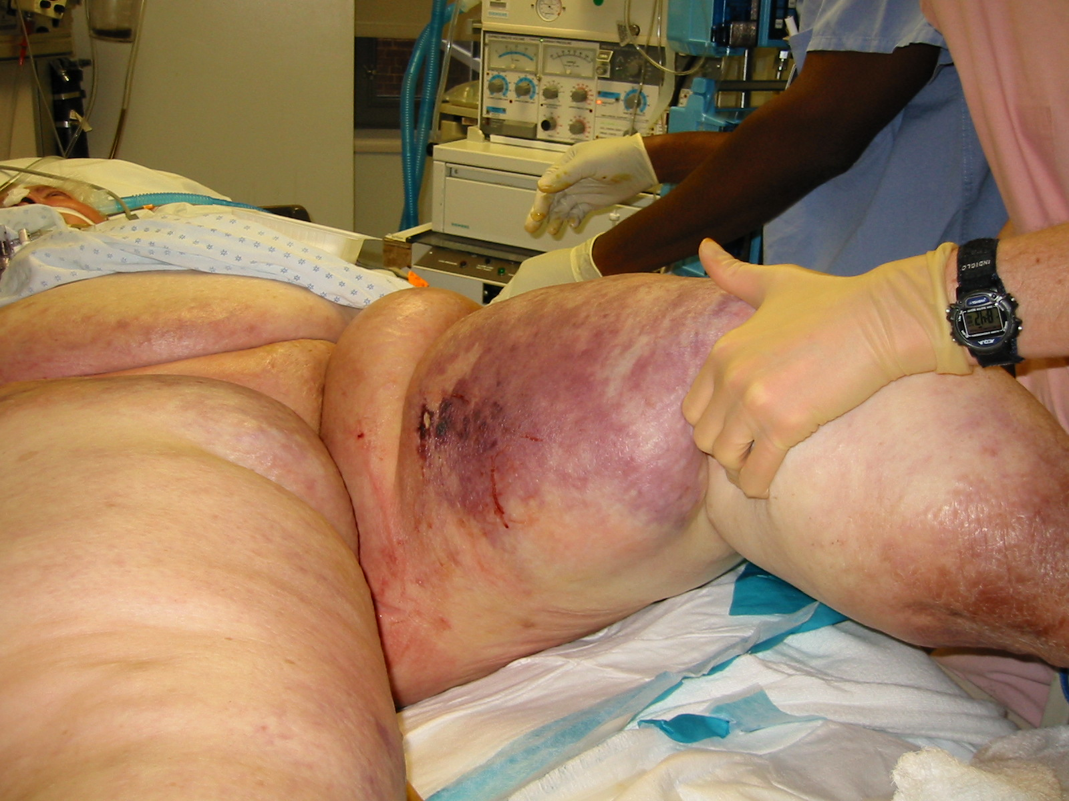
SOFT TISSUES INFECTIONS
Differentiate :
Abscess vs Phlegmon
Delineate:
Depth and Tissue plane

Slide 34
Ultrasound and Soft Tissue Infections
Cellulitis
Myositis
Fasciitis

Slide 38
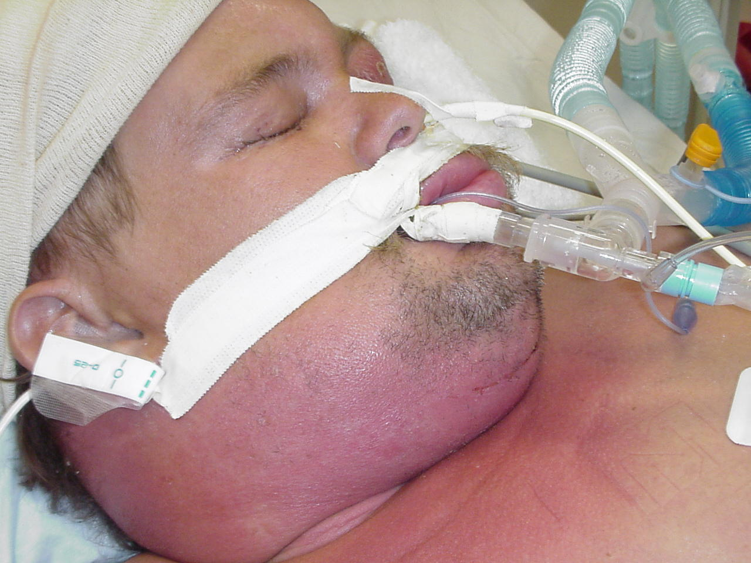

Slide 39
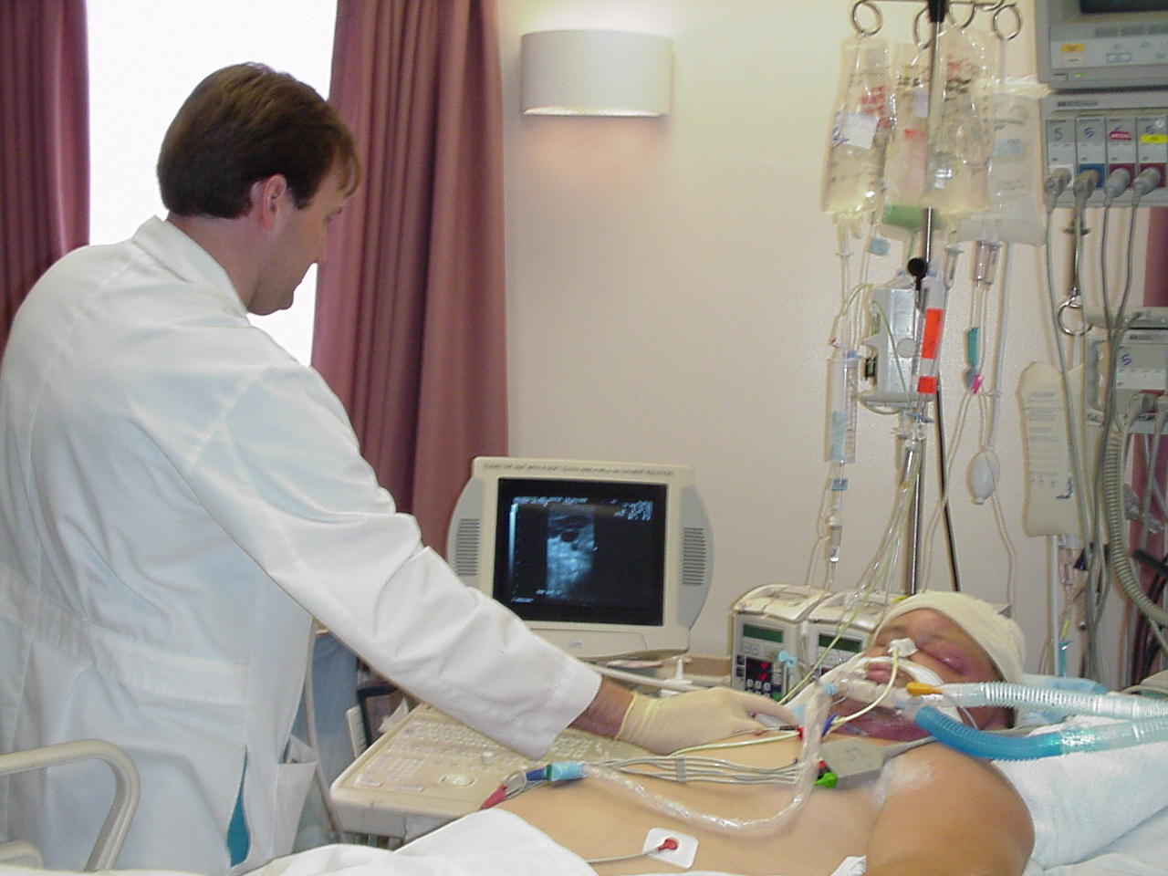

Slide 40
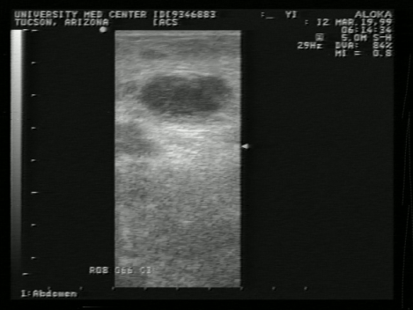

Slide 41
Ultrasound in the Acute Setting
FOREIGN
BODIES

Slide 43
FASCIAL INTEGRITY
Hernias
Wound
Dehiscence

Slide 44
Ultrasound and Soft Tissue Infections
Case: 56 yo male 5 days status post left
inguinal hernia repair with mesh.
Presents to ED c/o:
- redness and swelling
- pain
- no fevers

Slide 45
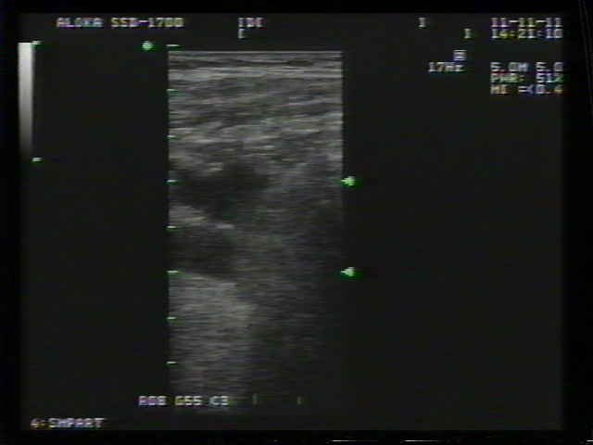

Slide 46

Surgeon Performed Echocardiography

Slide 47
In Trauma

Slide 49
Complications Following CVP Line Insertion
Malposition of the catheter
Hematoma
Arterial puncture
Pneumothorax
Hemorrhage
Sepsis
Catheter embolism
Thrombosis
Hemothorax
Cardiac tamponade
Cardiac arrhythmias
Air emboli

Slide 50
24 studies included 803 patients
Baseline CVP was 8.7 ± 2.32 mm Hg [mean ± SD] in the responders
As compared to 9.7 ± 2.2 mm Hg in non responders (not significant).
Very poor relationship between CVP and blood volume
Chest 2008 JUL134(10172-8

Slide 51
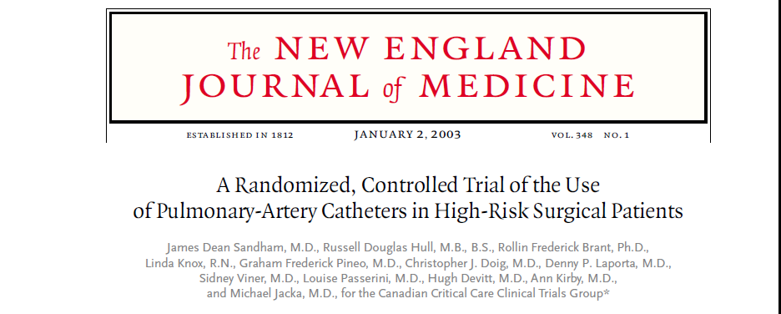
Pulmonary-Artery Catheters
1994 high-risk surgical patients underwent randomization for PA catheters
Preop placement, for elective or urgent surgery
Looked at 6mo and 12 mo mortality
No difference = mortality and length of hospitalization
Increased risk of PE in the catheter group

Slide 52
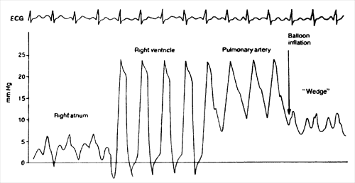
Pulmonary-Artery Catheters
1095 surveys
1/3 incorrectly identified PA occlusion pressure
New Horiz 1997, 5:201-206.

Slide 53
Vigileo
Twenty-nine studies
685 patients
Good correlation in patients receiving mechanical ventilation

Slide 54
Vigileo
N= 685
Poor correlation:
  Arrhythmias
  Obesity
  Spontaneously Breathing

Slide 56
BEAT Exam
Beat/Cardiac Index Estimates
Effusion Assessment
Area/Ventricular Size and Function
Tank/Pre-load Estimates

Slide 57
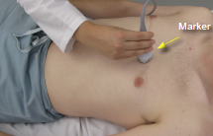
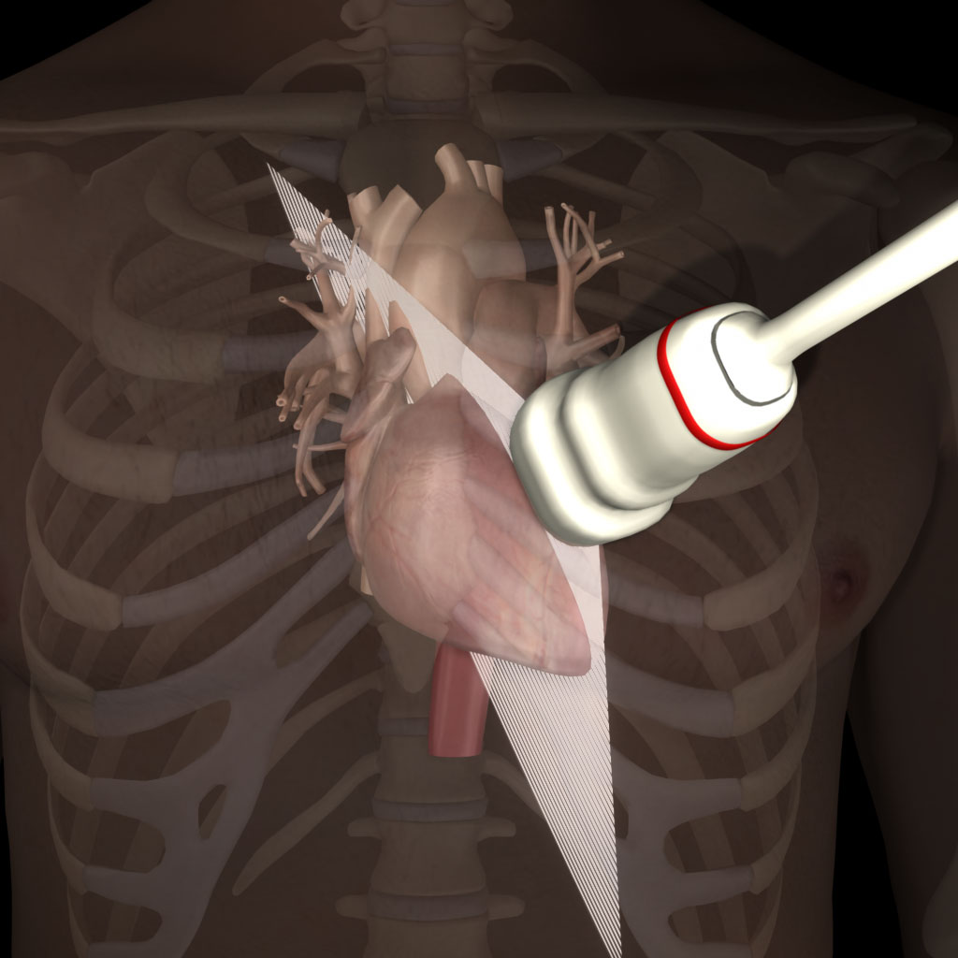
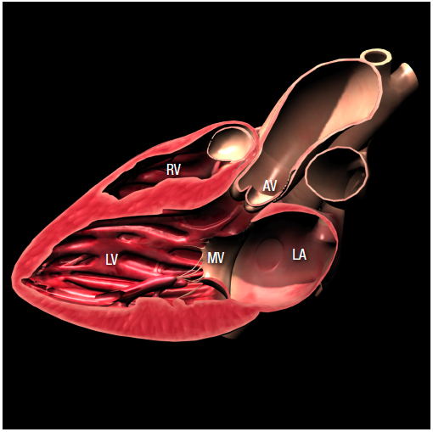
Parasternal Window/Long Axis View
Transducer Placement
About the 3rd or 4th intercostal space, left sternal border
Footprint pointing towards the spine
Long axis= Transducer marker at 10 o’clock or towards the right shoulder
Notes:
Describe the transducer position
Review the anatomy (LA, MV, LV, AV, RV)
No movies in this slide

Slide 58
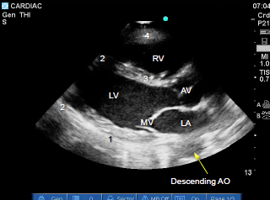
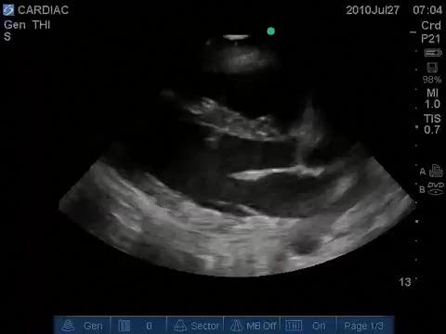
Parasternal Window/Long Axis View
Sonographic Findings:
Note the overall activity of the heart and any gross abnormality
Note any pericardial effusion especially below
the posterior wall
Examine the cardiac segments motion and structure
  Posterior basal and middle
  Apical inferior and anterior
  Septal
  RV Wall
Myocardial segments may be dysfunctional
during acute myocardial infarction
Notes:
Elaborate/repeat the anatomy for this view. The US image in the lower right is a movie showing a normal heart – it will start automatically

Slide 59
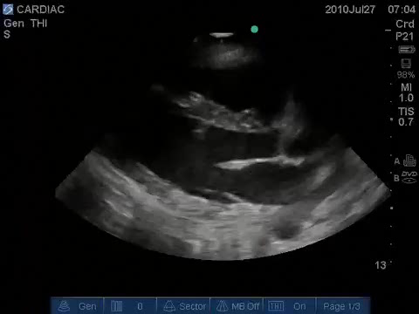
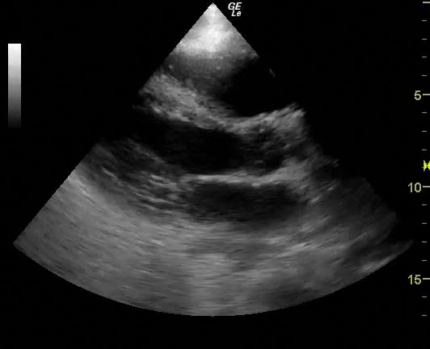
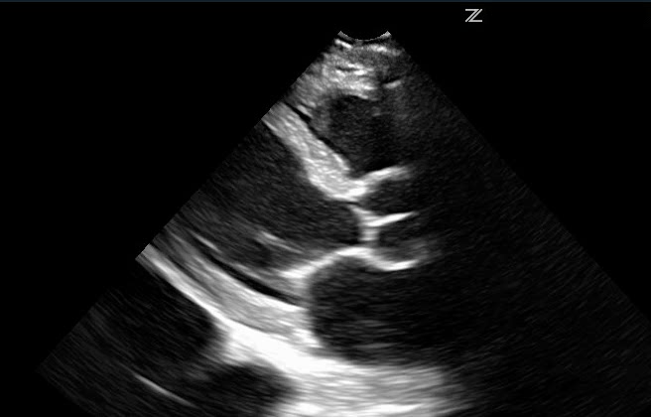
Parasternal Window/Long Axis View
Note the overall activity
Notes:
Three movies upper left to lower right: normal, hypekinetic, hypokinetic (EF is 20%)
The normal will start automatically and run continuously. The middle and lower right images will start when you click on them

Slide 60
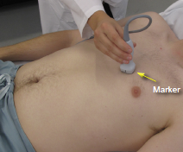
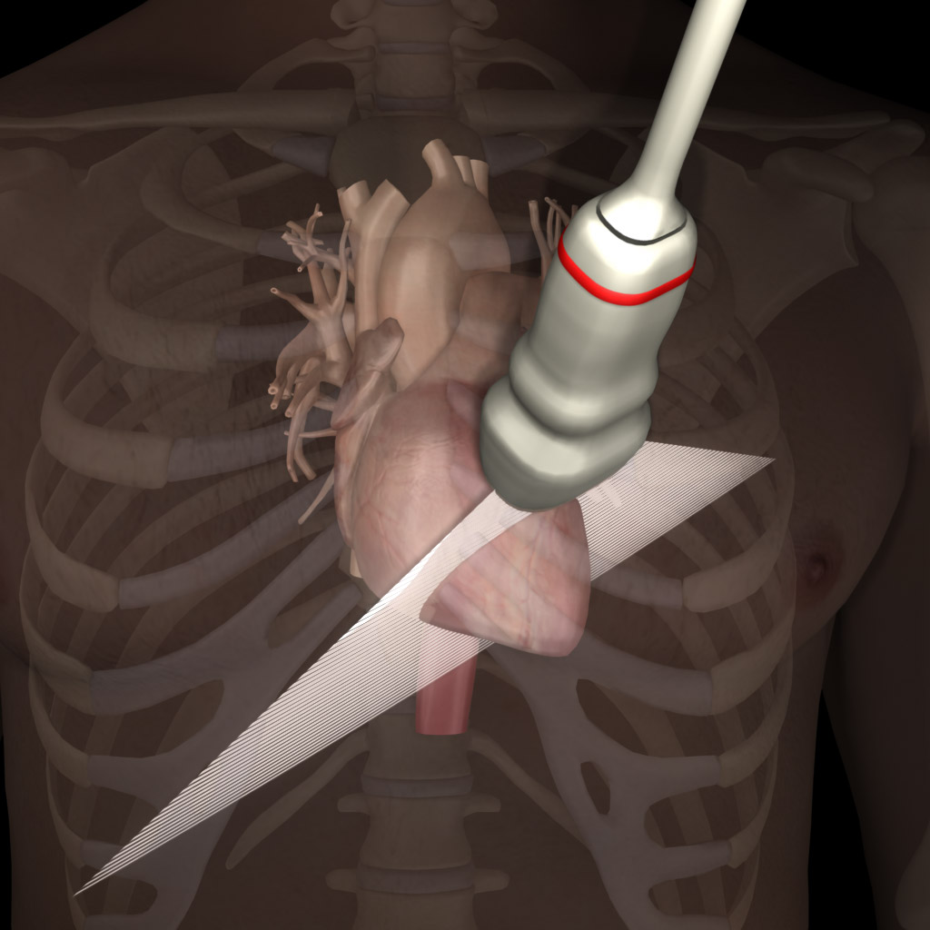
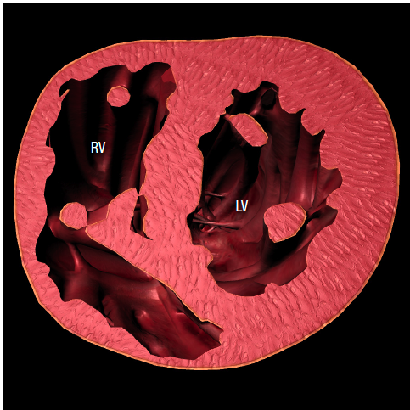
Parasternal Window/Short axis View
Transducer Placement
From the long axis view turn the marker towards left shoulder [i.e. turn 90° CW]
Start with the transducer footprint perpendicular to the skin to obtain the round shaped “Donut” image of the Short axis
Notes:
Go over transducer placement and review anatomy (LV, RV, paps)

Slide 61
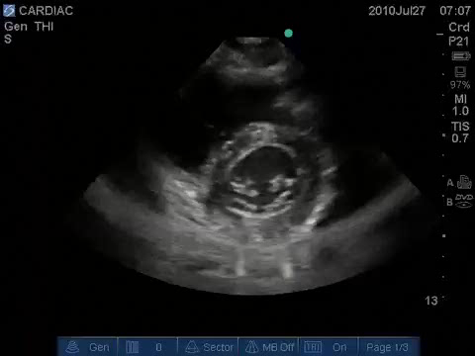
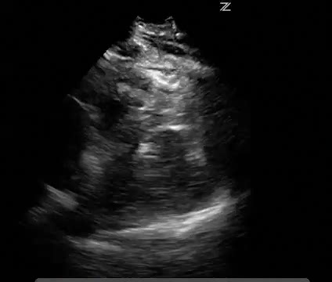
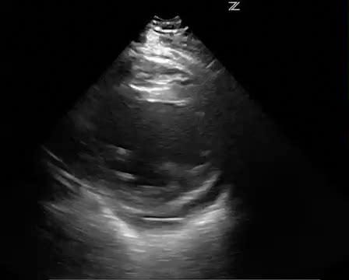
Parasternal Window/Short axis View
Note the overall activity
Notes:
Emphasize evaluation of overall cardiac activity. All three are movies that will run when clicked. Upper left normal, middle hypokinetic (EF of 20%) and lower right is yperkinetic

Slide 62
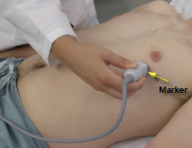
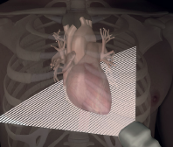
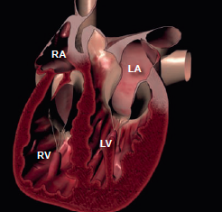
Apical
Transducer Placement:
Place the transducer at the apex with the footprint towards the
patient’s head or right shoulder. Transducer marker is rotated to
approximately 3 o’clock position
Notes:
Describe transducer position and anatomy revealed (4 chamber view) Can also mention 5 (with LVOT) if you wish.

Slide 63
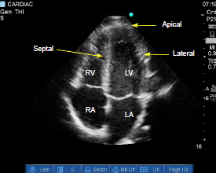
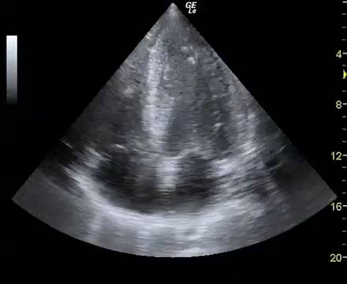
Apical
Sonographic Findings:
Examine the overall cardiac contractility
Note any wall motion abnormality in different segments, Lateral, Apical and Septal
Notes:
Review anatomy again. Point out and emphasize apical, lateral and septal walls. This is where they can look for wall motion abnormalities. Then bottom right is a video loop that will play when you click on it

Slide 64
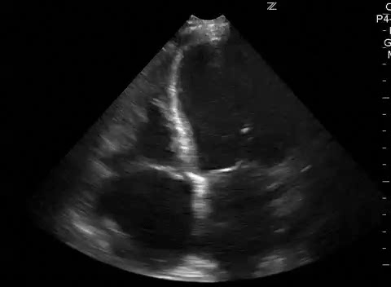
Apical View - Hypokinesis
Notes:
Hypokinesis with wall motion abnormality

Slide 65
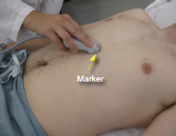
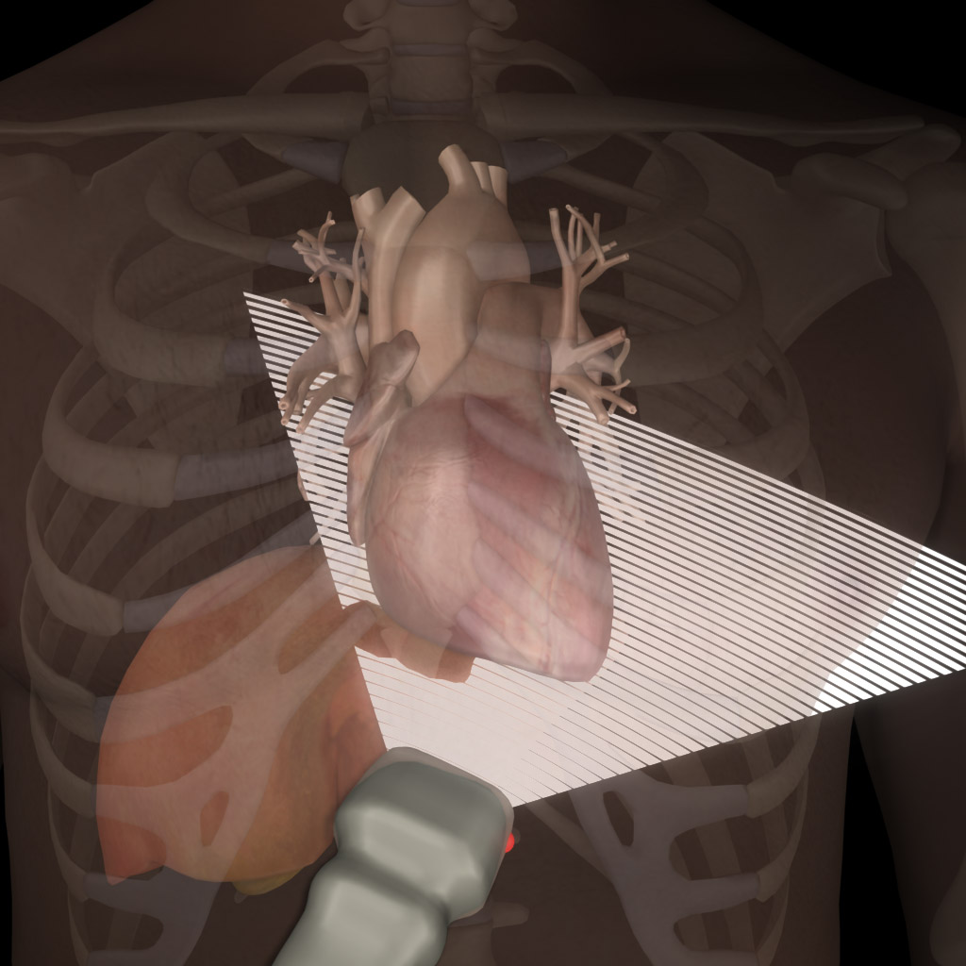
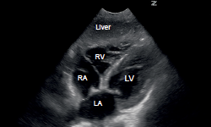
Subcostal Window
Transducer Placement:
Below the xiphoid process, the footprint pointingtowards the left shoulder. The marker is at about 3 o’clock position
Notes:
Review transducer position and the anatomic structure visualized (i.e 4 chambers)

Slide 66
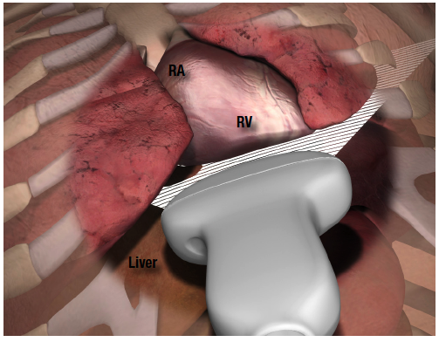
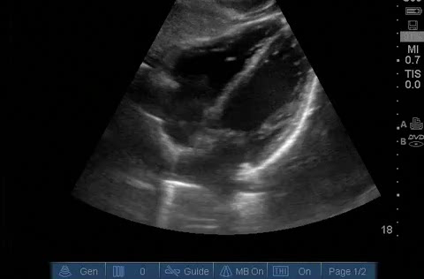
Subcostal Window
Sonographic Findings:
Evaluate the function of all chambers
Note any wall motion abnormality
Good view to detect any pericardial effusion
Notes:
Describe anatomy for upper left slide. The llower left is a video loop that should run automatically

Slide 67
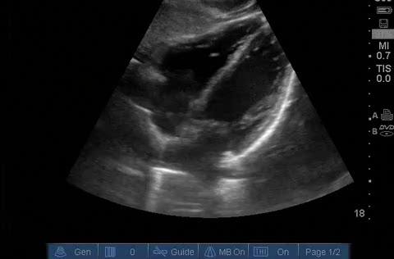
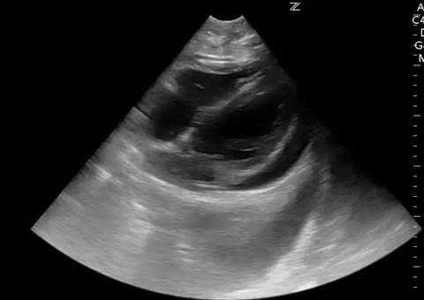
Subcostal Window
Good view to detect any pericardial effusion. Detection of echo-free rim around the heart within the hyperechoic parietal pericardium
False positive
• Pleural effusion
• Epicardial fat pad (usually anterior)
Notes:
Upper left is a loop showing normal which will run automatically. Lower right is a pericardial effusion – you need to click on it to make it run

Slide 68

Subcostal/Inferior Vena Cava (IVC)
  Curvilinear transducer can be used
  Depth 15-20 cm
  Subcostal, the footprint pointing towards the spine and the transducer marker is pointing cephalad

Slide 69


Subcostal/IVC
Liver
IVC
RA

Slide 70



IVC

Slide 71


IVC/M-Mode
Spontaneous breathing
Inspiratory phase
Expiratory phase

Slide 72



VOLUME STATUS???

Slide 73
SUMMARY
Surgeon-performed ultrasound allows both diagnostic and therapeutic intervention.
It is fast
It is portable
It is repeatable
HERE TO STAY!

Slide 74


Slide 75


